Slide 1

Data Structure III
CHAPTER 7
Wilson Ren

Slide 2
Intro to Graph Algorithms
- Graph Traversal (Depth First, Breadth First)
- Floyd-Warshall Algorithm
- Dijkstra’s Algorithm
Wilson Ren

Slide 3

Graph Traversal
- Traversal means we visited each node of a graph exactly once.
- Two main types of graph traversal algorithms are “Depth-First” and “Breadth-First.”
Wilson Ren

Slide 4
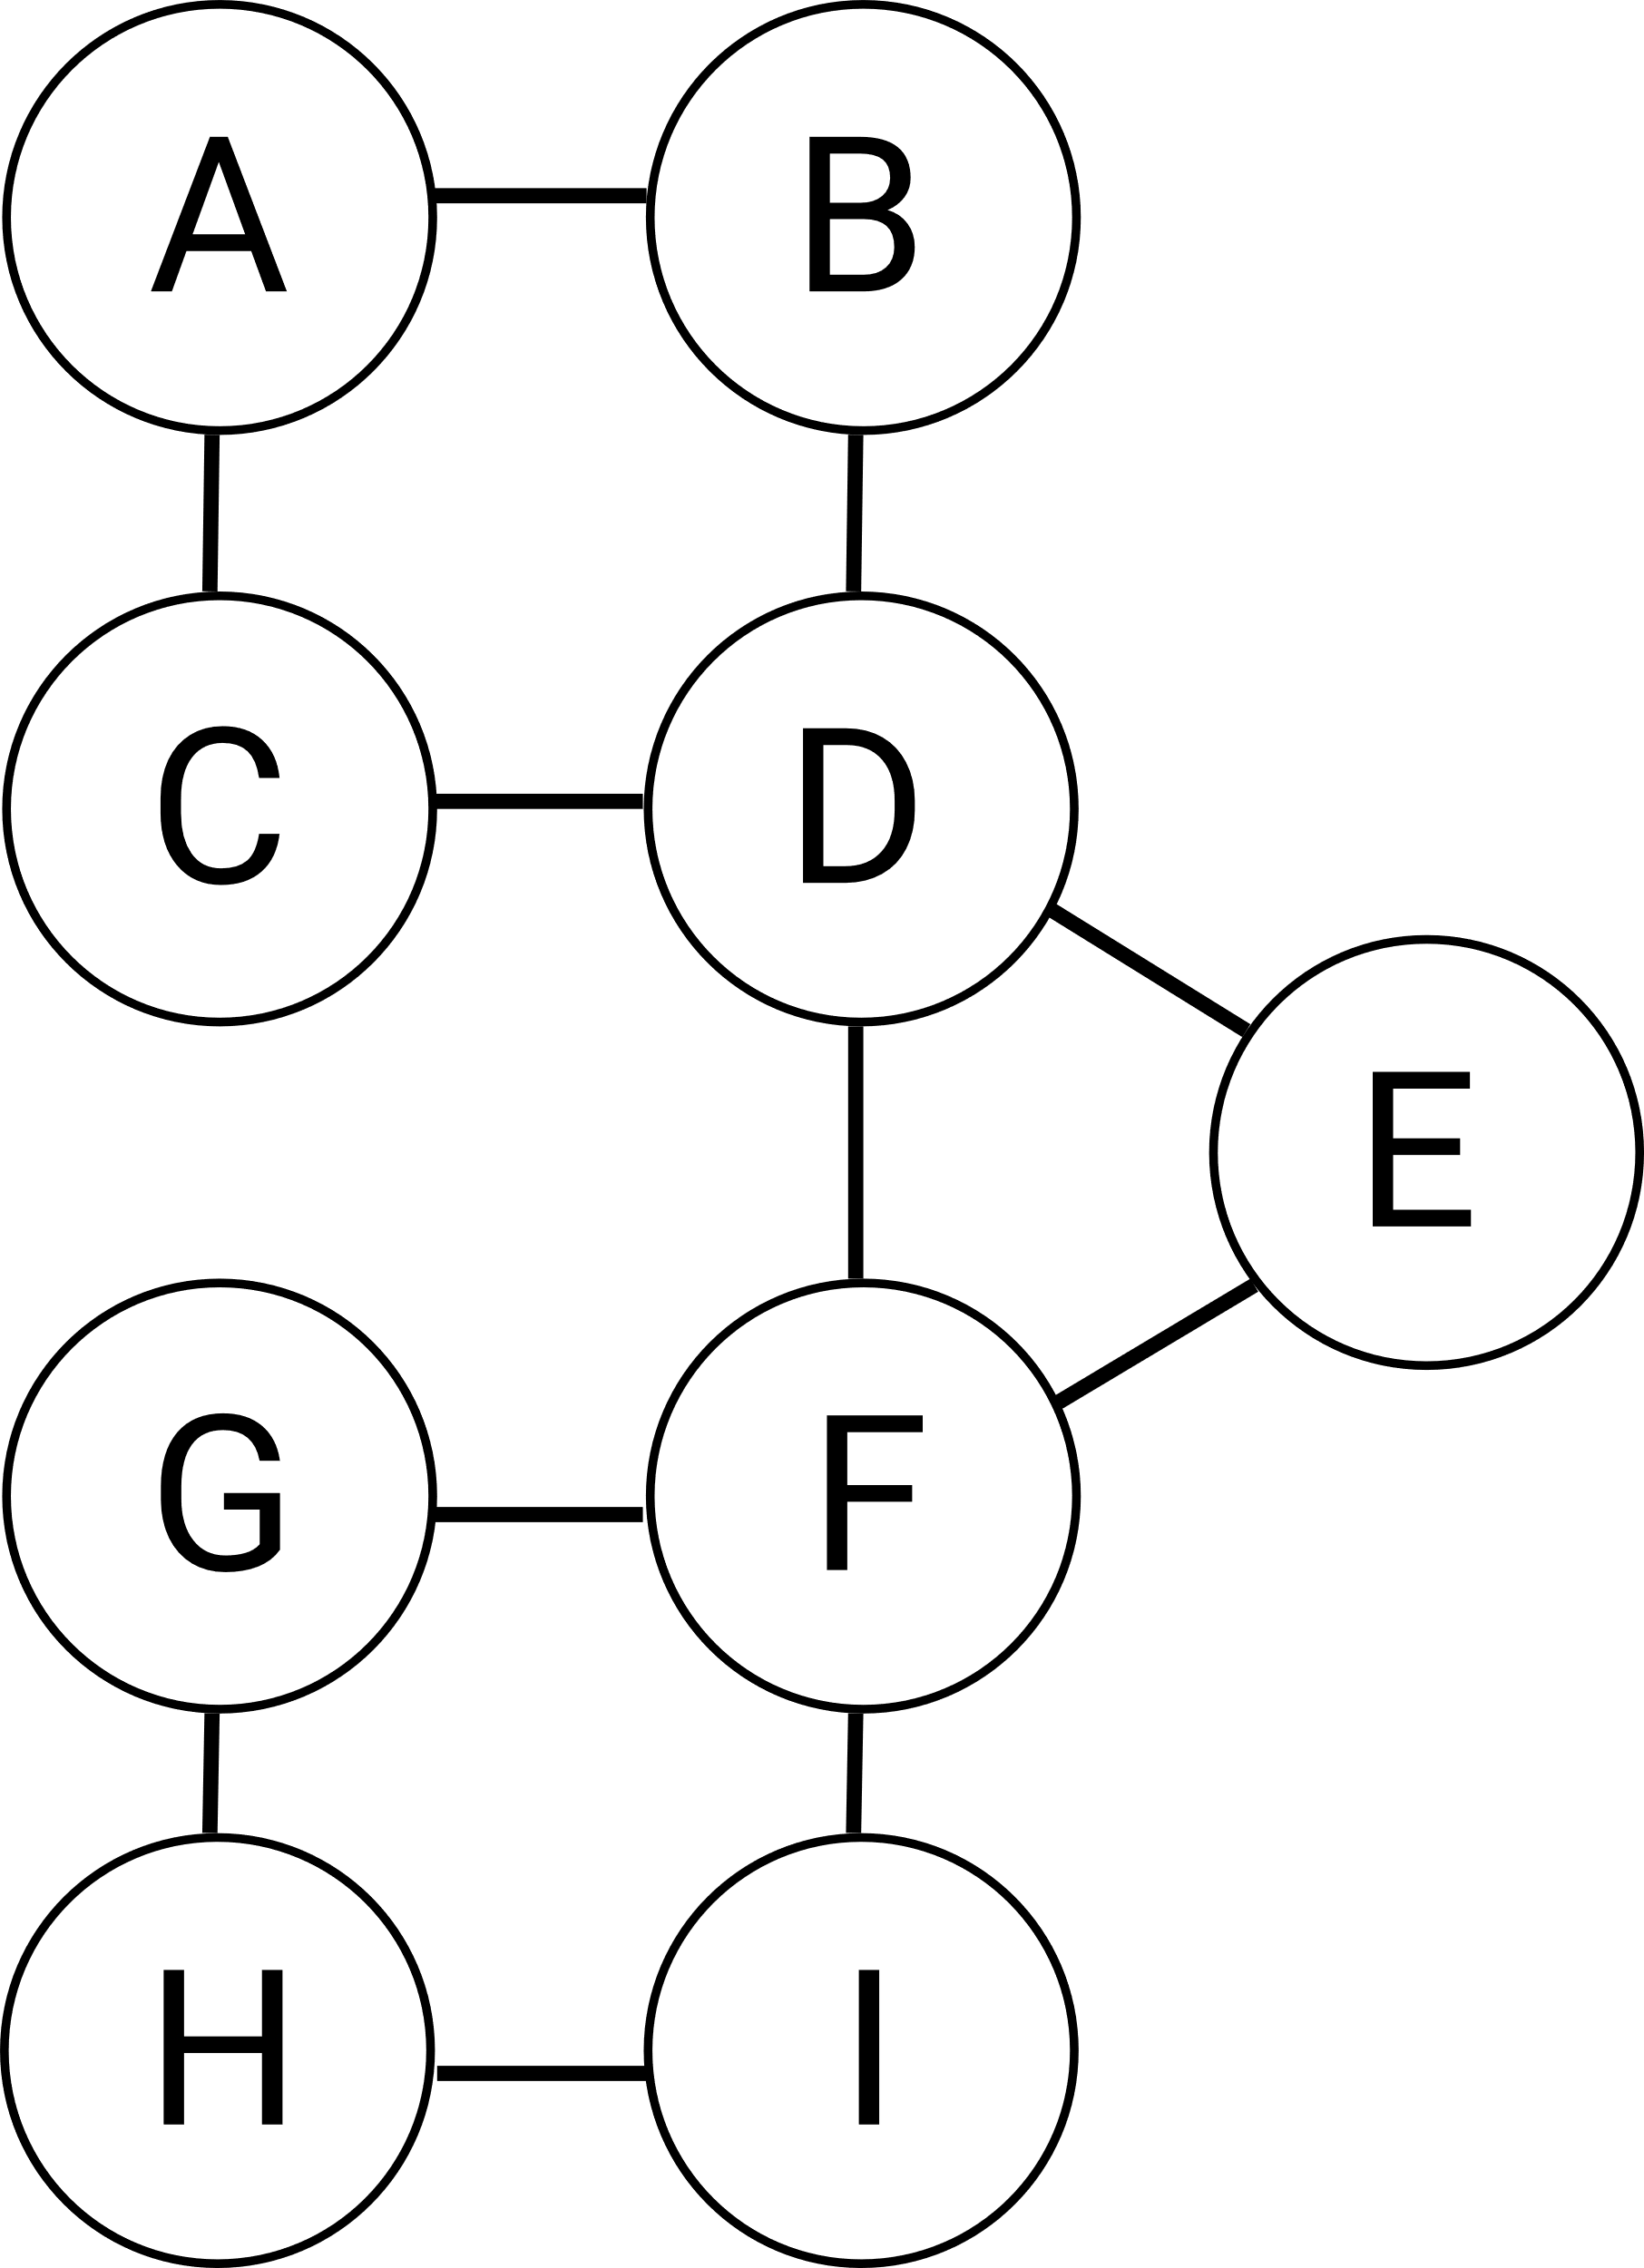
Exercise
DF from G:
BF from D:
Wilson Ren

Slide 5
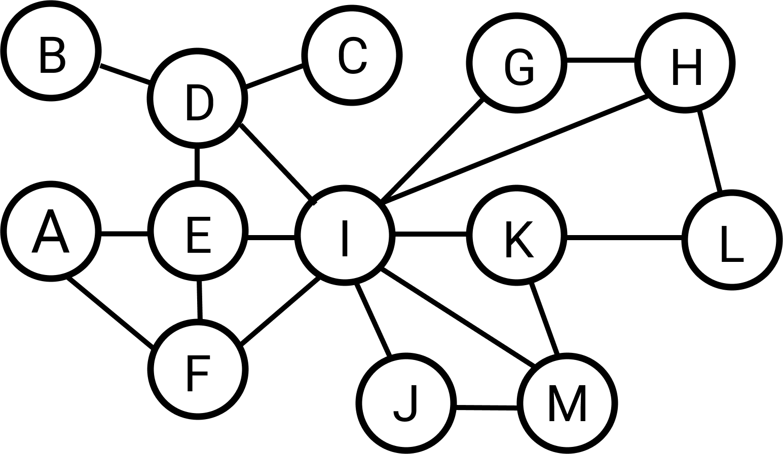
Pseudocode of Depth First Traversal
DFT(node): node.visited = true write node to the result list for each neighbor n of node: if n is not visited: DFT(n)
Wilson Ren

Slide 6
Pseudocode of Breadth First Traversal
BFT(starter): let queue be a new queue queue.push(starter) while queue.length is not 0: firstNode = queue.dequeue() if firstNode.visited is false: mark firstNode as visited write firstNode to the result list for each neighbor of firstNode: if neighbor has not been visited: queue.push(neighbor) return result
Wilson Ren

Slide 7
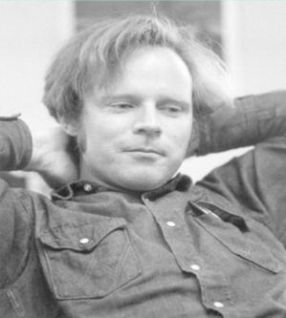
Floyd-Warshall Algorithm
- In computer science, the Floyd–Warshall algorithm is an algorithm for finding all-pairs shortest path problem in a directed weighted graph with positive or negative edge weights.
- The Floyd–Warshall algorithm is an example of dynamic programming and was published in its currently recognized form by Robert Floyd in 1962. However, it is essentially the same as algorithms previously published by Bernard Roy in 1959 and also by Stephen Warshall in 1962.
Wilson Ren

Slide 8
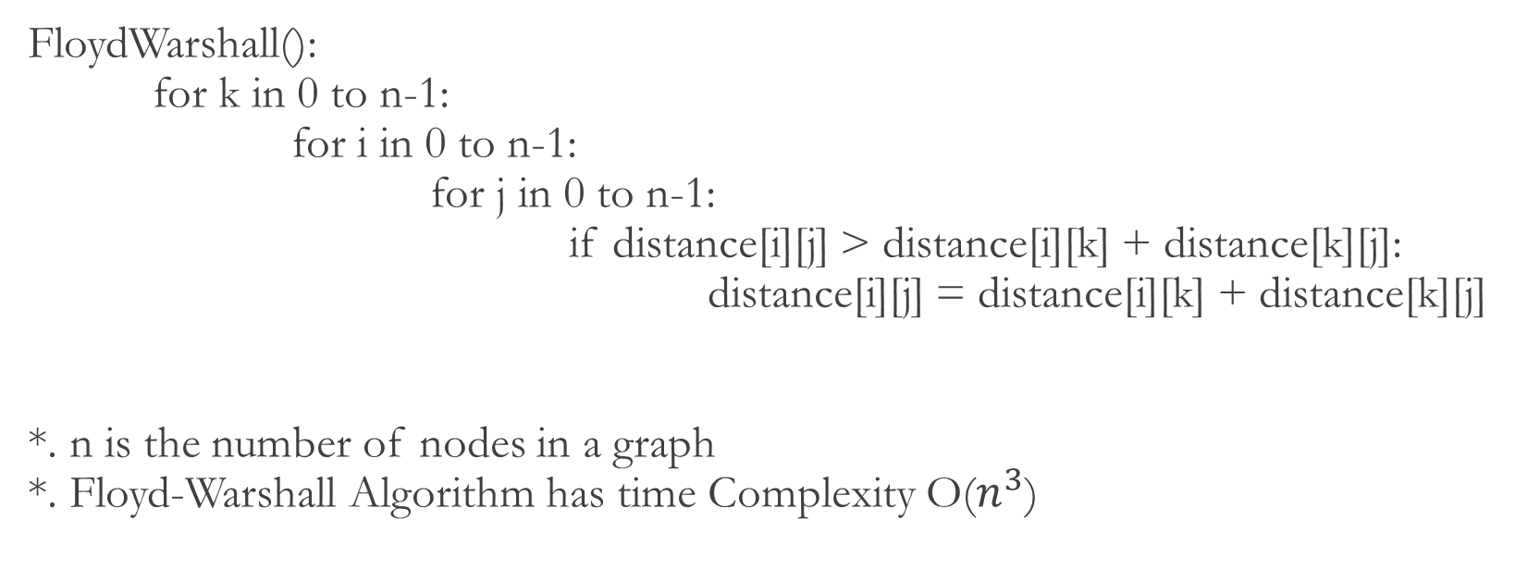
Pseudocode of Floyd-Warshall Algorithm
FloydWarshall(): for k in 0 to n-1: for i in 0 to n-1: for j in 0 to n-1: if distance[i][j] > distance[i][k] + distance[k][j]: distance[i][j] = distance[i][k] + distance[k][j] *. n is the number of nodes in a graph *. Floyd-Warshall Algorithm has time Complexity O($n^{3}$)
Wilson Ren

Slide 9
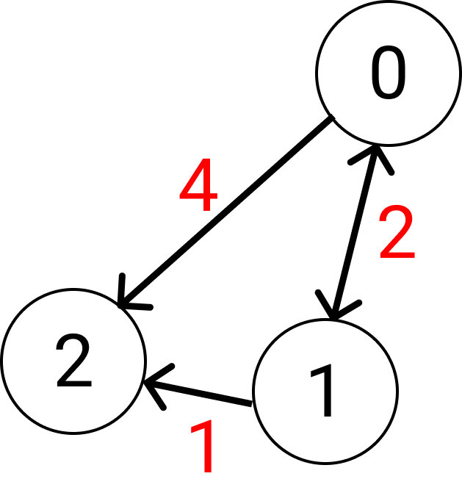
Implementing Floyd-Warshall
Wilson Ren

Slide 10
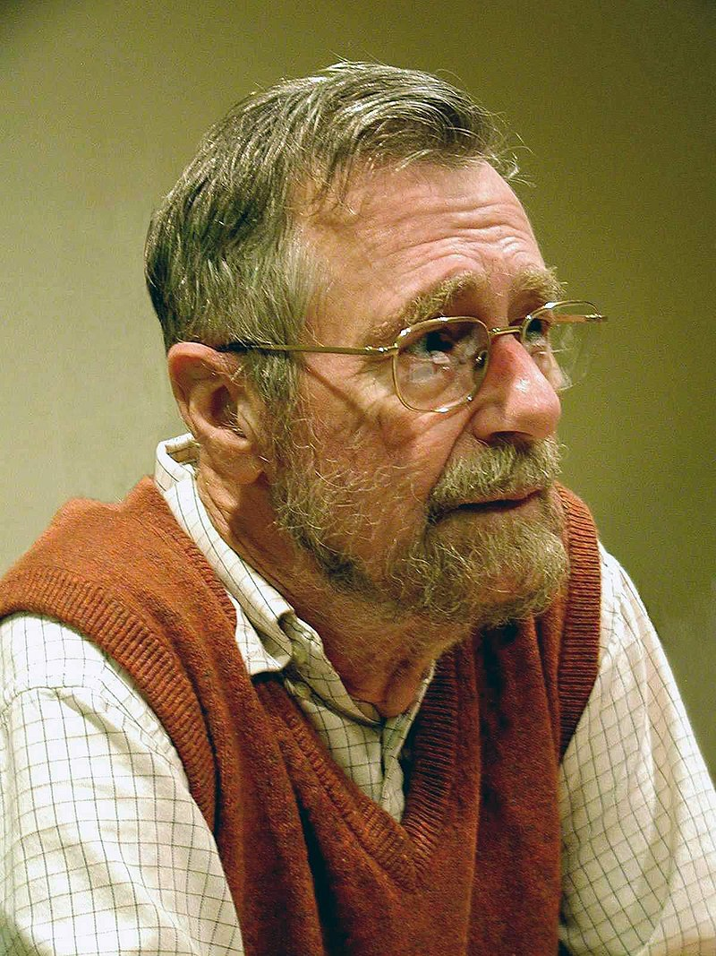
Dijkstra’s Algorithm
- Dijkstra's algorithm is an algorithm for finding the shortest paths between nodes in a graph. It was conceived by computer scientist Edsger W. Dijkstra in 1956 and published three years later.
- Given a start point, find the shortest path from this node to all other nodes.
- Least-cost paths are calculated for instance to establish tracks of electricity lines or oil pipelines. The algorithm has also been used to calculate optimal long-distance footpaths in Ethiopia and contrast them with the situation on the ground. Dijkstra’s Algorithm is also used in network routing.
Wilson Ren

Slide 11
Dijkstra’s Algorithm
- Have a function that takes one input – the starting node.
- Set all values in shortest table to be infinity except for the starting node.
- Set the previous object's property to be null.
- As long as there is something we need to visit, calculate the distance from A to currentNode plus currentNode to neighbor, if it's less than the shortest path, then update the shortest path and previous table and visited list.
Wilson Ren

Slide 12
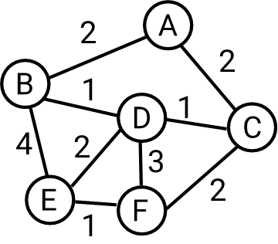
Implementing Dijkstra’s Algorithm
Wilson Ren

