Slide 1

Greedy Methods Dynamic Programming
CHAPTER 8
Wilson Ren

Slide 2
Greedy Methods
- "Greedy" algorithms are a class of algorithms that make choices based on what appears best at the moment, rather than considering the data as a whole. The greedy approach works for some problems, not so well for others.
- Huffman Encoding, Minimal Spanning Tree(Both Kruskal and Prim), and Dijkstra’s Algorithms are greedy algorithms. As you study these algorithms, you should notice that the decisions made, and data structures created, are based on only a subset of the data at any given time. And yet they still arrive at globally-optimal solutions. That is the Greedy way.
- Each step of a "greedy" algorithm only considers what seems best at the moment, rather than looking at the data as a whole.
Wilson Ren

Slide 3
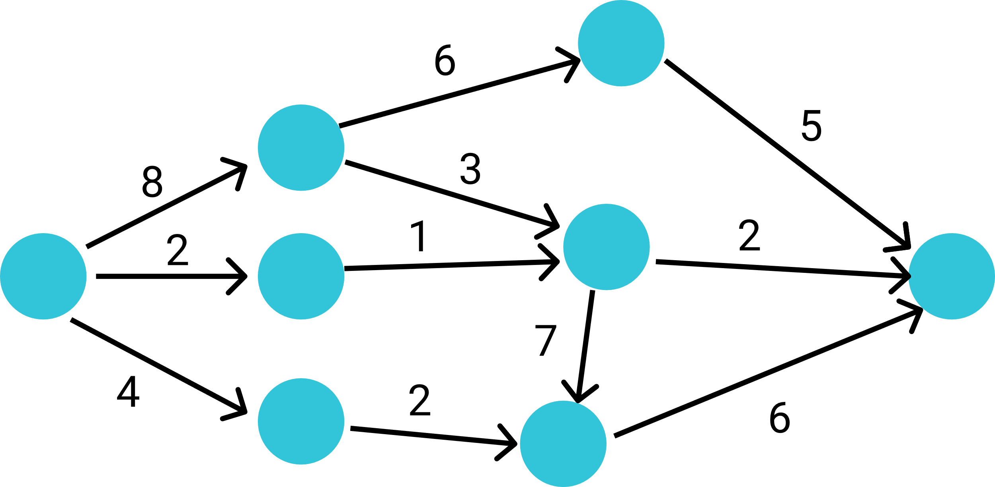
Shortest Path with Greedy Method I
*. Supposed that you NEVER learned Dijkstra’s Algorithm. Could we find the shortest path from left to right with greedy method?
Wilson Ren

Slide 4
Job Sequencing with Deadlines
-Supposed we have a set of given jobs in the following table. We have to find a schedule of jobs that all jobs should be completed within their deadlines and this schedule will give us the maximum profit.
- Supposed we have 4 days. Each day we can only complete one job.
Job | J1 | J2 | J3 | J4 | J5 | J6
Deadline | Day2 | Day2 | Day1 | Day4 | Day3 | Day1
Profit | 20 | 30 | 5 | 25 | 10 | 15
Wilson Ren

Slide 5
Fractional Knapsack Problem
- Supposed that we have several fruits to be sold. Our bag only has 15kg capacity. What choices should be made to make the maximum profit?
*. Supposed we can take cut fruits into piece and put them in our bag.
Fruit | Grape | Banana | Apple | Melon | Orange | Guava
Profit ($) | 15 | 10 | 20 | 12 | 6 | 16
Weight (kg) | 2 | 10 | 5 | 4 | 5 | 8
Wilson Ren

Slide 6
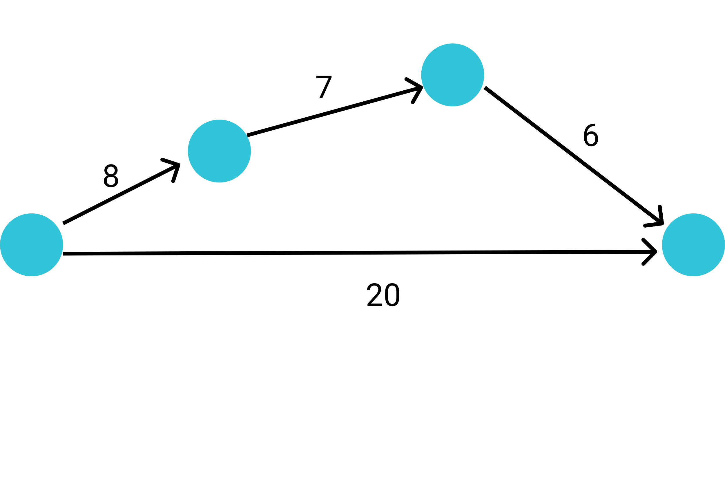
Shortest Path with Greedy Method II
Wilson Ren

Slide 7

Dynamic Programming

Slide 8
Longest Common Subsequence (LCS)
- A common substring is a collection of contiguous letters that appear in two strings.
- A common subsequence is any collection of letters that appear IN THE SAME ORDER, but not necessarily contiguously, in two strings.
- For example, in the strings ABACABE and BACCHAE the longest substring is BAC, while the longest subsequence is BACAE.
*. Please do not confuse the term "substring" and "subsequence".
Wilson Ren

Slide 9
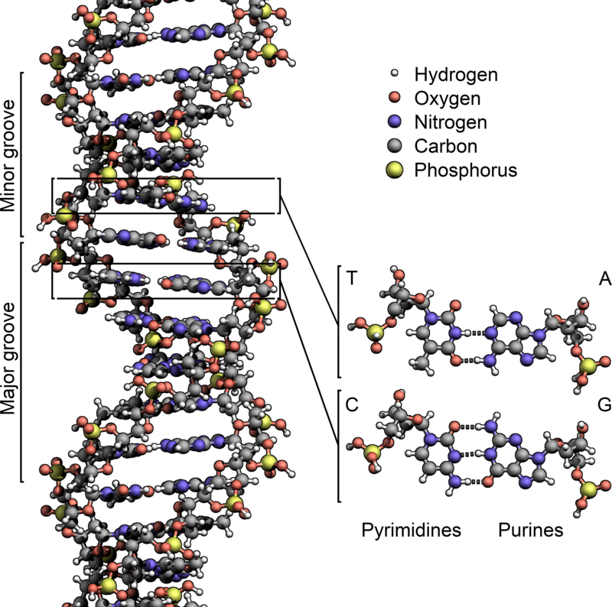
Let’s consider this interesting question.
- Supposed that we want to check if two DNAs are similar.
DNA1: ATAACGCGCTGCTCGGGT
DNA2: TCAATCAGGATCCGCTGA
(The length of LCS determines how similar they are.)
- Similarity means that the order of ATGCs are the same, but not contiguous.
- In this example, the longest common subsequence is “TAACGCCGCTG”.
Wilson Ren

Slide 10
Recursion Solution of LCS
LCS(“AGB”, “ACB”)
Wilson Ren

Slide 11
Dynamic Programming Solution
Wilson Ren

Slide 12
Dynamic Programming
- Dynamic Programming algorithms, like the LCS algorithm, take a very "global" approach to problem-solving. (Compared with Greedy Method, which makes decision based on the current situation.)
- Dynamic Programming algorithm solves every possible subproblem before producing its solution. (By doing this, we won’t have duplicate works.)
- While effective, dynamic programming is overkill for some types of problems. In some cases, a simpler, more efficient algorithm will still find the right answer.
Wilson Ren

Slide 13
Meaning of Dynamic Programming
- Dynamic simply means "changing“. The table of sub-solutions is ever growing as the algorithm proceeds.
- Programming here does NOT refer to writing computer code. Instead, it refers to making a detailed record of something. Example: when you go to a play or a concert, the booklet or flyer you're given as you enter the theater is called a "program". It's a list of all the songs, acts, artists, etc. involved in the production.
Wilson Ren

Slide 14
Fibonacci Sequence
- We learned about the recursion solution for solving Fibonacci Sequence; However, while this function works, it is horribly inefficient. The reason is that it ends up solving the same set of subproblems multiple times — creating a lot of duplicate work for itself.
- DYNAMIC PROGRAMMING is an alternative approach to solving problems with several subproblems. Whenever a subproblem is solved, a "dynamic programming" solution is to cache the solution to that subproblem so that it can be reused later, rather than having to solve it again.
Wilson Ren

Slide 15
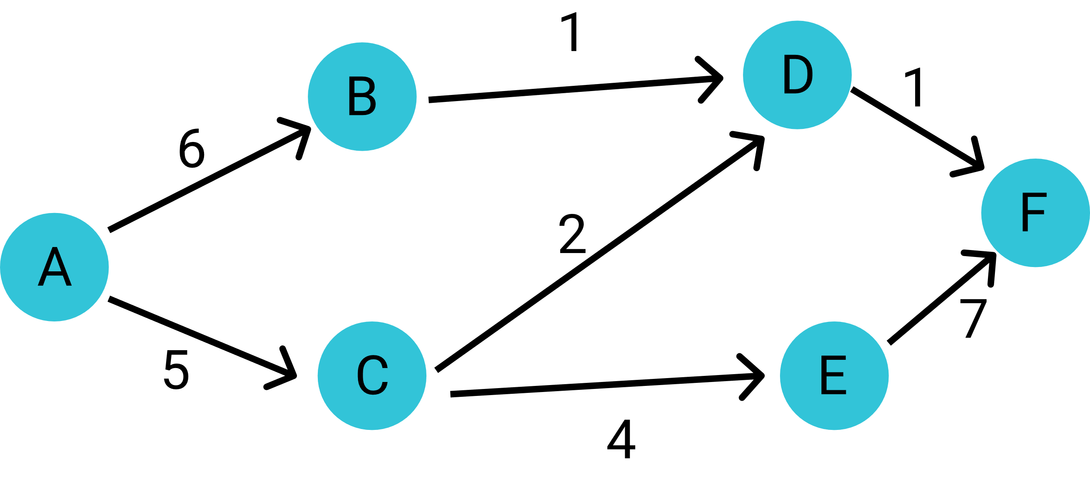
Shortest Path with Dynamic Programming
Wilson Ren

