Slide 1

Other Topics
CHAPTER 9
Wilson Ren

Slide 2
Backtracking
- Backtracking is a general algorithm for finding all (or some) solutions to some computational problems, notably constraint satisfaction problems, that incrementally builds candidates to the solutions, and abandons a candidate ("backtracks") as soon as it determines that the candidate cannot possibly be completed to a valid solution.
- Backtracking is considered as one of the BRUTE FORCE solutions.
- Backtracking is often much faster than brute force enumeration of all complete candidates, since it can eliminate many candidates with a single test.
Wilson Ren

Slide 3
Permutation of Numbers
Wilson Ren

Slide 4
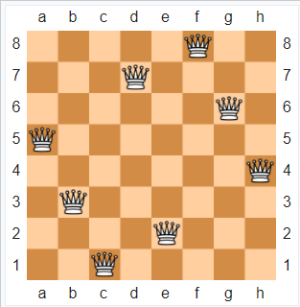
8 Queens Puzzle
- The eight queens puzzle is the problem of placing eight chess queens on an 8×8 chessboard so that no two queens threaten each other; thus, a solution requires that no two queens share the same row, column, or diagonal.
- In general, we want to know how many solutions are there in a N Queens puzzle.
Wilson Ren

Slide 5
0/1 Knapsack Problem
- 0/1 Knapsack problem means finding the maximum profit choice of items with the condition that we either take an item into our bag or not.
- Potential Solutions are:
1. Brute Force
2. Backtracking (Optimize the Brute Force Solution)
3. Branch and Bound
4. What other GENIUS IDEA could you think of?
Wilson Ren

Slide 6
Branch and Bound Algorithm
- Branch and bound is an algorithm design paradigm which is generally used for solving combinatorial optimization problems. These problems are typically exponential in terms of time complexity and may require exploring all possible permutations in worst case. The Branch and Bound Algorithm technique solves these problems relatively quickly.
- Before enumerating the candidate solutions of a branch, the branch is checked against upper or lower estimated bounds on the optimal solution, and is discarded if it cannot produce a better solution than the best one found so far by the algorithm.
*. If a problem can be solved by BRUTE FORCE with backtracking, then the optimization solution can be found by branch and bound.
Wilson Ren

Slide 7
Difference
Parameter | Backtracking | Branch and Bound
Approach | Backtracking is a general algorithm for finding all (or some) solutions to some computational problems. (constraint satisfaction problems) | Branch-and-Bound is used to solve combinatorial optimization problems. These problems are typically exponential in terms of time complexity.
Traversal | DFS (Depth First Search) | BFS (Breadth First Search)
Function | Feasibility Function | Feasibility Function Bounding Function
Wilson Ren

Slide 8
Difference
Parameter | Backtracking | Branch and Bound
Problems | Backtracking is used for solving Decision Problem. | Branch-and-Bound is used for solving combinatorial optimization Problem.
Applications | Useful in solving N-Queen Problem, Hamilton Cycle. | Useful in solving 0/1 Knapsack Problem, Travelling Salesman Problem.
Wilson Ren

Slide 9
Knuth-Morris-Pratt String Matching
- In computer science, the Knuth–Morris–Pratt string-searching algorithm (or KMP algorithm) searches for occurrences of a word within a main text string by employing the observation that when a mismatch occurs, the word itself embodies sufficient information to determine where the next match could begin, thus bypassing re-examination of previously matched characters.
Wilson Ren

