Slide 1
Fraud Detection in Insurance Claims
Yunze Zhang
06/12/2024

Slide 2
Project Background
Cars are common in families, and insurance products are essential.
Challenges:
- Staged accidents for insurance claims.
- Economic losses for insurance companies.
Solution:
- Machine learning to detect fraud efficiently.

Slide 3
Project Goals
- Build a powerful model for fraud detection.
- Identify key factors related to fraudulent claims.
- Evaluate the authenticity of customer claims.

Slide 4
Data Exploration and Preprocessing
Dataset:
- 15,240 records, 33 attributes.
Key Attributes:
- Customer details: Age, Gender, etc.
- Car details: Price, Age, etc.
- Accident details: Timestamp, Witness presence, etc.
Steps:
- Univariate, Bivariate Analysis.
- Correlation analysis and feature engineering.

Slide 5
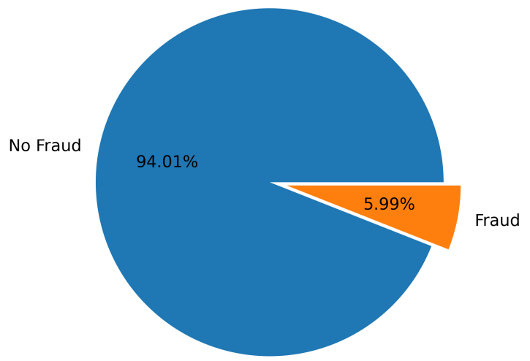
Univariate Analysis
typical extremely imbalanced classification
the metric of evaluating classification results and dealing with data imbalance are quite important

Slide 6
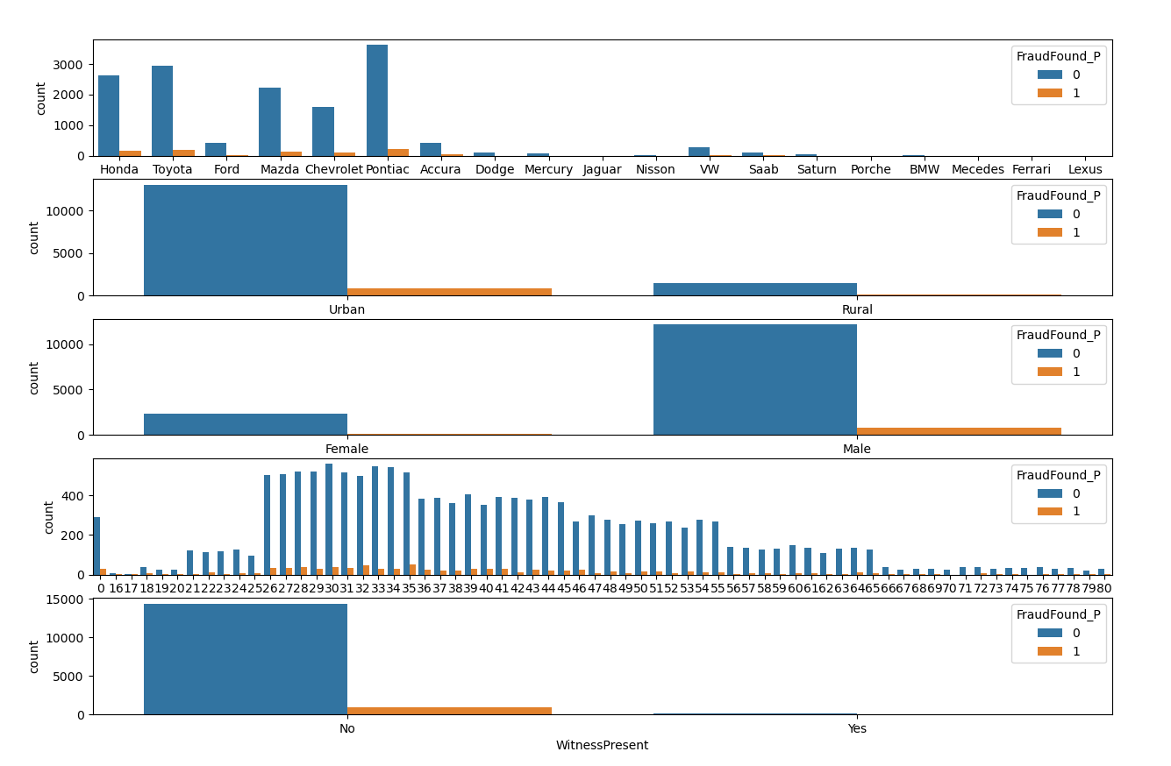
Bivariate Analysis

Slide 7
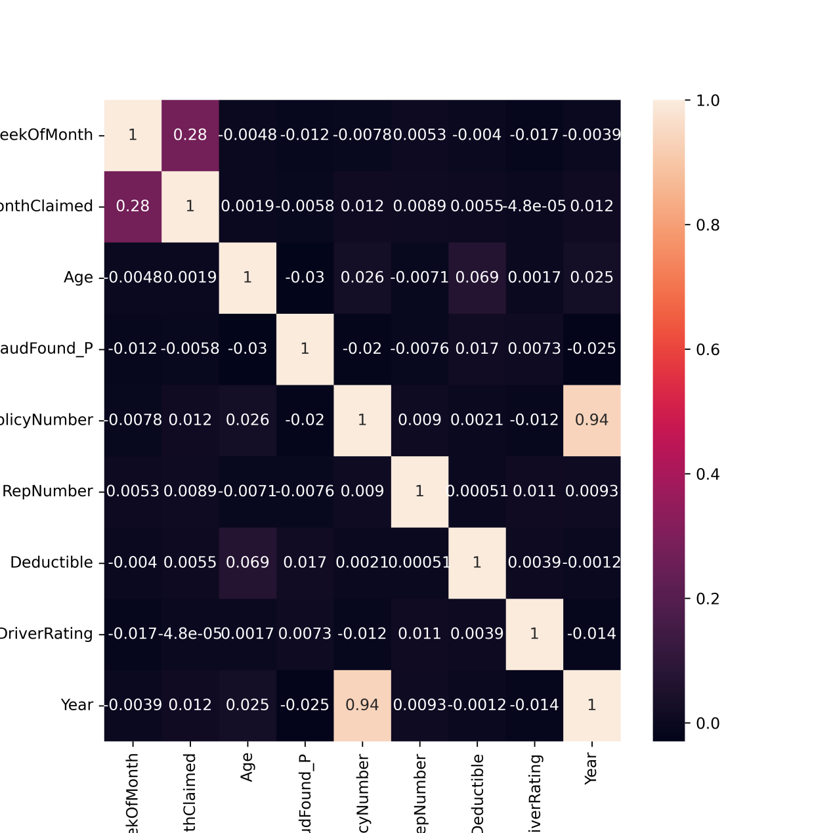
Correlation Analysis

Slide 8
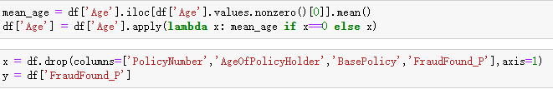
Feature Engineering
- “PolicyNumber”: highly related with Year.
- “AgeOfPolicyHolder”: redundant with Age
- “BasePolicy”: redundant with PolicyType
isnull().sum() and isna().sum()

Slide 9
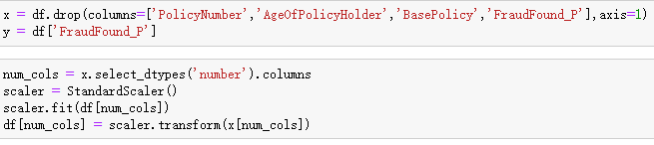
Numerical columns
standarization scaling or min-max scaling is typical strategy. And I choose the former in this project.

Slide 10
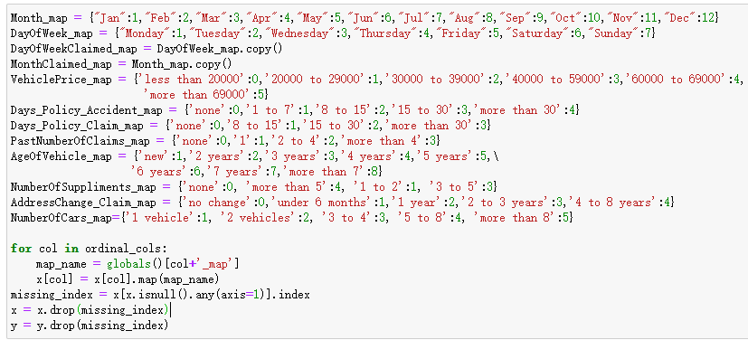
Discrete columns

Slide 11
Models Used
- Logistic Regression: Simple and interpretable.
- Decision Tree: Basic non-linear model.
- Random Forest: Ensemble technique for better accuracy.
- LightGBM: Boosting model for enhanced performance.

Slide 12
Evaluation Metrics
- Accuracy: Overall correctness.
- Recall: Detecting fraud effectively.
- Precision: Avoiding false positives.
- F1 Score: Balance between recall and precision.
- AUC: Evaluating model discrimination.

Slide 13
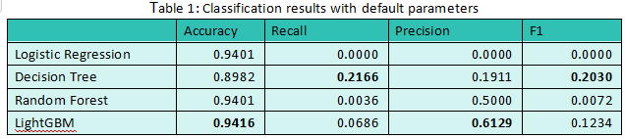
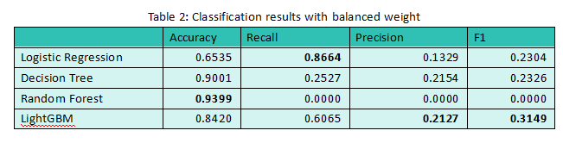
First Try
Adding class weight
For imbalance classification, setting weights for different class is a useful strategy. Each class is given weight by n_samples/(n_classes * np.bincount(y)) where np.bincount(y) count number of each class.

Slide 14
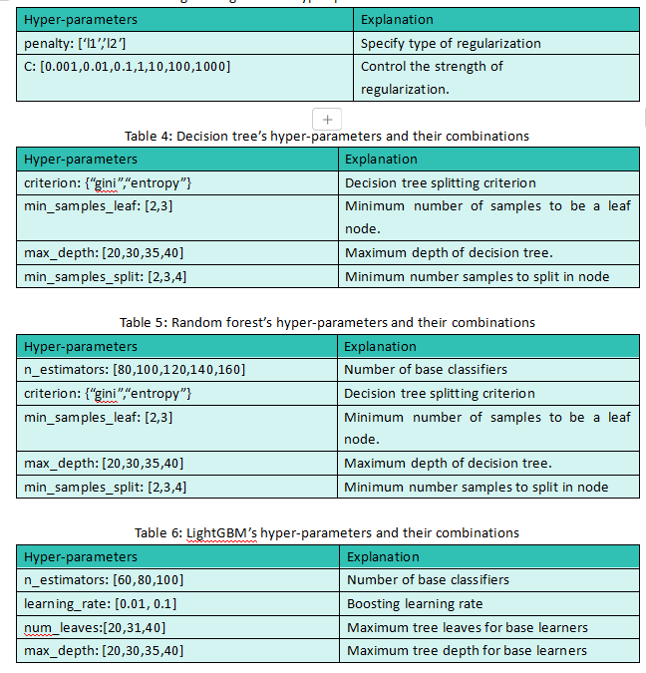

Slide 15
Results and Improvements
Initial Results:
- Low recall for Random Forest and LightGBM.
With Class Weights:
- Improved recall and F1 scores.
Hyperparameter Tuning:
- Significant improvements in all models.
- LightGBM achieved the best performance.

Slide 16
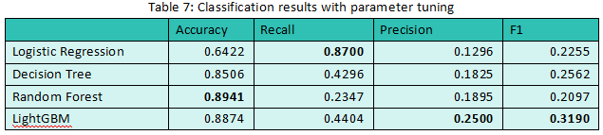
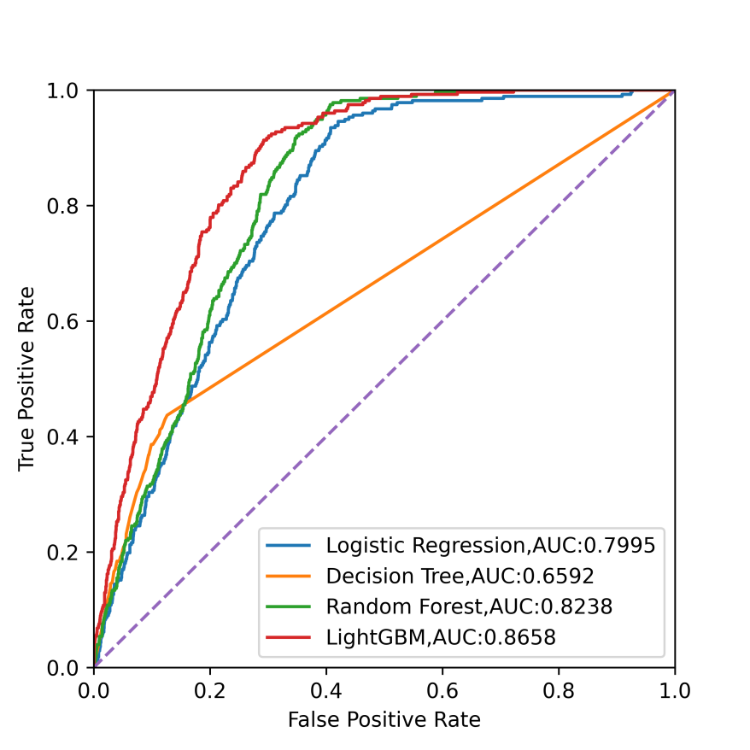

Slide 17
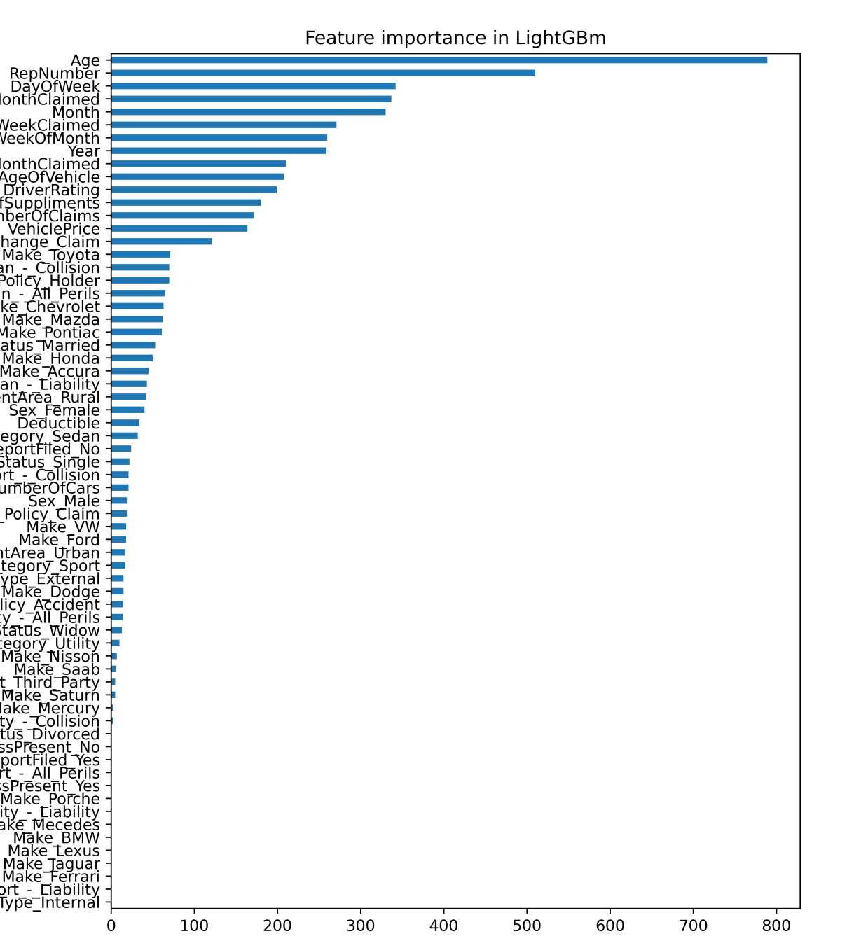

Slide 18
Feature Importance
Key Features:
- Age: Most critical in fraud detection.
- RepNumber: Significant contribution.
Insights:
- Focus on these features to optimize detection.

