Slide 1

CONTENT-BASED IMAGE RETRIEVAL USING COLOR DIFFERENCE HISTOGRAM
Guang-Hai Liu, Jing-Yu Yang
Course name: Multimedia Processing Technique (DD026_1594)
Project number: Option 1 – 9
201912110 LeeYunji

Slide 2


01 Introduction
02 Related work
03 The color difference histogram (CDH)
04 Experiments and results
05 Conclusion

Slide 3

01 Introduction
<Google image search>
Image retrieval has become an extremely active research area in the field of pattern recognition and artificial intelligence
Notes:
. 일상 생활에서 사람들은 주로 텍스트 키워드 검색을 기반으로 하는 Google,
Yahoo 등의 검색 엔진을 통해 주로 이미지를 검색합니다. 검색 서비스에 대한 시장
수요에 따라 이미지 검색은 패턴 인식 및 인공 지능 분야에서 매우 활발한 연구 분야
가 되었습니다.

Slide 4
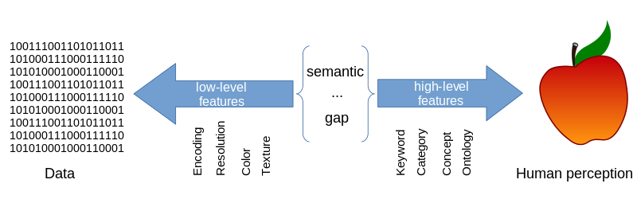

01 Introduction
MACHINE LEARNING
Notes:
현재 이미지 검색 기술은 일반적으로 낮은 수준의 기능(예: 색상, 질
감, 모양, 공간 레이아웃)을 기반으로 하지만 낮은 수준의 기능은 종종 높은 수준의
의미 개념을 설명하는 데 실패합니다.
. 이 '의미론적 격차'를 줄이기 위해 연구원들은 기계 학습 기술을 채택하여 높은 수준의 의미론을 도출했습니다.[1‒삼]. 또한 일
부 연구자들은 의 메커니즘을 시뮬레이션하여 낮은 수준의 기능을 추출합니다.

Slide 5
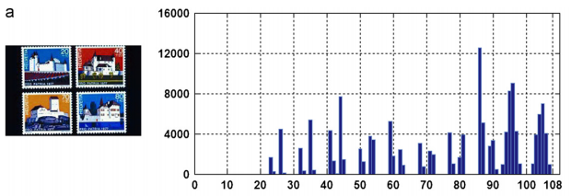
01 Introduction
CDH (Color Difference histogram)
A new method of feature representation for content based image retrieval.
The CDH can be viewed as a general visual attribute descriptor and has the discrimination power of low-level features and spatial layout.
Notes:
현재 이미지 검색 기술은 일반적으로 낮은 수준의 기능(예: 색상, 질
감, 모양, 공간 레이아웃)을 기반으로 하지만 낮은 수준의 기능은 종종 높은 수준의
의미 개념을 설명하는 데 실패합니다.

Slide 6

02 Related work
CBIR
Global
aim at the whole image as visual content, e.g., color, texture and shape
Local
focus mainly on key points or salient patches
Various algorithms have been designed for the extraction
of global and local features
Notes:
현재 이미지 검색 기술은 일반적으로 낮은 수준의 기능(예: 색상, 질
감, 모양, 공간 레이아웃)을 기반으로 하지만 낮은 수준의 기능은 종종 높은 수준의
의미 개념을 설명하는 데 실패합니다.

Slide 7


02 Related work
COLOR
wavelength-dependent perception and has become a very important visual cue for image retrieval and object recognition
color histograms characterize the spatial structures of images with difficulty
Suggested by multiple color descriptors to leverage spatial information ex) Key color descriptors, color layout descriptors and expandable color descriptors
in MPEG-& standards
Notes:
현재 이미지 검색 기술은 일반적으로 낮은 수준의 기능(예: 색상, 질
감, 모양, 공간 레이아웃)을 기반으로 하지만 낮은 수준의 기능은 종종 높은 수준의
의미 개념을 설명하는 데 실패합니다.

Slide 8

02 Related work
TEXTURE
Also widely used in CBIR systems
Various algorithms have been designed for texture analysis, such as gray level co-occurrence matrices, the Tamura texture feature, the Markov random field model, Gabor filtering, and local binary patterns
Some algorithms can ultimately combine color and texture together
Notes:
현재 이미지 검색 기술은 일반적으로 낮은 수준의 기능(예: 색상, 질
감, 모양, 공간 레이아웃)을 기반으로 하지만 낮은 수준의 기능은 종종 높은 수준의
의미 개념을 설명하는 데 실패합니다.

Slide 9

02 Related work
SHAPE
Humans can recognize objects solely based on their shapes
In many cases, shape feature extraction requires the use of image segmentation;
this remains difficult, thereby limiting its application in practice.
Notes:
현재 이미지 검색 기술은 일반적으로 낮은 수준의 기능(예: 색상, 질
감, 모양, 공간 레이아웃)을 기반으로 하지만 낮은 수준의 기능은 종종 높은 수준의
의미 개념을 설명하는 데 실패합니다.

Slide 10
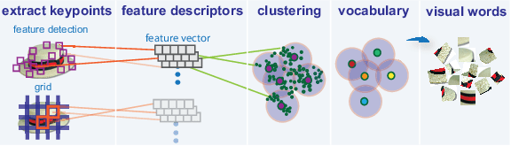
02 Related work
Bag-of-visual words-based methods
The bag-of-visual words technique has limitations, e.g., a lack of semantic information, the ambiguity of visual words, and a very high vector dimension
Notes:
, the bag-of-visual words technique has limitations, e.g., a
lack of semantic information, the ambiguity of visual words, and a
very high vector dimension

Slide 11
03 The color difference histogram (CDH)
CDH combines the use of orientation, color and color difference and considers the spatial layout without the use of any image segmentation or learning processes.
Color quantization in the L*a*b*
color space
Edge orientation detection in L*a*b* color space
Feature representation
L*a*b* Color space

Slide 12
03 The color difference histogram (CDH)
L*a*b* Color space
R, G and B components are highly correlated, and therefore, chromatic information is not directly fit for use.
CLE L*a*b* was designed to be perceptually uniform. CLE determines the difference between colors with high uniformity, and the difference between two color points can be measured by Euclidean distance.
In the CLE L*a*b* color space, the L*, a* and b* components
are computed obtained through a non-linear mapping of XYZ coordinates.

Slide 13
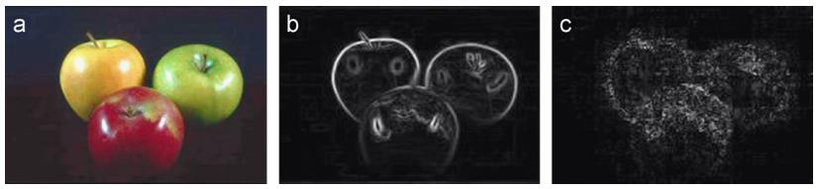
03 The color difference histogram (CDH)
Edge orientation detection in L*a*b* color space
L*a*b* color space computationally efficient algorithm was adopted for edge direction detection.
To minimize color information loss, we propose a method for gradient calculation.
The core idea involves extending the concept of a gradient to the vector maximum rate of a scalar function f(x, y) at coordinates (x, y).

Slide 14
03 The color difference histogram (CDH)
Color quantization in the L*a*b* color space
To extract color information and simplify manipulation, color quantization needs to be implemented.
The task of color quantization is to select and assign a limited set of colors for
representing a given color image with maximum fidelity.
The selection of color spaces for color quantization is an important step in many image search and object recognition algorithms.
In this work, we use the L*a*b* color space, which is quantized into 90 colors.

Slide 15
03 The color difference histogram (CDH)
Feature representation
It is an important challenge that feature representation use color difference and take into account both the spatial information of color and edge orientation cues.
Based on this idea, we propose a novel image feature representation method called chromatic difference histogram (CDH) for image retrieval.
Notes:
It is an important challenge that feature representation use color difference and take into
account both the spatial information of color and edge orientation cues. Based on this idea, we
propose a novel image feature representation method called chromatic difference histogram
(CDH) for image retrieval.

Slide 16
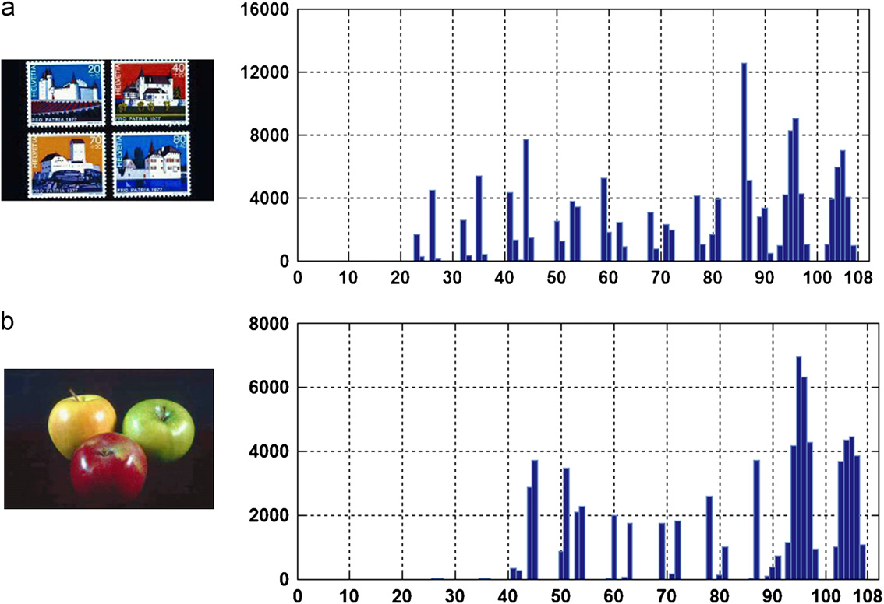
04 Experiments and results
Two examples of CDH: (a) stamps and (b) fruit. The horizontal axis corresponds to the index values for edge orientation and color (where values in the range 1–90 denote color index values and values in the range 91–108 denote edge orientation index values). The vertical axis corresponds to perceptually uniform color difference values.

Slide 17

04 Experiments and results
Data Set
There are data sets the Corel dataset, the Brodatz texture dataset, the OUTex texture
dataset, the Coil-100 dataset, the ETH-80 dataset, the Caltech 101 dataset and the PASCAL
VOC dataset, which are frequently used for various purposes in the field of image research.
Distance metric
In this paper, we extend the Canberra distance as a distance metric. For each template image in the dataset, an M-dimensional feature vector T=[T1, T2,…,TM] is extracted and stored in the database. Let Q=[Q1, Q2,…,QM] be the feature vector of a query image.
Then, the distance metric between them is simply calculated as follows:

Slide 18
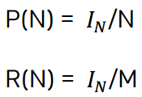
04 Experiments and results
Performance metrics
In our experiments, we use the Precision and Recall curves, a performance metric
commonly used in information retrieval. Precision and Recall is defined as follows:
where IN is the number of images retrieved in the top N positions that are similar to the query image,
M is the total number of images in the database that are similar to the query,
and N is the total number of images retrieved.

Slide 19

04 Experiments and results
Implementation details
In the RGB color space, the color difference between two colors is defined as follows:
where DR denotes the color difference between two points P1 and P2 in channel R, and so on.
In this paper, the proposed algorithm is designed for color image retrieval.
However, the MPEG-7 edge histogram descriptor (EHD) was originally designed for the retrieval of gray
texture images.

Slide 20
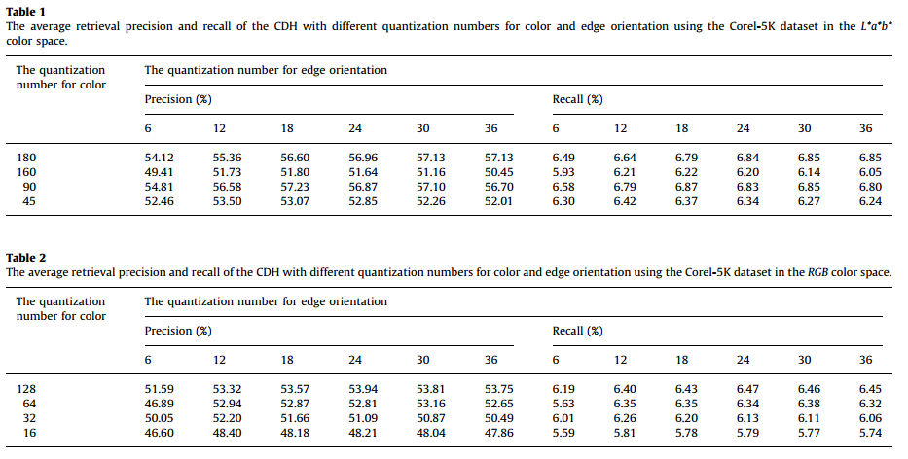
04 Experiments and results
Retrieval performance

Slide 21
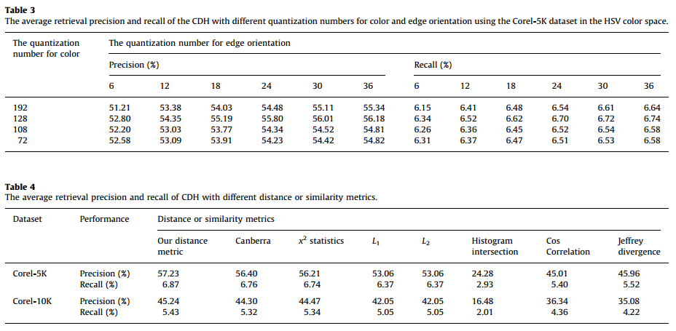
04 Experiments and results
Retrieval performance

Slide 22
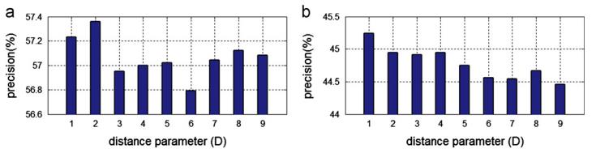
04 Experiments and results
Retrieval performance
The average retrieval precision of the CDH algorithm for various values of the distance parameter D: (a) the Corel-5K dataset and (b) the Corel-10K dataset.

Slide 23
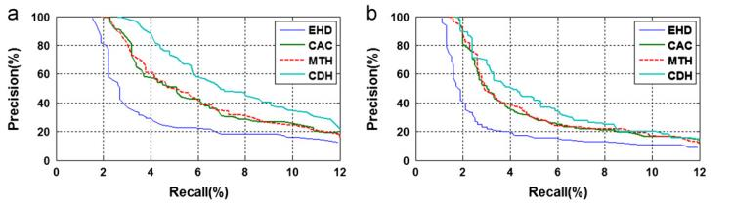
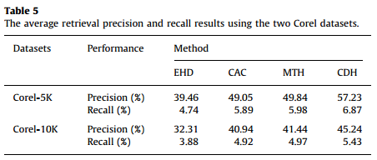
04 Experiments and results
Retrieval performance
The precision and recall curves of the EHD, CAC, MTH and CDH algorithms: (a) the Corel-5K dataset and (b) the Corel-10K dataset.

Slide 24

05 Conclusion
CDH
A novel image feature representation method used
to describe image features for image retrieval.
Calculate perceptually uniform color differences between two points
below different backgrounds with respect to color and edge orientation
Not require image segmentation, learning processes, or clustering implementation
Much more efficient than conventional image feature descriptors originally developed for content-based image retrieval!

