Slide 1
Reference
https://keras.io/api/models/model_training_apis/

Slide 2
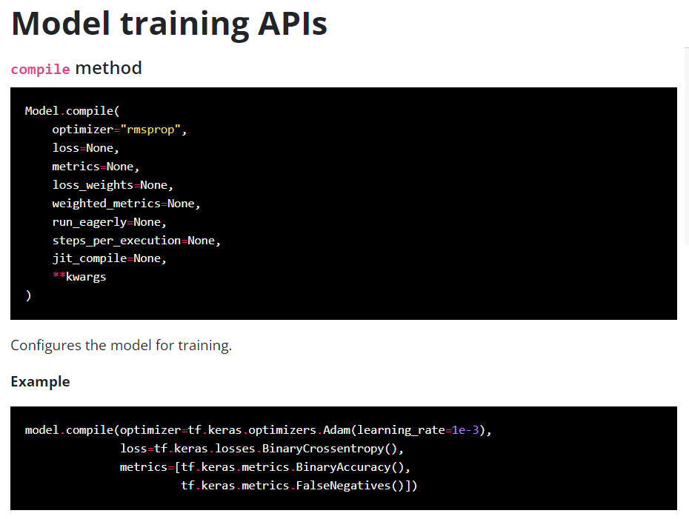

Slide 3
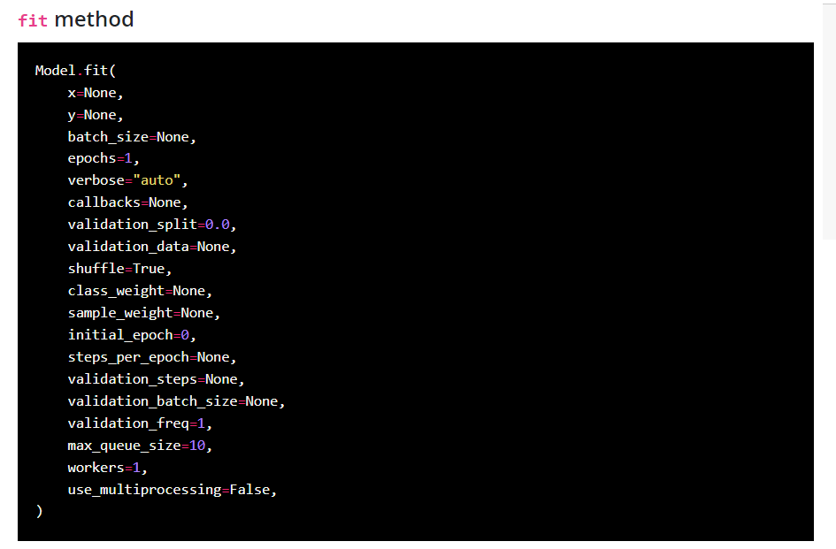

Slide 4
To do
Solve assignment#3 with tensorflow
Activation func.
sigmoid → relu
Loss
BCE → MSE
Optimizer
ADAM, RMSPROP, SGD
Mini-batch-size
Full (10000), 512, 128, 64

Slide 5
Code sample
model = tf.keras.models.Sequential([ tf.keras.Input(shape=(1,)), tf.keras.layers.Dense(2, activation='sigmoid'), tf.keras.layers.Dense(1, activation='sigmoid'), ])

