Slide 1
Real Estate Price Prediction
Chengyu Chen, Yupei Zhou
Notes:
In the following slides we will introduce our problem along with what we have accomplished.

Slide 2

Introduction
Individual
Enterprise
Society
Notes:
The fluctuation in housing prices has large influence to the world.
I will talk about it in three aspects.
First is the influence to individual.
Investors nowadays are trying to target on the housing they find most valuable. Therefore, knowing when the housing is going to increase or decrease will help investor or individual buyer to better make decisions and decide on the good time to invest.
Second is the influence to enterprise.
The changes in housing prices will influence the profit that enterprise gain, and some will even cause the company to go bankrupt if the prices of the places the company occupy went high enough.
Lastly, is the influence to the society.
If the profit made by each company decrease, the tax that those company paid to the country will also decrease and thus influence the economy in the society.
Therefore, in our project we created models that are able to predict housing prices in the future which not only inform people about the pricing changes but also enable them to make any adjustment ahead of time.

Slide 3

Problem
Many studies use regression models to predict housing prices, but few related to time series data.
Time series model such as ARIMA, Gaussian Process and LSTM
Able to analyze major patterns such as trends, seasonality and irregularity.
Notes:
We had previously done some research related to this problem and find out

Slide 4
Data Understanding
Data source: Housing data collected by Zillow’s research team
Data content:
State_time_series
Monthly data in range: 1996 ~ 2017
Median Listing Price for different types of housing
Target variable:
ZHVI_AllHomes: a smoothed seasonally adjusted measure of the median estimated home value across all types of home
ZHVIPerSqft_AllHomes: median of the value of all homes per square foot
https://www.kaggle.com/zillow/zecon?select=DataDictionary.csv
https://www.zillow.com/research/zhvi-methodology-2019-highlights-26221/
Notes:
The housing data we used
Which contains housing data for different groups such as state, county, zip code, etc.
In our project, we use the state_time_series data particularly.
We use adjusted median price instead of original median sale price:
Missing data
Focus on the general trend
You can find the information of how these two are calculated in the link below.

Slide 5
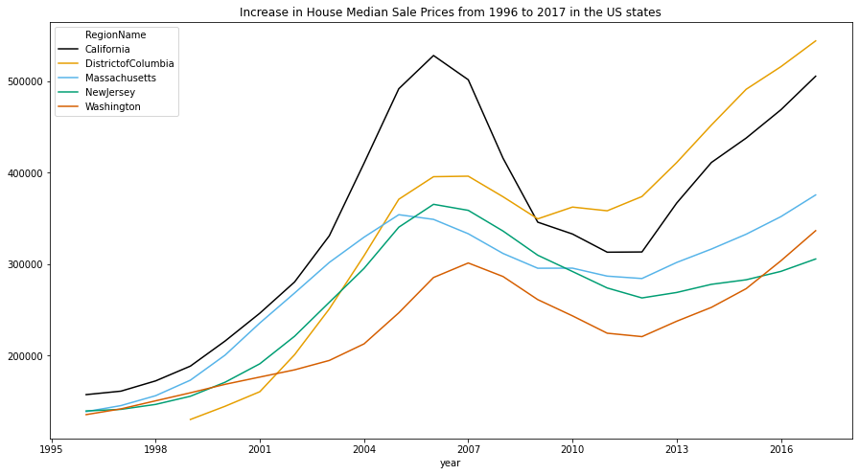
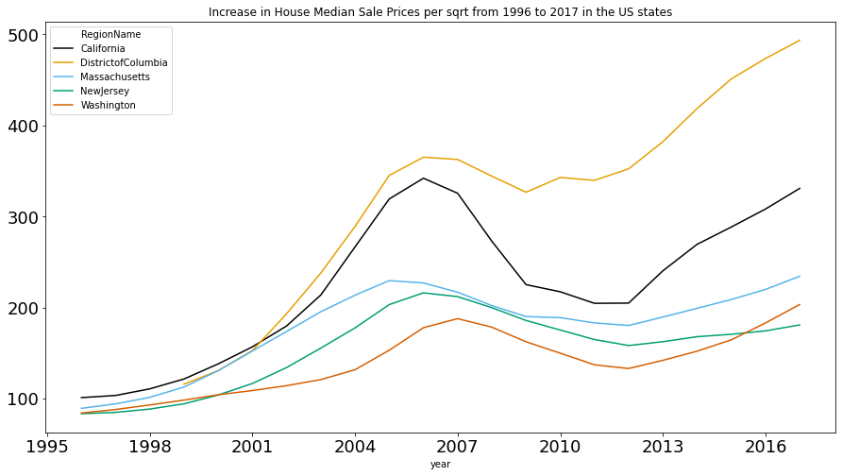
Approach
Top 5 highest cost states: 'District of Columbia', 'California', 'Massachusetts', 'New Jersey', ‘Washington'
Target variable: ZHVI_AllHomes, ZHVIPerSqft_AllHomes
1996 <= Training data <= 2015
2016 <= test data <= 2017
Notes:
subprime mortgage crisis
We choose the top 5 highest cost states to investigate on
The housing size is different across state
Housing values
Take log of the target variable
We split the data into training and testing

Slide 6
Approach 1 -- ARIMA
Choose p based on acf and pacf
Choose q and d in the range of (1,2)
Approach 2 -- Gaussian Process
Combination of various kernel
Linear Kernel, Periodic Kernel: Exp-Sine-Squared Kernel, Rational quadratic kernel

Slide 7
Approach 3 -- LSTM
Training:
Input: (x_{i} , …, x_{i+11}), label: (x_{i+12})
1 layer LSTM with 32 hidden units
MSELoss with Adam optimizer, learning rate = 5e-5
Prediction:
Initial input: (x_{n-11} , …, x_{n})
predict one data point (x_{n+1}) at each step.
Update input: (x_{n-10} , …, x_{n+1})

Slide 8
Result
Root mean square error between log of real housing price and its predicted value
Root MSE | District of Columbia | California | Massachusetts | New Jersey | Washington
ARIMA | 0.0382 | 0.0231 | 0.0054 | 0.0293 | 0.0345
Gaussian Process | 0.0254 | 0.0146 | 0.0112 | 0.0283 | 0.0261
LSTM | 0.0734 | 0.0348 | 0.0315 | 0.0129 | 0.0581

Slide 9
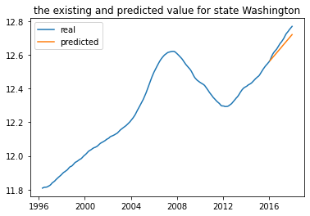
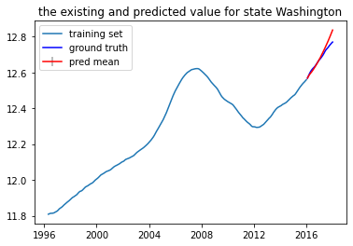
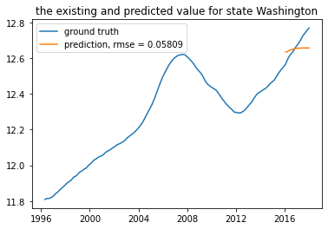
ARIMA
Gaussian Process
LSTM

Slide 10
Result
Root mean square error between log of real housing price per square foot and its predicted value
Root MSE | District of Columbia | California | Massachusetts | New Jersey | Washington
ARIMA | 0.0309 | 0.0166 | 0.0054 | 0.0067 | 0.0478
Gaussian Process | 0.0573 | 0.0044 | 0.0131 | 0.019 | 0.0523
LSTM | 0.0509 | 0.0327 | 0.0296 | 0.0118 | 0.0485

Slide 11
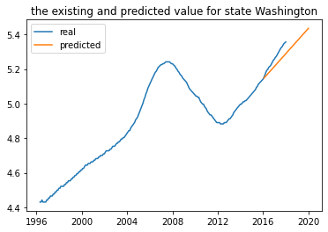
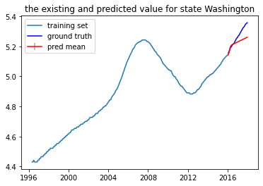
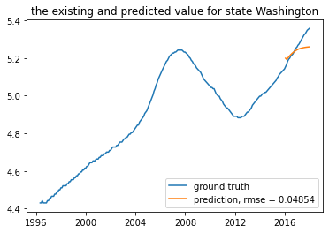
ARIMA
Gaussian Process
LSTM

Slide 12
Conclusion & Future Improvement
GP and ARIMA performing well overall
LSTM not performing well
Improvement
Work on county-level or zip code-level prediction
Use original median price instead of the price after adjustment of seasonality
Notes:
Real estate developer

Slide 13
We are open to questions, please feel free to discuss with us !

