Slide 1
SNPeffect
Qian & Colton & Xu
Professors:
Joost Schymkowitz
Mark Fiers
Rob van der Kant

Slide 2
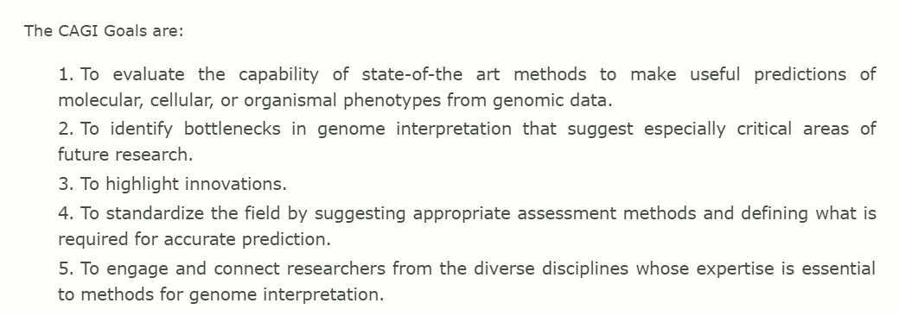
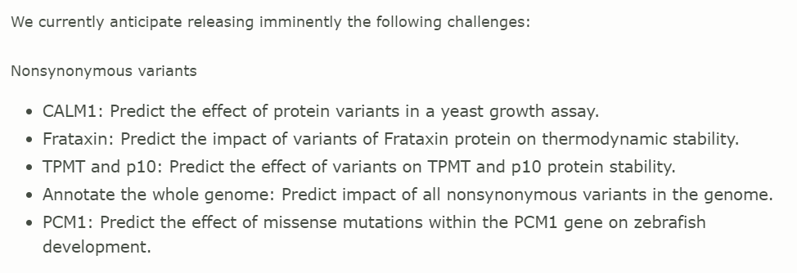
Questions from Last session
-How do we test it?
-Live competition
-Private Dataset
-> annotated
-> never tested on
before
Critical
Assessment
of
Genomic
Interpretation

Slide 3
Our work during this session
Database
Data Structure - user friendly (Query), extensibility, aggregation function (further analysis)
Data generation - resources
python, shell (UniprotKB)
vcf, RNA transcripts
Pipelines - first results

Slide 4
SQL
Pros
Cons
Work with structured data
Support ACID and joins
Limitless indexing
Validate data before it’s added to the database and increase data quality
Most SQL code is portable to other SQL databases
Don’t scale out horizontally very well
Data is normalized ⇒ lots of joins ⇒ affects speed
Don’t support semi-structured data
Full-text search requires third-party tools
Difficult to store high-variability data in tables
Sharding over many servers can be done but requires application code and will be operationally inefficient

Slide 5
NoSQL
Pros
Cons
Can scale out horizontally
Support unstructured and semi-structured data
High availability with BASE and some support ACID
Modular architecture allows components to be exchanged
Lower operational costs are obtained by autosharding
No need for an object-relational mapping layer
Weaker or eventual consistency
Limited support for joins
Data is denormalized, requiring mass updates
Limited indexing
The document store has its own proprietary non-standard query language ⇒ prohibits portability
Don’t work with existing reporting and OLAP tools

Slide 6
Reasons to choose NoSQL database for our project
SQL database is normalized, which needs lots of joins and affects the speed. ⇒ want a denormalized database.
Our database needs to be scaled out horizontally (e.g. want to add more analysis result in the future).
SQL database has ACID properties that more focus on consistency, but our database requires more availability. ⇒ choose BASE systems tend to be much simpler and faster.
Data can be flexible, i.e. don't need to pre-defined our data structure. ⇒ NoSQL support unstructured or semi-structured data.
Notes:
2.scalability or performance is more important than consistency in our expectation..
4. ⇒ Q: Mark said it’s required highly organized data structure. So need choose SQL database and pre-defined it ??
ACID (Atomicity, Consistency, Isolation, Durability)
BASE(Basic Availability; Soft-state; Eventual consistency)

Slide 7
NoSQL database types
Key-value stores[Redis]: offer very high speed via the less complicated data model.(Anything can be stored as a value, but only key can be queried.)
Column stores[Cassandra]: are fast and can be nearly as simple as Key-Value Stores, which is good for storing data and compress data.
Graph stores[Neo4j]: They are not typically scalable, but do have some great uses and they are really good for storing relationships.
Document stores[MongoDB]: All information can be stored in one document. ⇒ Have a flexible schemas, dynamic queries, defined indexes, good performance on big DB(since it can store data as binary format, e.g. bson).
Notes:
1 and 2.only key can be queried⇒ we need value can be queried as well.

Slide 8
MongoDB
Popular open-source document-oriented database
Data objects are inherently hierarchical, tree-like structures (most notably JSON or XML, JSON enables transferring data between servers and web apps with the use of the human-readable format.)
Have a flexible schemas, dynamic queries, defined indexes, good performance on big data application.
Examples: order data, customer data, log data, product catalog, user generated content (chat sessions, tweets, blog posts, ratings, comments). Fastest development.

Slide 9
Collections and fields
Collection (“table” in SQL): WT (protein), MT
Field (“column” in SQL):
WT: seqence detail - FoldX; domain - Pfam; graph - IUPred; score - Tango
Document (“row” in SQL): SNPs (embedded)
position; codon; nucleotide; AA; gene structure; Domain (boolean); IUPred (numeric)
MT: nucleotide; AA; coverage; seqence detail ddG- FoldX; domain - Pfam; graph - IUPred; score, dTango - Tango; Polyphen; SIFT

Slide 10
Collections and fields （Data Structure）
MT
WT
MT
MT
MT
snp1
snp2
snp3
snp4
Notes:
一个蛋白有很多PDB,pdb平均值？
uniprot是unique,但是pdb可以有很多。

Slide 11
Programming Language
MongoDB
Robo 3T - MongoDB GUI
Python
Shell

Slide 12
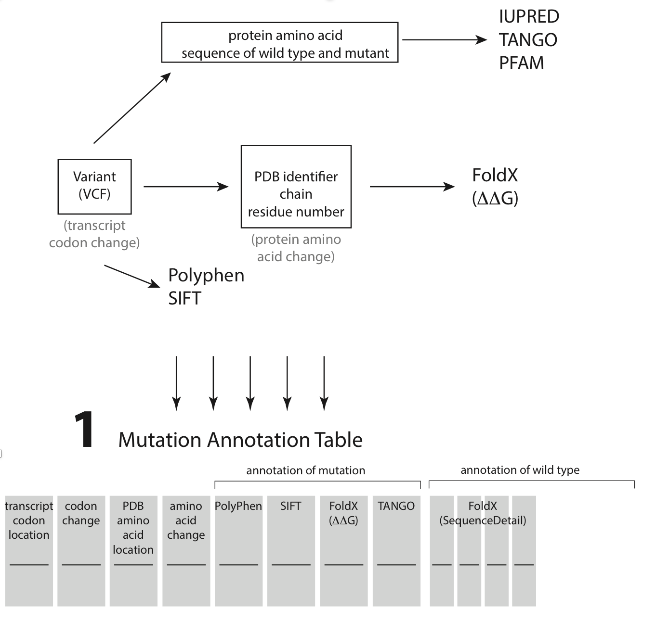
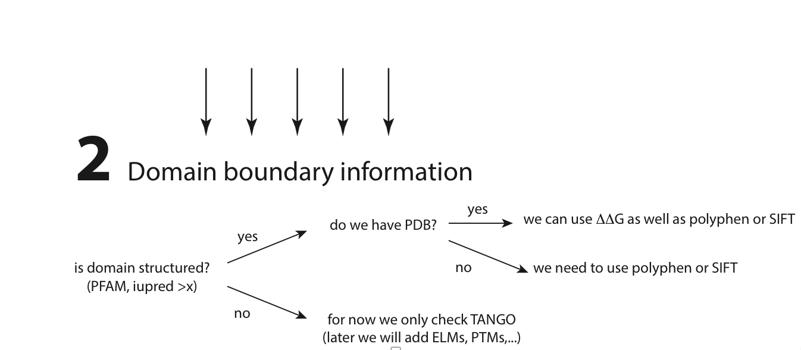
Analysis Pipeline

Slide 13
First Results

Slide 14
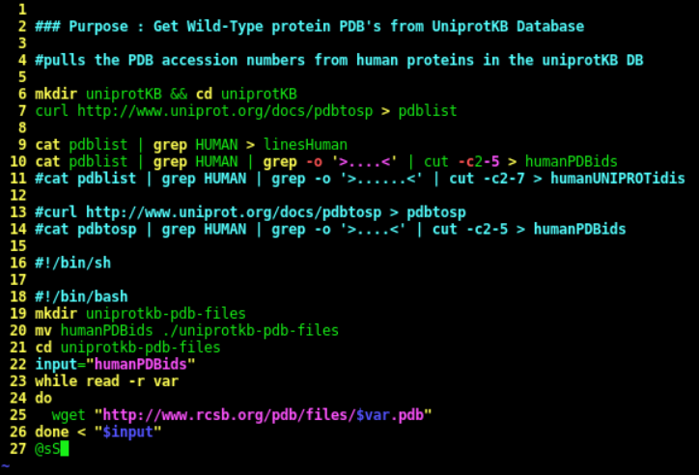
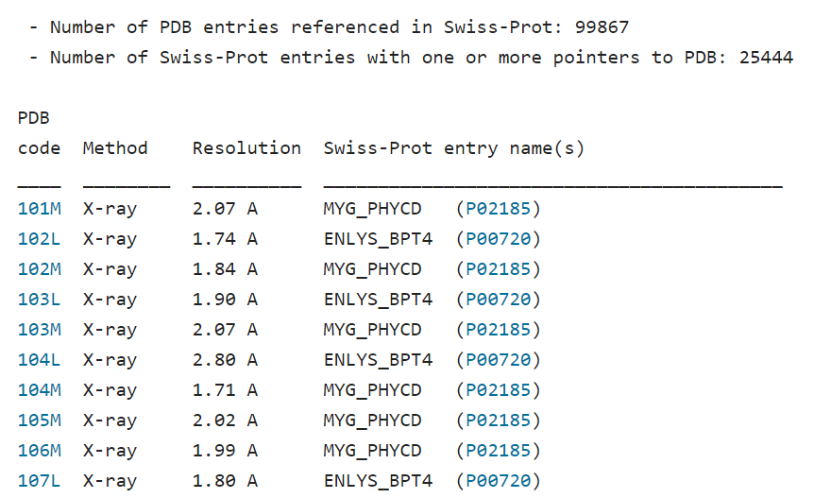
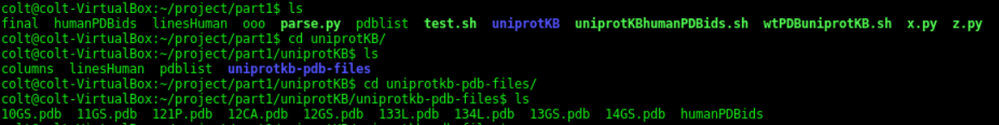
UniprotKB -> PDB Files
PDB to SP webpage
Notes:
Last meeting we mentioned that Uniprot would be a good place to get the wild type data. As far as I could tell, this webpage, http://www.uniprot.org/docs/pdbtosp , is what we were after. So I wrote a bash script which parses it and collects all the PDB codes with Human Entries and downloads them into a folder. I assume that these PDB files will be linked in the data structure somehow.

Slide 15
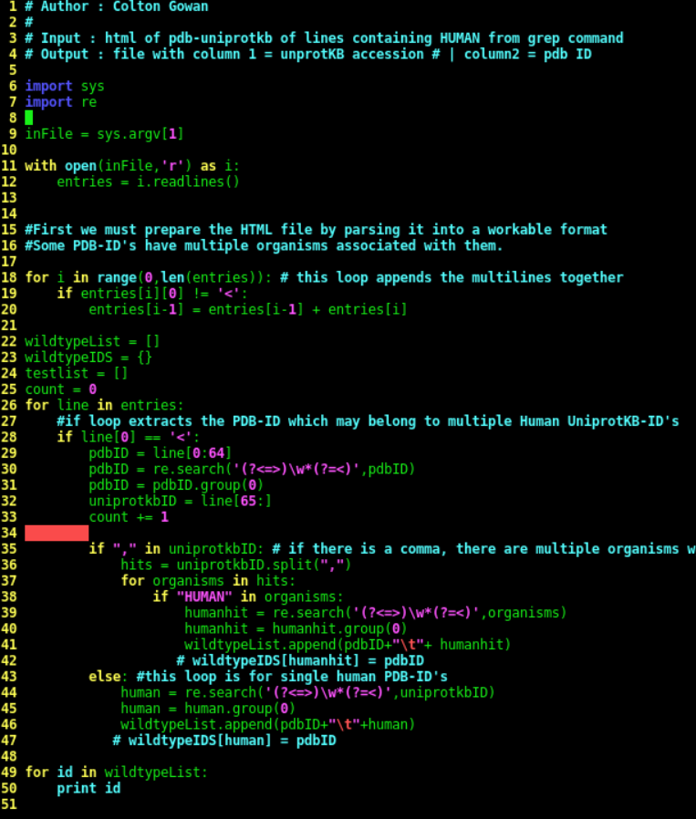
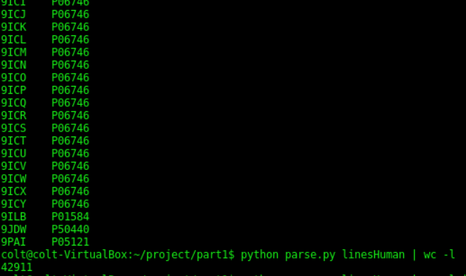
WildType Table - Columns
Parsing HTML with BASH/regex (BAD!)
Output : PDB-ID | UniprotKB-ID
Repair Enzyme - many structures since 90’s
~305 in UniprotKB
Notes:
Here I parsed the data and collected the PDB-codes with their associated Human UniprotKB accession ID’s. I was thinking these would be the most valuable columns... about 45k total. It should be noted that some Uniprot-ID’s point to multiple PDB-codes and vice versa.

Slide 16
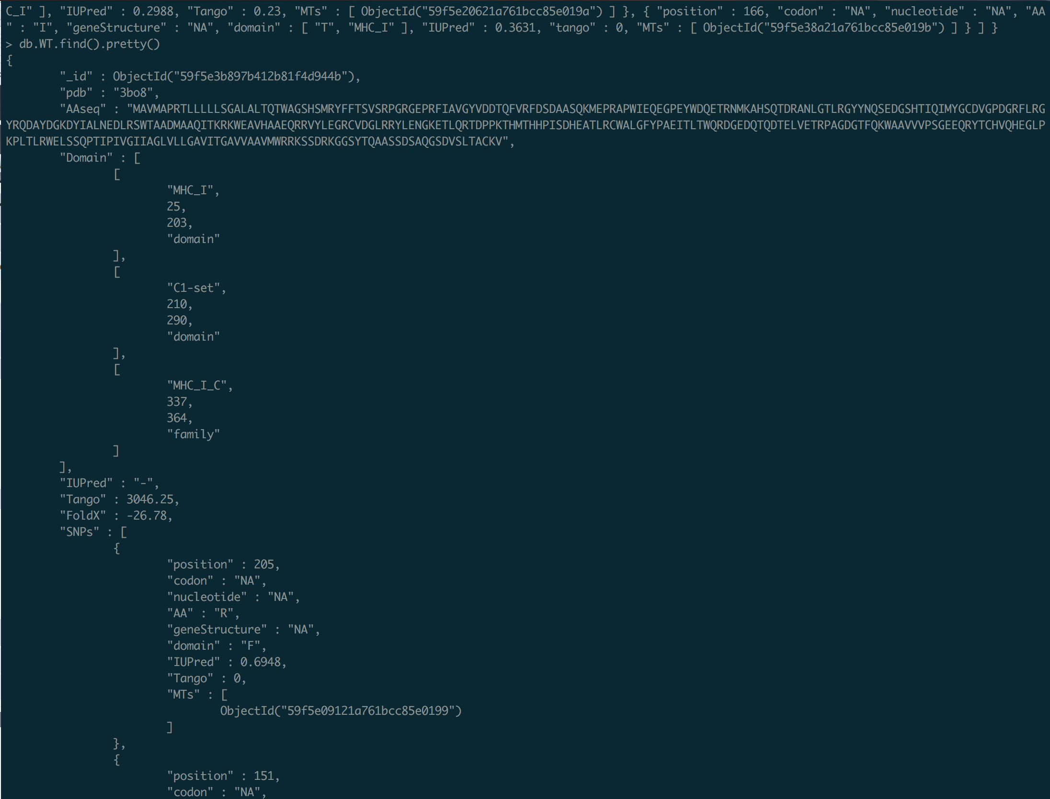
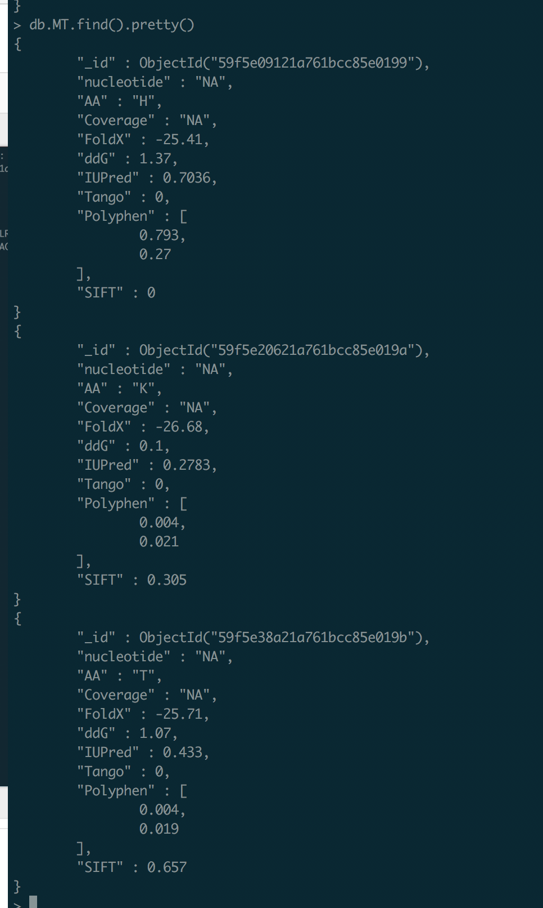

Slide 17
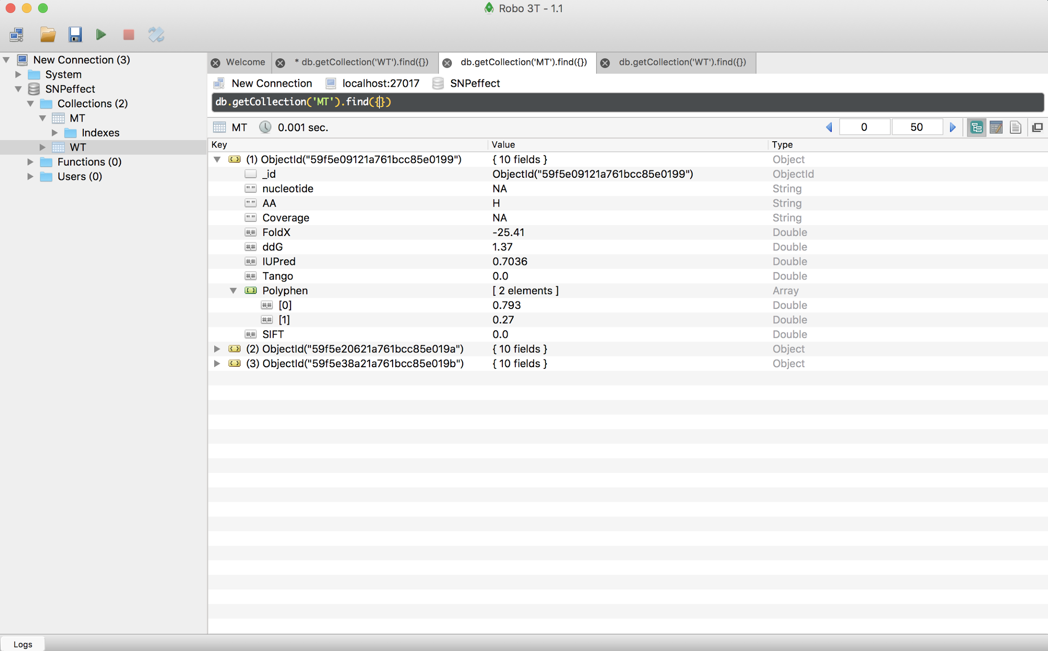
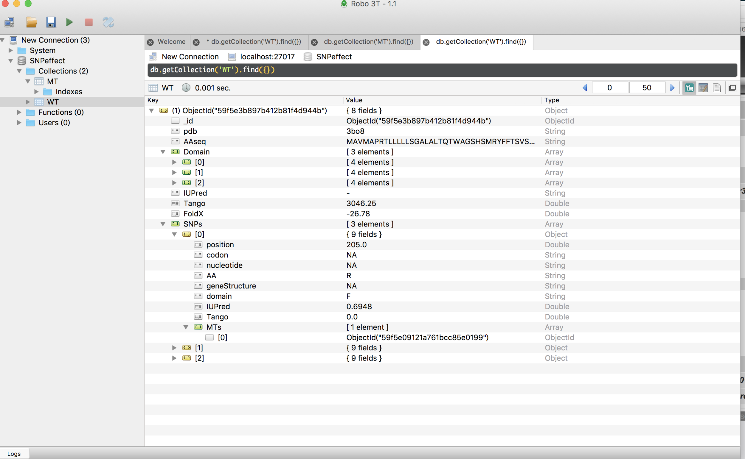

Slide 18
Next Session (3)
1) Collect Mutant PDB files from our cancer data set
Pipeline from VCF to Sequence to PDB
Intersect VCF files with Human Genome-19 -> Mutated Genome
Mutated Genome x Human Annotation GTF -> Mutated PDB
2) Collect data from Tools discussed in Session 1
Use WT and Mutant PDB files to collect FoldX information
Create single amino acid substitutions in WT PDB files for precomputation and run SIFT/Polyphen
3) Use this data to fill in tables in our database

