Slide 1
How do international economic activities between two countries impact a nation’s innovation over time?
MACSS Student
Yuqian Gong (Nancy)
National Innovation level before and after joining WTO?
Heterogeneous impacts on emerging innovator nation and leading innovator nation?
More trade and FDI lead to more innovation?

Slide 2
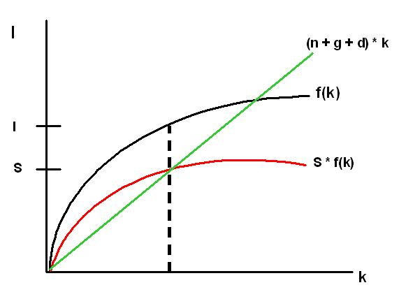
Background
Previous literature on drivers of innovation process
Solow Growth Model
National investments
Other factors play a role:
Intensity of a nation’s financial resources
Human capital to innovation activities
Accumulated technological capital
Supportive innovation environment in a nation’s industrial clusters
…….

Slide 3
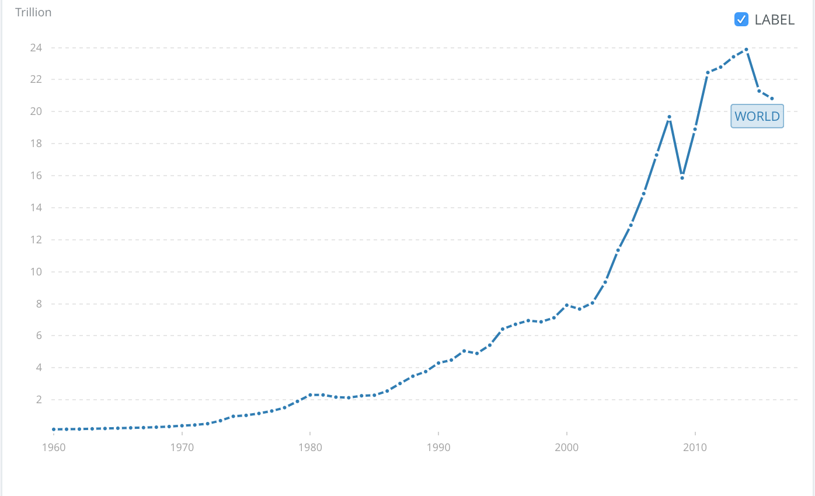
From closed economy to open economy
Foreign Direct Investment, net inflows (US$)
International Trade Flows (US$)

Slide 4
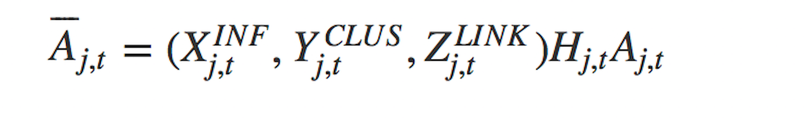
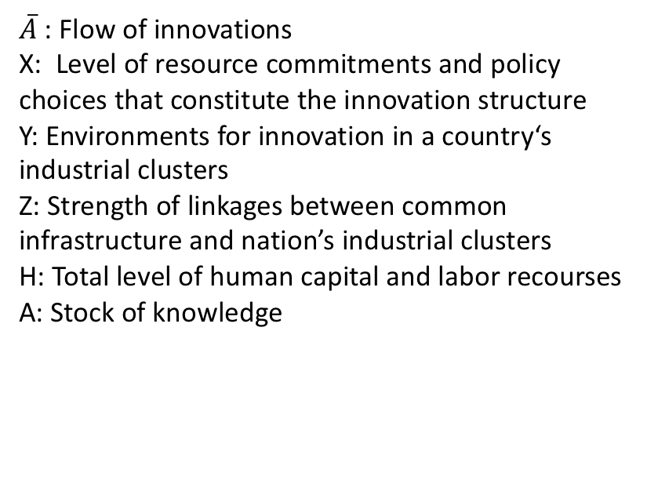
Model by Furman & Hayes
Determinants of national innovative capacity:
Variables of Interest:
Common innovation infrastructure
(e.g. Patent Stock, GDP, Education expenditure)
(b) Cluster-specific innovation environment
(c) Quality linkage between the two above
$\overline{A}$ : Flow of innovations
X: Level of resource commitments and policy choices that constitute the innovation structure
Y: Environments for innovation in a country‘s industrial clusters
Z: Strength of linkages between common infrastructure and nation’s industrial clusters
H: Total level of human capital and labor recourses
A: Stock of knowledge
Source: Furman, J. L., & Hayes, R. (2004). Catching up or standing still: National innovative productivity among ‘follower’ countries, 1978–1999. Research Policy, 33(9), 1329–1354

Slide 5
Model by Furman & Hayes
Determinants of national innovative capacity:
Variables of Interest:
Common innovation infrastructure
(e.g. Patent Stock, GDP, Education expenditure)
(b) Cluster-specific innovation environment
(c) Quality linkage between the two above
$\overline{A}$ : Flow of innovations
X: Level of resource commitments and policy choices that constitute the innovation structure
Y: Environments for innovation in a country‘s industrial clusters
Z: Strength of linkages between common infrastructure and nation’s industrial clusters
H: Total level of human capital and labor recourses
A: Stock of knowledge
Source: Furman, J. L., & Hayes, R. (2004). Catching up or standing still: National innovative productivity among ‘follower’ countries, 1978–1999. Research Policy, 33(9), 1329–1354

Slide 6
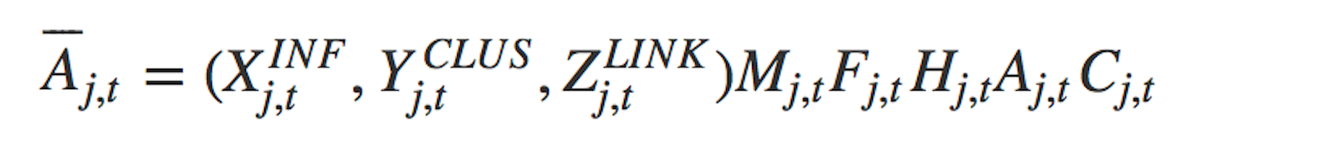
New Model
New variables to be incorporated:
M: trade flows
F: foreign direct investment
C: control variables

Slide 7
Data and Methods
Innovative Output
variable:
Patent Granted for each country each year
source:
WIPO
Quality of innovation
variable:
GDP, National education expenditure, number of
educational institutions…..
source:
WDI
Cluster-specific innovation environment
variable:
R&D expenditure by private industry
source:
OECD
Quality of linkage
variable:
national R&D expenditure(not
industry)
source:
OECD
Trade flows/FDI
variable:
imports/exports of goods and services,
high- technology imports and exports,
foreign direct investment net inflows
source:
WDI
Other control variable

Slide 8
Data and Methods
Innovative Output
variable:
Patent Granted for each country each year
source:
WIPO
Quality of innovation
variable:
GDP, National education expenditure, number of
educational institutions…..
source:
WDI
Cluster-specific innovation environment
variable:
R&D expenditure by private industry
source:
OECD
Quality of linkage
variable:
national R&D expenditure(not
industry)
source:
OECD
Trade flows/FDI
variable:
imports/exports of goods and services,
high- technology imports and exports,
foreign direct investment net inflows
source:
WDI
Other control variable

Slide 9
Methods
Time Series Method/Autoregression
PCA
Neural Networks

Slide 10
Further Discussion and Challenges
Alternative model
Better operationalize my model
Variable to measure innovation output
Variable to measure quality of linkage
Impacts of trade flows
Control variables

