Slide 1
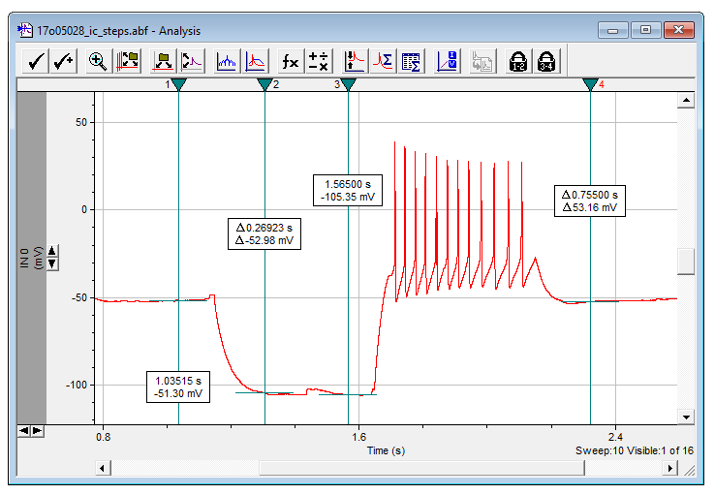

Slide 3
custom click&drag
ScottPlot graph
form buttons
form labels
form scrollbars

