Slide 1
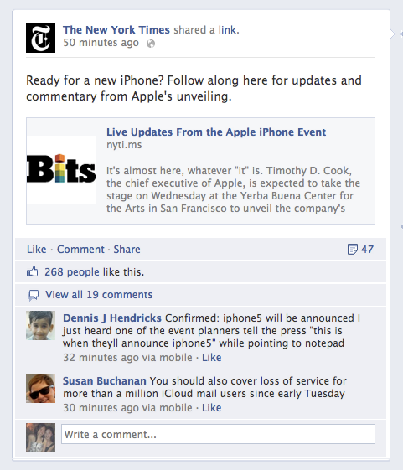
TYPE
MESSAGE
NAME
PICTURE
ARTICLE LINK
DESCRIPTION

