Slide 1
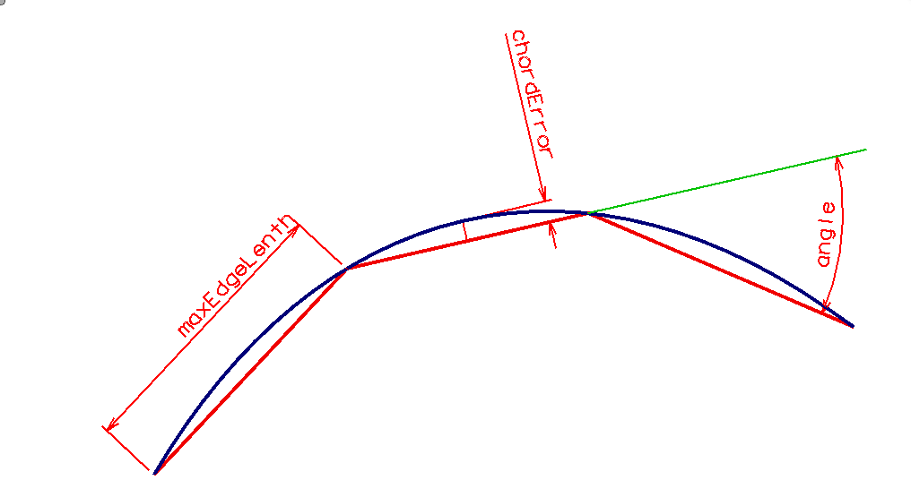
Facet tolerances
chordError | manufacturing
maxEdgeLength | FE mesh first cut
angle | graphics

