Slide 1

Neural Networks: Getting Started
Notes:
Hello and welcome to this first presentation in the Practicum AI Deep Learning Foundations workshop series. I’m Dan Maxwell, and I will act as your guide and mentor for this learning experience. I currently work as an AI Trainer / Consultant in the Research Computing Department at the University of Florida.
Let’s get started…

Slide 2

Deep Learning Foundations
Introduction
Neural
Network
Anatomy
Gradient
Descent
Notes:
Our Deep Learning Foundations series comprise 3 workshops. In this session and the next two which follow, we cover the basics of deep learning. Keep in mind that this series is foundational for our intermediate workshops.

Slide 3
Essential Questions
How does it work?
Where can I use it?
Notes:
This workshop series is guided by two essential questions: How does it – a particular AI algorithm – work? And where can I use it?
Now with respect to the first question, let me assure you that you can do interesting work in AI without having to master the mathematical details. You know – you can drive a car just fine, without knowing anything about the laws of thermodynamics. Likewise, you can do interesting things in AI without taking a year of calculus.
The second question is also important. This is not a question we can answer for you as it requires a certain level of knowledge and imagination on your part, though we can prime your thinking by demonstrating a specific application. That’s what you will do today. You are going to write some code to build and then test a neural network capable of classifying images.
=====
Two essential questions:
1st question: Just as you can drive a car without understanding the laws of thermodynamics, you can drive neural networks without having to master the math (calculus) which underpin them. Do not need a year of calculus…
2nd question: Equally important – but one you must creatively answer yourself, though we will share applications in today’s mini-lectures.

Slide 4
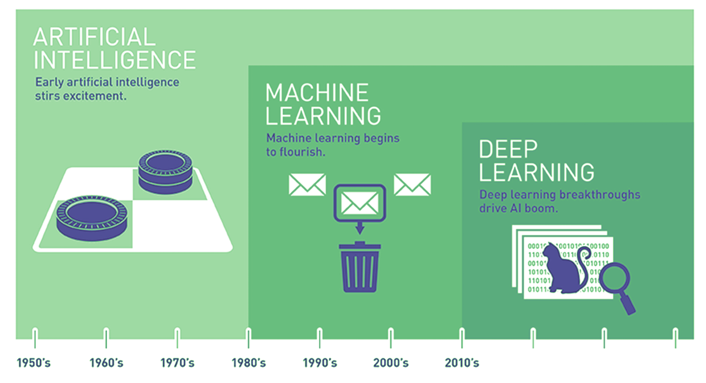
AI is Expansive
Source: Copeland, M. Retrieve from https://blogs.nvidia.com/blog/2016/07/29/whats-difference-artificial-intelligence-machine-learning-deep-learning-ai/
Notes:
The field of AI is expansive…
Often, the terms AI, Machine Learning, and Deep Learning are used interchangeably. But as pictured here, they are nested subsets, with AI encompassing the other two. Indeed, AI has a long and distinguished history. In fact, a lot of interesting AI research happened in the 1950s. Unfortunately, though, progress has been uneven.
Let’s now turn our attention to definitions…
[NEXT SLIDE]
=====
Expansive AI
AI encompasses ML and DL
Distinct domains
Uneven progress since the 1950’s, with multiple ‘winters’ where interest and funding dried up
Let’s first examine the relationship between machine learning and deep learning.

Slide 5
Artificial Intelligence is the study of “rational agents”: any system that perceives its environment and takes actions that maximize its chance of achieving its goals.
- Russell & Norvig (2003)
Notes:
In their best-selling textbook (Artificial Intelligence: A Modern Approach), Russell and Norvig define AI as the study of “rational agents”: any system that perceives its environment and takes actions that maximize its ability to achievie its goals. AI systems have come a long way in recent years. Many are now as good as humans at recognizing objects, understanding speech, and making decisions. And as the field advances, our understanding of human intelligence evolves as well. AI is now used in a wide variety of areas.
[NEXT SLIDE]
=====
Leading AI textbooks define the field of Artificial Intelligence as the study of “intelligent or rational agents” – any system that perceives its environment and takes actions that maximize its chance of achieving its goals.
Restatement of Russell & Norvig’s definition – Artificial Intelligence: A Modern Approach, 2nd edition – most widely used introductory text.
AI system performance = humans in many cases.
Broad array of applications.

Slide 6
Machine learning is the field of study that gives computers the ability to learn without being explicitly programmed.
- Arthur Samuel (1959)
Machine learning is the science and art of programming computers so they can learn from data.
- Aurélien Géron
Notes:
… and here’s a definition of machine learning coined by Arthur Samuel in 1959. This is concise and one of my personal favorites. However, I also like this second definition: Machine learning is the science (and art) of programming computers so they can learn from data. Now, the key word in that second definition is data. In fact, deep learning or machine learning is not possible without data.
[NEXT SLIDE]
=====
Machine Learning algorithms parse data, learn from it, and then make a prediction about something in the world. So rather than hand-coding software routines with a specific set of instructions to accomplish a particular task, the machine is “trained” using large amounts of data and algorithms that give it the ability to learn how to perform the task.

Slide 7

Deep Learning
Image Credit: https://www.bettycrocker.com/recipes/rainbow-layer-cake/4969fed8-141e-45f5-9a04-e03addd20fbb
Notes:
As noted earlier, deep learning is a subfield of machine learning. The focus of deep learning is neural networks. Now a neural network is a special type of learning algorithm, inspired by the billions of interconnected neurons in the human brain. In a deep learning model, neurons are grouped together in layers, as in a multi-layered cake. If you have many layers, the cake is “deep” when viewed from above. And that’s why we say, “deep learning.”
[NEXT SLIDE]
=====
Since 2010, deep learning became possible because:
Enhanced hardware – GPUs from Nvidia and other suppliers
Open AI software frameworks – Tensorflow, Pytorch, Keras, etc…
Big Data

Slide 8

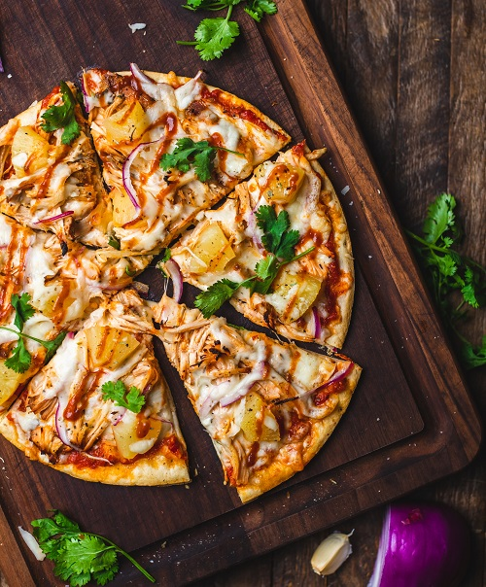
Amelia’s Pizza Obsession
Notes:
In our first hands-on exercise, you’ll work with a deep learning model. But first, I want to provide you with some background information. Here’s Amelia’s story…
Amelia, our teenage heroine, is an extremely picky eater. Some say she’s a pizza fanatic 🍕. When dinner rolls around, she only wants to come down from her bedroom if pizza is served. To achieve that goal, Amelia has installed a hidden camera in the dining room. Once dinner is set, the camera snaps a photo of the meal. Now, she wants to develop an AI image recognition system to determine if pizza is on the menu or not. After doing some research, Amelia finds ResNet, a neural network classifier trained to identify a thousand different kinds of images, include pizza.
Let’s quickly review the three-step process of creating a ResNet like classifier.

Slide 9

Train Model
“This is an image of a pizza”
ResNet50 Model
1,000 Categories
Notes:
Step One: design a deep learning model. The ResNet50 architecture, as its name suggest, consists of 50 layers. The box picture here is black because the inner workings of a deep neural network are largely hidden. This is known as the black-box problem. Also, we do not discuss the technical details of the architecture in this learning experience.
Step Two: train the ResNet model, using the ImageNet dataset. Since 2010, this dataset has been used in the ImageNet Large Scale Visual Recognition Challenge. This competition has played an important role in advancing the state-of-the-art in computer vision over the past decade.
And finally, step three: move the trained model to production – allowing Amelia to submit a pizza image to see if the system classifies it correctly.

Slide 10
Exercise
(A Simple Classification Model) 01.1_resnet.ipynb

Slide 11
Neural Network Architectures
Notes:
As you might guess, there is a wide variety of neural network architectures. And in this short briefing, I provide a quick look at some of the more popular ones and where they are used.

Slide 12
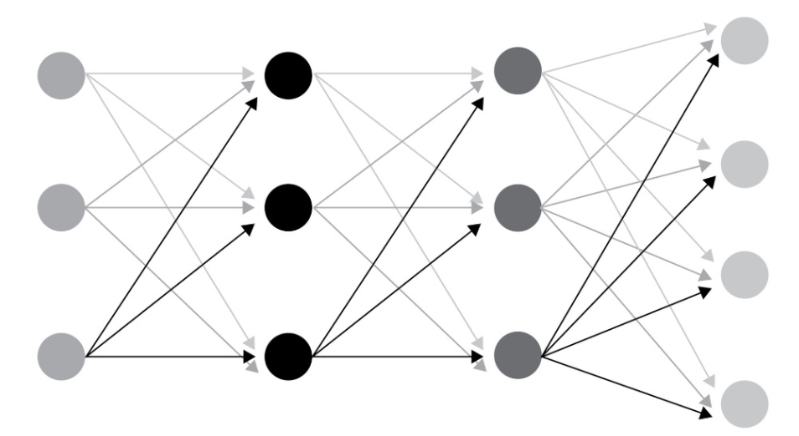
Fully-Connected Network
Input
Layer
Output
Layer
Hidden Layers
Notes:
A fully connected network is the most basic kind of neural network. In this architecture, every neuron in a specific layer is connected to every neuron in the next layer. Some application include:
Complex Classification
Machine Translation

Slide 13
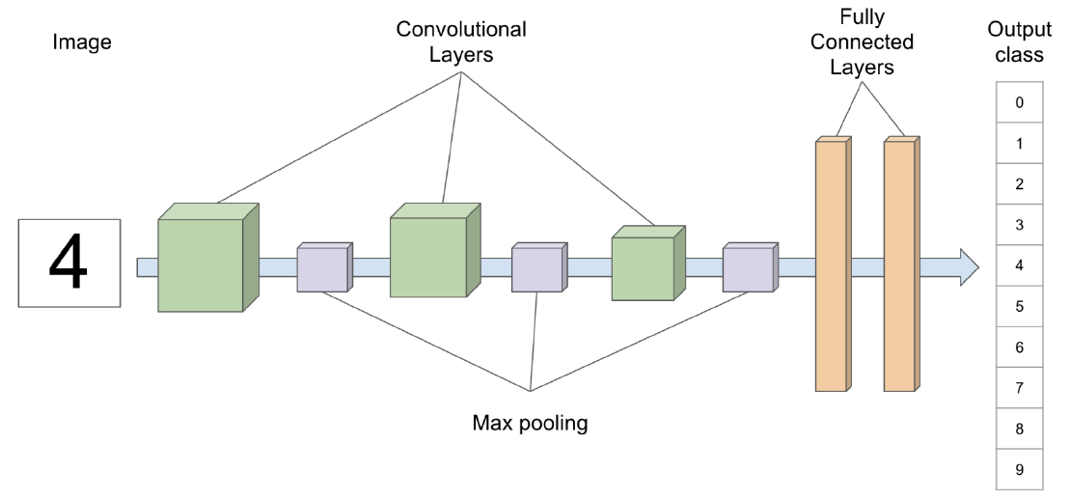
Convolutional Neural Network
Fully
Connected
Layers
Convolutional
Layers
Output
class
Image
4
Max pooling
Notes:
A convolutional neural network (CNN) is a class of AI models used primarily for image recognition tasks. In a fully connected network, each neuron in a layer is connected to every neuron in the next layer (previous slide). CNNs, however, adopt a different strategy and do not use a fully connected architecture. As well, CNNs are typically constructed with one or more convolution and/or pooling layers. These specialized layers allow the model to extract local features from images which are then fed to the subsequent layers.
Some application of CNNs include:
Image processing
Computer Vision
Speech Recognition

Slide 14
Recurrent Neural Network
Input Layer
INPUT
Hidden Layer
Output Layer
OUTPUT
Notes:
Recurrent neural networks (RNNs) are specifically designed to process sequential data such as time series, speech, and text. RNNs have a feedback loop in which the output of each neuron is fed back to itself – shown here by the red arrow. This allows the network to maintain an internal state, giving it the ability to remember what it has already done. More recently, Transformers have begun to displace RNNs as they are more versatile and effective.
Some application of RNNs include:
Text processing like auto suggest, grammar checks, etc.
Text to speech processing
Sentiment Analysis
Time sequence projections
Translation

Slide 15
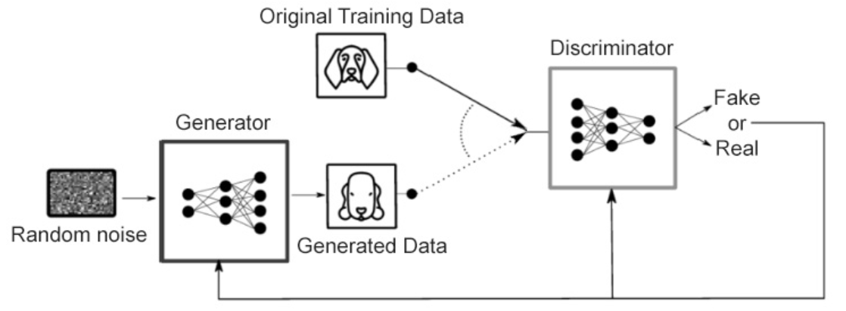
Generative Adversarial Network
Original Training Data
Discriminator
Fake
Generator
or
Real
Random noise
Generated Data
Notes:
Generative Adversarial Networks (GANs) are a type of deep learning model that generate new data samples. The basic idea behind a GAN is to train two neural networks in a game-like setting, where one network (the generator) attempts to fool another network (the discriminator) into thinking that the data samples it generates come from the discriminator’s training dataset.
Some applications of GANs include:
• Image translation
• Text to image synthesis
• Generation of musical scores, images, and text.

Slide 16
Practice
(Tensorflow Introduction) 01.2_tensorflow_intro.ipynb

Slide 18

Image Credit: https://cktechcheck.com/

