Slide 1


Anatomy of a Neural Network

Slide 2
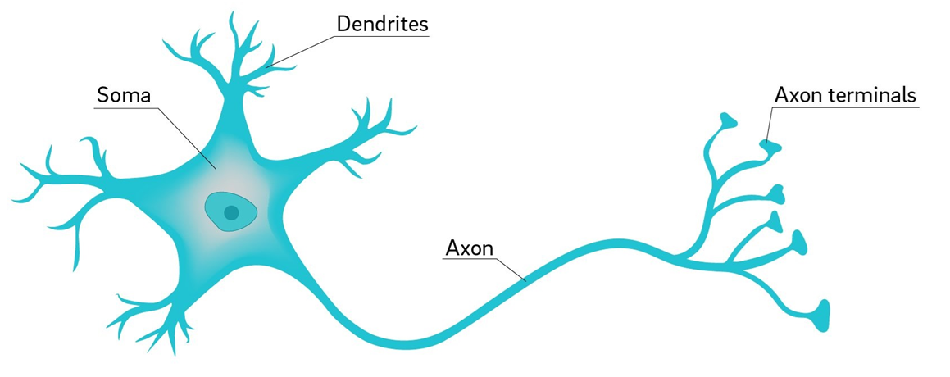
Image Credit: https://ucsdnews.ucsd.edu/pressrelease/why_are_neuron_axons_long_and_spindly
Notes:
Let’s begin by examining the anatomy of a “real” neuron, the inspiration behind its computer science equivalent.
As shown here, a neuron is comprised of Dendrites, a cell body (labeled here as the Soma – the Greek word for body), and an Axon with multiple branches, tipped with Axon terminals. The Axon terminals, in turn, connect to Dendrites from other neurons. Hence, the flow of electrical impulses is from Dendrite to Soma to Axon and then to Axon terminal. And finally, the strength of the electrical impulse sent to the Axon depends on the combined strength of impulses coming into the neuron’s body. Neural networks essentially work the same way.

Slide 3
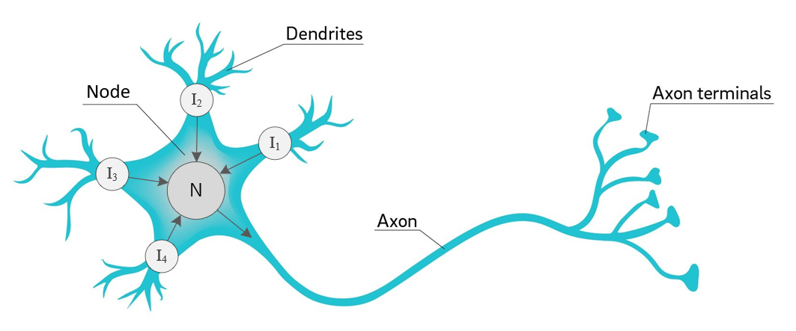
Image Credit: https://ucsdnews.ucsd.edu/pressrelease/why_are_neuron_axons_long_and_spindly
Notes:
The process of creating an artificial neuron begins by diagramming basic operations. First, we’ll use the term node or neuron – instead of Soma or cell body – to designate a centralized location which collects incoming signals and then outputs a value. Second, let’s label each of our inputs as I1, I2, I3, and I4. In this case, the arrows indicate signal direction, with four coming into the Node and one leaving as output.
We’re now ready to take another step towards a computational abstraction.

Slide 4
Input 1
Input 2
Weight 1
Weight 2
+
Input 3
Weight 3
Weight 4
Input 4
Weight 5
Net Input
Function
Activation
Function
Bias = 1.0
Source: Glassner, A. (2021). Deep learning: A visual approach. San Francisco, CA: No Starch Press. (Chapter 13)
Notes:
Our biological underpinnings have now disappeared, though we still see our 4 inputs on the left, with the addition of a bias value. In the case of an artificial neuron, each input value is multiplied by its associated weight before it is fed into the net input function. And from there, the net input function sends its output to an activation function. Together, the net input and activation functions comprise the body of a single node.
Also note: the number of inputs coming into a node is not limited to four. We can have as many as we like.

Slide 5
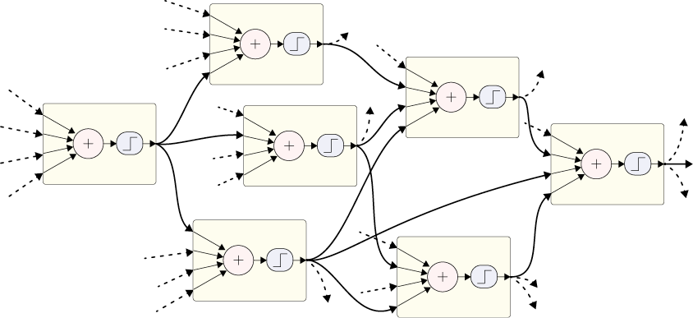
+
+
+
+
+
+
+
Source: Glassner, A. (2021). Deep learning: A visual approach. San Francisco, CA: No Starch Press. (Chapter 13)
Notes:
Like their biological equivalents, artificial neurons can be wired up into networks, where the input for each neuron comes from the output of upstream neurons. We draw lines between the neurons to show the connections between them, as we see here. The goal of a network like this one is to produce one or more output values.

Slide 6
A
D
AD
AE
AF
B
BD
E
BE
BF
CD
C
CE
F
CF
Source: Glassner, A. (2021). Deep learning: A visual approach. San Francisco, CA: No Starch Press. (Chapter 13)
Notes:
Network weights or parameters lie in-between the nodes. A common convention used to identify specific weights is illustrated here. Here we see six nodes, arranged in two layers. For convenience, we’ve labeled each with a letter. Each weight corresponds to how the output of one specific neuron is changed on its way to another specific neuron, shown as lines. To name a weight, we combine the name of the output neuron with the input neuron. For example, the weight that multiplies the output of A before it’s used by D is called AD.

Slide 7
Layer 1
Layer 2
Layer 3
Inputs
Outputs
Input layer
Hidden Layer
Hidden Layer
Output Layer
Source: Glassner, A. (2021). Deep learning: A visual approach. San Francisco, CA: No Starch Press. (Chapter 13)
Notes:
Of the many possible ways to organize neurons in a network, placing them in a series of layers has proven to be both flexible and extremely powerful. Typically, neurons within a layer aren’t connected to one another. Their inputs come from the previous layer, and their outputs go to the next layer. In fact, the phrase deep learning comes from this structure.

Slide 8

Deep
Wide
Image Credit: https://sugargeekshow.com/recipe/rainbow-cake/
Notes:
Consider a layered cake. If we lay the cake on its side, with many layers side-by-side, we say the network is wide. But if we stand the cake up and look at it from above, we say it is deep. And that’s what deep learning means: a network composed of a series of layers – often drawn vertically.

Slide 9
Fully Connected
Partially Connected
Notes:
Layers can be fully or partially connected. In a fully connected layer - these are called dense layers in the Keras API – every neuron in the layer receives an input from every neuron in the previous layer. That is not the case in a partially connected network where some of the network connections are dropped. Interestingly, model training with partially connected layers is often faster and more effective.

Slide 10
Bias Node
X₀
G₀
Network Output
W_{xg0}
W_{gf0}
X₁
W_{xg1}
G
F
E
W_{gf1}
Input Features
Error
X₂
W_{xg2}
y_{truth}
Input Layer
Hidden Layer
Output Layer
Error/Loss Function
Notes:
Alright, let’s create a simple neural network, consisting of three layers – an input layer, a single hidden layer, and an output layer.
During forward propagation, input features are fed to the input layer, one feature per node. The input data can be structured data (for example, a CSV file) or unstructured data, such as an image or sound file.
We now add our weights, also called parameters. Weights are adjusted during the training process. And this is how a neural network learns.
Typically, a bias node is associated with each layer.
And finally, this small network has a single output node, labelled (F). From here, the network’s output is passed to an error function that calculates the network’s total error, that is, the difference between ground truth (labelled y) and the output.

Slide 11
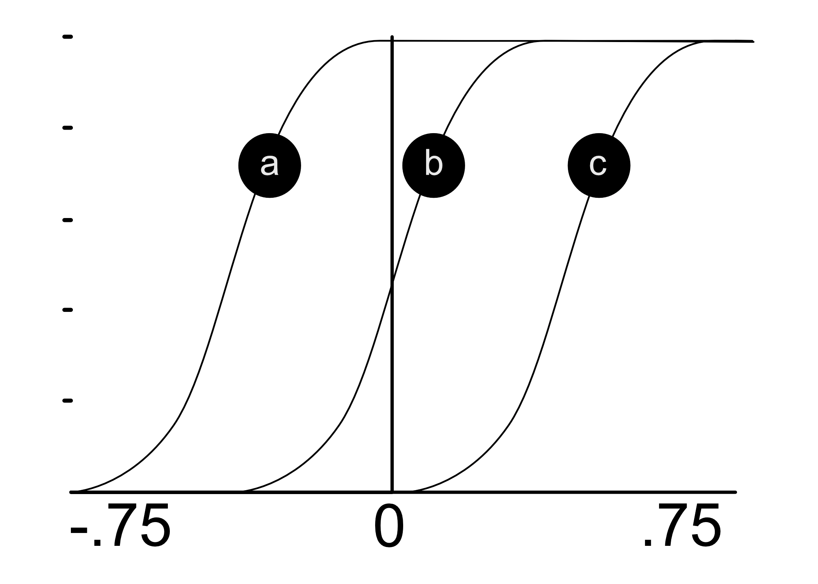
Source: Taylor, M. (2017). Neural networks: A visual introduction for beginners. Vancouver, Canada: Blue Windmill Media.
Notes:
Before we conclude this briefing, I need to justify and explain the existence of the bias nodes. Technically, bias provides every node in a neural network with a trainable constant value (1 or -1). But why do we need them? Well – on a practical level – input from the bias node enables an activation function to be shifted to the left or right. As shown here, the output from what appears to be a sigmoid function can be shifted left (to position A) or right (to position C). The ability to shift like this is an important factor in network training. In other words, bias enhances the learning process.

Slide 12
Exercise
(Amelia’s Perceptron) 02.1_perceptron.ipynb
Notes:
The learning experience for this workshop starts on page 55 of the textbook. For additional information, please watch the exercise 2.01 orientation video.

Slide 13

Exercise
Notes:
Link: https://teachablemachine.withgoogle.com
Link: https://developers.google.com/machine-learning/glossary#e

Slide 14
History of the Artificial Neuron

Slide 15
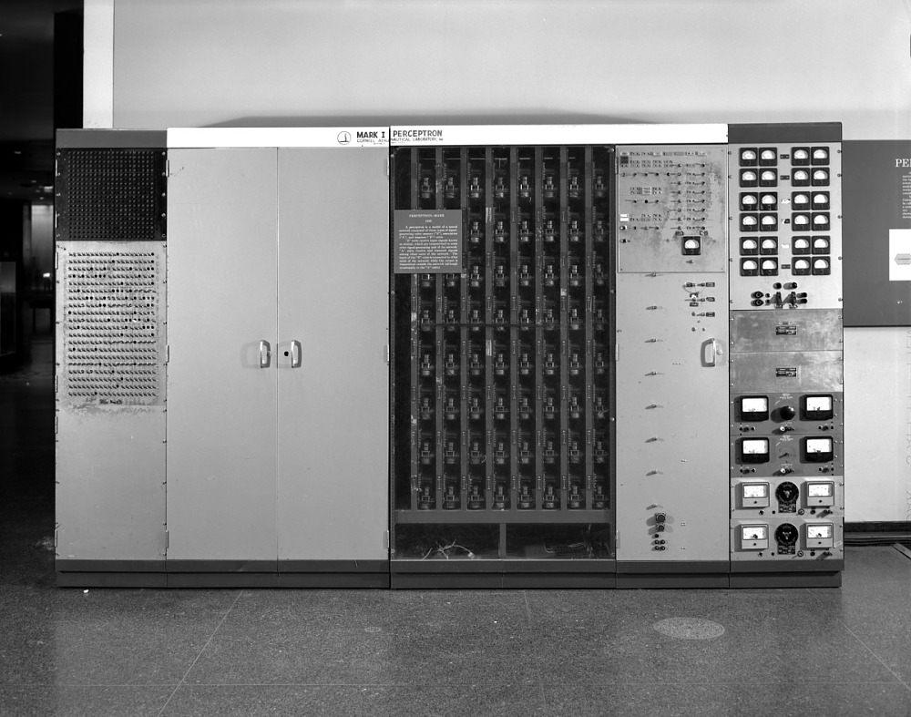
Image Credit: https://americanhistory.si.edu/collections/search/object/nmah_334414
Notes:
The history of the artificial neuron begins in 1943, with the publication of a paper by Warren McCulloch and Walter Pitts. In this article, the authors presented a simple abstraction of a neuron’s basic functions. They also described how multiple artificial neurons could be linked up to form a network.
In 1957 Frank Rosenblatt proposed the perceptron as a simplified mathematical model of a neuron (Rosenblatt 1962). And the following year (1958), a perceptron-based computer was built at Cornell University. It was the size of a refrigerator and called the Mark I Perceptron (Wikipedia 2020c). The Mark I is pictured here. The device was built to process and classify simple images. Its grid of 400 photocells could digitize an image at a resolution of 20 by 20 pixels. Enthusiasm for the perceptron, however, was short lived.
In 1969, Marvin Minsky and Seymour Papert wrote a book in which they argued that Rosenblatt’s perceptron technique was severely limited. Soon, a popular consensus formed that neural networks were a dead end. Enthusiasm, interest, and funding all dried up. The first AI Winter had begun. However, all that changed about 10 years ago. Big data combined with powerful hardware made it possible to create complex neural networks, capable of doing interesting things.
Source: Glassner, A. (2021). Deep learning: A visual approach. San Francisco, CA: No Starch Press

