Slide 1


Activation Functions

Slide 2

y = f(x)
Input 1
Input 2
Weight 1
Weight 2
+
Input 3
Weight 3
Weight 4
Input 4
Weight 5
Net Input
Function
Activation
Function
Bias = 1.0
Source: Glassner, A. (2021). Deep learning: A visual approach. San Francisco, CA: No Starch Press. (Chapter 13)
Notes:
We begin with a quick review. This image was featured in our neural network training video. And as we learned there, an artificial neuron is comprised of a net input or summation function and an activation function. Remember: a function is a named block of code that runs when called. Most functions allow you to pass data into them. These are called parameters. Most functions also return a value once they’ve been executed.
Here we see a simple function called f, with one parameter called x. When we pass an input value on the x-axis to this function, it returns y as its output.
Activation functions work the same way. You pass a value in, and it returns a value. The choice of activation function is important as it can have a major impact on how well your model trains.

Slide 3
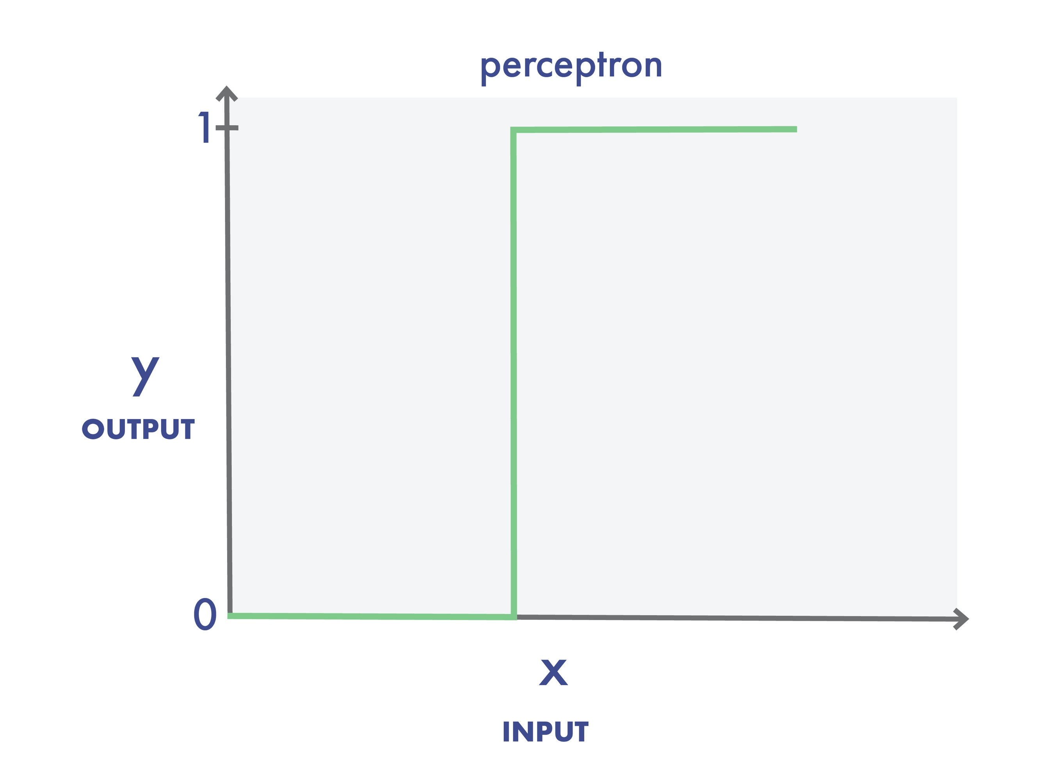
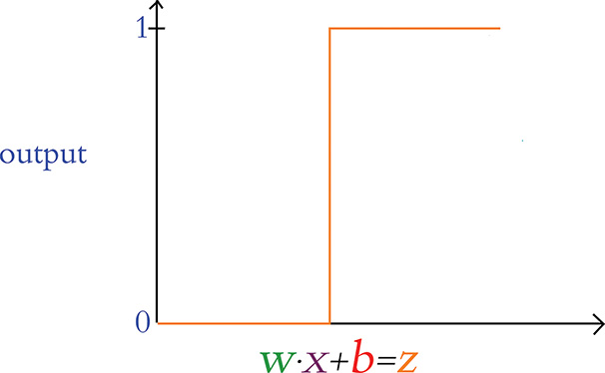
perceptron
y
output
x
input
Source: Krohn, J. et al (2020). Deep learning illustrated: A visual, interactive guide to AI. New York, NY: Addison-Wesley. (Chapter 6)
Notes:
Our first activation function is the simple perceptron. When its input is less than or equal to zero, the perceptron outputs 0. If the input becomes positive – even by a tiny amount – the perceptron outputs a 1. But this sudden and extreme transition is not ideal for training. Essentially, the neuron has no finesse – it’s either yelling or its silent.
Think about it like this. In real life, learning is generally incremental, consisting of a series of small steps towards mastery. Complete understanding rarely happens in an instant. The same holds true in deep learning. Ideally, we’d like to move along a gradient, capable of reflecting small learning adjustments.

Slide 4
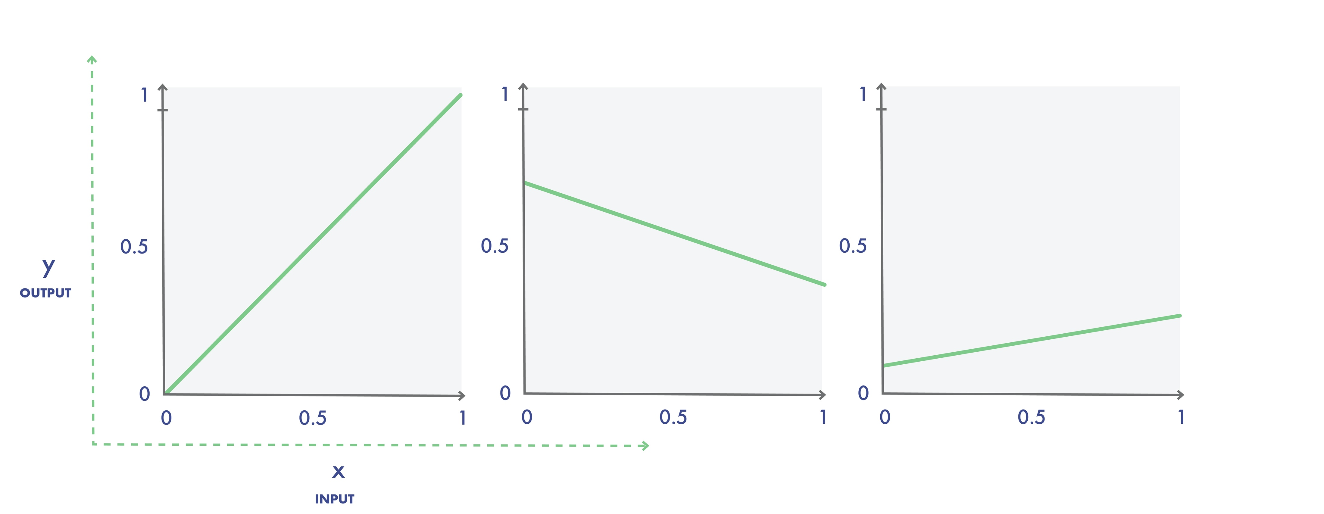
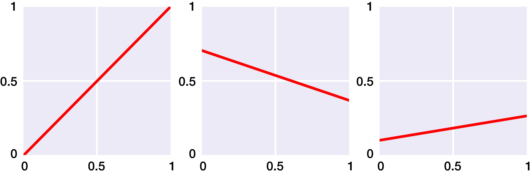
y
y
output
x
x
input
Source: Glassner, A. (2021). Deep learning: A visual approach. San Francisco, CA: No Starch Press. (Chapter 13)
Notes:
Linear functions consist of one or more straight lines. Unlike the simple perceptron, these functions have a learning gradient.
Three linear functions are pictured here. The function on the left is an identity function. In other words, y equals x. Whatever you pass to the function is what you get out of it. With the other two graphs, the lines are tilted, reflecting different slopes. This is typically what we see in simple linear regression.

Slide 5
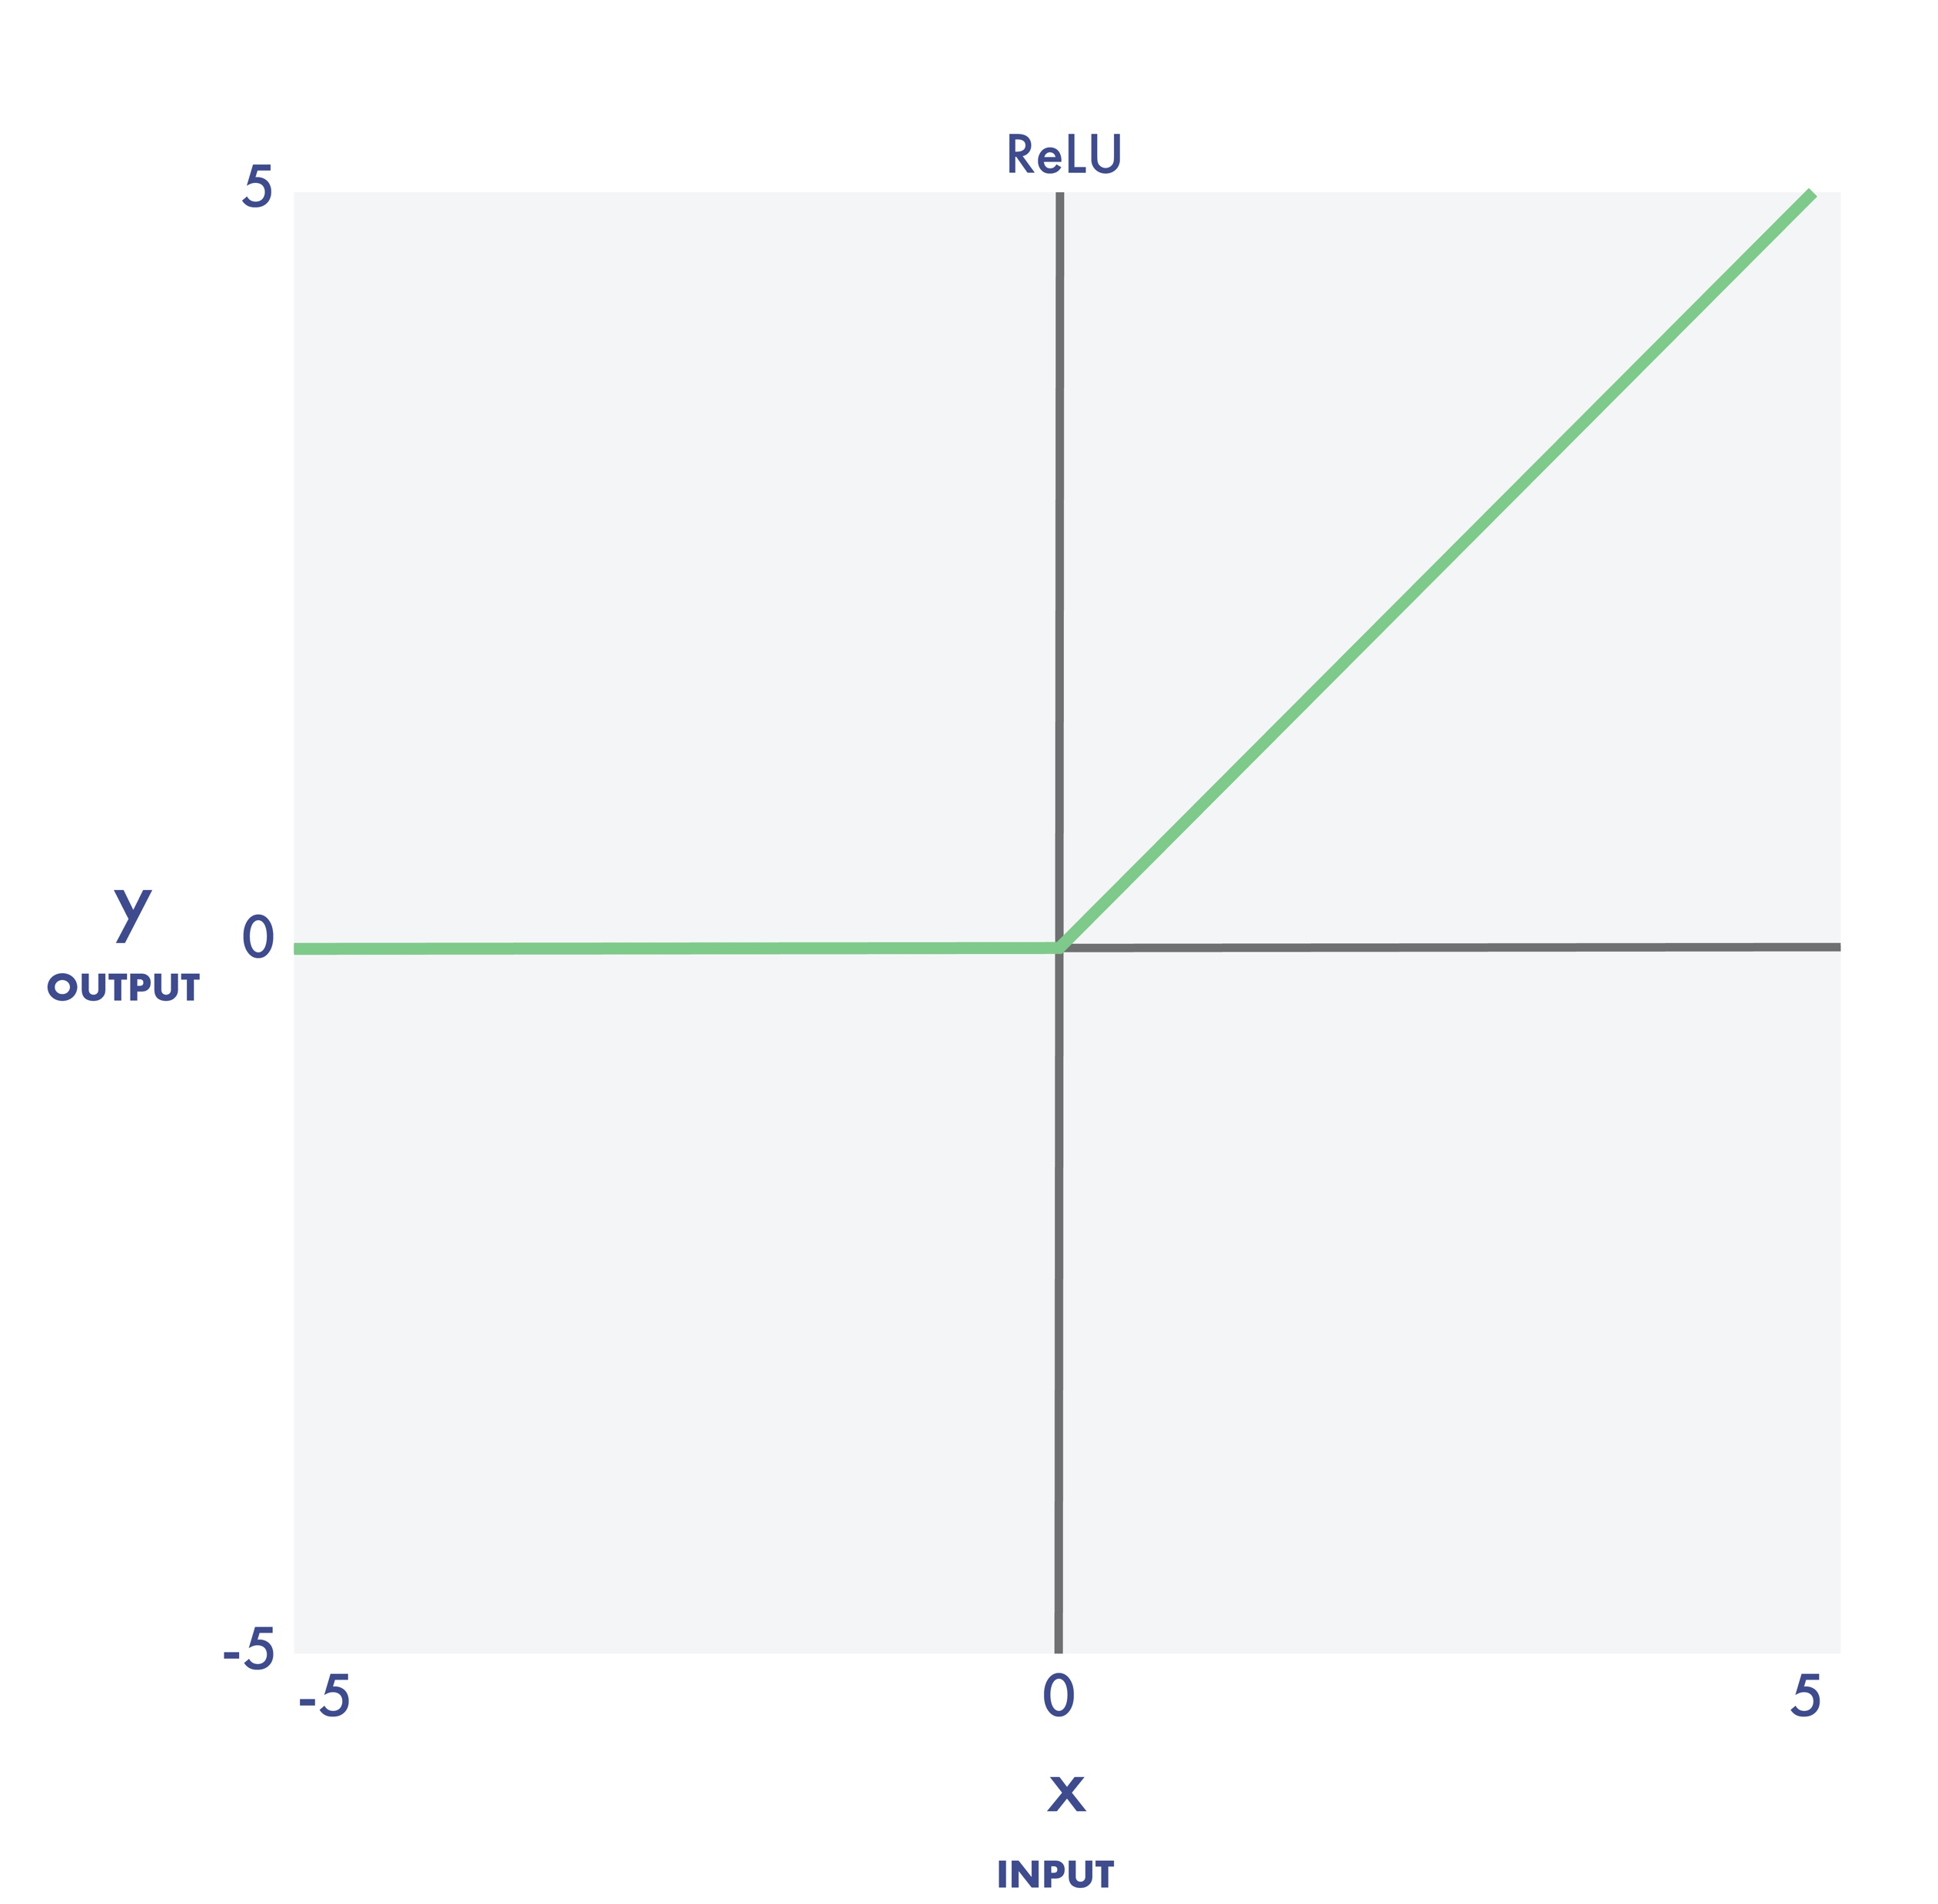
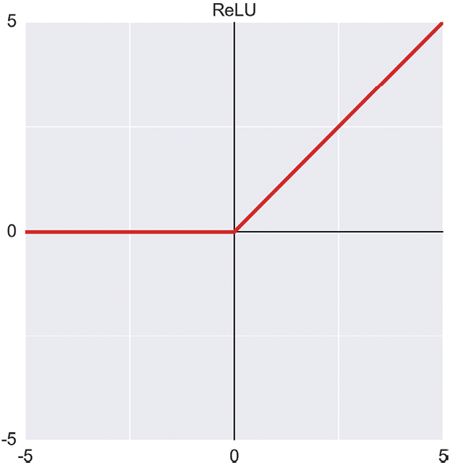
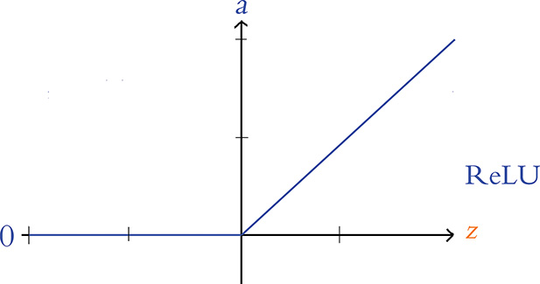
ReLU
y
output
x
input
Source: Glassner, A. (2021). Deep learning: A visual approach. San Francisco, CA: No Starch Press. (Chapter 13)
Notes:
The ReLU (rectified linear unit) function outputs 0 for all negative inputs, otherwise the output is the input.
Now in recent years, the ReLU activation function has become quite popular because it’s simple and trains extremely well.

Slide 6
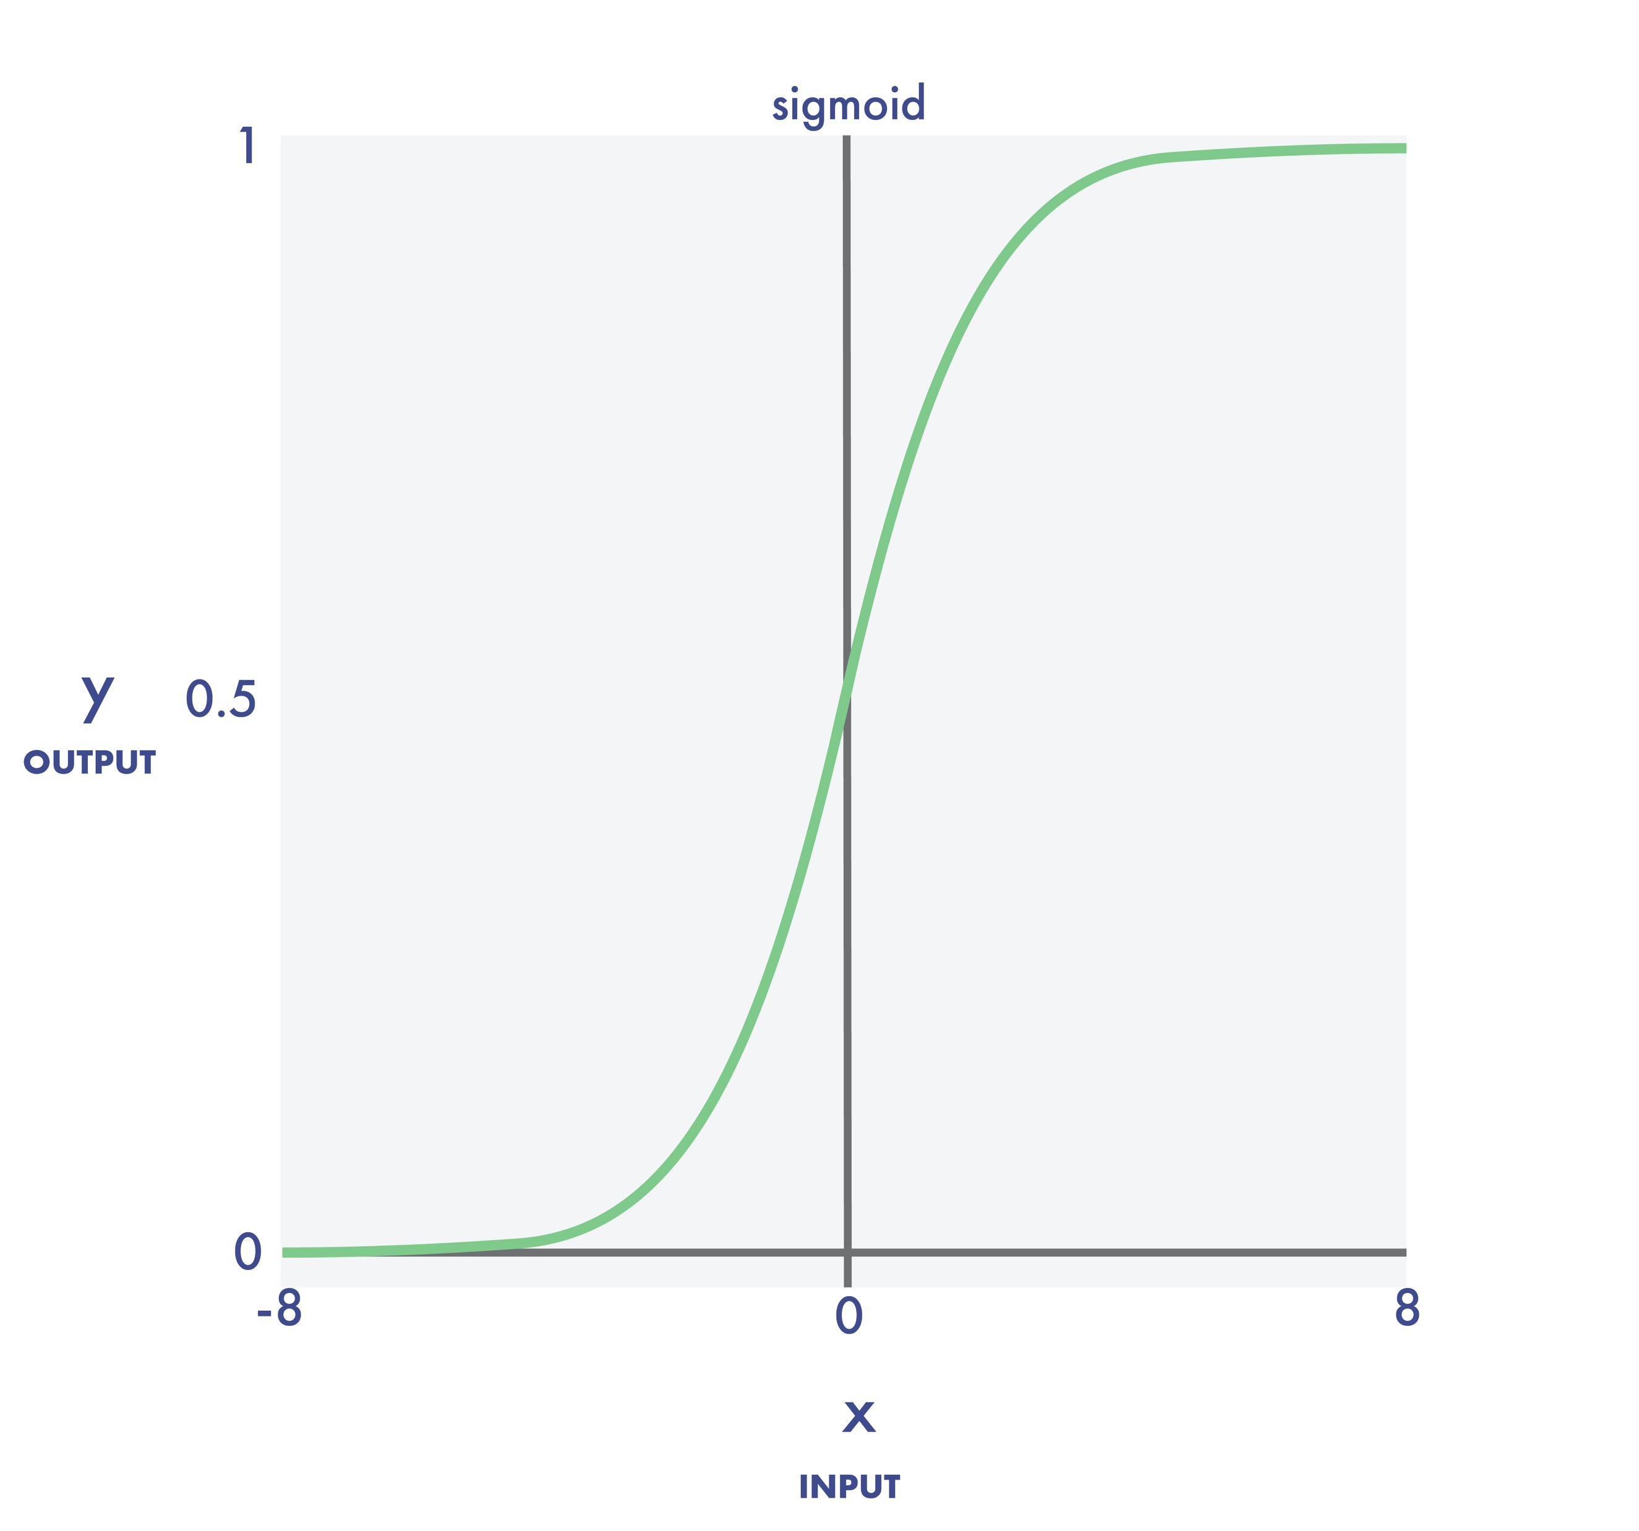
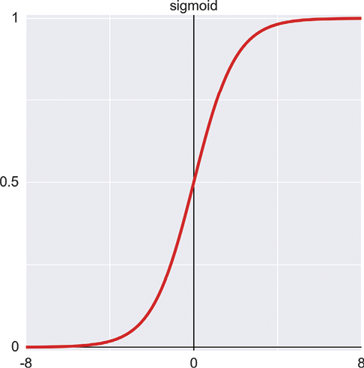
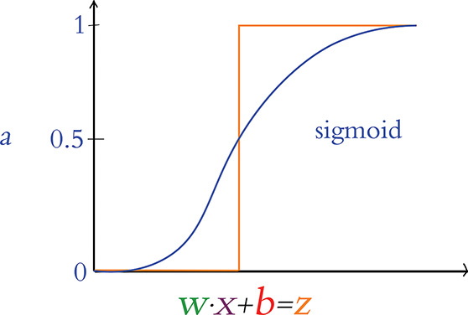
sigmoid
y
output
x
input
Source: Glassner, A. (2021). Deep learning: A visual approach. San Francisco, CA: No Starch Press. (Chapter 13)
Notes:
The sigmoid function – also known as the logistic function – returns a 0 value for extremely negative inputs, and a value of 1 for extremely positive inputs. In this example, we see a smooth transition between 0 and 1 for x values between -6 to 6. This function is called sigmoid because it resembles the curve of an S shape.

Slide 7
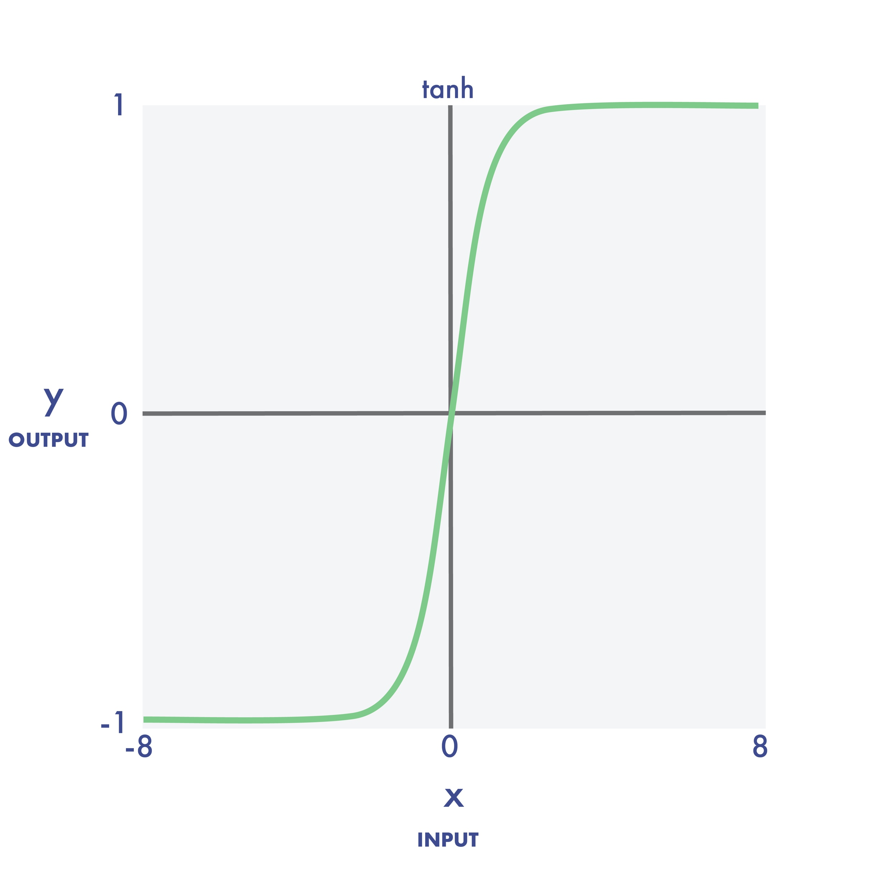
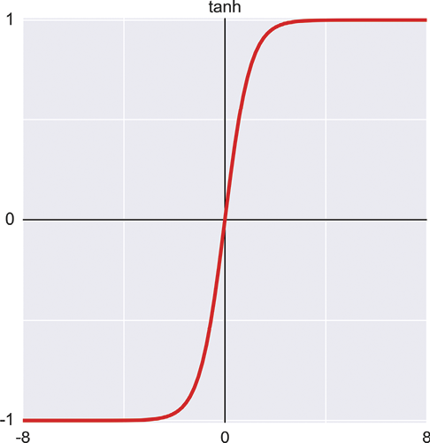
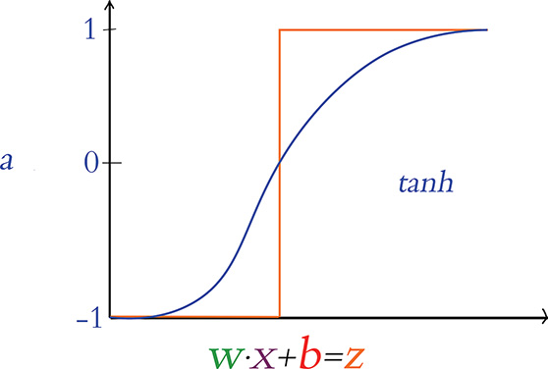
tanh
y
output
x
input
Source: Glassner, A. (2021). Deep learning: A visual approach. San Francisco, CA: No Starch Press. (Chapter 13)
Notes:
The output from the hyperbolic tangent function, written TANH, looks like the sigmoid function. It has that same S-shape. But there are differences. For example, the TANH function returns a value of −1 for extremely negative inputs. And as we see here, the transition zone is not as wide.

Slide 8
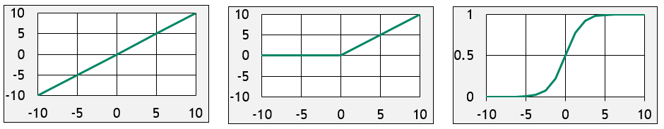
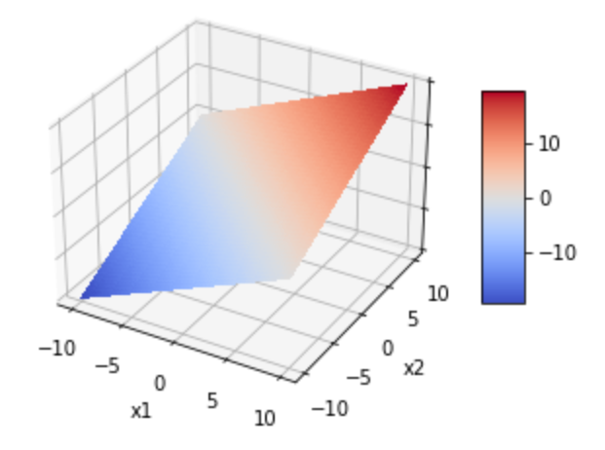
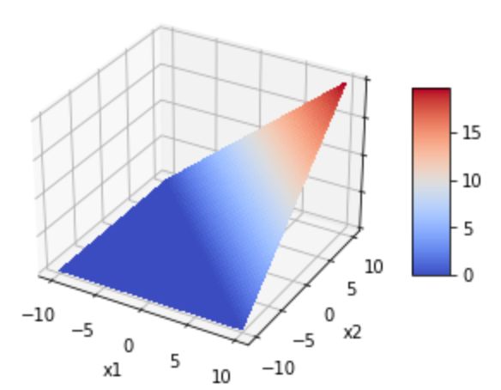
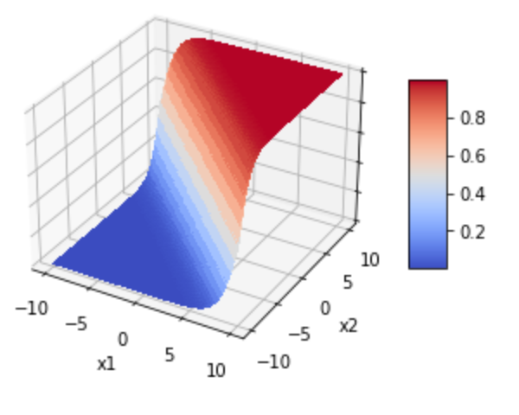
Linear
ReLU
Sigmoid
Notes:
Let’s take a moment to visualize the Linear, ReLu, and Sigmoid activation functions in three-dimensional space. The graphs in the first row are no surprise as we saw them in earlier slides. On the second row, however, we see their three-dimensional equivalents. Linear is just a plane, like a sheet of paper. ReLU looks like a wedge. And Sigmoid looks like a surf wave.

Slide 9
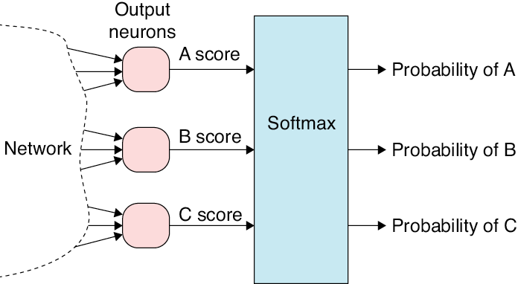
Output Neurons
Output
neurons
A score
Probability of A
Network
B score
Softmax
Probability of B
C score
Probability of C
Source: Glassner, A. (2021). Deep learning: A visual approach. San Francisco, CA: No Starch Press. (Chapter 13)
Notes:
And finally, there’s an activation function that’s typically used only in the output layer of a neural network. And only if there are two or more output neurons. It’s called the softmax function. A softmax turns the numbers that come out of a classification network into a set of probabilities where all the class probabilities add up to 1.

Slide 10
Activation Function Recommendations
The Perceptron
The Sigmoid
The Tanh
The ReLU
Source: Krohn, J. (2020). Deep learning Illustrated. New York, NY: Addison-Wesley. (p. 96)
Notes:
I conclude this briefing with the following recommendations which come from Jon Krohn’s wonderful book: Deep Learning Illustrated:
Because it’s either all on or off, the perceptron is not a practical choice for deep neural networks.
However, the Sigmoid is an acceptable option. But keep in mind: neural networks comprised of sigmoid functions tend to train slower than those with Tanh or ReLU functions. So, limit the use of sigmoid functions to situations where the neuron needs to provide output between 0 – 1.
The Tanh is also a solid choice as the 0 centered output helps networks train rapidly.
And according to Krohn, the best choice is ReLU because of its computational efficiency. This activation function tends to lead to well-calibrated models in the shortest training time.
Now because ReLU is so popular, there are many variants -- Leaky ReLU, parametric ReLU, and the Exponential Linear Unit. For more information about these options, please refer to the documentation of the framework you are currently using.

Slide 11

Exercise
Notes:
Tensorflow Playground: https://playground.tensorflow.org/

Slide 12

Exercise
Notes:
Source: Google Teachable Machine: https://teachablemachine.withgoogle.com
Two Locations for the Hanfu/Hanbok dataset
https://drive.google.com/file/d/1q3RIgIoeePNW-fEgNyCgh45gBvMAdeOU/view
https://drive.google.com/file/d/1WbZPzunh6u9f0leymbzmVrJjSxq6JW5w/view?usp=sharing

Slide 13
(Perceptron as Binary Classifier) 02.2_binary_classifier.ipynb
Practice
(Multi-class Classification Using a Perceptron) 02.3_multi_classifier.ipynb

