Slide 1


Training a Deep Neural Network
Notes:
Hello and welcome to this Practicum AI recording.
I’m Dan Maxwell, the AI Trainer / Consultant for Research Computing.
In this briefing, I will cover the basic steps involved in training a small neural network.
We train the people who train the computers.

Slide 2
Bias Node
X₀
G₀
Network Output
W_{xg0}
W_{gf0}
X₁
W_{xg1}
G
F
E
W_{gf1}
Input Features
Error
X₂
W_{xg2}
y_{truth}
Input Layer
Hidden Layer
Output Layer
Error/Loss Function
Forward Propagation
Notes:
We begin with a simple example. Pictured here is a complete, though small, neural network. As such, it consists of an input layer, a single hidden layer, and an output layer.
Input features are fed to the input layer, one feature per node. And depending on the size of the input example, the number of input nodes varies. The input data can be structured data (such as a CSV file) or unstructured data, such as an image. Feature engineering, as it’s called, is an important component of any deep learning project.
During forward propagation, the flow of numbers is from left to right. That flow is reversed in back propagation - to be discussed shortly.
We now label each of our weights. During forward propagation, the output from each node is multiplied by its corresponding weight before becoming input to the downstream node. So, for example, the output from (G) is multiplied by weight Wgf1 before becoming input to node (F).
A bias node is typically associated with each layer. Bias nodes are important because they help the network learn.
And finally, the network’s output is passed from node (F) to an error function that calculates the network’s total error, that is, the difference between ground truth (labelled y) and the output. Let’s now take a look at what’s inside that G node.

Slide 3
X₁
G
X₂
+
Output
Net Input
Function
Activation
Function
Notes:
Each node or neuron in a network is activated in a two-step process.
First, the net input function sums up all the incoming input. Here the plus sign indicates that operation, though an upper-case Sigma (Greek letter) is often used in the literature.
Second, the net input function passes its result to the activation function which, in turn, produces the node’s output.

Slide 4
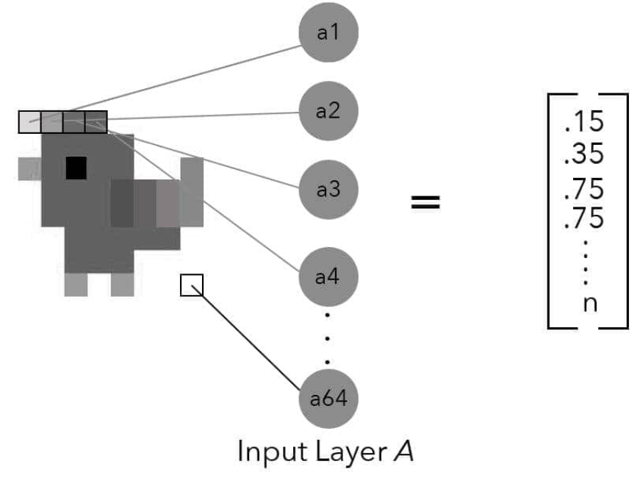
Bias Node
1
1
Weight
B₁
B₂
Node
Optimizer
X₁
E
W_{xe1}
Label
W_{xf1}
W_{eg1}
G
Loss
Input Features
P(chicken)
Loss Score (E)
W_{xe2}
W_{gf1}
X₂
F
W_{xf2}
…
X_{n}
…
Input Layer
Hidden Layer
Output Layer
Forward Propagation
Source: Taylor, M. (2017). Neural networks: A visual introduction for beginners. Vancouver, Canada: Blue Windmill Media.
Source: Taylor, M. (2017). Neural networks: A visual introduction for beginners. Vancouver, Canada: Blue Windmill Media.
Notes:
Let’s now simulate the forward propagation process. Here we feed an image to a small classifier network whose output is the probability that a given image is a chicken. Like the previous example, this network consists of an input layer, a single hidden layer, and an output layer.
Each example of input data is fed to the input layer. In this example, a greyscale image of a chicken 8 pixels by 8 pixels has been converted into a vector of 64 numbers, each one representing the intensity of the color at that point. These features are then fed to the input layer, one feature per node. In this case, X sub 2 is the second value in the vector.
The value in X sub 2 is then multiplied by weight xf2.
At node F, the net input function sums up all its incoming values and passes that value to its activation function which, in turn, calculates an output value.
The output value from node F is then multiplied by weight wgf1.
At node G, the net input function sums up all its incoming values and passes that value to its activation function. Because node G is the only node in the output layer, its output is the probability P() that the input image is a chicken. That value is then passed to the loss function which compares it to the label and calculates a loss or error score (E). A high error score indicates that the model’s inference was far from ground truth. A low score, on the other hand, indicates that the inference closely matches ground truth. The model’s total error is then passed to the optimizer which adjusts the weights during backpropagation.
====
We note that the input layer is fully connected to the hidden layer, consisting of two nodes. And as you can see, each weight on the connecting lines is labelled. During forward propagation, the output from each node is multiplied by the weights before becoming input to the downstream node. The numbers flow from left to right. However, the flow is reversed during backpropagation, and this is where the neural network ‘learns.’ The backpropagation process is fully described in our next presentation, including the loss function, total error, and optimizer.

Slide 5
Bias Node
1
1
Weight
B₁
B₂
Node
X₁
E
W_{xe1}
W_{xf1}
W_{eg1}
G
Optimizer
Error
W_{xe2}
W_{gf1}
X₂
F
W_{xf2}
…
X_{n}
…
Input Layer
Hidden Layer
Output Layer
Backward Propagation
Source: Taylor, M. (2017). Neural networks: A visual introduction for beginners. Vancouver, Canada: Blue Windmill Media.
Source: Taylor, M. (2017). Neural networks: A visual introduction for beginners. Vancouver, Canada: Blue Windmill Media.
Notes:
And now we reverse course during backpropagation. (This is where a neural network actually learns).
First, the optimizer receives the network’s total error or loss from the loss function.
From there, the optimizer passes that value to node G – the single output node in this network.
Next, the two weights between node G and the hidden layer nodes are adjusted, either up or down to minimize the error. Additionally, the bias weight is adjusted as well.
The error then passes through nodes E and F and is used, once again…
… to adjust the weights sitting between the input and hidden layers.

Slide 6



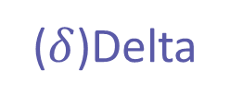
X₀
G₀
X₁
W_{xg0}
W_{gf0}
G($δ$)
F($δ$)
O
E
W_{xg1}
W_{gf1}
Error
o
$$δ$$
W_{xg2}
X₂
Output (o)
($δ$)Delta
Input Layer
Hidden Layer
Output Layer
Optimizer
Error/Loss Function
Back Propagation
Notes:
Let’s take a closer look at the weight update process. Once the optimizer receives the network’s total error or loss from the loss function, it must then propagate the error back through the network.
Now, the goal of the optimizer is to minimize the network’s error, in a process called gradient descent. (Please watch our gradient descent video.) At this point, the network needs to adjust all its weights such that the total error is minimized. More concretely, the model must calculate the individual contribution of each weight to the total error and then adjust each (up / down) in relation to its contribution to that total error.
To adjust a weight, we need two things: the delta from the backpropagation operation and…
… the output from the originating neuron (o). In the next few slides, I’ll step through the process of updating weight Wgf1. Let’s begin with delta…

Slide 7

x₀
W_{xg0}
W_{xg1}
x₁
+
+
Output of G
W_{xg2}
x₂
Changes
in error due
to m
m
+
$$δ$$
G
Source: Glassner, A. (2021). Deep learning: A visual approach. San Francisco, CA: No Starch Press. (Chapter 14)
Notes:
So, what is delta? Well, imagine that the output from node G has just changed. What happens to the network’s error as a result? As it turns out, any change in the final error is always proportional to the change in a neuron’s output. In other words, the connection between any change in the neuron’s output and the change in the final error is simply the neuron’s change multiplied by some number. This number goes by various names, but the most popular is the lowercase Greek letter δ.
Now if the output from node G changes by some amount – with the rest of the network frozen – we can multiply that change by delta and see how the network’s final error changes.
To illustrate the idea, let’s consider the output from G, the single node in the hidden layer of our network from the previous slide. We’ll add some arbitrary value to G’s output just before that value emerges. As shown here, the variable named m (for modification) holds that extra value. Because the output changes by m, we know that the change in the network’s final error is m times the neuron’s δ.
Source: Deep Learning: A Visual Approach (p. 357)

Slide 8
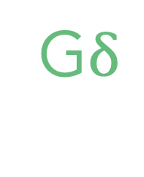
G
G$δ$
Go
Source: Glassner, A. (2021). Deep learning: A visual approach. San Francisco, CA: No Starch Press. (Chapter 14)
Notes:
Because training includes both forward and backpropagation phases, each node in a neural network has two outputs. Node G, for example, produces an output to the right, during forward propagation, and an output to the left, during backpropagation. Here the output to the right (forward prop) is called Go while the output to the left (backprop) is called Gδ.
With preliminaries out of the way, the process of updating weight Wgf1 can be summarized as follows.,,

Slide 9

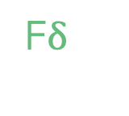
-11
-1
x
+
G
o
$$δ$$
F
W_{gf1}
Go
F$δ$
Source: Glassner, A. (2021). Deep learning: A visual approach. San Francisco, CA: No Starch Press. (Chapter 14)
Notes:
Here the process of updating weight Wgf1 is pictured in its entirety. Let’s step through this diagram. We start with the output o from neuron G and the delta from neuron F. We first multiply these two numbers together, as shown by the multiplication sign. We then multiply that product by −1 and add it to weight Wgf1. This final step is pictured here by the gold arrow.
So, why do we multiply by -1? Well, the problem is that it’s not clear which value to subtract from the other when we have a “minus” node with two incoming arrows. If the inputs are x and y, do we compute x – y or y – x? To sidestep that problem, we simply multiply the product of the two values by -1.
Source: Deep Learning: A Visual Approach (p. 367)

