Slide 1


BOMBERECT
Yuqi Wu

Slide 2
Game introduction
https://www.youtube.com/watch?v=f98ZwgzYyig
Based on bomberman
Gameplay involves strategically placing down bombs, which explode in multiple directions after a certain amount of time, in order to other player. The player can pick up various power-ups, giving them benefits such as larger explosions or the ability to place more bombs down at a time. The player is killed if they touch an enemy or get caught up in a bomb's explosion, including their own, requiring players to be cautious of their own bomb placement.

Slide 3


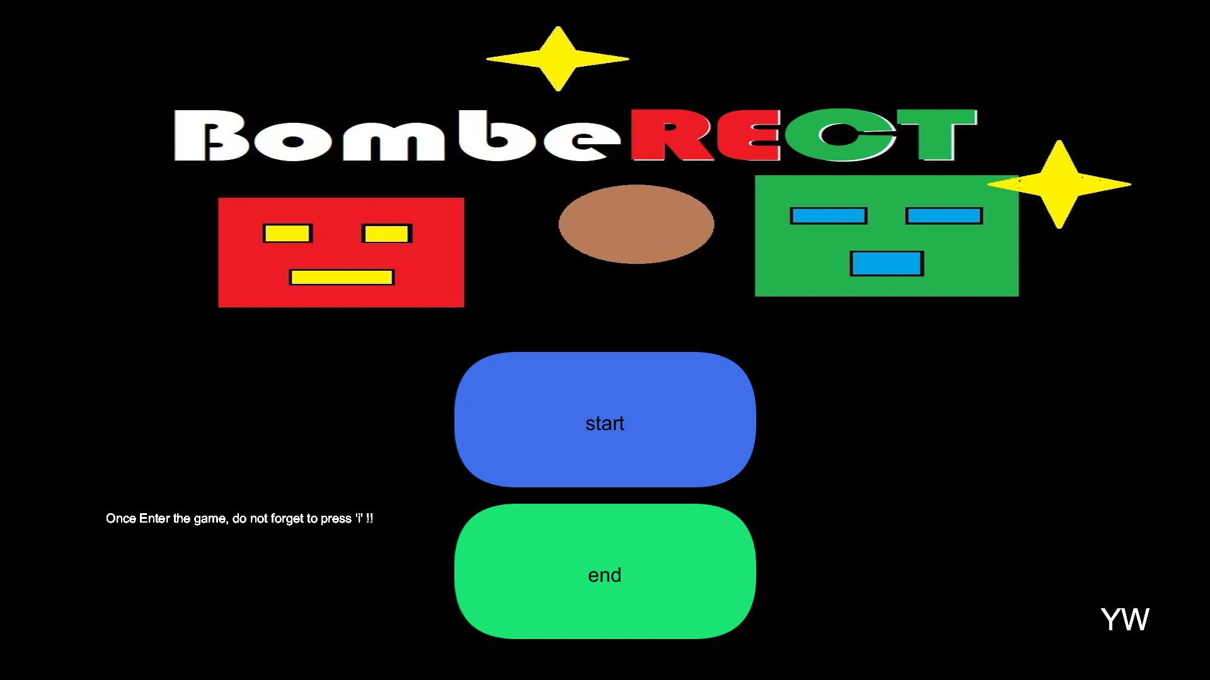



Main page

Slide 4
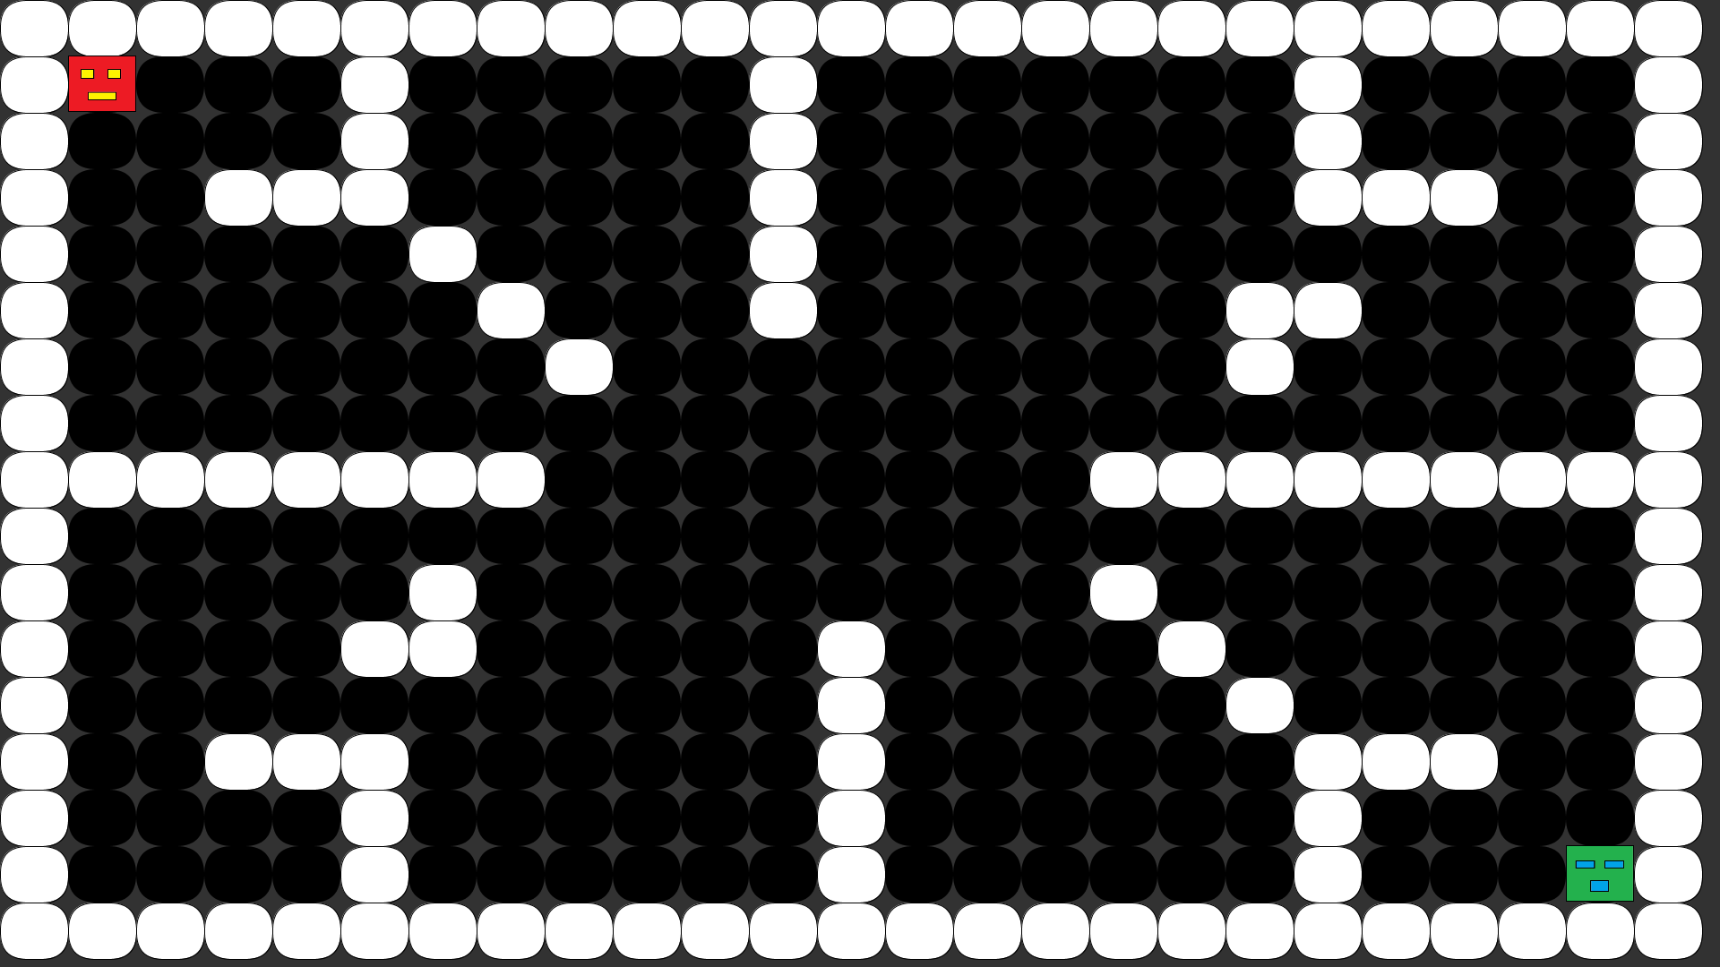
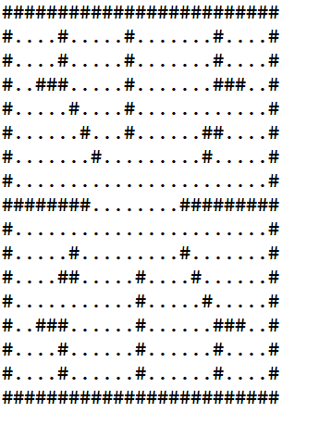
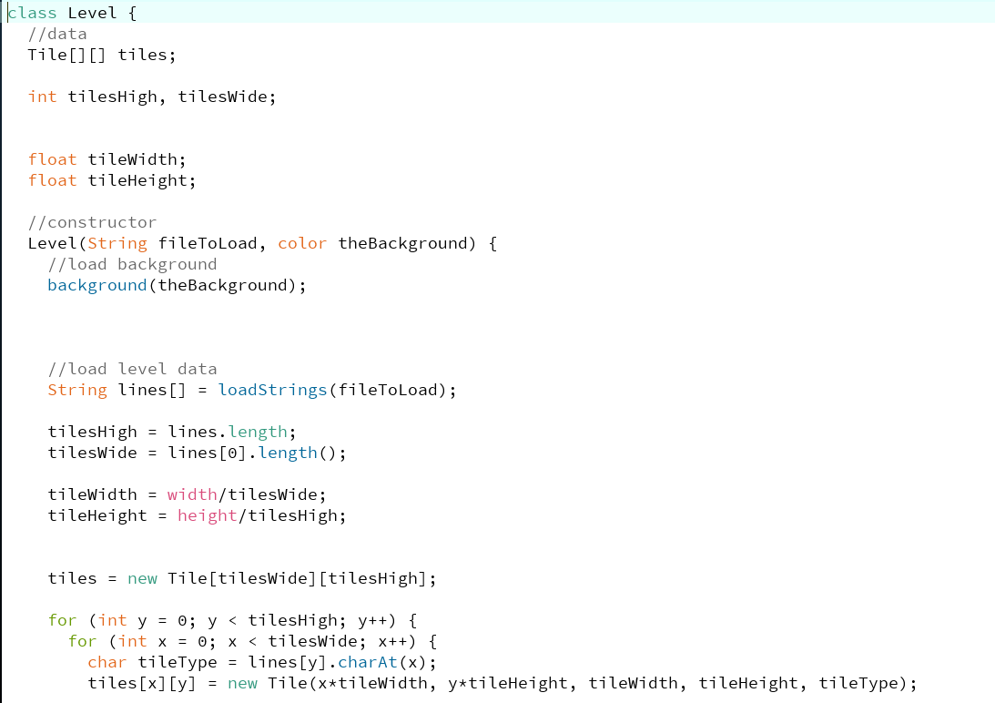
Level Class

Slide 5
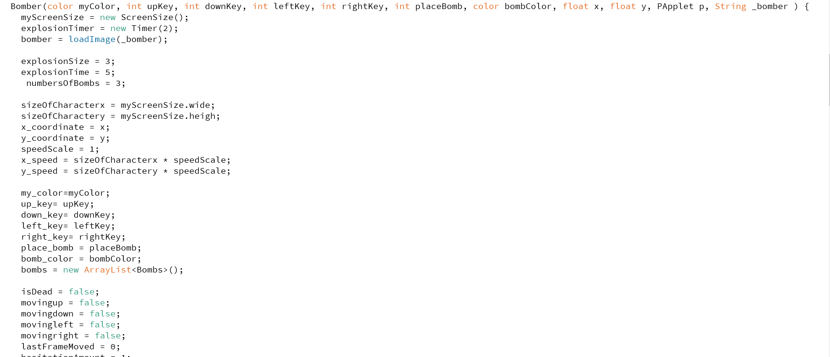
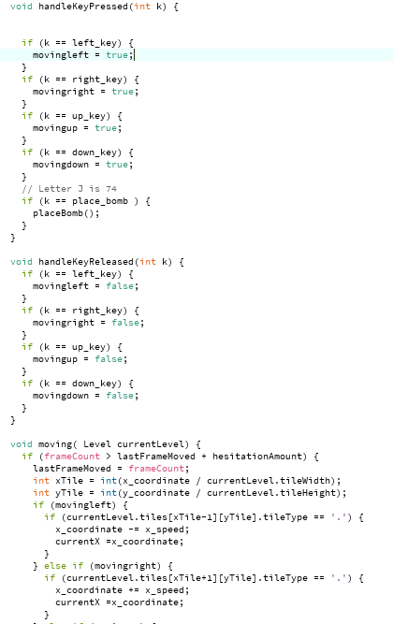
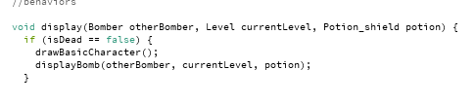
player1
player2
Bomber Class

Slide 6


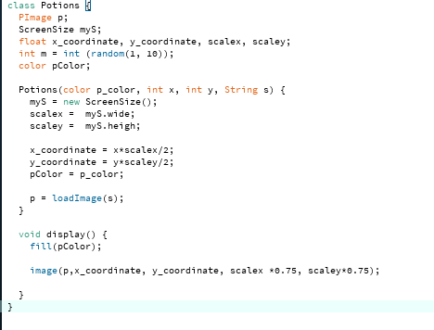


Potions Class

Slide 7
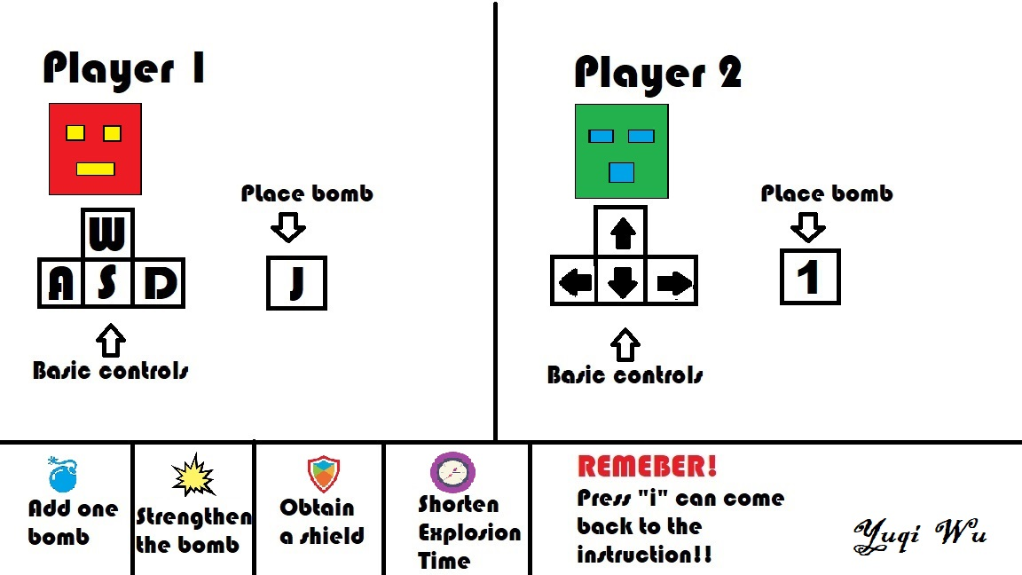
Game rule

Slide 8
COLLISION DETCTION !

