Slide 1
CV_PROGRESS_2019
1
Yu qianjin
2019.12.12
Notes:
Resideo launched at the end of October 2018 and is trading on the New York Stock Exchange under the ticker symbol “REZI.”
We are a growing company with approximately $4.8 billion of net sales.
Resideo has two business segments:
Products segments which includes our connected home solutions under the trusted Honeywell Home brand.
Our Distribution segment, ADI, is a leading global distributor of security and low-voltage solutions.
1

Slide 2
Object Detection
Open DataSet: Pascal VOC 2012(http://host.robots.ox.ac.uk/pascal/VOC/voc2012/index.html), identifying specific objects from a given picture, of which there are 20 types of objects to be identified including person，bird，cat, cow, dog, horse, sheep，airplane, bicycle, boat, bus, car, motorbike, train，bottle, chair, dining table, potted plant, sofa, tv/monitor. For detection tasks, VOC2012 Train-Val / test contains all corresponding pictures from 2008-2011(which has updated to voc2017). Train-Val has 11,540 pictures with a total of 27450 objects, which is a relatively large data set for object classification and detection.
Net backbone: Mobilenet is selected as the basic backbone, and adopted an end-to-end network detection algorithm.
Test results: The mAP value is 71.2%, and the latest algorithm research is about 83.5% or more (this latest result is the latest test result in October 2018, and the best result may be far better than this value. The comparison chart is in the second page)
The algorithm is suitable for running on a local port device, which is small and light

Slide 3
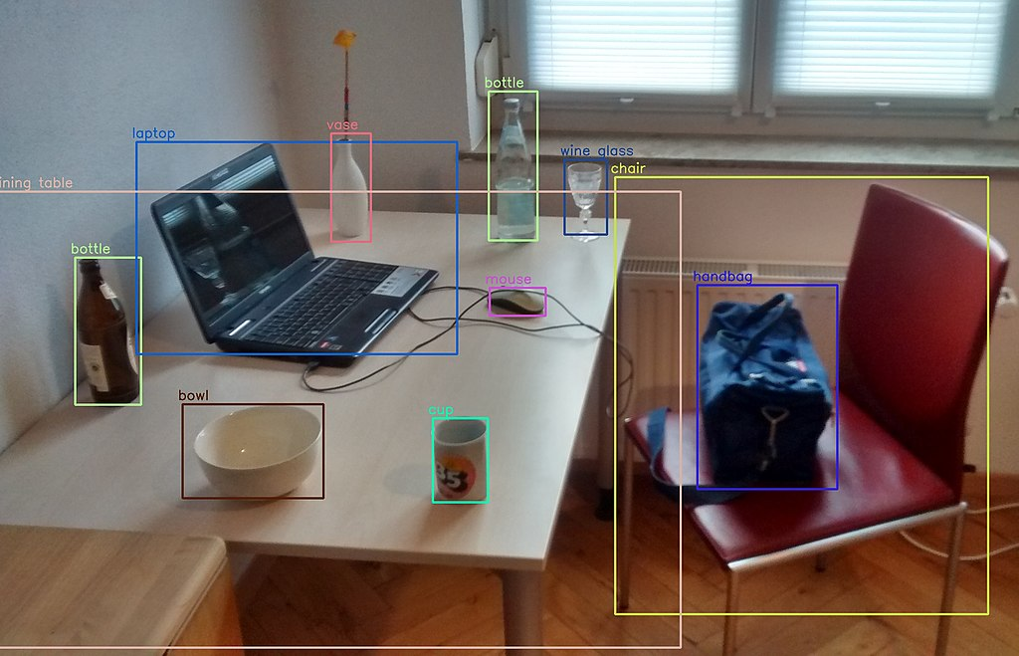
mAP | Method
ours | 71.2%
SSD | 79.5%
YOLOV3 (AP50) | 60%
DSSD | 81.5%
Note: The test data set is pascal voc 2012. The val data set contains 5823 images.

Slide 4
Face Detection
Open Data Set WIDER FACE is a benchmark dataset for face detection that provides a wider range of face data from the Chinese University of Hong Kong. It was collected by YangShuo, Luo Ping, Loy, et. al. It contains 32,203 images and 393,703 face images, showing great changes in scale, pose, occlusion, expression, dressing, and care. WIDER FACE is organized based on 61 event categories. For each event category, 40% of it is selected as the training set, 10% is used for cross validation, and 50% is used as the test set. Like the PASCAL VOC dataset, this dataset also uses the same indicators. As with the MALF and Caltech datasets, no corresponding background bounding box is provided for the test images. The image is shown below and the download link is http://mmlab.ie.cuhk.edu.hk/projects/WIDERFace/
widerface val set mAP value is 79.5% which does not detect faces below 20px pixels,

Slide 5
face detector
pribox layer
outputs
5X5X4
algorithm graph
algorithm evaluate:
pixels solution: 20 px
mAP: 79.5%
10X10X4
generate 23450 boxes to map labels
detector box
20X20X4
CNN MOUDLE
data(640x640x3)
40X40X4
box classes
80X80X4
160X160X4

Slide 6
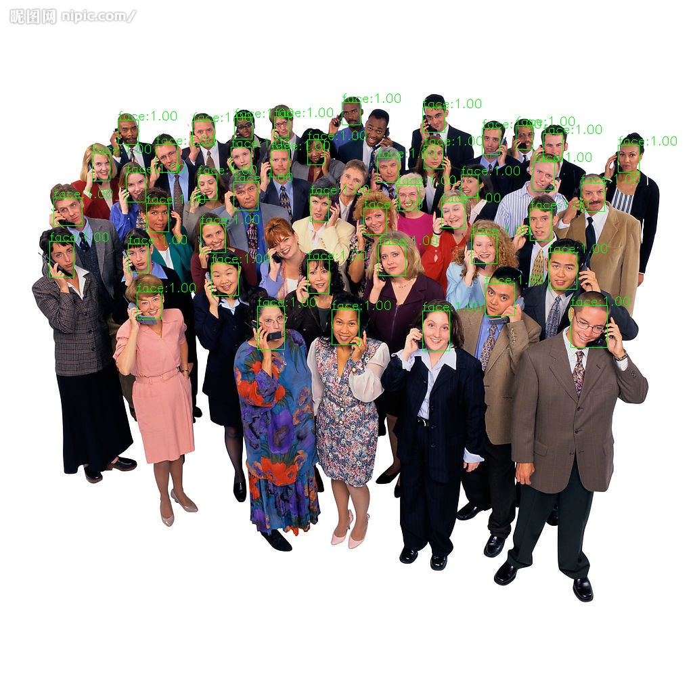
mAP | Method
ours | 79.5%
DSFD | 94%
PyramidBox | More 94%
S3FD | More 94%

Slide 7
Face Attributes Recognition
Open Data Set UMDFaces dataset contains lots of face attributes including face pose, face gender, and face box and so on.
Our model is a multi-task recognition network. The main recognition tasks are face attributes including gender, whether or not glasses are worn, the pose (pose and angle) of the face, and the position of the facial features, which helps us to recognize the face later.
At the same time, we use a network to complete these tasks, using a double-stranded neural network, merging the residual structure improves the network's feature extraction capabilities. Through analysis, it is considered that the pose of the face and the facial features of the face are highly correlated, so when training them, combine the two to increase the weight alpha of the loss function. During training, alpha is set to 0.8.
At present, the accuracy reaches gender is 99%, wearing glasses is 99%, angle 99%, eu_landmarks: 3% (<10%)

Slide 8
Face Attributes: landmarks gender glasses headpose
face landmarks
algorithm graph
CNN MOUDLE
face angle
data(128x128x3)
glasses
CNN MOUDLE
gender

Slide 9
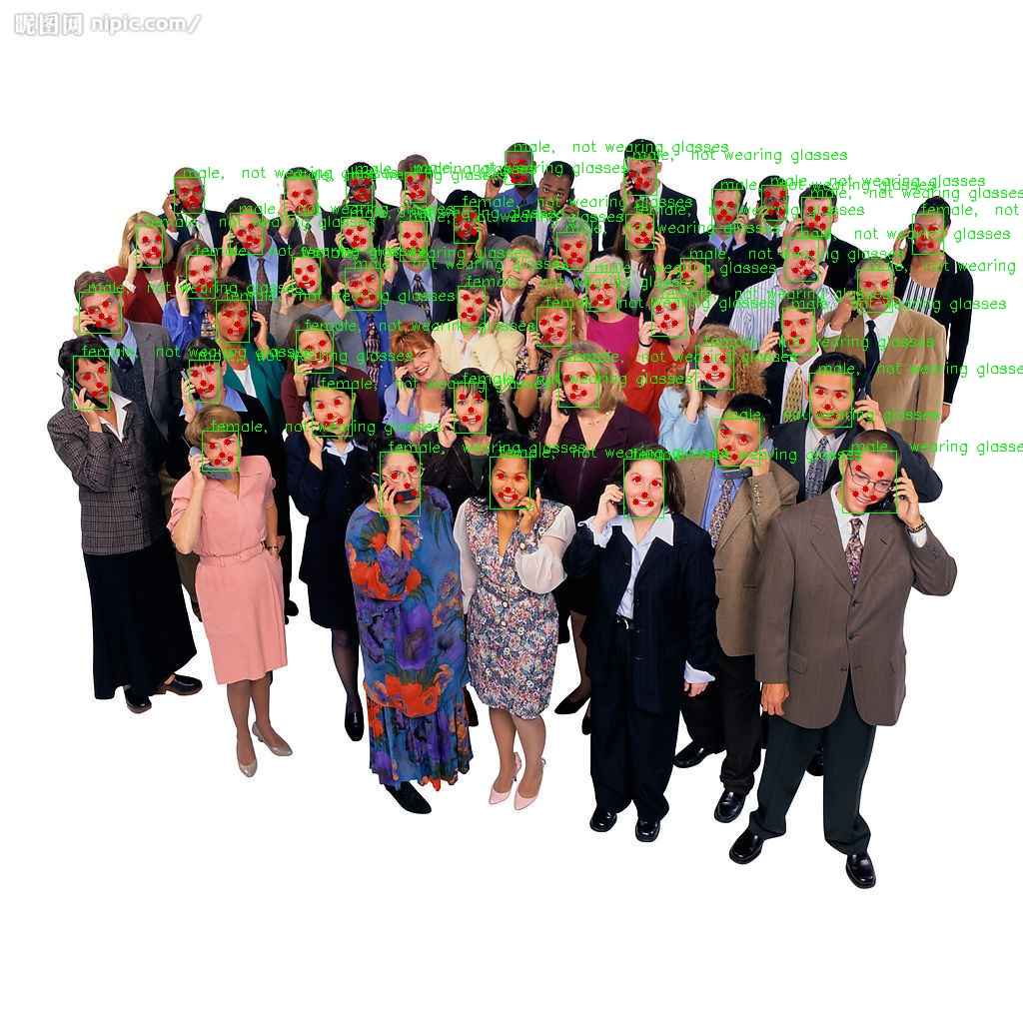
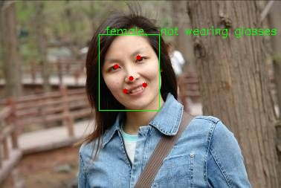

Slide 10
Face Recognition
Using a lightweight network skeleton, with the softmaxwithloss + tripletloss loss function, training on the vggface dataset, the test accuracy on the lfw dataset is 99.5%, and the facenet test accuracy on the same dataset is 99.78%
The weight file is 25 times smaller than facenet and only about 4M in size.
Test speed. on PC is 20 times faster than facenet

Slide 11
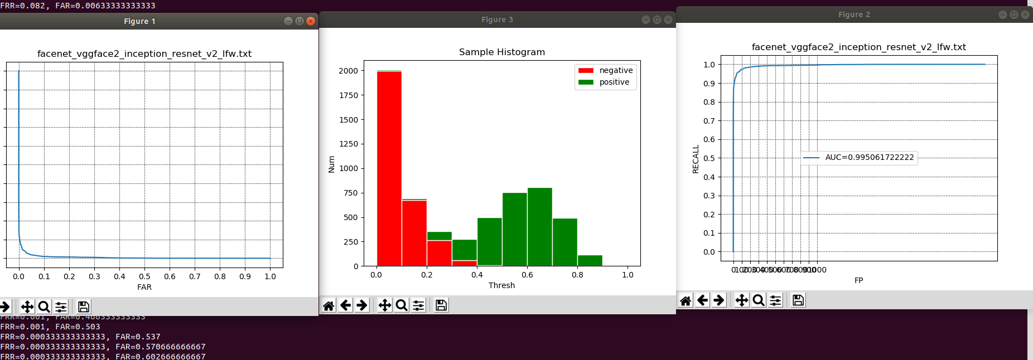

Slide 12
Pedestrian re-identification
On the cuhk03 + DukeMTMC + Market1501 dataset (2946 pedestrians), using the googlenet and the softmaxwithloss + tripletloss loss function.
the test accuracy is 96.5 on the val dataset (40,000 pairs of whole datasets), but this high accuracy is built on the complete Body image set which I used. So the body will be randomly cut later to simulate the real situation
Using data enhancement technology, random cutting, cropping, etc.
I plan to use centerloss to continue to optimize the network.

Slide 13
