Slide 1
Results of calculations for numbers in IEEE 754 standard and NPAt format
Comparative results of summing signed decimal numbers according to the standard IEEE 754 algorithm and summation in NPAt format.
The terminal screenshots show the output data obtained using the demonstration algorithm npap-algorithm.cpp

Slide 2
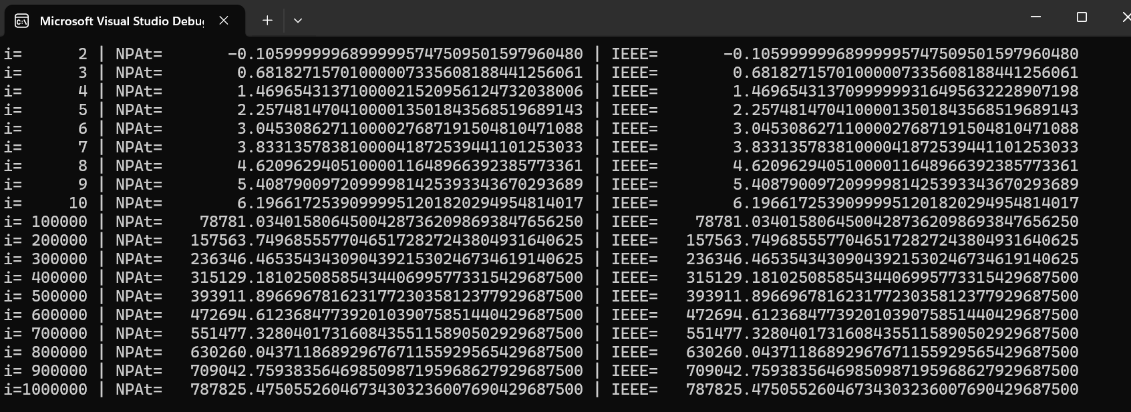
1. Sum of x₁ = -0.89382715639 with 999999 additions of x₂ = 0.7878271567

Slide 3
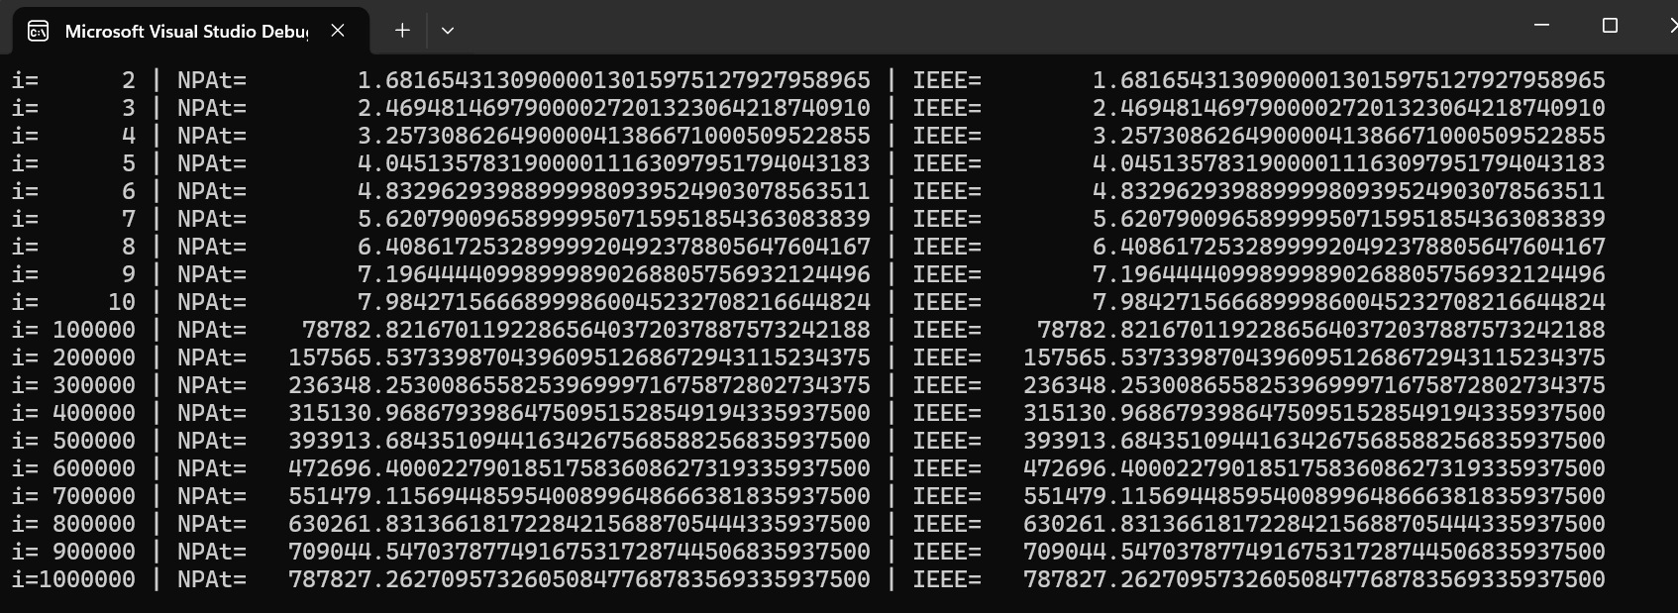
2. Sum of x₁ = 0.89382715639 with 999999 additions of x₂ = 0.7878271567

Slide 4
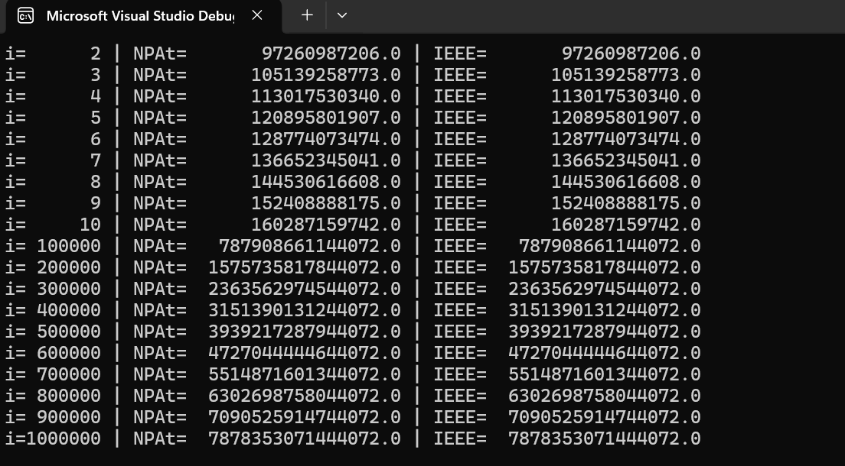
3. Sum of x₁ = 89382715639 with 999999 additions of x₂ = 7878271567

Slide 5
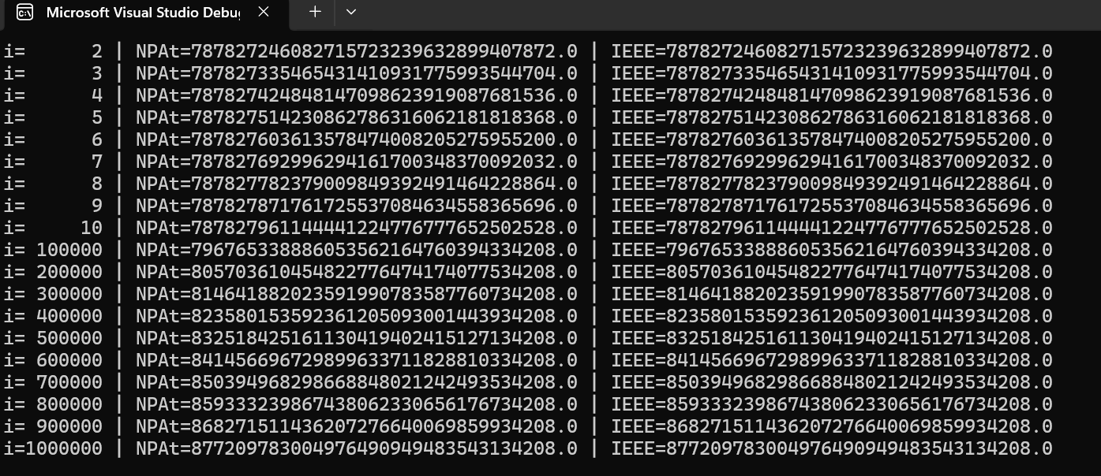
4. Sum of x₁ = 89382715639e+15 with 999999 additions of x₂ = 7878271567e+23

Slide 6
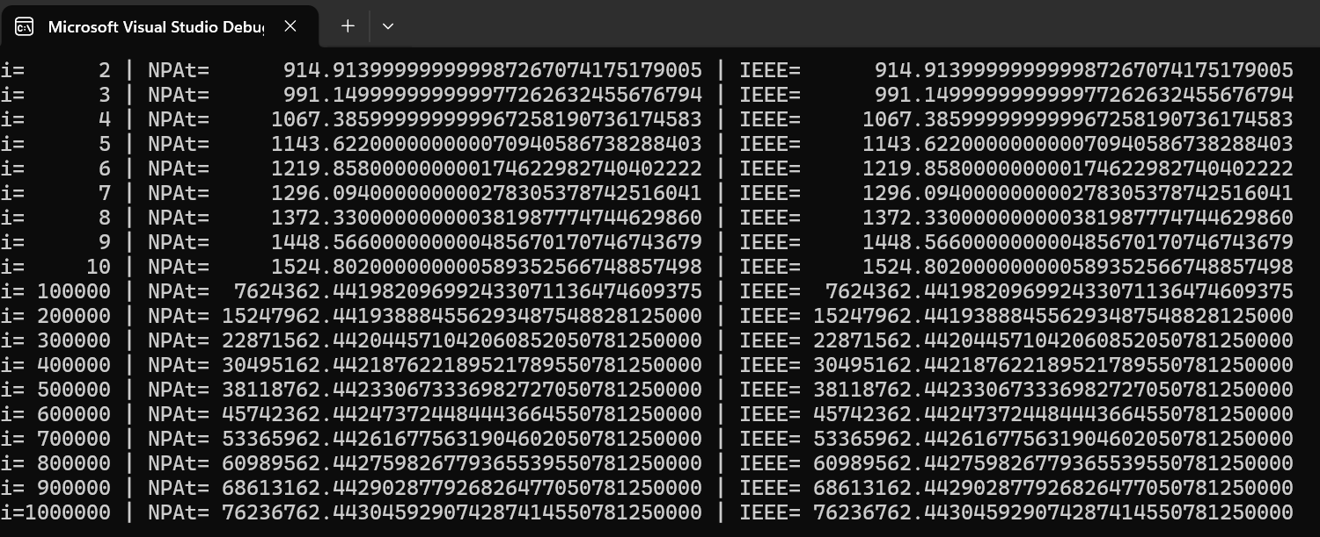
5. Sum of x₁ = 838.678 with 9999999 additions of x₂ = 7.87827e+76.236

Slide 7
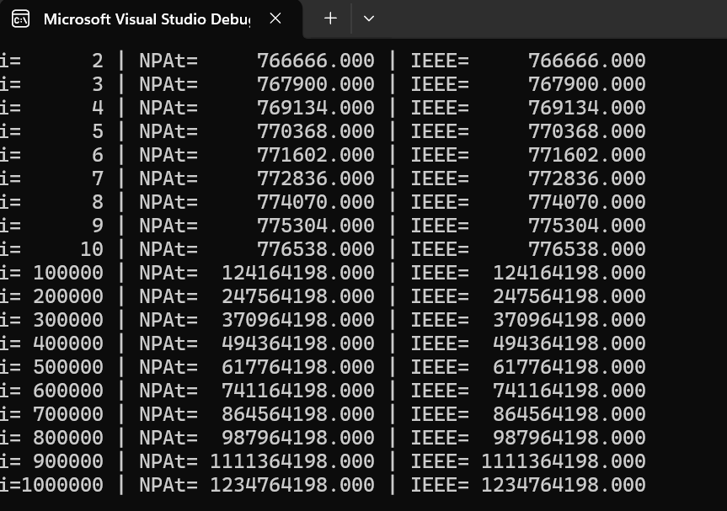
6. Sum of x₁ = 1234 with 999999 additions of x₂ = 765432

Slide 8
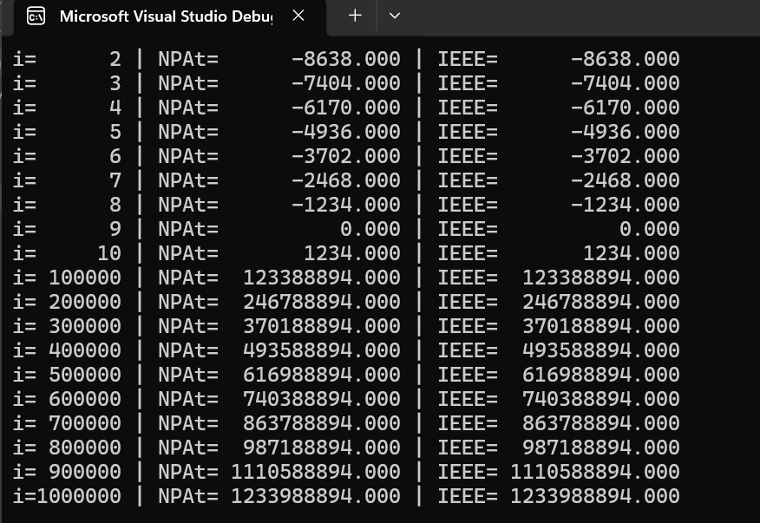
7. Sum of x₁ = -8.93827e+10 with 99999 additions of x₂ = 7.87827e+09

Slide 9
END

