Slide 1

Exoft Camp Lecture 1
GIT basic usage

Slide 2
What we are going to learn about?
What is a “version control system”?
Why Version Control system is so Important?
Benefits of the version control system
Types of Version Control Systems
How it's working?
Installing Git
Git commands
gitignore
Clone of existing repository
Work with branches
Mergers and conflicts
Interaction with remote repo
Git Workflow
Additional software to work with GIT

Slide 3
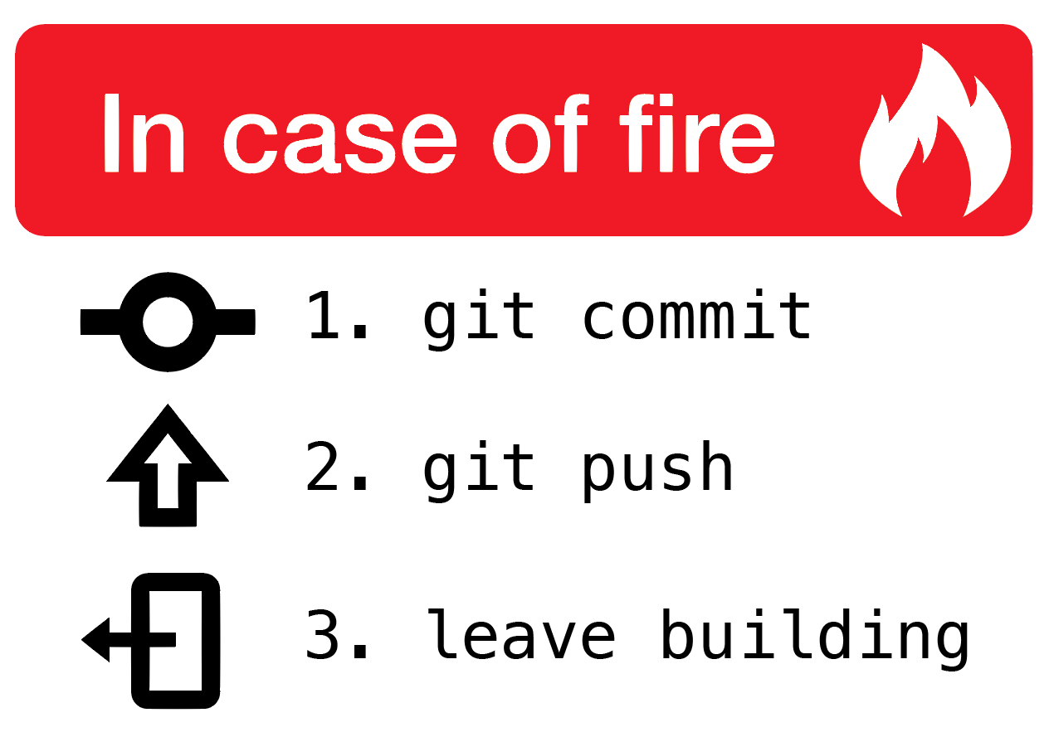
GIT basic usage
Just remember this simple rules :)

Slide 4
GIT basic usage What is a “version control system”?
Version control systems are a category of software tools that helps in recording changes made to files by keeping a track of modifications done to the code.

Slide 5
GIT basic usage Why Version Control system is so Important?
Software product is developed in collaboration by a group of developers they might be located at different locations and each one of them contributes in some specific kind of functionality/features. So in order to contribute to the product, they made modifications in the source code(either by adding or removing). A version control system is a kind of software that helps the developer team to efficiently communicate and manage(track) all the changes that have been made to the source code along with the information like who made and what change has been made. A separate branch is created for every contributor who made the changes and the changes aren’t merged into the original source code unless all are analyzed as soon as the changes are green signalled they merged to the main source code. It not only keeps source code organized but also improves productivity by making the development process smooth.

Slide 6
GIT basic usage Benefits of the version control system
Increases the project development speed by providing efficient collaboration.
Leverages the productivity, expedite product delivery, and skills of the employees through better communication and assistance
Reduce possibilities of errors and conflicts meanwhile project development through traceability to every small change
Employees or contributor of the project can contribute from anywhere irrespective of the different geographical locations through this VCS
For each different contributor of the project a different working copy is maintained and not merged to the main file unless the working copy is validated.
Helps in recovery in case of any disaster or contingent situation.
Informs us about Who, What, When, Why changes have been made.

Slide 7
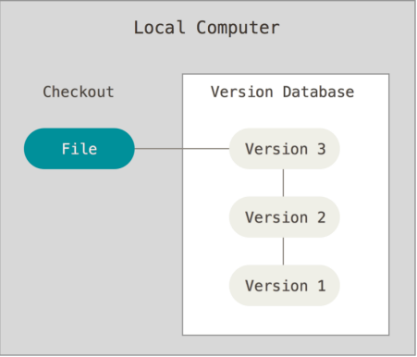
GIT basic usage Local version control systems

Slide 8
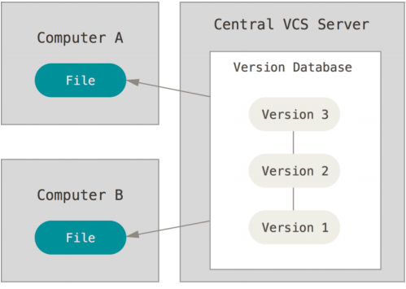
GIT basic usage Centralized Version Control Systems

Slide 9
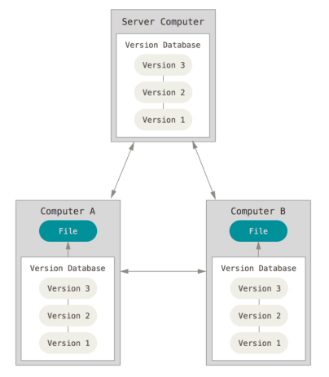
GIT basic usage Distributed Version Control Systems

Slide 10
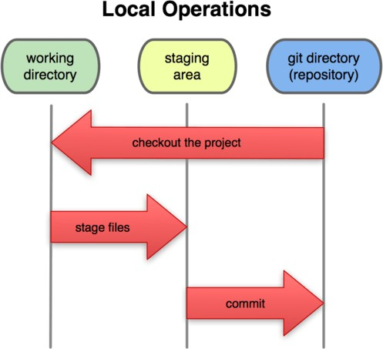
GIT basic usage How it's working?

Slide 11
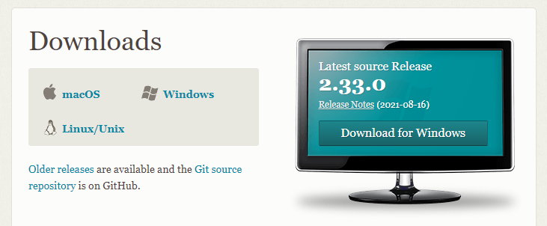
GIT basic usage Installing Git
https://git-scm.com/downloads

Slide 12
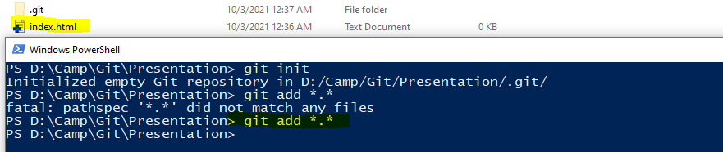
GIT basic usage Git commands
git init - Create an empty Git repository or reinitialize an existing one
git add *.* - Add file contents to the index

Slide 13
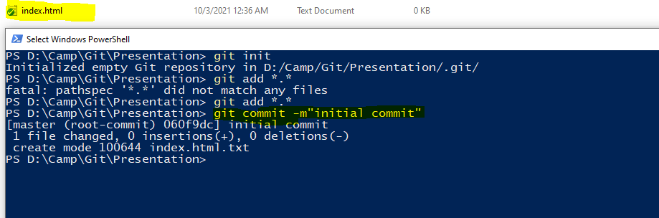
GIT basic usage Git commands
git commit -m"initial commit“ - Record changes to the repository

Slide 14
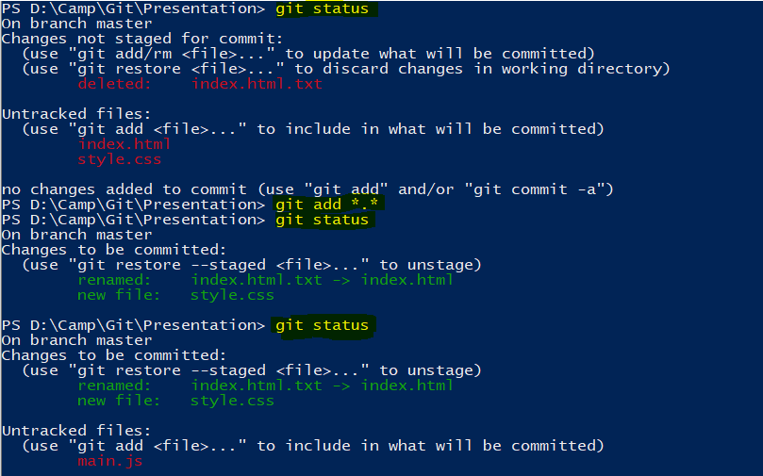

GIT basic usage Git commands
git status - Show the working tree status

Slide 15
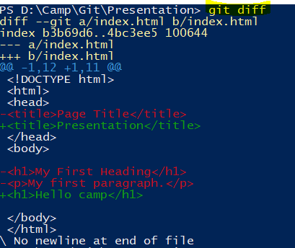
GIT basic usage Git commands
git diff - Show changes between commits, commit and working tree.

Slide 16
GIT basic usage gitignore
# ignore all .a files
*.a
# Keep track of lib.a, although we ignore the .a files above
!lib.a
# Ignore the TODO file only in the current folder, not in other subdirs subdir/TODO
/TODO
# Ignore all files in build folder
build/
# Ignore doc/notes.txt, but not ignore doc/server/arch.txt
doc/*.txt
# Ignore all .pdf files in the folder doc/ and in the all subfolders
doc/**/*.pdf

Slide 17
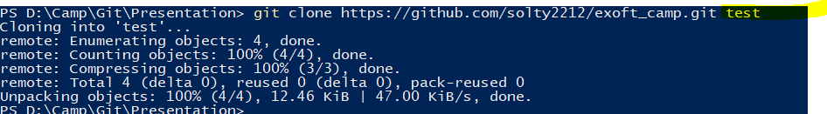
GIT basic usage Clone of existing repository
git clone https://github.com/solty2212/exoft_camp.git project_name

Slide 18

GIT basic usage Branch Workflow

Slide 19
GIT basic usage Work with branches
git branch feature/sidebar – Create new branch
git checkout -b feature/sidebar master - Switch branches or restore working tree files
git checkout feature/sidebar
git branch -d feature/sidebar2

Slide 20

GIT basic usage Work with branches
git branch – List of branches

Slide 21

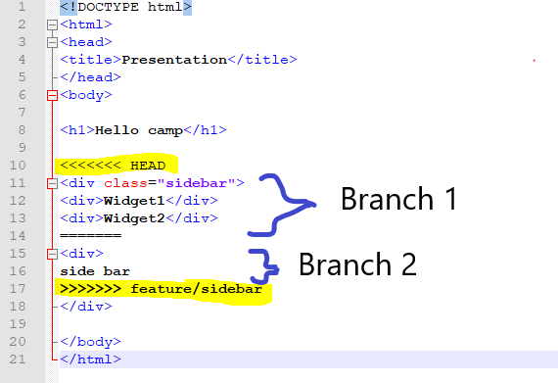
GIT basic usage Mergers and conflicts
git checkout master
git merge feature/sidebar

Slide 22
GIT basic usage Interaction with remote repo
git fetch - Download objects and refs from another repository
git pull - Fetch from and integrate with another repository or a local branch
git push origin branch_name - Update remote refs along with associated objects

Slide 23
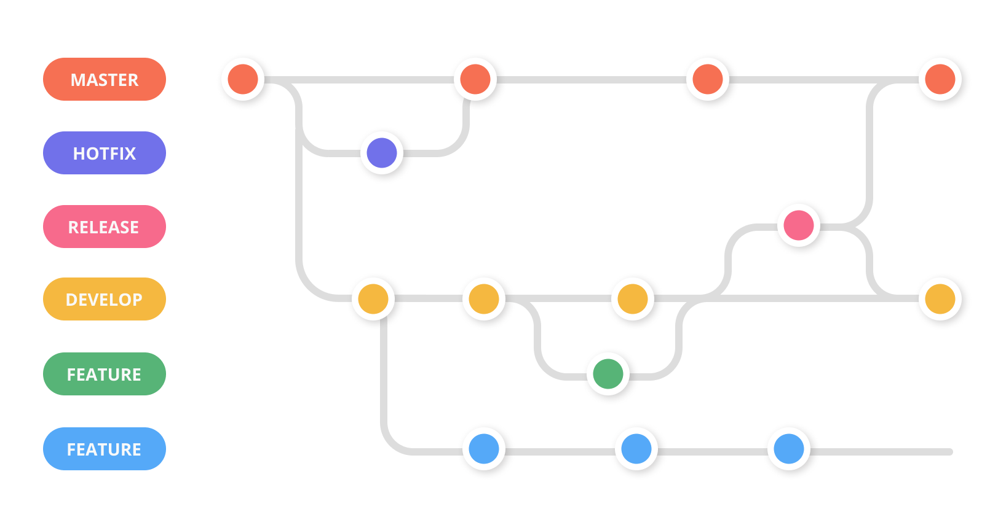
GIT basic usage Git Workflow

Slide 24
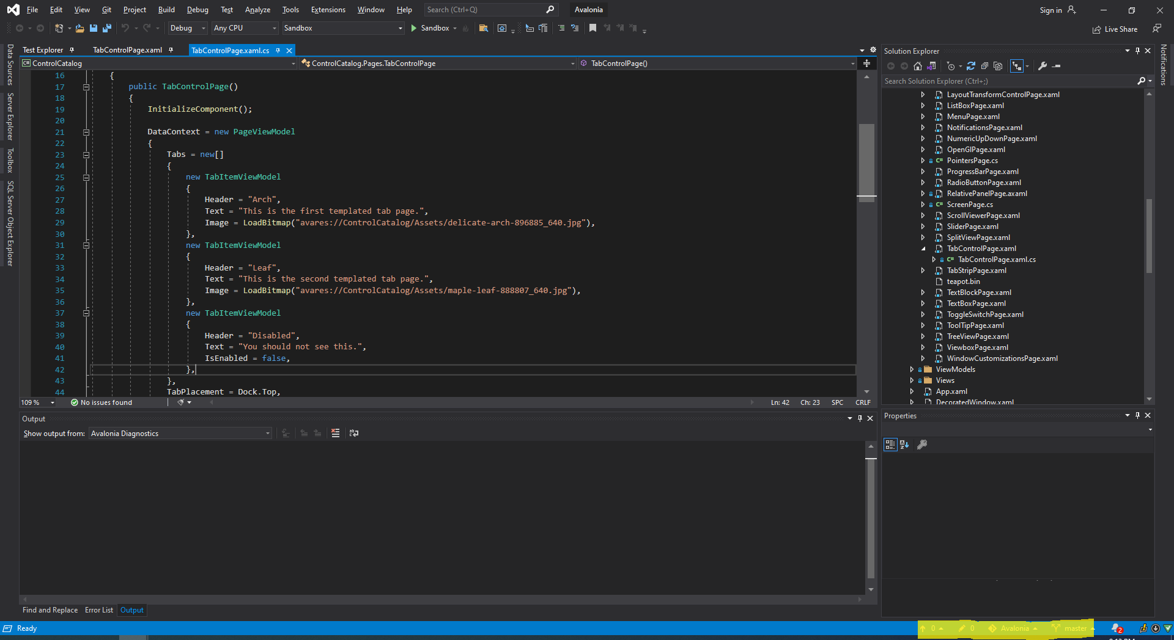
GIT basic usage Additional software: Inner VS feature

Slide 25
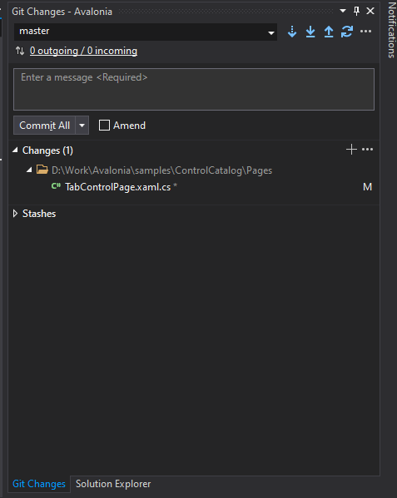
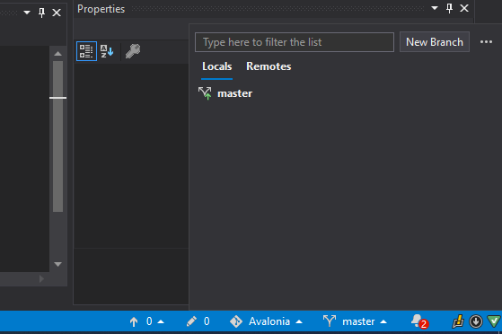
GIT basic usage Additional software: Inner VS feature

Slide 26
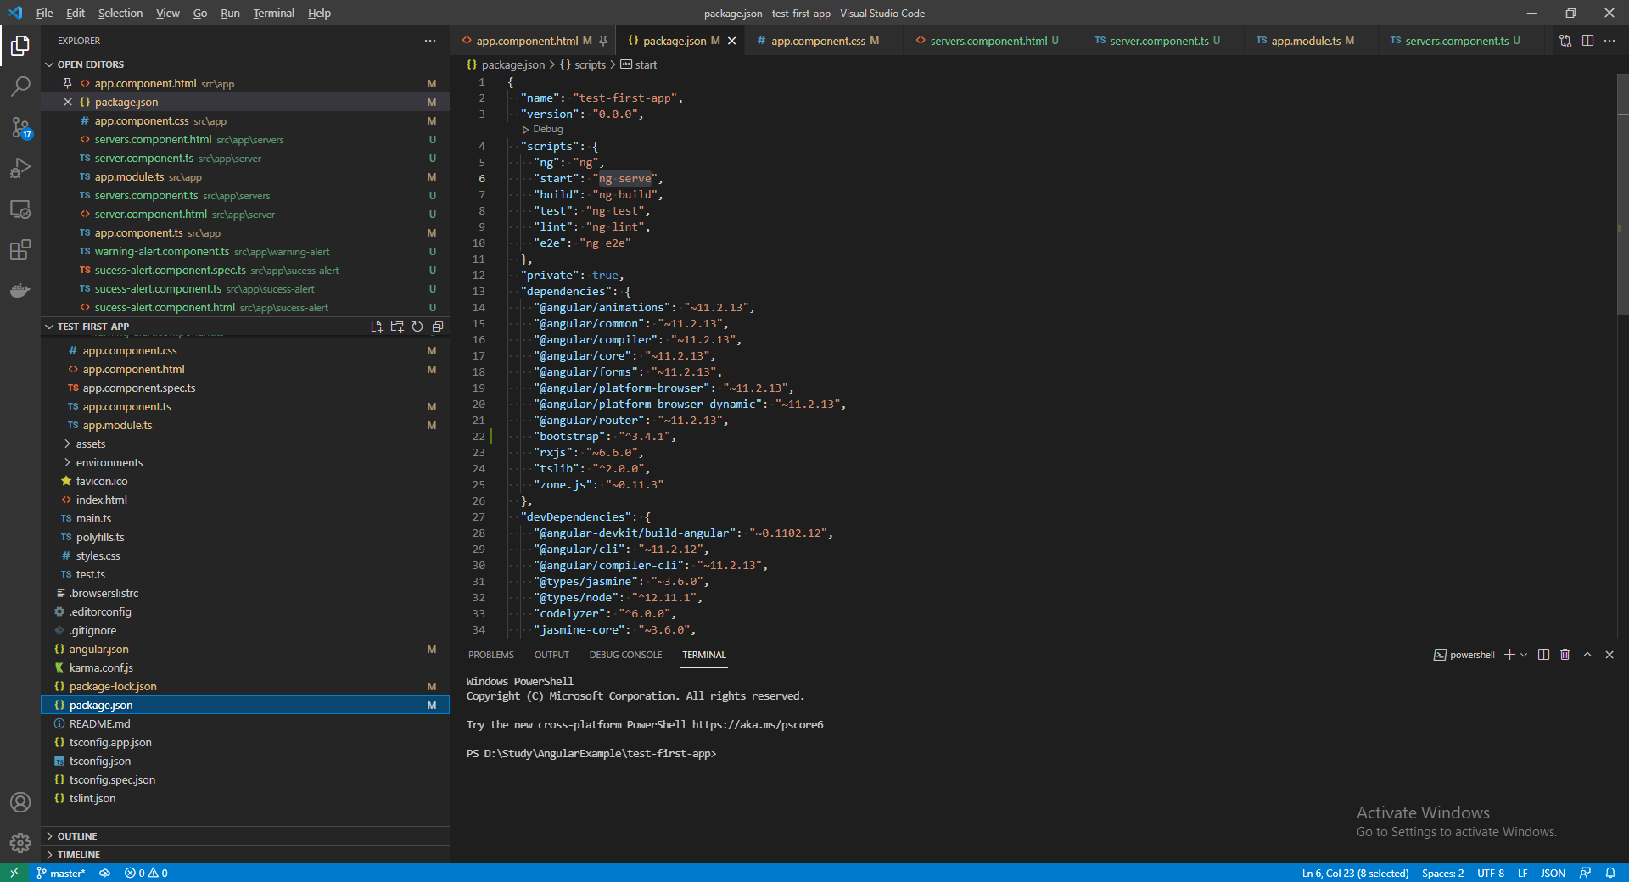
GIT basic usage Additional software: Inner VS Code feature

Slide 27
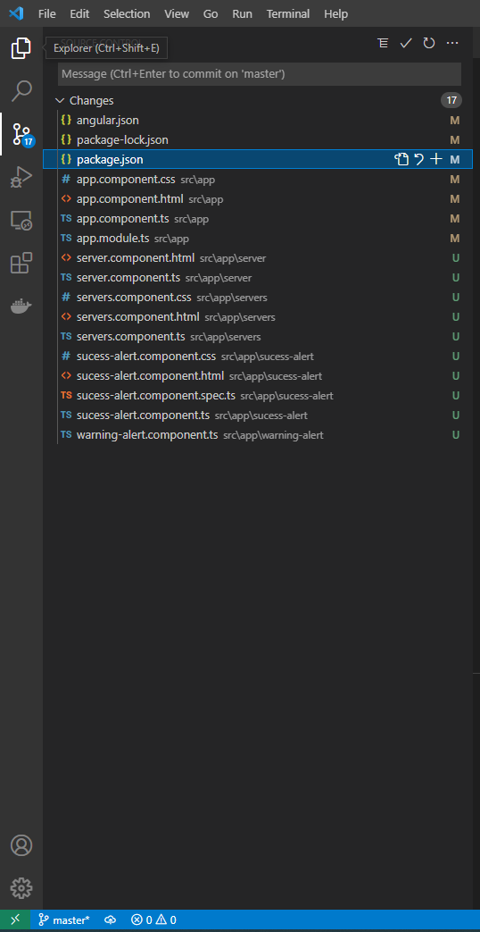
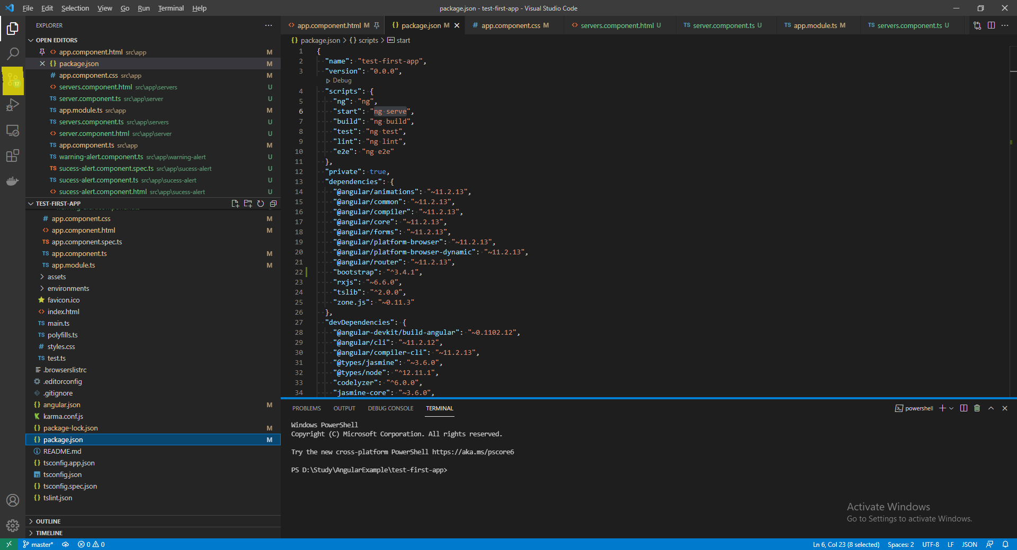
GIT basic usage Additional software: Inner VS Code feature

Slide 28
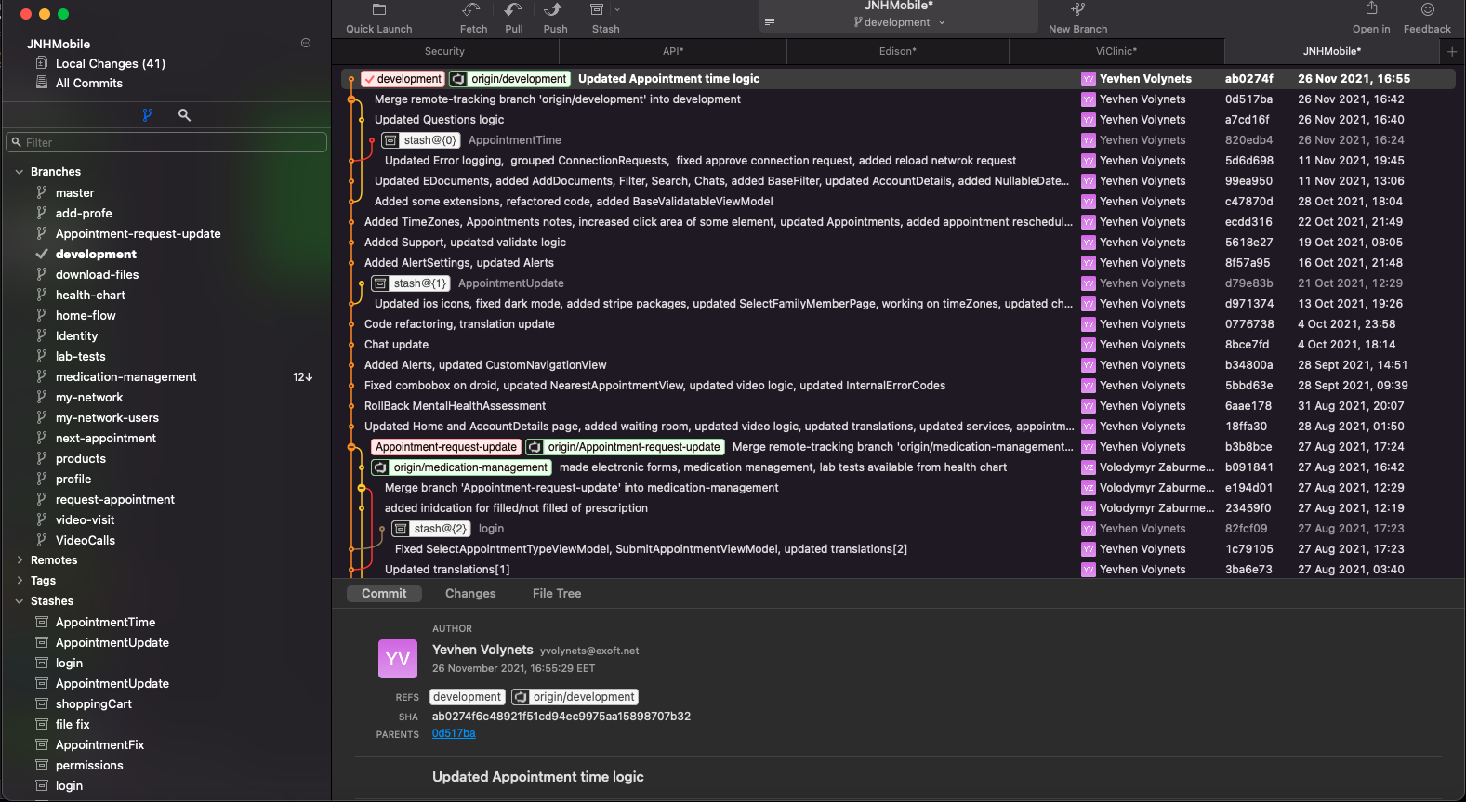
GIT basic usage Additional software: Fork

Slide 29
Links
https://git-scm.com/download/win
https://git-scm.com/docs
https://zepel.io/blog/5-git-workflows-to-improve-development/
https://www.geeksforgeeks.org/version-control-systems/

Slide 30


Any questions?

