Slide 1
What Makes an Android App Popular?
Team 15: Yuran, Daniel, Jiaxuan
95885: Data Science and Big Data

Slide 2
Agenda
Motivation
Questions to Answer
Recommendations
Detailed Analysis
Key Findings
Future Work

Slide 3
Motivations
The Apple App Store has 2.2 million apps available for download while there are 2.8 million apps on the Google Play Store. Besides, the developers need to pay Apple $99/year to keep your app online, but only $25 one time for Google Play Store.
Developers are more satisfied with the policies of Android apps

Slide 4
Questions to Answer
Popular Apps?
What categories of apps are most available/popular and receive higher ratings?
Price Strategy?
Do paid apps perform better than free apps?
For paid apps, do those with higher ratings commonly have a price in a reasonable range?
What categories tend to set higher prices?
Size Optimization?
Do users prefer apps with lighter size?
Can we find a reasonable range of an app size?
User Review & Preference?
Which categories receive the most positive reviews?
What factors make an app positively/negatively evaluated?

Slide 5
Recommendations
Pick a Category
To have more and higher rating, you can pick the categories of family, game, tools, productivity, and medical
To have more revenue from installation, you can pick the categories of lifestyle, finance, family, and photography
Price Strategy
If you want to have higher rating, you can choose to develop a paid app, but better to keep its price below $30
Size Optimization
Try to reduce your app's download size (below 40 MB) to enable more downloads
Larger app size is okay for game or family apps due to sophisticated design, but try to optimize
Satisfy User Preference
Design your app to be fun and easy to use, equip it with cool features, embed less advertisements, fix problems frequently, and charge less!

Slide 6

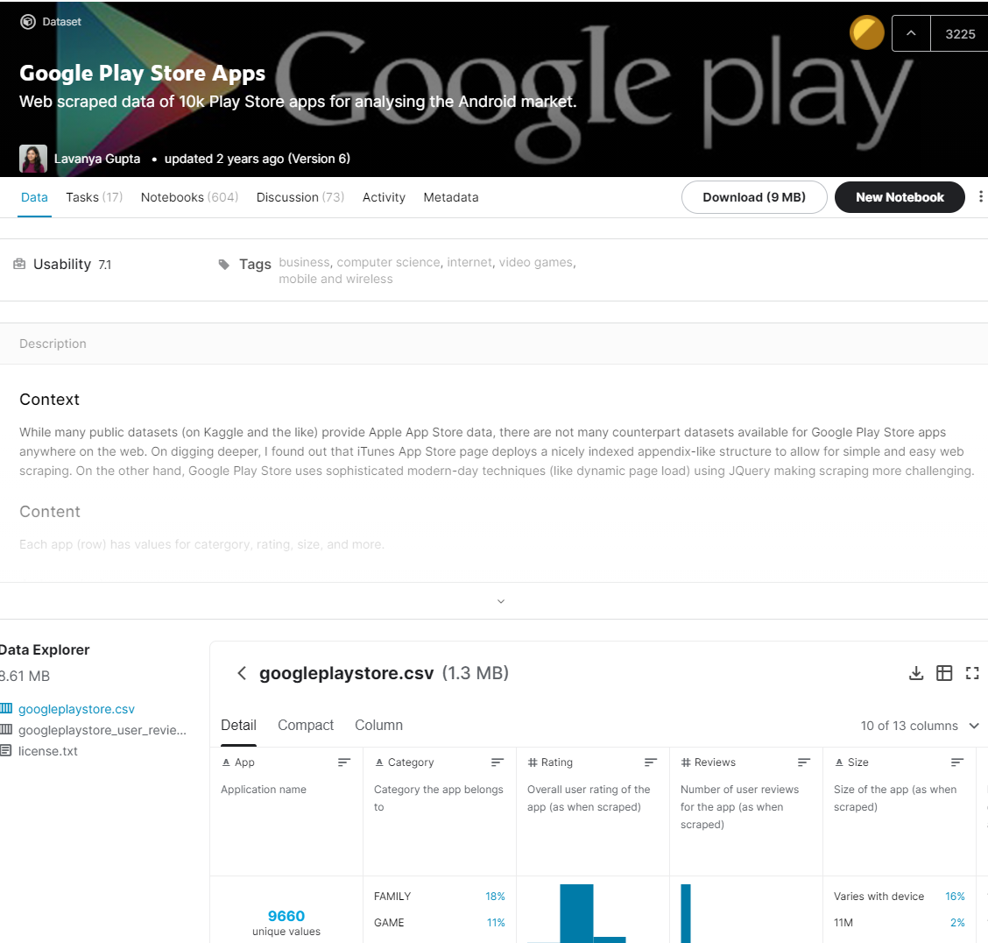
Dataset Summary
Google Play Store Kaggle Dataset
Apps Information Data
13 columns and 10,842 rows
App characteristics, such as category, rating, size ,and download counts
Users Review Data
5 columns and 64,295 rows
Reviews, such as sentiment type (positive/negative) , score of polarity, and subjectivity

Slide 7
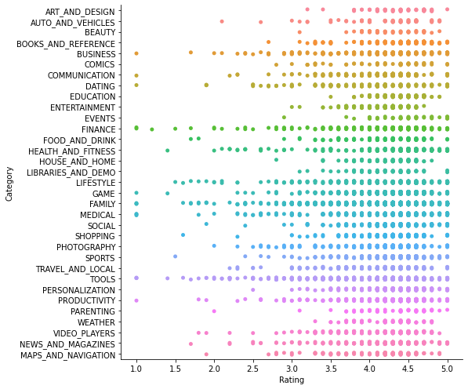
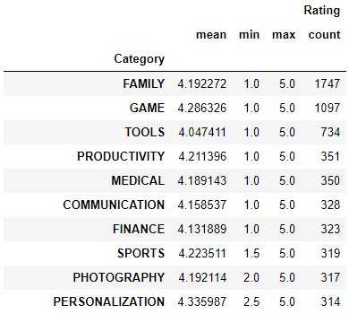
App Rating Analysis
Categories of family, game, tools productivity are more are well rated for the developers

Slide 8
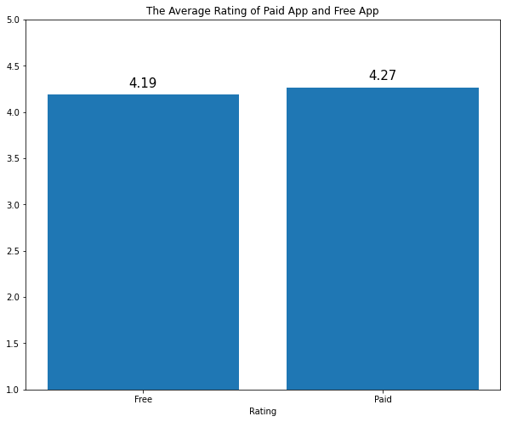
App Price Analysis
The paid apps have a higher average rating than free apps.
But the rating difference is small, which is less than 0.1

Slide 9
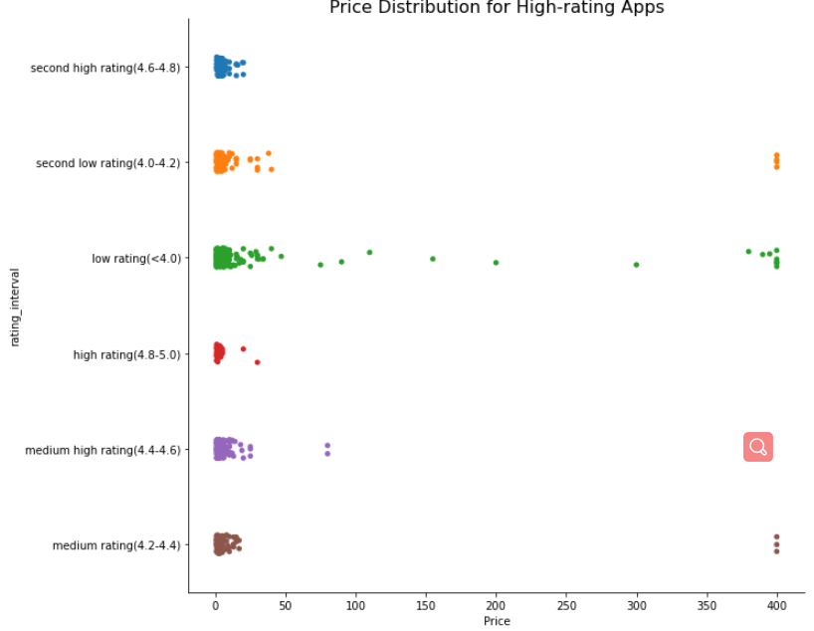
App Price Analysis (Cont.)
Most of the high rating app are located in $30 or lower price range.
App developer shouldn't set the app price too high, it may take risk of strict evaluation and lower downloads.

Slide 10
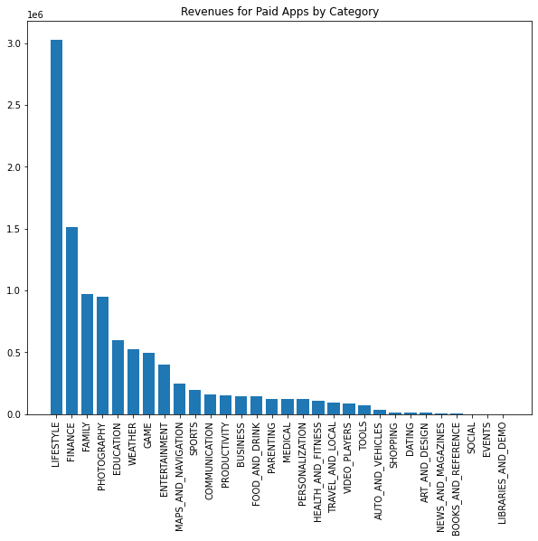
App Price Analysis (Cont.)
Categories of lifestyle, finance, family, and photography are more profitable for the developers if they simply want to earn the installation charge
*Revenue = price * installation

Slide 11
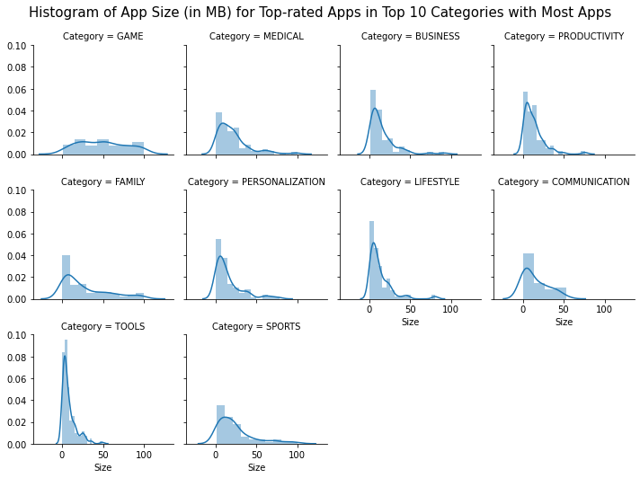
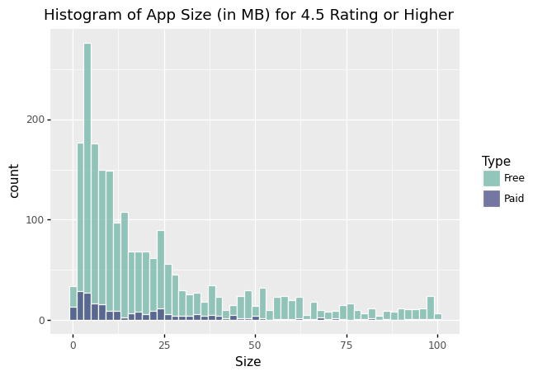
App Size Analysis
Most of Paid apps have size less than or equal to 50MB, while Free apps have sizes up to 100MB
Most of app categories show a large partial of small app size, while GAME and FAMILY apps have considerable number of apps to be sized larger

Slide 12
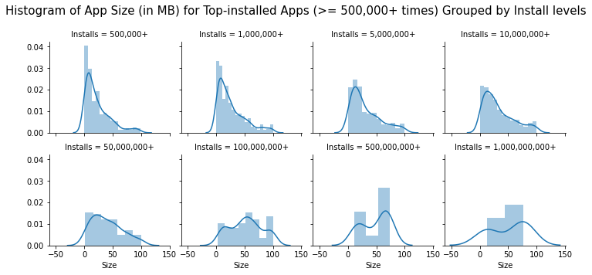
App Size Analysis (Cont.)
A majority of top-downloaded apps (>= 500,000+ times) are sized below 50MB

Slide 13
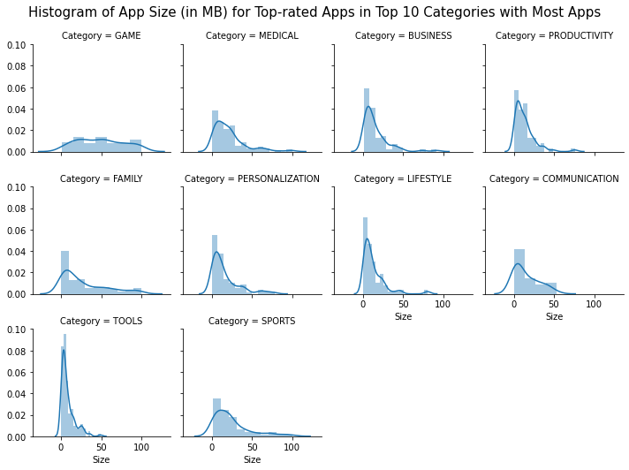

App Size Analysis (Cont.)
Most top-rated apps (rating >= 4.5) are in size of 2MB - 36MB, which is neither too big nor too small.

Slide 14
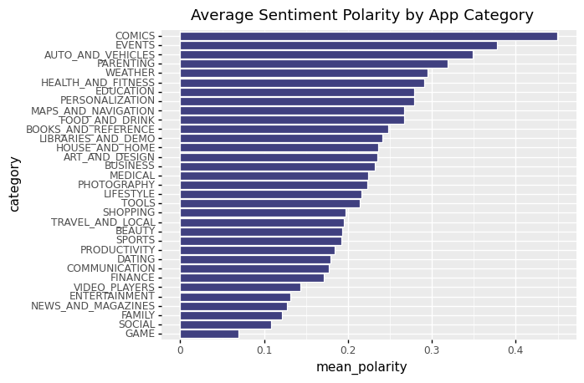
User Review Analysis
COMICS, EVENTS, AUTO & VEHICLES, PARENTING apps are the TOP 4 categories that receive the most positive evaluations, which achieve an average score more than 0.3
GAME, SOCIAL, FAMILY apps are the TOP 3 categories that receive the least positive evaluations, mainly due to there're more apps in those categories which could lead to higher variance

Slide 15
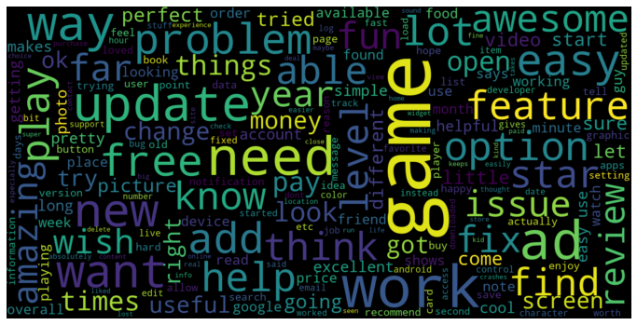
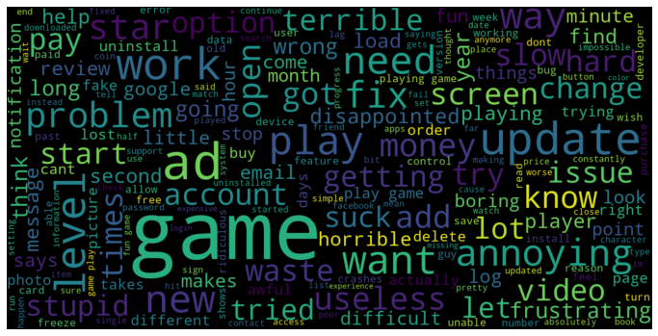
User Review Analysis
An app is expected to be welcomed with the following characteristics:
Lower price, less advertisements, cool features, easy to use, is fun to users, works well with few problems

Slide 16
Key Findings
App categories of family, game, tools, productivity, and medical are more popular
App categories of lifestyle, finance, family and photography are more profitable from charging for installation
Users prefer a paid app with price below $30 and tend to give higher evaluation
Lower price, easy to use, cool features, less advertisements, usefulness is the important features for a good app!
Users prefer lighter apps, app size below 40 MB would be a good choice

Slide 17
Future Work
Perform feature engineering and work towards using machine learning methods to predict the rating of an app.
The prediction could help app developers:
To quantify the effect of price, size, contents and other features on app rating
To further think about how to improve app rating through optimizing strategy and app design regarding important feature characteristics.

Slide 18

THANK YOU!
Any questions?
You can find us at:
sangwony@andrew.cmu.edu
yuranz@andrew.cmu.edu
jiaxuanz@andrew.cmu.edu

