Slide 1
Global Life Expectancy Data Insights
Team 12: Sixuan Tian, Yuran Zhu
Date: December 15th

Slide 2
Agenda
Problem Scope & Goal
Dataset Exploration
Model Development
Model Insights
Recommendations

Slide 3


Problem Scope
Problem
Motivation
Impact
People in some countries are still struggling to live longer
Identify features related with life expectancy to help countries develop policy
Help people live longer with corresponding policy changes

Slide 4



Project Scope
Type of Learning: Regression
Domain Definition: P(T, E+ ΔE) > P(T, E)
Task: Predict life expectancy for a country
Experience: Historical data of countries
Performance measure: Root Mean Squared Error (RMSE)
Baseline model: use mean to create predictions for the life span
Notes:
Supervised learning - regression
Task T: Predict the life expectancy for a given country
Experience E: Historical data for countries about health, economic and social factors, life expectancy
Performance measure P: Root Mean Squared Error (RMSE) (R-Squared also for reference)

Slide 5




Recommendation
Healthcare Development
Human Development and Welfare Improvement
Education Promotion
Global Support Program

Slide 6
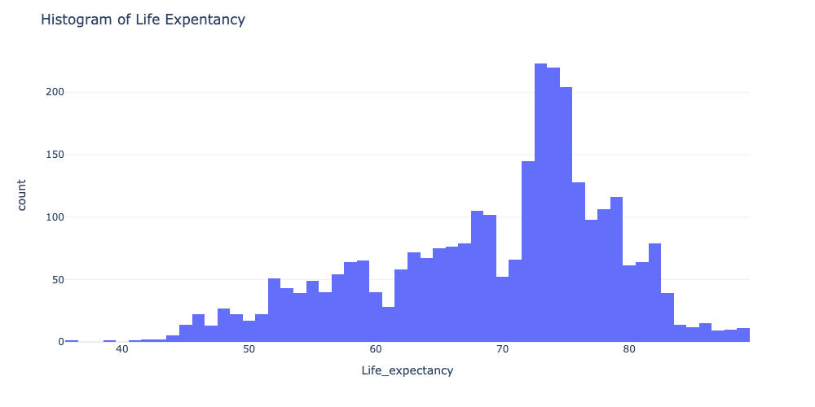
Dataset Description
Health-related
Economy-related
BMI
Development Status
Adult Mortality
Expenditure %
Infant Death
Total expenditure
Alcohol
GDP
Hepatitis B
Population
Measles
Schooling
193 Countries
2000 - 2015 data
Under 5 Death
Income Composition
Polio
Thinness in child
Diphtheria
Thinness in teen
HIV/AIDS
Year
Notes:
Year 2938 non-null int64
2 Status 2938 non-null object
3 Life_expectancy 2928 non-null float64
4 Adult_mortality 2928 non-null float64
5 Infant_deaths 2938 non-null int64
6 Alcohol 2744 non-null float64
7 Percentage_exp 2938 non-null float64
8 Hepatitis_B 2385 non-null float64
9 Measles 2938 non-null int64
10 BMI 2904 non-null float64
11 Under-five_deaths 2938 non-null int64
12 Polio 2919 non-null float64
13 Total_exp 2712 non-null float64
14 Diphtheria 2919 non-null float64
15 HIV/AIDS 2938 non-null float64
16 GDP 2490 non-null float64
17 Population 2286 non-null float64
18 Thinness_1to19_years 2904 non-null float64
19 Thinness_5to9_years 2904 non-null float64
20 Income_comp 2771 non-null float64
21 Schooling 2775 non-null float64

Slide 7

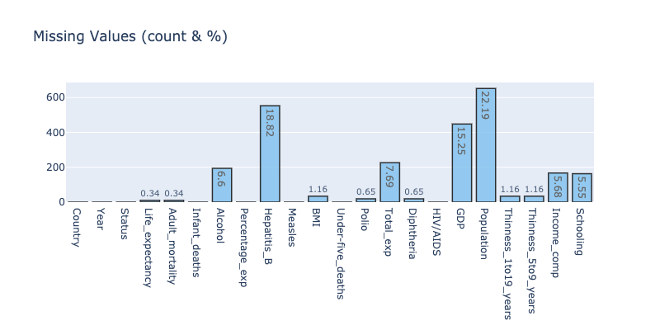

Missing Data
3 features have several missing value ranging from 15% to 23%
Notes:
The population column has 22.2% missing values.
The Hepatitis B columns have 18.8% missing values.
The GDP has 15.2% missing values.
There are also 13 other columns which have 0.3% - 6.6% of missing values.

Slide 8
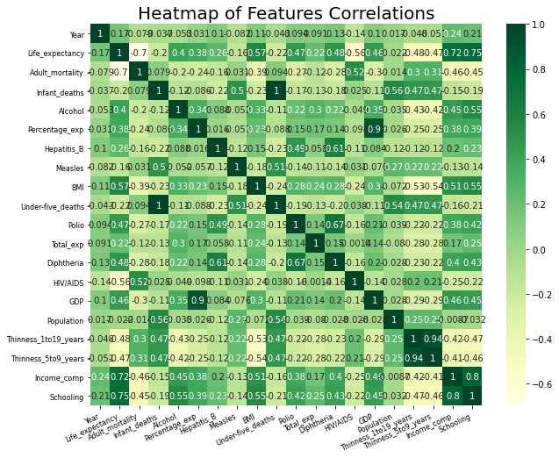
Correlations Between Variables and Outcome
Insights
Features do have high intercorrelation:
Infant deaths vs under-five deaths
Thinness in child vs thinness in teen
GDP vs expenditure %
Income composition vs schooling
Some correlations between features and life expectancy are also notable
Notes:
Generally, most of the correlation coefficients are below 0.6. Those columns display higher correlations:
Infant_deaths and Under-five_deaths: 1.0
thinness_1to19_years and thinness_5to9_years: 0.94
GDP and Percentage_exp: 0.9
Income_comp and Schooling: 0.8
Schooling and Life_expectancy: 0.75
Income_comp and Life_expectancy: 0.72
Polio and Diphtheria: 0.67
It seems reasonable to detect the high positive correlations. For example,
In countries with higher schooling level, people are more educated and tend to understand as well as master the ways to keep healthy.
For countries with higher Gross Domestic Product (GDP), they may tend to spend more on healthcare, which leads to higher Percentage_exp.
With higher Income_comp (A Human Development Index in terms of income composition of resources), countries tend to have longer average life expectancy due to better living standards and conditions.
Additionally, there are some notable high correlations between life expectancy and other variables:
Schooling: 0.75
Income Comp: 0.72
Adult mortality: -0.7
BMI: 0.57
HIV/AIDS: -0.56
As well as low correlation between life expectancy and other variables:
Population: 0.022

Slide 9
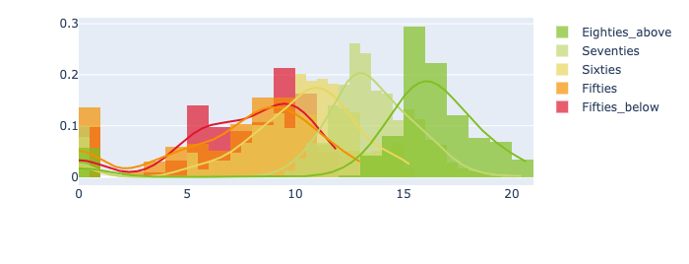
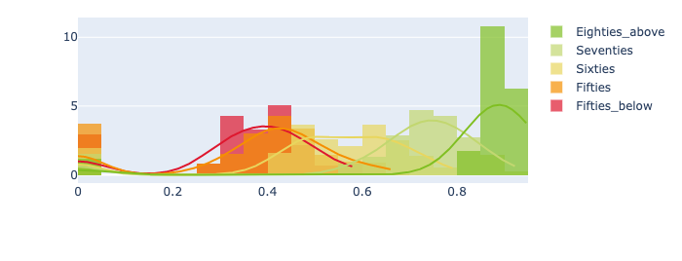
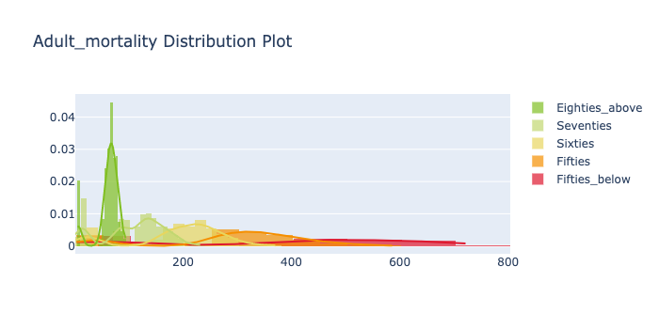
Schooling, Income Composition, and Adult Mortality
Schooling/LE Distribution (C: 0.75)
Income Composition/LE Distribution (C: 0.72)
Adult Mortality/LE Distribution (C: -0.7)
Countries with higher years of schooling (>10), Income composition index (>0.5), and lower adult mortality (<200 per 1000 people) tend to have significantly higher life expectancy
Notes:
Schooling: 0.75
Income Comp: 0.72
Adult mortality: -0.7

Slide 10
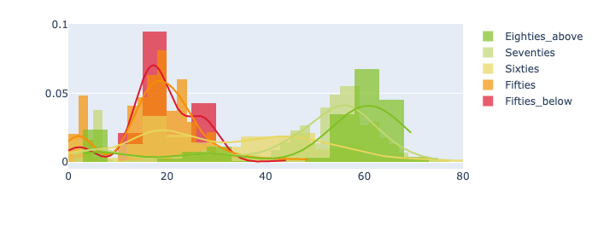
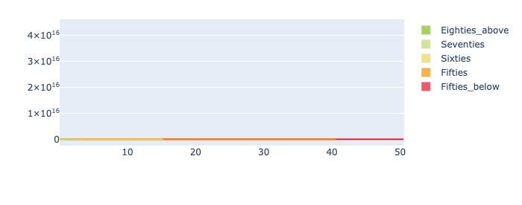
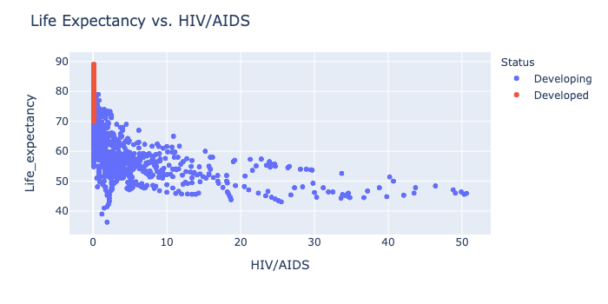
BMI and HIV&AIDS
BMI/LE Distribution (C: 0.57)
HIV&AIDS/LE Distribution (C: -0.56)
HIV&AIDS/LE Scatter Plot
Countries with higher BMI (>30), and rate of death in HIV/AIDS (<15 per 1000) tend to have moderately higher life expectancy
Notes:
BMI: 0.57
HIV/AIDS: -0.56
and developed country tend to have higher life expectancy.

Slide 11
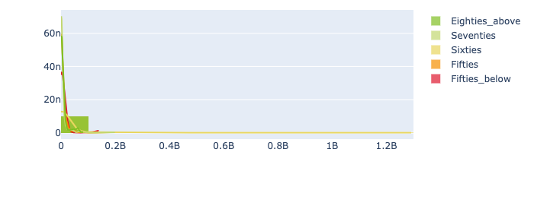
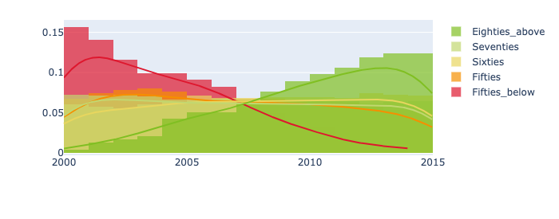
Population and Year
Population/LE Distribution (C: 0.022)
Year/LE Distribution (C: -0.17)
Different population, and year doesn’t tend to affect the life expectancy of the recorded country
Notes:
As well as low correlation between life expectancy and other variables:
Year: -0.17
Population: 0.022

Slide 12
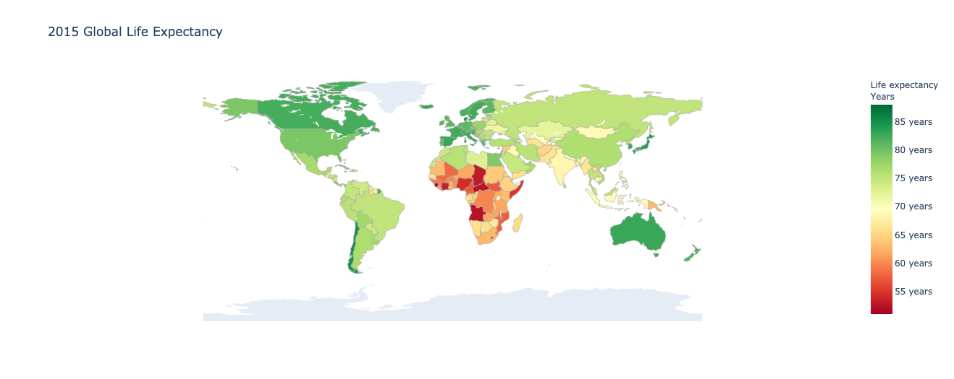
2015 Global Life Expectancy
America
High LE
South
Asia
Mid LE
South Africa
Low LE
Countries in American continents have higher life expectancy, while countries in South Africa have lower life expectancy.

Slide 13





Model Development
Impute Data
Encode Feature
Status Feature
Feature Scaling
Normalize features
Random Forest
Result Analysis
Train, Test & Tune Model
With median,
refer to country status
Feature importance & impact
Notes:
In the model development, first complete the data preparation including …
Afterwards, we train and test with various models, after hyperparameter tuning, we select random forest regression model as the best one
Finally analyze the model results for more practical insights

Slide 14
Base Model Performance (w/o Tuning)
Model | RMSE | R-Squared
Baseline | 9.298235 | /
LinearRegression | 4.023431 | 0.820978
Ridge | 4.124698 | 0.811747
Lasso | 8.031577 | 0.290075
DecisionTreeRegressor | 2.688964 | 0.917359
RandomForestRegressor | 1.881211 | 0.960848
SVR | 3.810336 | 0.839274
XGBRegressor | 2.44710 | 0.944276
Notes:
We first use 10-fold CV to train and test the base model performance.
The seven models we tried all outperform the baseline, showing less root mean squared error.
Among them, we short-list top 3 models - and performed hyperparameter tuning afterwards.

Slide 15

Fine-tuned Model Performance
Tune hyperparameters via
GridSearchCV or RandomizedSearchCV
Model | Base RMSE | Tuned RMSE
DecisionTreeRegressor | 2.688964 | 2.482851
RandomForestRegressor | 1.881211 | 1.836189
XGBRegressor | 2.44710 | 1.843759

Slide 16

Model Evaluation
Measure the performance on the test set to estimate the generalization error for these three models
Model | 10-Fold CV RMSE | Test RMSE | Test R-Squared
DecisionTreeRegressor | 2.482851 | 2.226168 | 0.942650
RandomForestRegressor | 1.836189 | 1.754724 | 0.964368
XGBRegressor | 1.843759 | 1.807827 | 0.962179

Slide 17


Model Performance
For our tuned Random Forest Regression model:
RMSE 1.75
Low standard deviation of the unexplained variance (residuals)
R-Squared 0.96
High performance that data are close to the fitted values
Train with more data, adding data for 2016 - 2020
Add more features: (un)employment, happiness index
Find out the reason of invalid/missing values
Experiment with other imputation methods
Improvement

Slide 18





Model Insights - Feature Importance
HIV/AIDS
Countries should focus on:
Healthcare
Better command of HIV
Human Development
Higher life quality
Reasonable allocation of resources
Education
More expenditure on education
0.480
1
0.237
Income Composition
2
0.139
Adult Mortality
3
0.041
Schooling
4
0.018
Under-five
Deaths
5
*Income Composition: Human Development Index in terms of income composition of resources (index ranging from 0 to 1)
Notes:
Based on the random forest model, we come to know the top 5 important features
The composition of the total income of a population group or a geographic area refers to the relative share of each income source or group of sources, expressed as a percentage of the aggregate total income of that group or area.

Slide 19
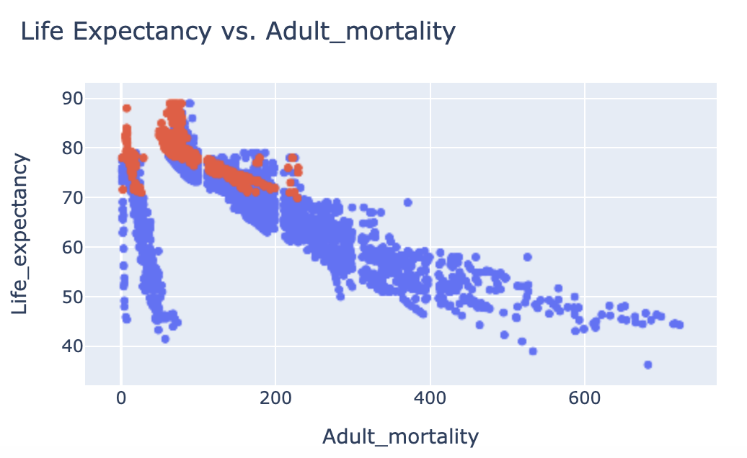
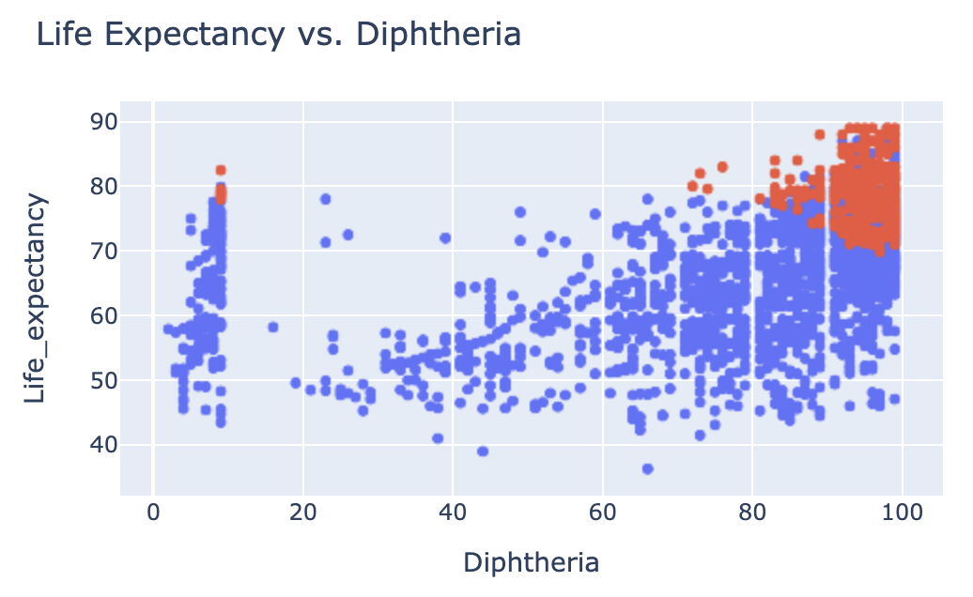
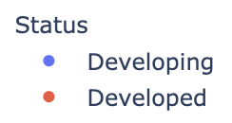
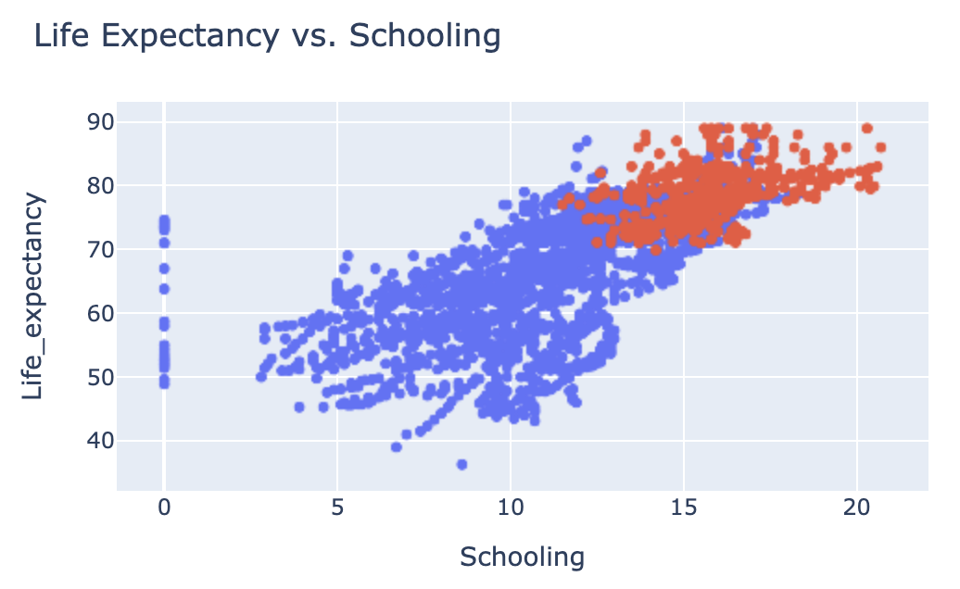
Model Insights - Feature Impact
Obvious gap between developed and developing countries regarding public health, immunization coverage, education, etc.
Positive impact of schooling, immunization coverage on life expectancy
Negative impact of mortality on life span
Notes:
we also investigate the impact on several factors of interest

Slide 20
Recommendations
Healthcare
Human Development
Education
Expand Immunization Coverage
More expenditure on public health fixture and immunization expansion
Raise Awareness
Improve people’s awareness of diseases and educate on prevention
Reallocate Budget
Reallocation of the
government budget to
prioritize social needs
Reallocate Resources
Allocate more social
resource on public
welfare
Enforce Education
Guarantee the chance
of education for child
and teens
International Organization Sponsored Projects
United Nations, World Bank,
etc. to finance education
projects, establish funds
Notes:
International Organization Sponsored Projects
United Nations, World Bank,
etc. to finance education
projects, establish funds

Slide 21

Together We Can Live Better

