Slide 1

Shopping Study Russia October’ 2010
Detailed Results

Slide 2
List of Contents
I. Study Design 3
Main Results
  Sales Scores 4 - 5
III. Sales Process
  Initial Contact 6 - 12
  Salesperson‘s Greeting 13 - 17
  Needs Analysis 18 - 21
  Product Presentation 22 - 29
  Provision of Information 30 - 36
  Product Argumentation 37 - 61
  Sales offer 62 - 73
  Test Drive 74 - 136
  Behaviour at the End of the Meeting / Follow up 137 - 143
IV. Customer Experiences / Salespersons behaviour 144 - 165
V. Dealership 166 - 231

Slide 3
I. Study Design
Objectives
  To collect information about the behaviour of VW salespersons towards prospective buyers of a new car.
  To review the hypothesis that undesirable behaviour can cause a decline in purchase orders.
Contents
  Analysis of requirements, product presentation, product argumentation, provision of information, time of
  delivery, test drive, price negotiation, salesperson`s behaviour.
Sample &
ModelSpec
 | VW Golf | VW Touareg
Number of Visits | 270 | 270
Version Name/Equipment | Trendline | V6 TDI
Engine / hp | 1,6/102 | 3.0/240
Method
  Interviewers acting as mystery customers. Following the consultation they put down their experience and findings in a protocol.
Interviewing Period: October/November 2010

Slide 4
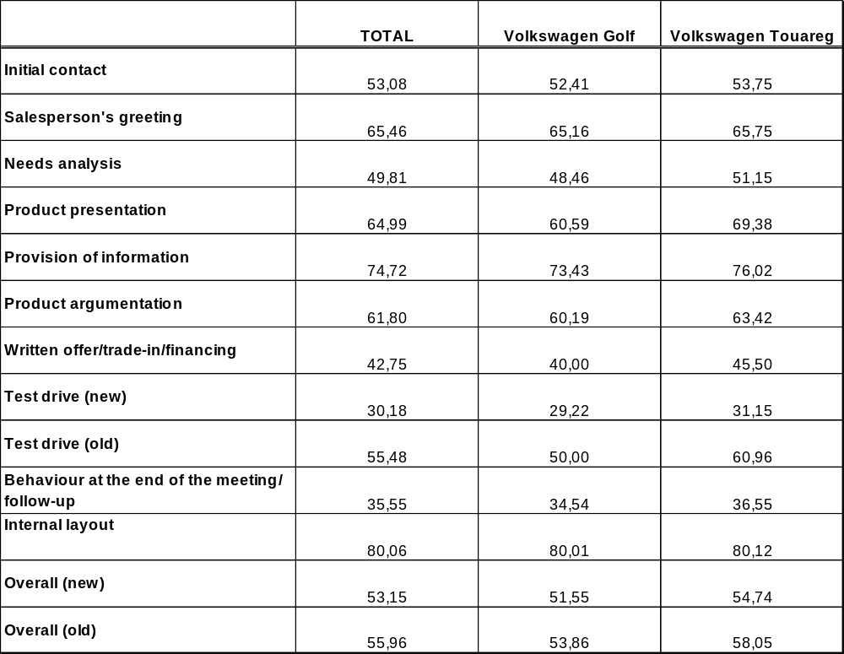
II. Main Results
1. Sales Scores
Scale: 100 = best score, 0 = worst score

Slide 5
II. Main Results
Scoring Model
Internal layout (100-110)
New bracket
Not included in the score model
….
….
Needs Analysis (17)
Asking right away (5)
Number of aspects (5)
Individual and detailed (7)
Salespersons Greeting (15)
By name / name badge (5)
Showing interest (5)
Personal atmosphere (5)
Product Presentation (15)
Without being asked (5)
With requested line (5)
Number/kind of activities (5)
Sales Process
(Old met. 132 = 100%)
(New met. 329-331= 100%)
Provision of Information (8)
Number of used means (3)
Accessibility of material (3)
Presentation well organized (2)
Initial Contact (8)
(Nonverbal) Greeting (3)
Waiting time (5)
Product Argumentation (18)
Number of arguments (5)
Recommendation of extras (3)
After-Sales Service mentioned (2)
Additional points about brand (3)
Refer to personal needs (5)
End of the meeting/follow-up (19)
Tried to make new appointment (5)
Handing out brochure / pricelist (1)
Handing out business card (1)
Asking for contact details (5)
Contact within 5 working days (7)
Sales Offer (20)
Written offer provided (5)
Financing offer (5)
Trade-in of present car (5)
insurances offer (5)
Test Drive (209-211)
New met.
New bracket
….
….
….
Test Drive Offer (12)
OLD met.
Without being asked (7)
Short-term possible (5)
(In brackets): maximum points to be achieved

Slide 6
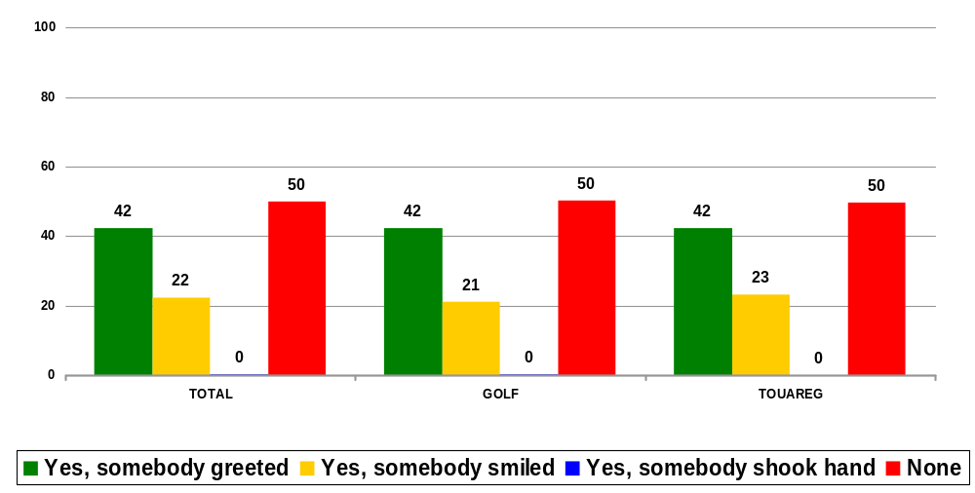
III. Sales Process
1. Initial Contact: When the customer entered the dealership somebody did …
Percentages
Multiple
response
Question 152: When you entered the dealership did somebody greet you or smile at you?

Slide 7
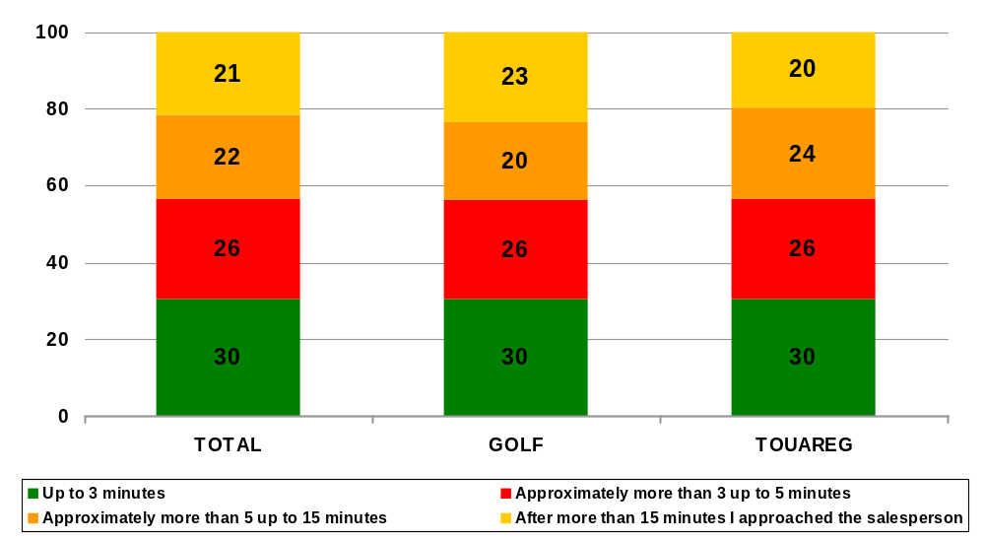
III. Sales Process
1. Initial Contact: Waiting time before salesperson acknowledged customer
Percentages
Question 153: How long did you have to wait until a salesperson approached you for the first time?

Slide 8
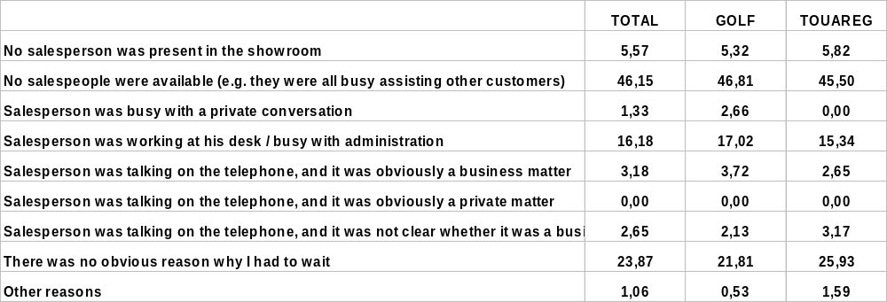
III. Sales Process
1. Initial Contact: Reasons for having to wait
Percentages
Multiple
response
Question 154: Why did you have to wait?

Slide 9
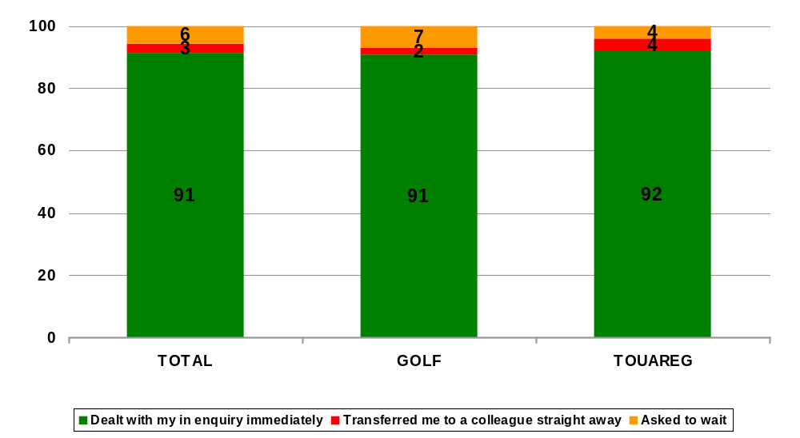
III. Sales Process
1. Initial Contact: Start of the consultation. Salesperson …
Percentages
Question 155: Did the salesperson deal with your enquiry immediately or were you asked to wait?

Slide 10
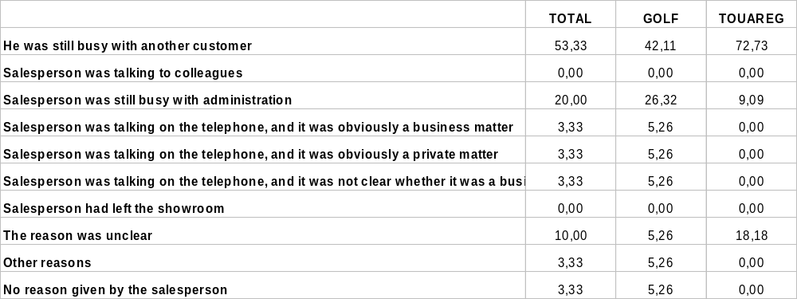
III. Sales Process
1. Initial Contact: Reasons for having to wait
Percentages
Multiple
response
Question 156: What reasons were you given when the salesperson asked you to wait?

Slide 11
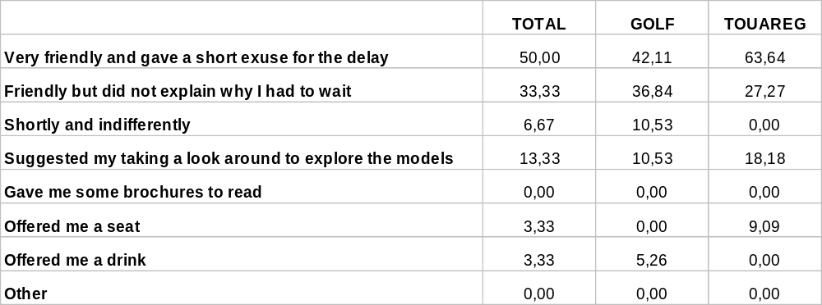
III. Sales Process
1. Initial Contact: How the salesperson asked to wait
Percentages
Multiple
response
Question 157: How did the salesperson ask you to wait?

Slide 12
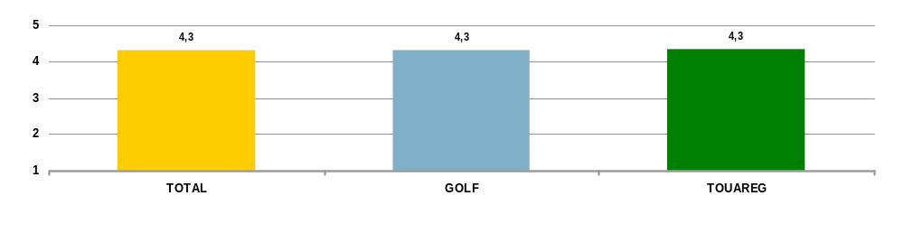
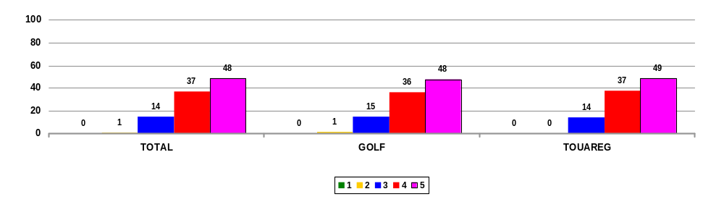
III. Sales Process
1. Initial Contact: Evaluation of waiting time
Scale: 5= appropriate, 1= unacceptable
Mean Values
Percentages
Question 158: How appropriate was the waiting time before you were approached by a salesperson?

Slide 13
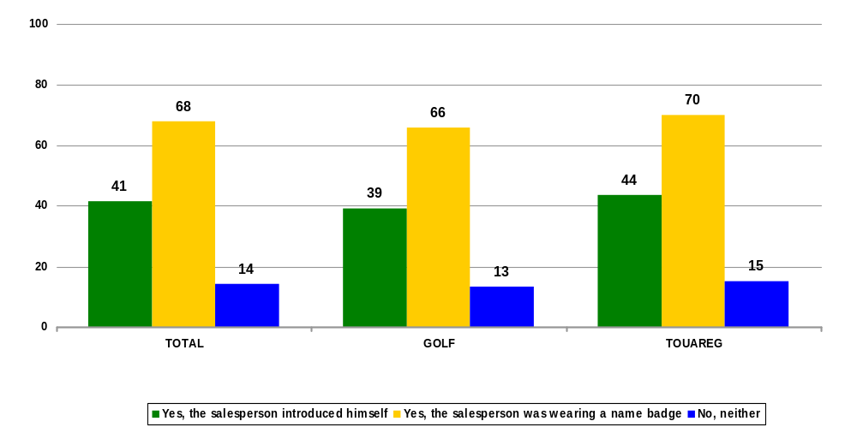
III. Sales Process
2. Salesperson's Greeting: Introduction of the salesperson by name / name badge
Percentages
Multiple
response
Question 160: Did the salesperson introduce himself and/or did he have a name badge?

Slide 14
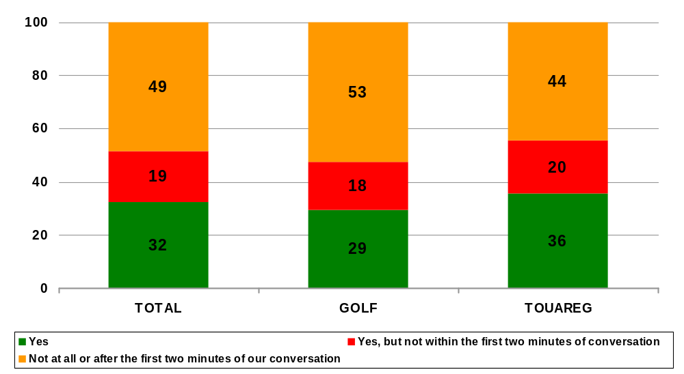
III. Sales Process
2. Salesperson's Greeting: Salesperson asked for customers name
Percentages
Question 161: Did the salesperson ask you for your name?

Slide 15
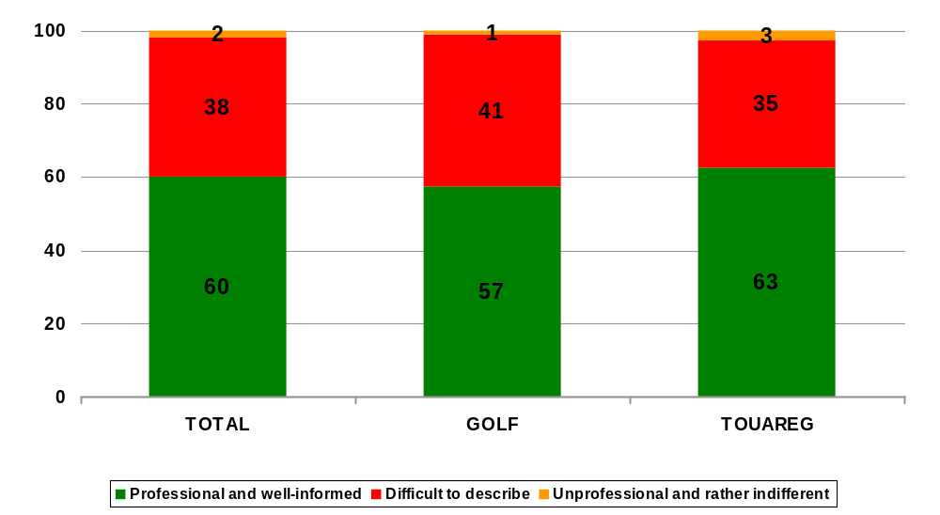
III. Sales Process
2. Salesperson's Greeting: Impression of the salesperson
Percentages
Question 162: What was your initial impression of the salesperson?

Slide 16
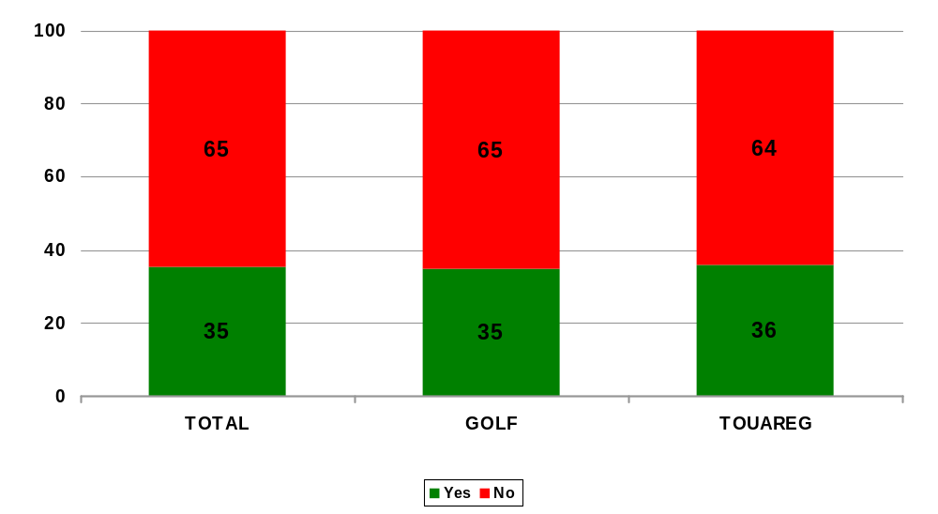
III. Sales Process
2. Salesperson's Greeting: Salesperson tried to create a relaxed atmosphere
Percentages
Question 163: Did the salesperson make an attempt to create a relaxed atmosphere with personal questions or conversation?

Slide 17
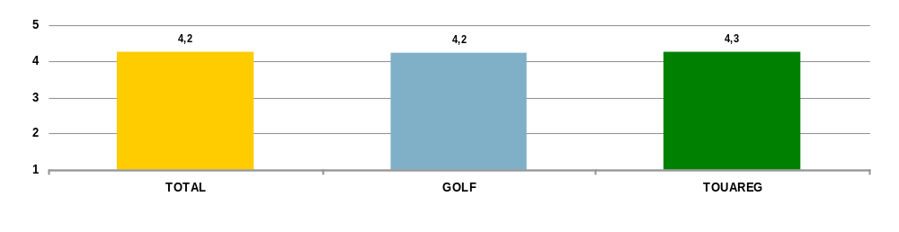
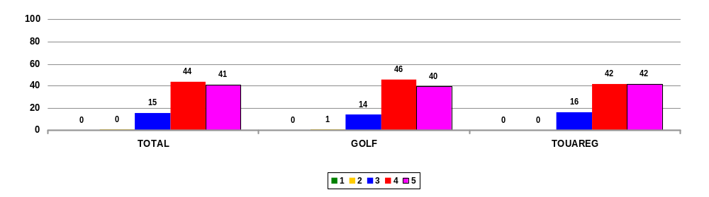
III. Sales Process
2. Salesperson's Greeting: Evaluation of the Salesperson's greeting
Scale: 5= very pleasant, 1= impersonal
Mean Values
Percentages
Question 164: What was your impression of the salesperson’s greeting?

Slide 18
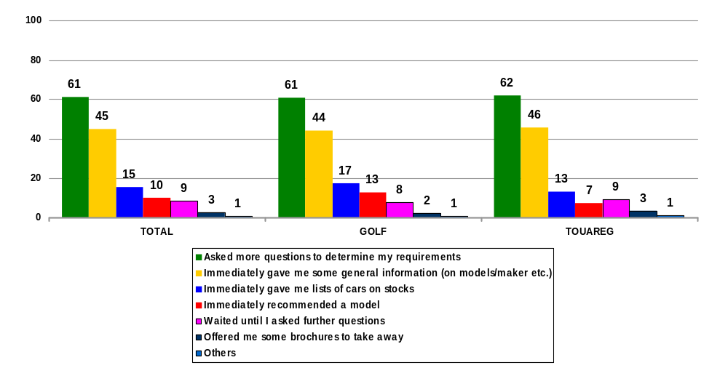
III. Sales Process
3. Needs Analysis: Salesperson’s reaction to customer’s request
Percentages
Multiple
response
Question 170: How did the salesperson react when you told them what you wanted?

Slide 19
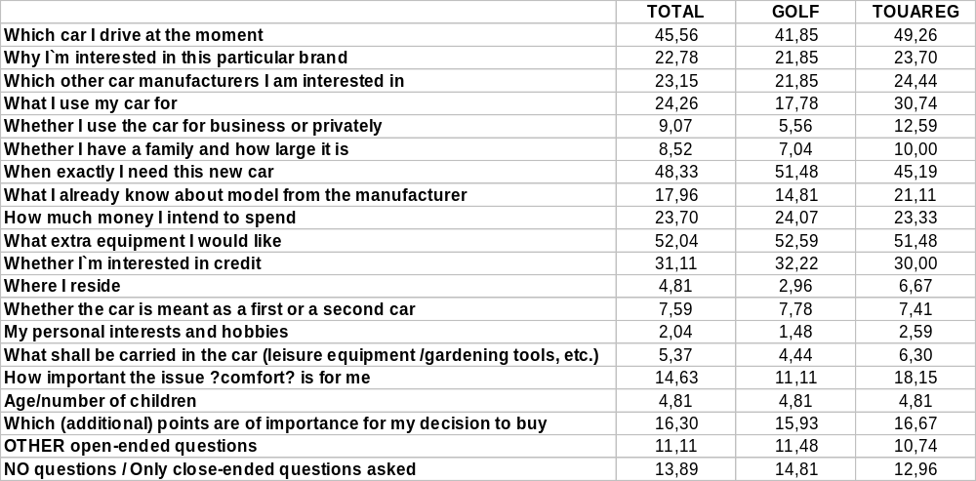
III. Sales Process
3. Needs Analysis: Salesperson’s questions to determine customer’s requirements
Percentages
Multiple
response
Question 171: Which of the following questions did the salesperson ask you during the consultation?

Slide 20
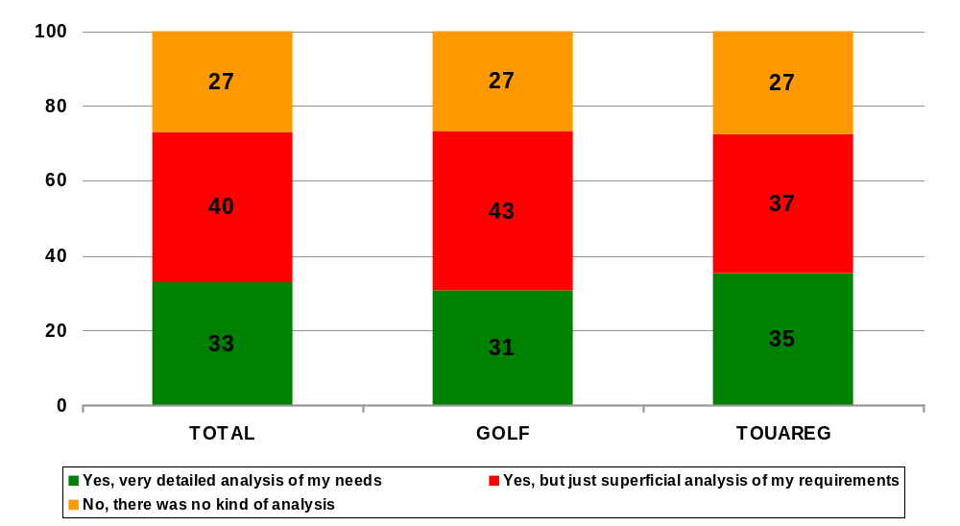
III. Sales Process
3. Needs Analysis: Salesperson’s questions to determine customer’s personal needs
Percentages
Question 172: Did you have the impression that the salesperson asked the necessary questions to determine your personal needs?

Slide 21
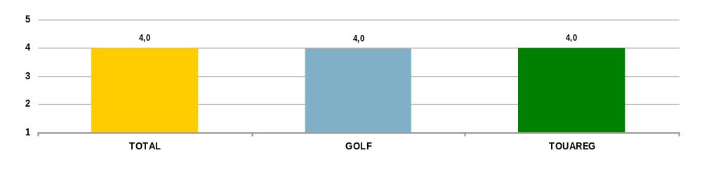
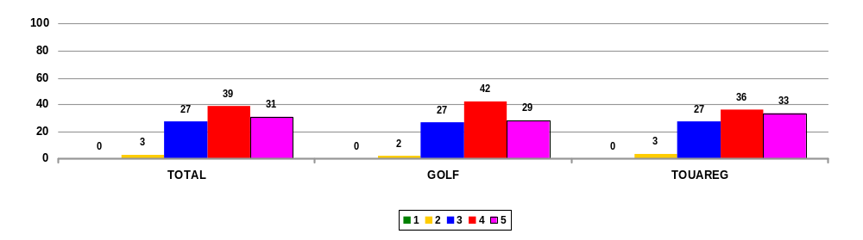
III. Sales Process
3. Needs Analysis: Evaluation of the identification of the customer’s requirements
Scale: 5= very good, 1= poor
Mean Values
Percentages
Question 173: What was your overall impression of the identification of your requirements for a vehicle by the salesperson?

Slide 22
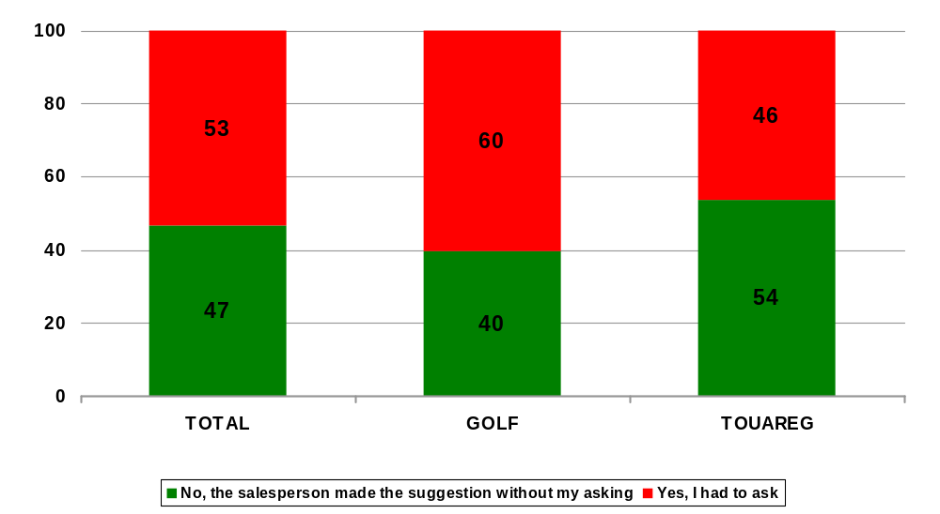
III. Sales Process
4. Product Presentation: Presentation was offered without being asked
Percentages
Question 175: Did you have to ask for a presentation of the model?

Slide 23
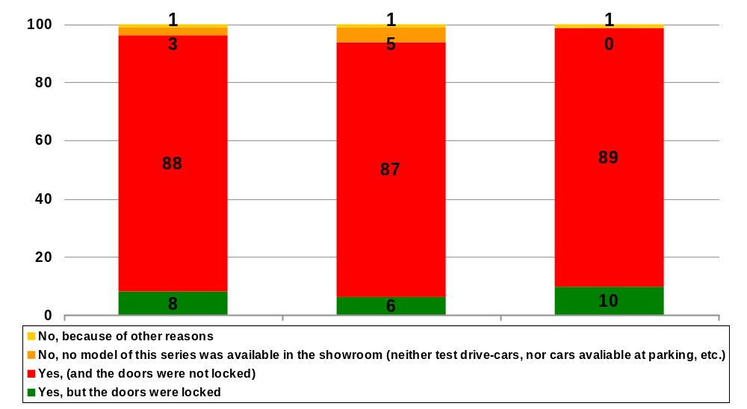
III. Sales Process
4. Product Presentation: Presentation finally took place
Percentages
Question 176: Was there finally a product presentation?

Slide 24
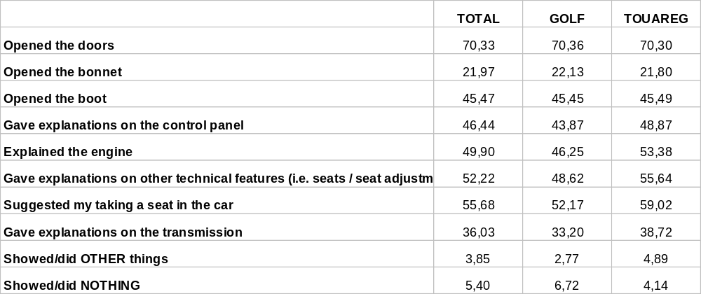
III. Sales Process
4. Product Presentation: Salesperson’s behaviour during the presentation
Percentages
Multiple
response
Question 177: Please note the behaviour of the salesperson during the product presentation:

Slide 25
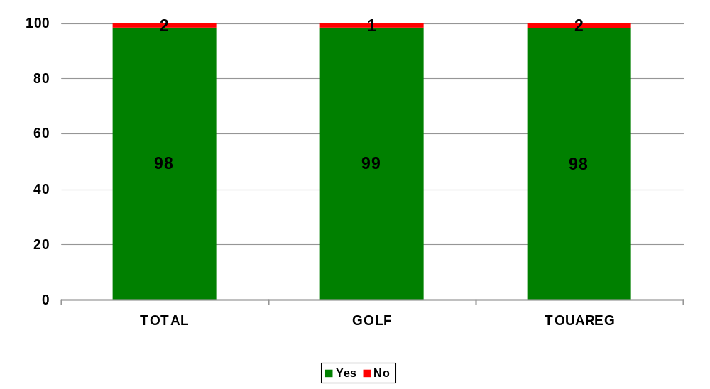
III. Sales Process
4. Product Presentation: Salesperson explained the model clearly and understandably
Percentages
Question 178: Did the salesperson explain the model clearly and understandably?

Slide 26
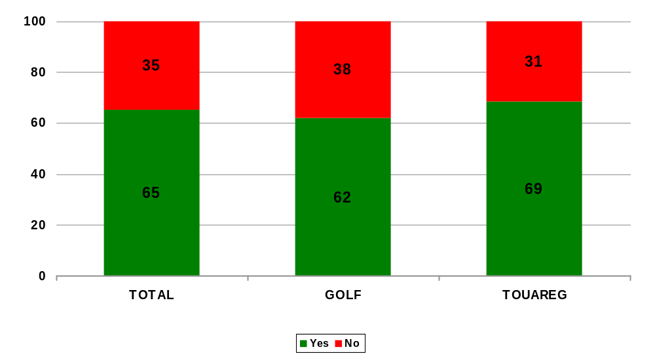
III. Sales Process
4. Product Presentation: Salesperson pointed out benefits of the demonstrated features with refer to customers needs and buying motivation
Percentages
Question 179: Did the salesperson point out the benefits of the demonstrated features with refer to your needs / buying motivation?

Slide 27
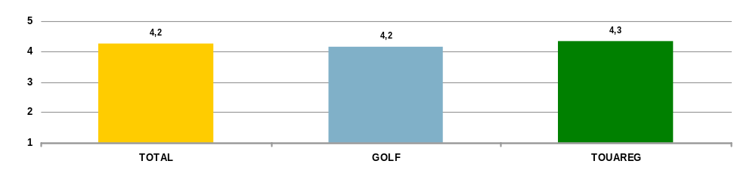
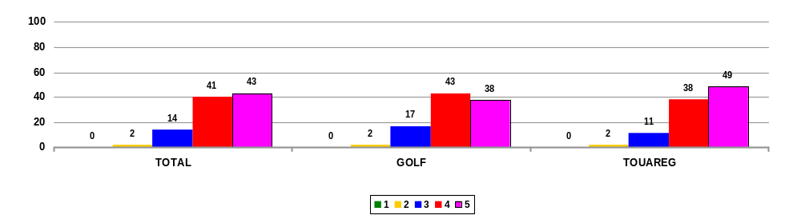
III. Sales Process
4. Product Presentation: Evaluation of the vehicle presentation by the salesperson
Scale: 5= very good, 1= poor
Mean Values
Percentages
Question 180: What overall impression did you get of the vehicle presentation by the salesperson?

Slide 28
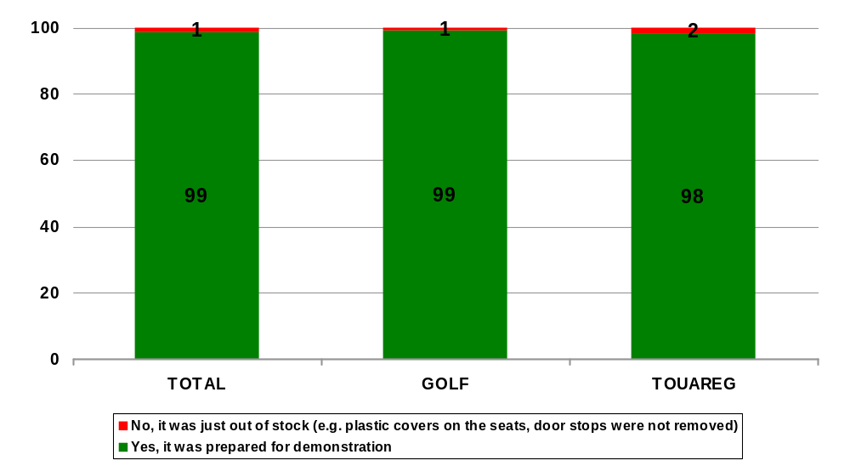
III. Sales Process
4. Product Presentation: Car was prepared for demonstration
Percentages
Question 181: Was the car prepared for demonstration?

Slide 29
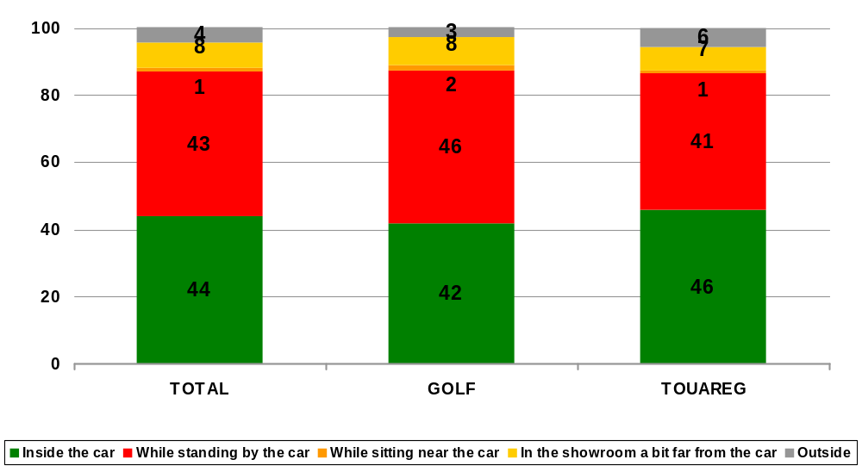
III. Sales Process
4. Product Presentation: Product presentation took place mainly …
Percentages
Question 182: Where did the product presentation take place mainly?

Slide 30
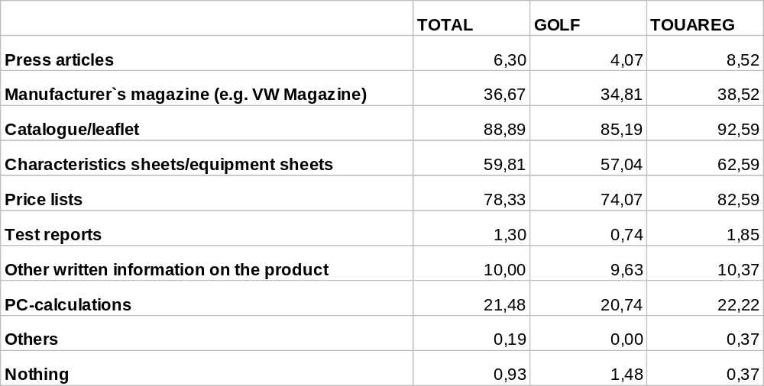
III. Sales Process
5. Provision of Information: What type of written information was available in the showroom?
Percentages
Multiple
response
Question 190: What type of written information was available in the showroom?

Slide 31
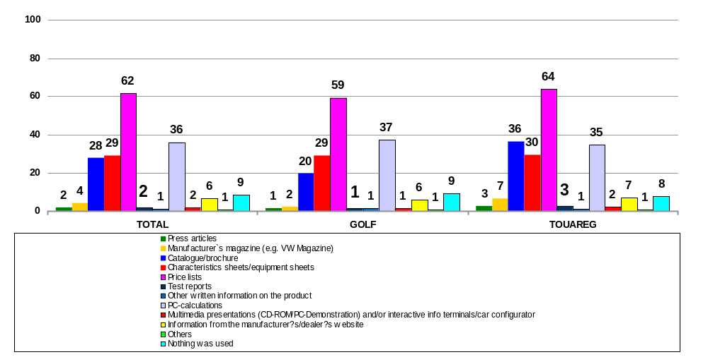
III. Sales Process
5. Provision of Information: Number of means used
Percentages
Multiple
response
Question 191: Which means did the salesperson use during the consultation to provide you with information?

Slide 32
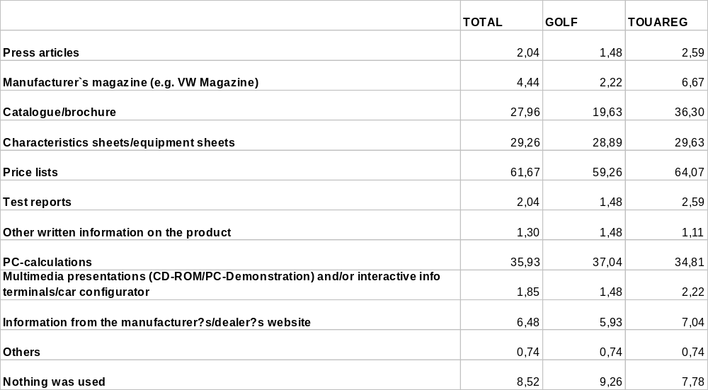
III. Sales Process
5. Provision of Information: Salesperson used means to provide information
Percentages
Multiple
response
Question 191
: Which means did the salesperson use during the consultation to provide you with information?

Slide 33
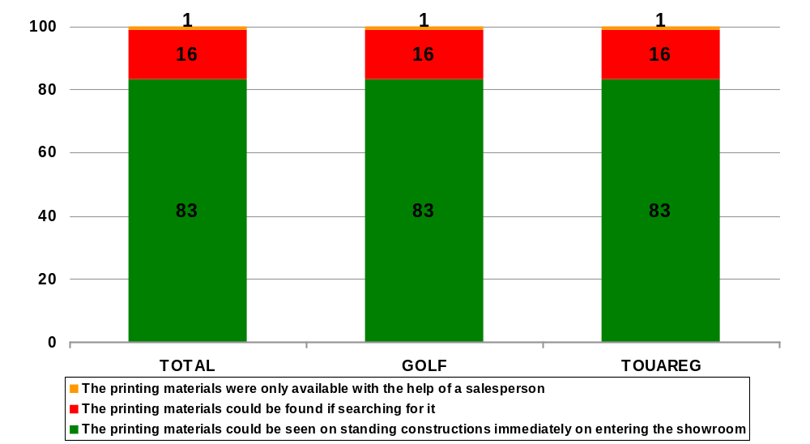
III. Sales Process
5. Provision of Information: Availability of the brochure material
Percentages
Question 192: How was the brochure material available?

Slide 34
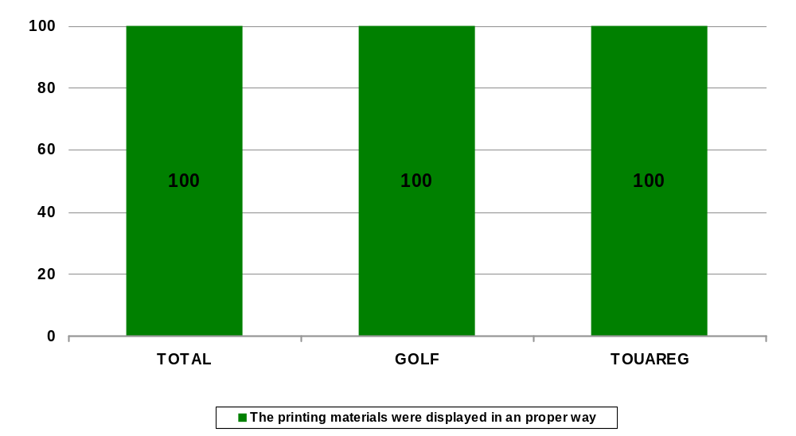
III. Sales Process
5. Provision of Information: Presentation of the brochure material
Percentages
Question 193: How was the brochure material presented in the showroom?

Slide 35
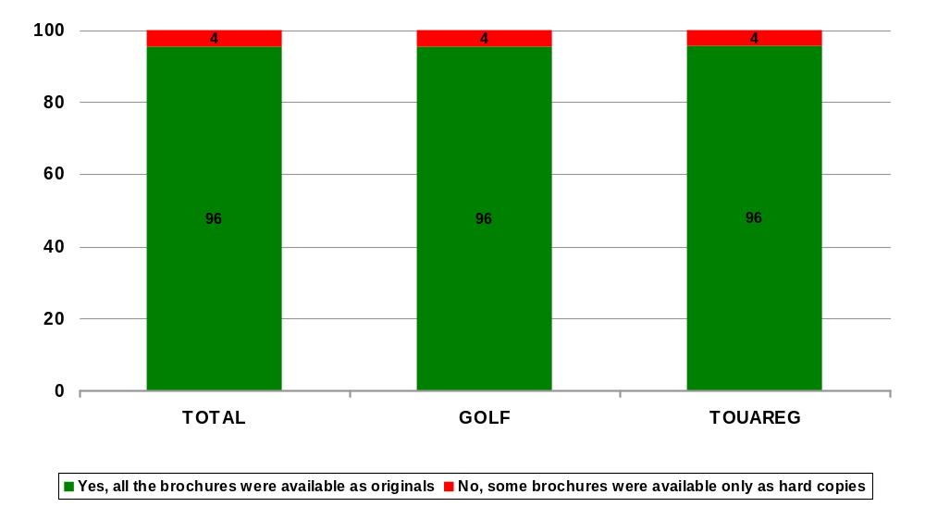
III. Sales Process
5. Provision of Information: Brochure material was available as originals
Percentages
Question 194: Was all the brochure material available as originals?

Slide 36
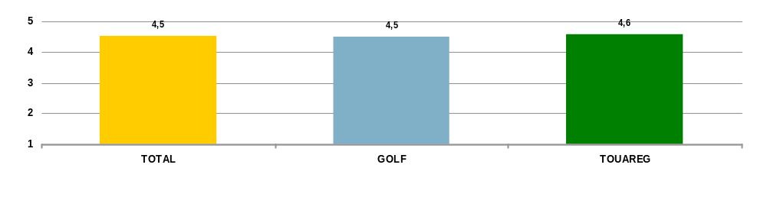
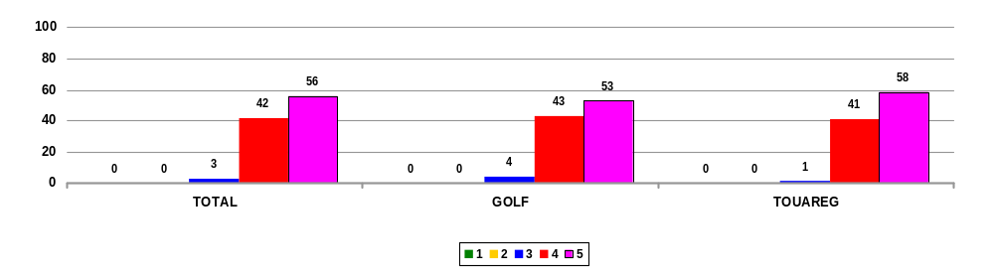
III. Sales Process
5. Provision of Information: Evaluation of the availability of information material
Scale: 5= very good, 1= poor
Mean Values
Percentages
Question 195: What overall impression did you get of the availability of information material?

Slide 37
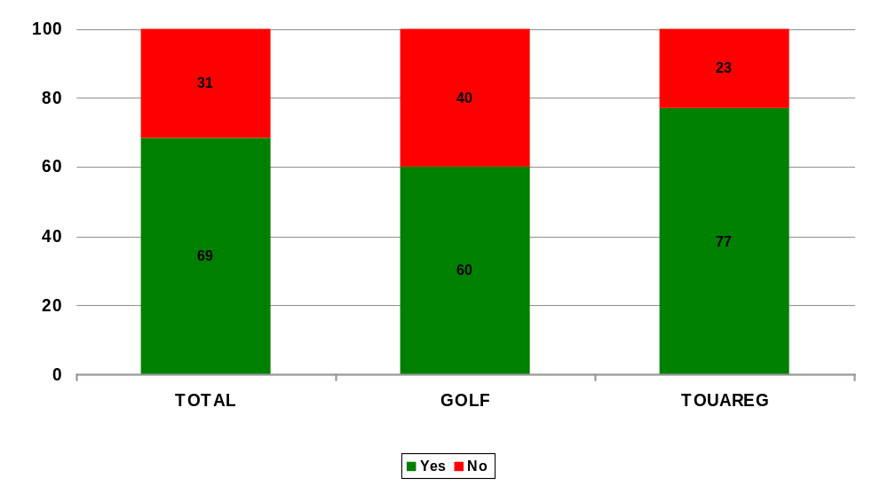
III. Sales Process
6. Product Argumentation: Salesperson explained the different engine types
Percentages
Question 200: Did the salesperson explain the different engine types?

Slide 38
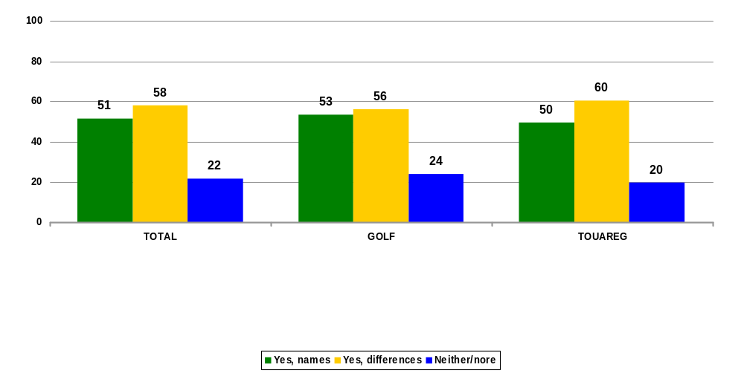
III. Sales Process
6. Product Argumentation: Salesperson explained names and differences of the available equipment levels
Percentages
Multiple
response
Question 201: Did the salesperson explain names and differences of the available equipment levels?

Slide 39
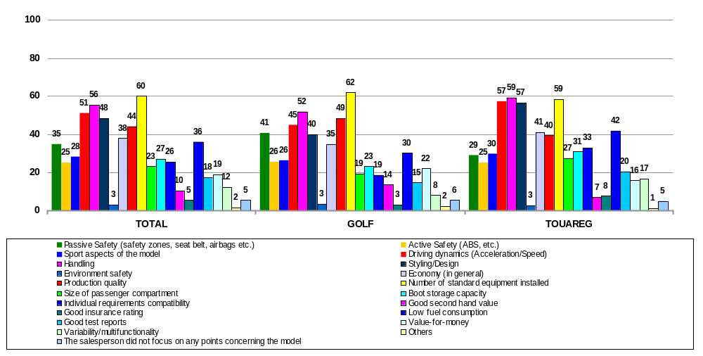
III. Sales Process
6. Product Argumentation: Salesperson made the following points concerning recommended model
Percentages
Multiple
response
Question 202: What points did the salesperson make concerning the recommended model?

Slide 40
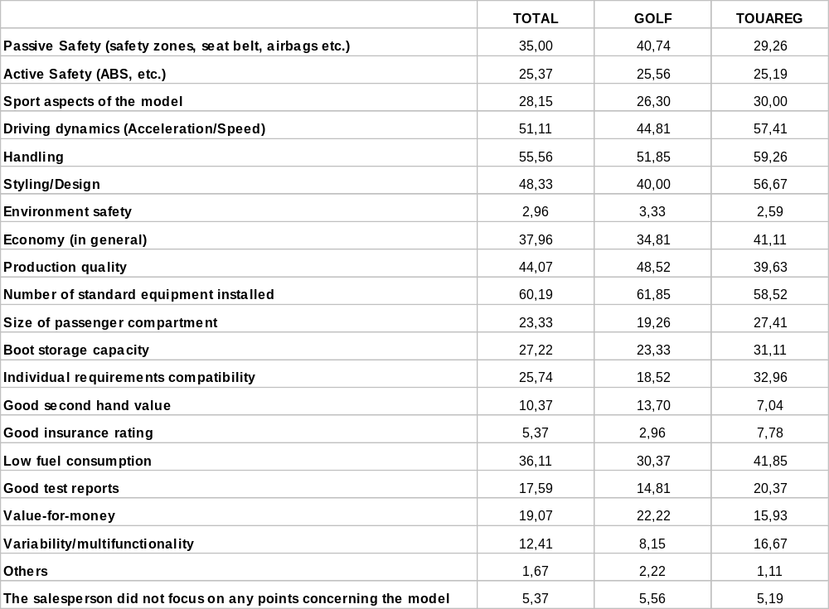
III. Sales Process
6. Product Argumentation: Salesperson made the following points concerning recommended model
Percentages
Multiple
response
Question 202: What points did the salesperson make concerning the recommended model?

Slide 41

III. Sales Process
6. Product Argumentation: Salesperson pointed out benefits of the product features with refer to customers needs and buying motivation
Percentages
Question 203: Did the salesperson point out the benefits of the mentioned product features with refer to your needs / buying motivation?

Slide 42
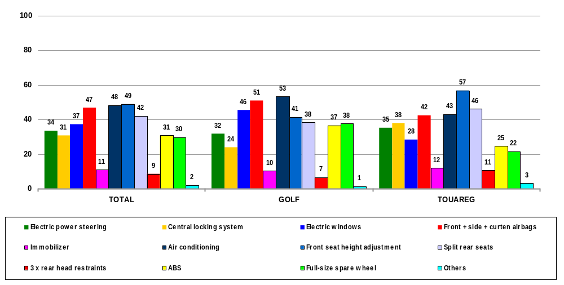
III. Sales Process
6. Product Argumentation: Salesperson pointed out the following standard fittings
Percentages
Multiple
response
Question 204: Which standard fittings did he point out, when he already knew about the preferred equipment level?

Slide 43
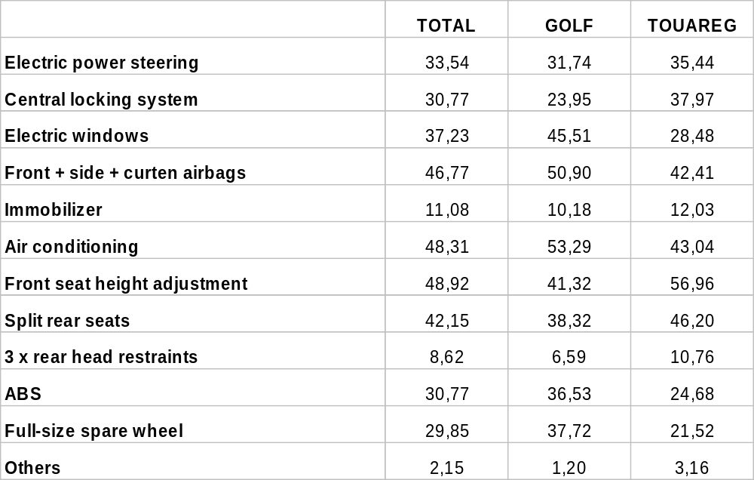
III. Sales Process
6. Product Argumentation: Salesperson pointed out the following standard fittings
Percentages
Multiple
response
Question 204: Which standard fittings did he point out, when he already knew about the preferred equipment level?

Slide 44
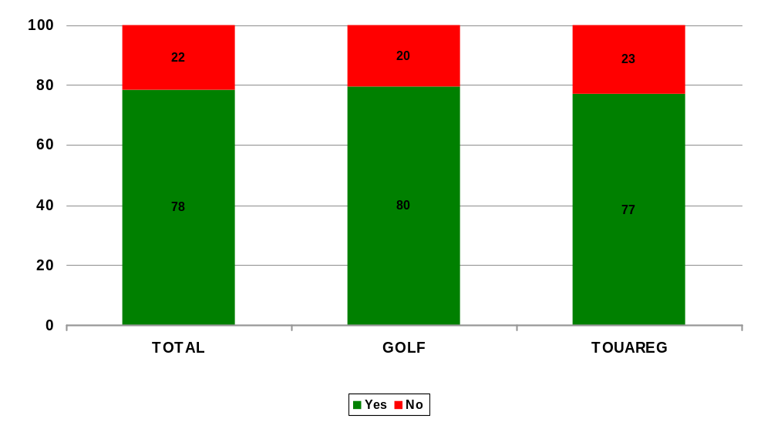
III. Sales Process
6. Product Argumentation: Salesperson pointed out benefits of the standard equipment with refer to customers needs and buying motivation
Percentages
Question 205: Did the salesperson point out the benefits of the mentioned standard equipment with refer to your needs/buying motivation?

Slide 45
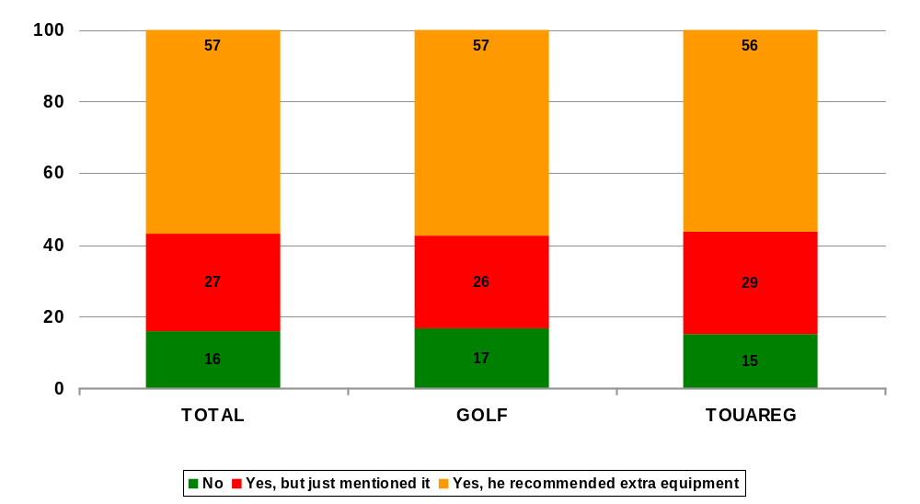
III. Sales Process
6. Product Argumentation: Salesperson recommended extra equipment
Percentages
Question 206: Did the salesperson mention/recommend any extra equipment?

Slide 46
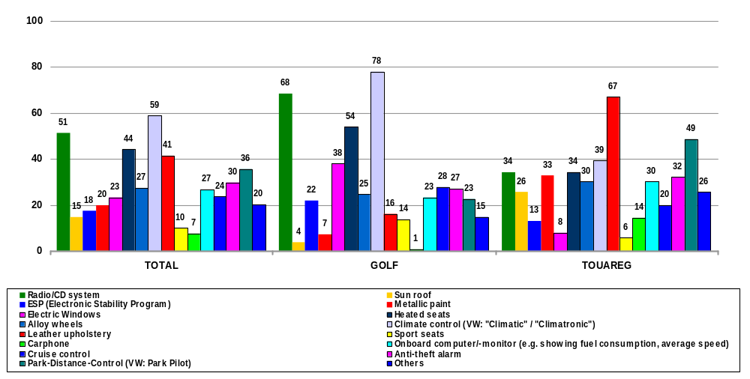
III. Sales Process
6. Product Argumentation: Salesperson recommended extra equipment
Percentages
Multiple
response
Question 207: Which extra equipment did the salesperson recommend?

Slide 47
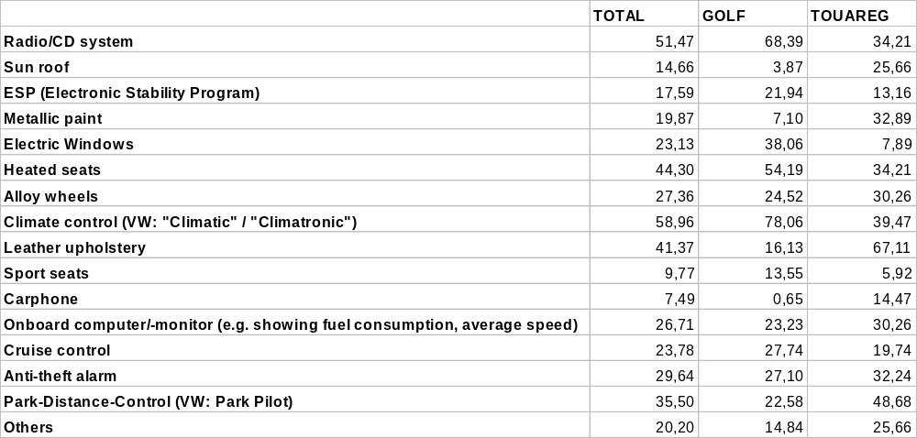
III. Sales Process
6. Product Argumentation: Salesperson recommended extra equipment
Percentages
Multiple
response
Question 207: Which extra equipment did the salesperson recommend?

Slide 48
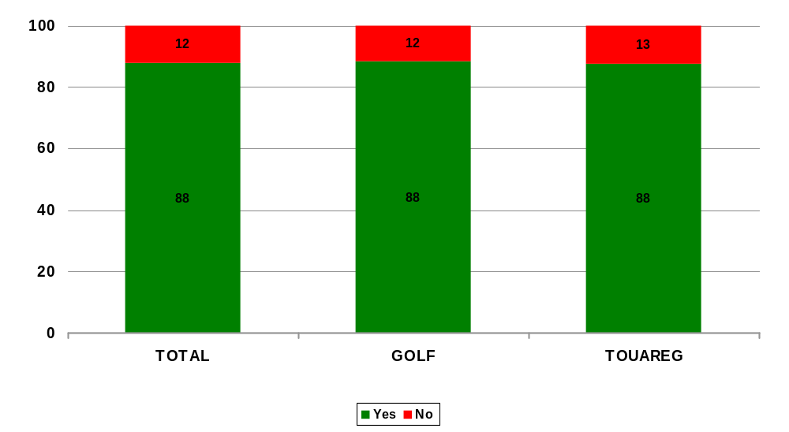
III. Sales Process
6. Product Argumentation: Salesperson pointed out benefits of the recommended extras with refer to customers needs and buying motivation
Percentages
Question 208: Did the salesperson point out the benefits of the recommended extras with refer to your needs / buying motivation?

Slide 49
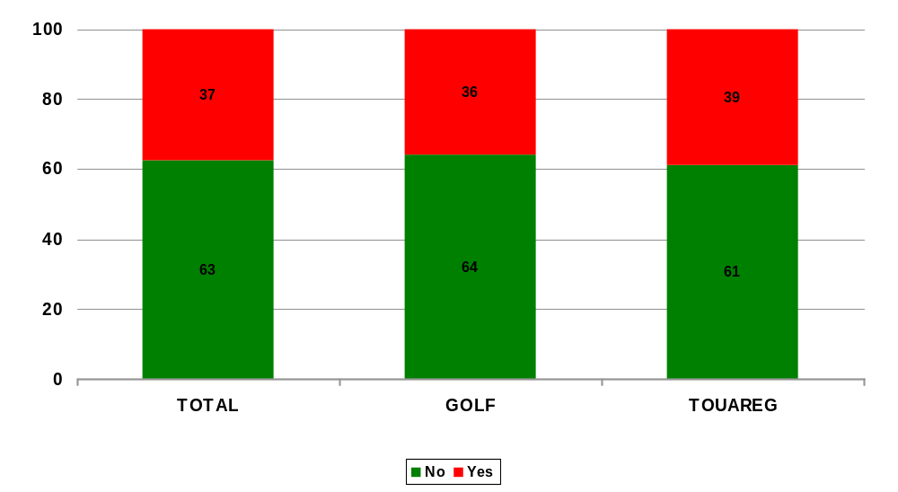
III. Sales Process
6. Product Argumentation: Salesperson mentioned after sales service
Percentages
Question 209: Did the salesperson mention the after sales service?

Slide 50
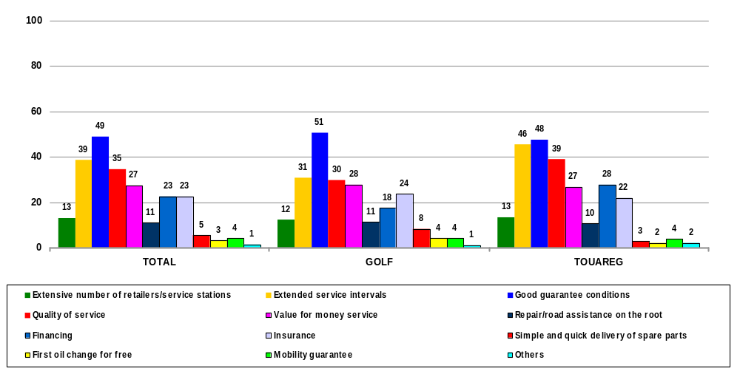
III. Sales Process
6. Product Argumentation: Salesperson’s points regarding after sales service
Percentages
Multiple
response
Question 210: Which reasons regarding the customer service were mentioned by the salesperson?

Slide 51

III. Sales Process
6. Product Argumentation: Salesperson’s points regarding after sales service
Percentages
Multiple
response
Question 210: Which reasons regarding the customer service were mentioned by the salesperson?

Slide 52

III. Sales Process
6. Product Argumentation: Salesperson stressed additional points concerning brand image
Percentages
Question 211: What additional points did the salesperson stress concerning the brand image?

Slide 53

III. Sales Process
6. Product Argumentation: Additional points stressed concerning the brand image
Percentages
Multiple
response
Question 211: What additional points did the salesperson stress concerning the brand image?

Slide 54

III. Sales Process
6. Product Argumentation: Salesperson used reasons to prefer the “own” model
Percentages
Question 212: Did the salesperson use arguments for you to prefer the “own” model instead of the given alternative model?

Slide 55

III. Sales Process
6. Product Argumentation: Used arguments to prefer the “own” model
Percentages
Multiple
response
Question 213: Which arguments did the salesperson use?

Slide 56

III. Sales Process
6. Product Argumentation: Used arguments to prefer the “own” model
Percentages
Multiple
response
Question 213: Which arguments did the salesperson use?

Slide 57

III. Sales Process
6. Product Argumentation: Salesperson argued concerning the mentioned competitor …
Percentages
Question 214: How did the salesperson argue concerning the competitor?

Slide 58

III. Sales Process
6. Product Argumentation: Salesperson gave delivery date for the recommended model
Percentages
Question 215: Did the salesperson give a delivery date for the recommended model or did you have to ask for it?

Slide 59

III. Sales Process
6. Product Argumentation: Given delivery date (Ø in weeks)
Question 216: What delivery date did he give you?

Slide 60

III. Sales Process
6. Product Argumentation: Salesperson could justify delivery date convincingly
Percentages
Question 217: Could the salesperson justify the delivery date convincingly?

Slide 61


III. Sales Process
6. Product Argumentation: Evaluation of the salesperson’s arguments
Scale: 5= very good, 1= poor
Mean Values
Percentages
Question 218: What overall impression did you get of the salesperson’s arguments concerning the recommended model?

Slide 62
III. Sales Process
7. Sales Offer: Discount
With regard to the price negotiation the instructions were as follows: After having specified the model they were interested, in the customers asked for the price for this specific vehicle (first given price). Before initiating the discount discussion they had to wait for a short time to allow the salespersons to give them a cheaper price than the first given price without being asked. Then the customers had to start the discount discussion to get the final price.
 | TOTAL | VW Golf |  | VW Touareg
Average First price |  | 772 763 |  | 2 658 115
Average Final given price |  | 771 507 |  | 2 637 757
Difference from first price: … in RUB |  | 1 256 |  | 20 358
… in % |  | 0.16 |  | 0.77
Salesperson offered a discount before price discussion (%) | 3 | 3 |  | 3
On demand salesperson … offered (further) reduction | 63 | 51 |  | 76
… in cash | 28 | 17 |  | 35
… in form of free extras | 26 | 25 |  | 26
… in form of free insurance | 2 | 2 |  | 2
… didn’t want to finalise price | 57 | 61 |  | 54
Mean Values
Questions 220-230

Slide 63

III. Sales Process
7. Sales Offer/Trade In: Salesperson talked about trade in on his own
Percentages
Question 231: Did the salesperson talk about trade in on his own?

Slide 64

III. Sales Process
7. Sales Offer/Trade In: Salesperson asked to see customer’s present car
Percentages
Question 232: Did the salesperson ask to see your present car?

Slide 65

III. Sales Process
7. Sales Offer/Trade In: Salesperson wanted to know details of customer’s present car
Percentages
Multiple
response
Question 233: What details about your present car did the salesperson want to know?

Slide 66

III. Sales Process
7. Sales Offer/Trade In: Salesperson wanted to know details of customer’s present car
Percentages
Multiple
response
Question 233: What details about your present car did the salesperson want to know?

Slide 67

III. Sales Process
7. Sales Offer/Trade In: Trade in of customer’s present car for salesperson was …
Percentages
Question 234: In your opinion, was the trade in of your present car for the salesperson …?

Slide 68

III. Sales Process
7. Sales Offer/Financing: Salesperson made an offer of finance for the car
Percentages
Question 235: Did the salesperson make you an offer of finance for the new car?

Slide 69

III. Sales Process
7. Sales Offer/Financing: Salesperson offered the following kind of financing
Percentages
Multiple
response
Question 236: Which kind of financing by which company did he offer you?

Slide 70

III. Sales Process
7. Sales Offer/Trade In: Salesperson draw attention to special financing schemes
Percentages
Question 237: Did the sales person draw your attention to special financing schemes which were only available for a limited period for the relevant model?

Slide 71

III. Sales Process
7. Sales Offer/Financing: Salesperson prepared written quotation offer
Percentages
Question 238: Did the salesperson prepare a written quotation showing the price?

Slide 72

III. Sales Process
7. Sales Offer/Trade In: Salesperson offered insurances
Percentages
Question 239: Did the salesperson offer you any insurances?

Slide 73


III. Sales Process
7. Sales Offer: Evaluation of the salesperson’s style of price negotiation
Scale: 5= very good, 1= poor
Mean Values
Percentages
Question 240: What overall impression did you get of the salesperson’s style of price negotiation?

Slide 74

III. Sales Process
8. Test Drive: Salesperson offered a test drive without being asked
Percentages
Question 300: Did the salesperson offer you a test drive without asking?

Slide 75

III. Sales Process
8. Test Drive: Test drive was possible
Percentages
Question 301: Was a test drive possible?

Slide 76

III. Sales Process
8. Test Drive: Possible duration of the test drive
Percentages
Question 302: What did the salesperson say about the timing of a test drive?

Slide 77

III. Sales Process
8. Test Drive:Did a test-drive take place?
Percentages
Question 303:Did a test-drive take place?

Slide 78

III. Sales Process
8. Test Drive:Before test-drive
Percentages
Question 304:Did the salesperson explain you the test-driving route?

Slide 79

III. Sales Process
8. Test Drive: Before test-drive
Percentages
Question 305:Did the salesperson tell you how long the test-drive would last?

Slide 80

III. Sales Process
8. Test Drive: Before test-drive
Percentages
Question 306:Did the salesperson offer you to fill in questionnaire before test-driving?

Slide 81

III. Sales Process
8. Test Drive: Before test-drive
Percentages
Question 307:When did the salesperson pay his attention to appearance of the test-car - prior to the test-drive or straight after it?

Slide 82

III. Sales Process
8. Test Drive: Before test-drive
Percentages
Question 308:What was the priority of the test-drive?

Slide 83

III. Sales Process
8. Test Drive:The procedure of getting into the car ...
Percentages
Question 310:The salesperson opened the passenger door for you and assisted you to comfortably seat down on a passenger seat?

Slide 84

III. Sales Process
8. Test Drive: The procedure of getting into the car ...
Percentages
Question 311: Did the salesperson assist you to understand the passenger seat settings as you sat down?

Slide 85

III. Sales Process
8. Test Drive: The procedure of getting into the car ...
Percentages
Question 312:Did the salesperson close the passenger door as you got into the car?

Slide 86

III. Sales Process
8. Test Drive: The procedure of getting into the car ...
Percentages
Question 313:Did the salesperson draw your attention to other car elements located by the passenger seat?

Slide 87

III. Sales Process
8. Test Drive:Before starting the test-drive...
Percentages
Question 314:The salesperson explained the general informationconcerning the route, the traffic rules, the test-drive?

Slide 88

III. Sales Process
8. Test Drive: Before starting the test-drive...
Percentages
Question 315: The salesperson asked you to fasten the seat belt

Slide 89

III. Sales Process
8. Test Drive: Before starting the test-drive...
Percentages
Question 316:The salesperson fastened his seat belt as well

Slide 90

III. Sales Process
8. Test Drive: Before starting the test-drive...
Percentages
Question 317:The salesperson displayed some inner equipment devices to you (such as the audio-system or the mirror adjustment, window regulators, etc.)

Slide 91

III. Sales Process
8. Test Drive: Before starting the test-drive...
Percentages
Question 318:The salesperson opened a window and left it a bit opened

Slide 92

III. Sales Process
8. Test Drive: Before starting the test-drive...
Percentages
Question 319:The salesperson focused your attention on the easy way to seat down/ getting into/ getting out of the car

Slide 93

III. Sales Process
8. Test Drive: First lap…
Percentages
Question 320:Salesperson's communication style during the test-drive (the salesperson drove the car in the opening lap)

Slide 94

III. Sales Process
8. Test Drive: First lap…
Percentages
Question 321:The salesperson posed questiones to you

Slide 95

III. Sales Process
8. Test Drive: First lap…
Percentages
Question 322:The salesperson answered your questiones

Slide 96

III. Sales Process
8. Test Drive: First lap…
Percentages
Question 323:The salesperson discussed personal issues, own experience, rememberings to make the conversation pleasant and informal

Slide 97

III. Sales Process
8. Test Drive: First lap…
Percentages
Question 325:The salesperson demonstrated how the audio-system operated and turned it off

Slide 98

III. Sales Process
8. Test Drive: First lap…
Percentages
Question 326:The salesperson demonstrated performance of equipment ( for example, the climate control system, the window regulators, the wind-screen wipers, the helm settings, etc.)

Slide 99

III. Sales Process
8. Test Drive: First lap…
Percentages
Question 327:The salesperson noticed to the braking system and demonstrated its operation

Slide 100

III. Sales Process
8. Test Drive: First lap…
Percentages
Question 328:The salesperson noticed to sound isolation

Slide 101

III. Sales Process
8. Test Drive: First lap…
Percentages
Question 329:The salesperson noticed to the light ( it is estimated during night-time)

Slide 102

III. Sales Process
8. Test Drive: First lap…
Percentages
Question 330:The salesperson noticed to the climate control system and demonstrated its operation

Slide 103

III. Sales Process
8. Test Drive: First lap…
Percentages
Question 331:The salesperson noticed to the suspender operation

Slide 104

III. Sales Process
8. Test Drive: First lap…
Percentages
Question 332:The salesperson noticed to general comfort while driving

Slide 105

III. Sales Process
8. Test Drive: First lap…
Percentages
Question 335:The salesperson noticed to and demonstrated dynamics and the speed-up

Slide 106

III. Sales Process
8. Test Drive: First lap…
Percentages
Question 336:The salesperson noticed to the lack of careens in turning movements

Slide 107

III. Sales Process
8. Test Drive: First lap…
Percentages
Question 337:The salesperson noticed to the gear box operation

Slide 108

III. Sales Process
8. Test Drive: First lap…
Percentages
Question 338:The salesperson noticed to the engine (engine thrust, dynamics, quiet work, low flow)

Slide 109

III. Sales Process
8. Test Drive: First lap…
Percentages
Question 339:The salesperson noticed to roadability

Slide 110

III. Sales Process
8. Test Drive: First lap…
Percentages
Question 340:The salesperson noticed to the design and the interior of the passenger compartment

Slide 111

III. Sales Process
8. Test Drive: First lap…
Percentages
Question 341:The salesperson obeyed traffic rules

Slide 112

III. Sales Process
8. Test Drive: Replacing a driver and/or before moving...
Percentages
Question 350:The drivers exchanged in a safe location (i.e. on a road side, in the dealership area, or on a wide road)

Slide 113

III. Sales Process
8. Test Drive: Replacing a driver and/or before moving...
Percentages
Question 351:The salesperson switched off the engine and got the key out of the ignition lock

Slide 114

III. Sales Process
8. Test Drive: Replacing a driver and/or before moving...
Percentages
Question 352:The salesperson closed all the opened windows

Slide 115

III. Sales Process
8. Test Drive: Replacing a driver and/or before moving...
Percentages
Question 353:The salesperson didn't cross your way while replacing the driver

Slide 116

III. Sales Process
8. Test Drive: Replacing a driver and/or before moving...
Percentages
Question 354:The salesperson opened for you the driver's door and assisted you to take the driver's seat

Slide 117

III. Sales Process
8. Test Drive: Replacing a driver and/or before moving...
Percentages
Question 355:The salesperson showed you the control panel (how to switch on the direction lights and head lamps, the wind-screen wipers, the window regulators, etc.)

Slide 118

III. Sales Process
8. Test Drive: Replacing a driver and/or before moving...
Percentages
Question 356:The salesperson noticed to the lengthways and height-adjustable driver's seat

Slide 119

III. Sales Process
8. Test Drive: Replacing a driver and/or before moving...
Percentages
Question 357:The salesperson explained you superficially the way the speed box works

Slide 120

III. Sales Process
8. Test Drive: Replacing a driver and/or before moving...
Percentages
Question 358:The salesperson handed you the key and asked you to start the engine

Slide 121

III. Sales Process
8. Test Drive: Replacing a driver and/or before moving...
Percentages
Question 359:The salesperson asked you to regulate the side-view mirrors

Slide 122

III. Sales Process
8. Test Drive: Replacing a driver and/or before moving...
Percentages
Question 360:The salesperson asked you to regulate the passenger compartment rear-vision mirror

Slide 123

III. Sales Process
8. Test Drive: Replacing a driver and/or before moving...
Percentages
Question 361:The salesperson reminded you to fasten the seat belt

Slide 124

III. Sales Process
8. Test Drive: Replacing a driver and/or before moving...
Percentages
Question 362:The salesperson fastened his seat belt as well

Slide 125

III. Sales Process
8. Test Drive: Second lap…
Percentages
Question 365:The salesperson's communication style during the test-drive ( the customer was driving the car in the second lap)

Slide 126

III. Sales Process
8. Test Drive: Second lap…
Percentages
Question 366:The salesperson, basing on the customer's needs, revealed the car advantages

Slide 127

III. Sales Process
8. Test Drive: Second lap…
Percentages
Question 367:The salesperson persuaded you to agree with the advantages, asked you some questions, and you answered them affirmatively

Slide 128

III. Sales Process
8. Test Drive: Second lap…
Percentages
Question 368:The salesperson asked you to try to use various equipment

Slide 129

III. Sales Process
8. Test Drive: Second lap…
Percentages
Question 369:The salesperson explained the route and was telling you where to drive

Slide 130

III. Sales Process
8. Test Drive: Second lap…
Percentages
Question 370:The salesperson was not only telling you where to drive but also gestured the route

Slide 131

III. Sales Process
8. Test Drive: After test-drive…
Percentages
Question 375:The salesperson asked your impressions from test-driving

Slide 132

III. Sales Process
8. Test Drive: After test-drive…
Percentages
Question 376:The salesperson noticed to some peculiar things that you really liked during the test-drive and they became very important to you; so, you told the salesperson about that while you were driving a car (for example, about noise isolation)

Slide 133

III. Sales Process
8. Test Drive: After test-drive…
Percentages
Question 377:The salesperson showed you/ draw your attention to the back seats and space for passengers there

Slide 134

III. Sales Process
8. Test Drive: After test-drive…
Percentages
Question 378:The salesperson opened the trunk and demonstrated you its capacity

Slide 135

III. Sales Process
8. Test Drive: After test-drive…
Percentages
Question 379:The salesperson invited you to go inside of the showroom

Slide 136

III. Sales Process
8. Test Drive: Evaluation of the salesperson‘s offer for a test drive?
Scale: 5= very good, 1= poor
Mean Values
Percentages
Question 380: What overall impression did you get of the salesperson’s offer for a test drive?

Slide 137

III. Sales Process
9. End of the Meeting: Salesperson tried to make another appointment
Percentages
Question 400: Did the salesperson try to make another appointment with you?

Slide 138

III. Sales Process
9. End of the Meeting: Salesperson gave customer information material
Percentages
Multiple
response
Question 401: Did the salesperson give you any information material?

Slide 139

III. Sales Process
9. End of the Meeting: Salesperson gave customer his business card
Percentages
Question 402: Did the salesperson give you their business card?

Slide 140

III. Sales Process
9. End of the Meeting: Salesperson asked for customer‘s contact details
Percentages
Multiple
response
Question 403: Did the salesperson ask for your full name, address, telephone number and/or Email address?

Slide 141


III. Sales Process
9. End of the Meeting: Evaluation of the salesperson‘s behaviour
Scale: 5= very good, 1= poor
Mean Values
Percentages
Question 404: What overall impression did you get of the salesperson’s behaviour at the end of the meeting?

Slide 142

III. Sales Process
9. Follow up: Salesperson contacted customer within 5 working days after the visit
Percentages
Question 459: Did the salesperson contact you again within 5 working days after the visit?

Slide 143

III. Sales Process
9. Follow up: On this occasion salesperson offered a test drive
Percentages
Question 460: Did the salesperson offer you a test drive on this occasion?

Slide 144

IV. Customer Experience
Customer‘s judgement of salesperson‘s attempt to gain prospective buyer as customer
Percentages
Question 450: In your opinion how hard did the salesperson try to gain you as a customer?

Slide 145

IV. Customer Experience
Customer‘s judgement whether salesperson had set his mind on the customer
Percentages
Question 451: Did you get the impression that the salesperson had their mind on you as a customer?

Slide 146

IV. Customer Experience
Customer received additional services during the meeting
Percentages
Question 452: Did you receive any additional services during the meeting?

Slide 147

IV. Customer Experience
Duration of the meeting (in minutes)
Mean Values
Question 453: How long did the whole meeting take?

Slide 148

IV. Customer Experience
Looking at the salesperson’s behaviour customer would … to buy a new car from this salesperson
Percentages
Question 454: Ignoring your possible preference for a specific brand and just looking at the salesperson’s behaviour, how would you judge your willingness to buy a
new car from this salesperson?

Slide 149

IV. Customer Experience
Just thinking about the dealership customer would … to buy a new car from this dealership
Percentages
Question 456: And if you were just thinking about the dealership, how would you judge your willingness to buy a car from this dealership?

Slide 150


IV. Customer Experience
Evaluation of the overall sales process
Scale: 5= very good, 1= poor
Mean Values
Percentages
Question 458: What impression did you get of the overall sales process?

Slide 151


IV. Evaluation of salesperson’s behaviour
Scale: 6 = fully appropriate, 1 = not at all appropriate
Mean Values
Percentages
Question 501: Please do a final evaluation of the salesperson according to the following criteria: was nice

Slide 152


IV. Evaluation of salesperson’s behaviour
Scale: 6 = fully appropriate, 1 = not at all appropriate
Mean Values
Percentages
Question 502: Please do a final evaluation of the salesperson according to the following criteria: created a pleasant and relaxed atmosphere

Slide 153


IV. Evaluation of salesperson’s behaviour
Scale: 6 = fully appropriate, 1 = not at all appropriate
Mean Values
Percentages
Question 503: Please do a final evaluation of the salesperson according to the following criteria: was very friendly during the whole visit

Slide 154


IV. Evaluation of salesperson’s behaviour
Scale: 6 = fully appropriate, 1 = not at all appropriate
Mean Values
Percentages
Question 504: Please do a final evaluation of the salesperson according to the following criteria: was polite and courteous

Slide 155


IV. Evaluation of salesperson’s behaviour
Scale: 6 = fully appropriate, 1 = not at all appropriate
Mean Values
Percentages
Question 505: Please do a final evaluation of the salesperson according to the following criteria: seemed persuasive and trustworthy

Slide 156


IV. Evaluation of salesperson’s behaviour
Scale: 6 = fully appropriate, 1 = not at all appropriate
Mean Values
Percentages
Question 506: Please do a final evaluation of the salesperson according to the following criteria: addressed to me by my name no less than three times

Slide 157


IV. Evaluation of salesperson’s behaviour
Scale: 6 = fully appropriate, 1 = not at all appropriate
Mean Values
Percentages
Question 507: Please do a final evaluation of the salesperson according to the following criteria: was confident

Slide 158

IV. Evaluation of salesperson’s behaviour
Scale: 6 = fully appropriate, 1 = not at all appropriate
Mean Values
Percentages
Question 508: Please do a final evaluation of the salesperson according to the following criteria: seemed quiet and relaxed

Slide 159


IV. Evaluation of salesperson’s behaviour
Scale: 6 = fully appropriate, 1 = not at all appropriate
Mean Values
Percentages
Question 509: Please do a final evaluation of the salesperson according to the following criteria: had appropriate appearance

Slide 160


IV. Evaluation of salesperson’s behaviour
Scale: 6 = fully appropriate, 1 = not at all appropriate
Mean Values
Percentages
Question 510: Please do a final evaluation of the salesperson according to the following criteria: patiently answered every question

Slide 161


IV. Evaluation of salesperson’s behaviour
Scale: 6 = fully appropriate, 1 = not at all appropriate
Mean Values
Percentages
Question 511: Please do a final evaluation of the salesperson according to the following criteria: advised me comprehensively

Slide 162


IV. Evaluation of salesperson’s behaviour
Scale: 6 = fully appropriate, 1 = not at all appropriate
Mean Values
Percentages
Question 512: Please do a final evaluation of the salesperson according to the following criteria: built up a personal relationship with me

Slide 163


IV. Evaluation of salesperson’s behaviour
Scale: 6 = fully appropriate, 1 = not at all appropriate
Mean Values
Percentages
Question 513: Please do a final evaluation of the salesperson according to the following criteria: never seemed arrogant

Slide 164


IV. Evaluation of salesperson’s behaviour
Scale: 6 = fully appropriate, 1 = not at all appropriate
Mean Values
Percentages
Question 514: Please do a final evaluation of the salesperson according to the following criteria: expressed himself clearly

Slide 165

IV. Evaluation of salesperson’s behaviour
Scale: 6 = fully appropriate, 1 = not at all appropriate
Question 501-514: Please do a final evaluation of the salesperson according to the following criteria.

Slide 166

V. Dealership: First Impressions
It was easy to locate and find the dealership
Percentages
Question 50: Was it easy to locate and find the dealership?

Slide 167

V. Dealership: First Impressions
There were identification signs
Percentages
Question 51: Where there any identification signs?

Slide 168

V. Dealership: First Impressions
First impression of the exterior of the dealership
Percentages
Question 52: What first impression did you have of the exterior of the dealership?

Slide 169

V. Dealership: First impressions
Did you see standard POS equipment outside the dealership?
Percentages
Multiple
response
Question 53: Did you see standard POS equipment outside the dealership?

Slide 170

V. Dealership: First Impressions
There was a reception desk
Percentages
Question 150: Was there a reception desk at the entrance or inside the showroom?

Slide 171

V. Dealership: First Impressions
Somebody was present at the reception desk
Percentages
Question 151: Was somebody (a hostess) present at the reception?

Slide 172

V. Dealership: Internal layout.
CLIENT PARKING
Percentages
Question 54: Were there any free parking places in front of the automobile dealership as you approached it?

Slide 173

V. Dealership: Internal layout.
CLIENT PARKING
Percentages
Question 55:Evaluate the client parking

Slide 174

V. Dealership: Internal layout.
CLIENT PARKING
Percentages
Question 56:Were the parking places indicated with marking?

Slide 175

V. Dealership: Internal layout.
CLIENT PARKING
Percentages
Question 57:Was the parking area at the entrance clean (no rubbish) ?

Slide 176

V. Dealership: Internal layout.
AD's cleanness
Percentages
Question 58:Were the front door and the building's facade clean (particularly with no bin OVERFILLED)

Slide 177

V. Dealership: Internal layout.
AD's cleanness
Percentages
Question 59:Were the show-room walls and the floor clean?

Slide 178

V. Dealership: Internal layout.
AD's cleanness
Percentages
Question 60:Were the windows clean from both, the inner and outer sides?

Slide 179

V. Dealership: Internal layout.
AD's cleanness
Percentages
Multiple
response
Question 61:Evaluate the salespersons' workplace condition

Slide 180

V. Dealership: Internal layout.
AD's cleanness
Percentages
Question 62:No rubbish on the floor, the floor is clean, no rubber tyres lines

Slide 181

V. Dealership: Internal layout.
The AD and recreation area design
Percentages
Question 63:There is a water cooler (or a coffee slot-machine) with clean plastic glasses and a bin for them nearby.

Slide 182

V. Dealership: Internal layout.
The AD and recreation area design
Percentages
Question 64:The WC in the building contains the following: mirror, tissue, paper towels or an electric drier, clothes hooks, electricity, water. The WC is clean.

Slide 183

V. Dealership: Internal layout.
The AD and recreation area design
Percentages
Question 66:Clients' area is clean (incl. coffee table, armchairs, sofas)

Slide 184

V. Dealership: Internal layout.
The outer and inner condition of all the cars presented in AD:
Percentages
Question 74:The body and the windscreen surface

Slide 185

V. Dealership: Internal layout.
The outer and inner condition of all the cars presented in AD:
Percentages
Question 75:Wheel tyres of all the cars are carbonized

Slide 186

V. Dealership: Internal layout.
The outer and inner condition of all the cars presented in AD:
Percentages
Question 76:In front and in back all cars contain their model name in automobile number frames

Slide 187

V. Dealership: Internal layout.
The outer and inner condition of all the cars presented in AD:
Percentages
Question 77:Automobile number frames contain information about the dealer center (name and tel.)

Slide 188

V. Dealership: Internal layout.
The outer and inner condition of all the cars presented in AD:
Percentages
Question 78:All the cars presented had no protection films at all (white or blue) and there were no door block systems

Slide 189
V. Dealership: Internal layout.
The outer and inner condition of all the cars presented in AD:
Percentages
Question 79:The model naming tables have white background and black font (or black background and white font)

Slide 190

V. Dealership: Internal layout.
The outer and inner condition of all the cars presented in AD:
Percentages
Question 80:All the model naming tables contained only letters (no figures)

Slide 191

V. Dealership: Internal layout.
The outer and inner condition of all the cars presented in AD:
Percentages
Question 81:The windscreens had no materials presented or there was a test-drive offer on them

Slide 192

V. Dealership: Internal layout.
The details concerning the inner condition of the car you are interested in:
Percentages
Question 90:The trunk of the car you are interested in was not closed and you could open it

Slide 193

V. Dealership: Internal layout.
The details concerning the inner condition of the car you are interested in:
Percentages
Question 91:The underbonnet space of the car you are interested in is absolutely clean

Slide 194

V. Dealership: Internal layout.
The details concerning the inner condition of the car you are interested in:
Percentages
Question 92:The petrol cap area of the car you are interested in is absolutely clean (without dirt and/or dust and/or water drops)

Slide 195

V. Dealership: Internal layout.
The details concerning the inner condition of the car you are interested in:
Percentages
Question 93:The cabin and the truck of the car you are interested in were clean

Slide 196

V. Dealership: Internal layout.
The details concerning the inner condition of the car you are interested in:
Percentages
Question 94:In the cabin of the car you are interested in there were four paper or rubber mats available

Slide 197

V. Dealership: Internal layout.
The details concerning the inner condition of the car you are interested in:
Percentages
Question 95:All the paper mats were absolutely clean and not crumpled / the rubber mats were clean

Slide 198

V. Dealership: Internal layout.
The details concerning the inner condition of the car you are interested in:
Percentages
Question 96:There were no polyethylene covers available on all the seats inside the car

Slide 199

V. Dealership: Internal layout.
The details concerning the inner condition of the car you are interested in:
Percentages
Question 97:In the cabin there were no protection films (see-through and/or blue) on the panels (control, gage panel, door panels, etc.)

Slide 200

V. Dealership: Internal layout.
Price-holders
Percentages
Question 98:Price-holders, presence and layout

Slide 201

V. Dealership: Internal layout.
Price-holders
Percentages
Question 99:The presented price holders' appearance

Slide 202

V. Dealership: Internal layout.
Price-holders
Percentages
Question 100:Did text and the materials of both the papers correspond to the standards fixed?

Slide 203

V. Dealership: Internal layout.
Sales supporting materials condition
Percentages
Question 110:There is a stand containing color samples

Slide 204

V. Dealership: Internal layout.
Sales supporting materials condition
Percentages
Question 111:There are three or more demonstrative standers with brightly colored posters

Slide 205

V. Dealership: Internal layout.
Sales supporting materials condition
Percentages
Question 112:There are holders for original booklets

Slide 206

V. Dealership: Internal layout.
Sales supporting materials condition
Percentages
Question 113:There are original booklets for all the cars presented

Slide 207

V. Dealership: Internal layout.
Sales supporting materials condition
Percentages
Question 114:All the walls contain posters (at least two for each wall)

Slide 208

V. Dealership: Internal layout.
Sales supporting materials condition
Percentages
Question 115:The "Volkswagen Insurance" booklets and "the special credit program" are available at the Reception stand.

Slide 209

V. Dealership: Internal layout.
Sales supporting materials condition
Percentages
Question 116:The "Volkswagen Insurance" booklets and "the special credit program" are presented on the salesperson's table

Slide 210

V. Dealership: Internal layout.
Sales supporting materials condition
Percentages
Question 117:There are three mobile stands presented (Volkswagen Credit Express, Volkswagen Insurance, Volkswagen Leasing)

Slide 211

V. Dealership: Internal layout.
Das WeltAuto materials layout
Percentages
Question 120:There is at least one Das WeltAuto stander presented

Slide 212

V. Dealership: Internal layout.
Das WeltAuto materials layout
Percentages
Question 121:One stander (no more than one) Is located near the used cars salesperson's work-place

Slide 213

V. Dealership: Internal layout.
Das WeltAuto materials layout
Percentages
Question 122:The Das WeltAuto booklets are located at a used cars salesperson's work-place

Slide 214

V. Dealership: Internal layout.
Das WeltAuto materials layout
Percentages
Question 123:The Das WeltAuto booklets are located at the Reception stand

Slide 215
V. Dealership: Internal layout.
Test-automobiles location and their outer and inner condition
Percentages
Question 130:Test-automobiles are located in front of the entrance or near the AD's entrance (e.g. gable facade)

Slide 216

V. Dealership: Internal layout.
Test-automobiles location and their outer and inner condition
Percentages
Question 131:The test-automobiles foreparts are directed to the place from where you are leaving the AD (e.g. if you left the AD, and then came to the gable fa?ade, the cars' foreparts would be directed up to you)

Slide 217

V. Dealership: Internal layout.
Test-automobiles location and their outer and inner condition
Percentages
Question 132:All the test cars were clean outside

Slide 218

V. Dealership: Internal layout.
Test-automobiles location and their outer and inner condition
Percentages
Question 133:All the test-automobiles had no visible damage

Slide 219

V. Dealership: Internal layout.
Test-automobiles location and their outer and inner condition
Percentages
Question 134:All the test-automobiles were glued over in a special way

Slide 220

V. Dealership: Internal layout.
The condition of the test-drive car
Percentages
Question 135:All the inner rocker panels were clean

Slide 221

V. Dealership: Internal layout.
The condition of the test-drive car
Percentages
Question 136:All the elements and the internal panels in the cabin were clean

Slide 222

V. Dealership: Internal layout.
The condition of the test-drive car
Percentages
Question 137:All the equipment demonstrated to you by the salesperson and used during the test-drive was in proper operating condition

Slide 223

V. Dealership: Internal layout.
The condition of the test-drive car
Percentages
Question 138:There was a test route inside the car cabin (on a seat, in a pocket or glove compartment)

Slide 224

V. Dealership: Internal layout.
The condition of the test-drive car
Percentages
Question 139:In the cabin (in the glove compartment, in the holders, on the door panels, etc.) there were no secondary things which had nothing to do with a test-drive (e.g. paper, napkins, warrants, registration documents, spare parts, broken car elements, etc.

Slide 225

V. Dealership: Internal layout.
The condition of the test-drive car
Percentages
Question 140:What type of tyres were the test-cars equipped with?

Slide 226

V. Dealership: Internal layout.
The Das WeltAuto cars' location and their design
Percentages
Question 141:The automobiles are located in a special visible area or near the AD entrance and are easy to be found on your own

Slide 227

V. Dealership: Internal layout.
The Das WeltAuto cars' location and their design
Percentages
Question 142:In the automobile number frames there were "Das WeltAuto" tables of orange or white background

Slide 228

V. Dealership: Internal layout.
The Das WeltAuto cars' location and their design
Percentages
Question 143:Under the windscreen there was a price tag

Slide 229

V. Dealership: Internal layout.
Location of new automobiles at the dealer's storehouse
Percentages
Question 144:You managed to visit the new cars' parking

Slide 230

V. Dealership: Internal layout.
Location of new automobiles at the dealer's storehouse
Percentages
Question 145:The location of the new automobiles at the dealer's storehouse

Slide 231

V. Dealership: Internal layout.
Location of new automobiles at the dealer's storehouse
Percentages
Question 146:ALL the cars had NO visible damage at the dealer's storehouse

