Slide 1
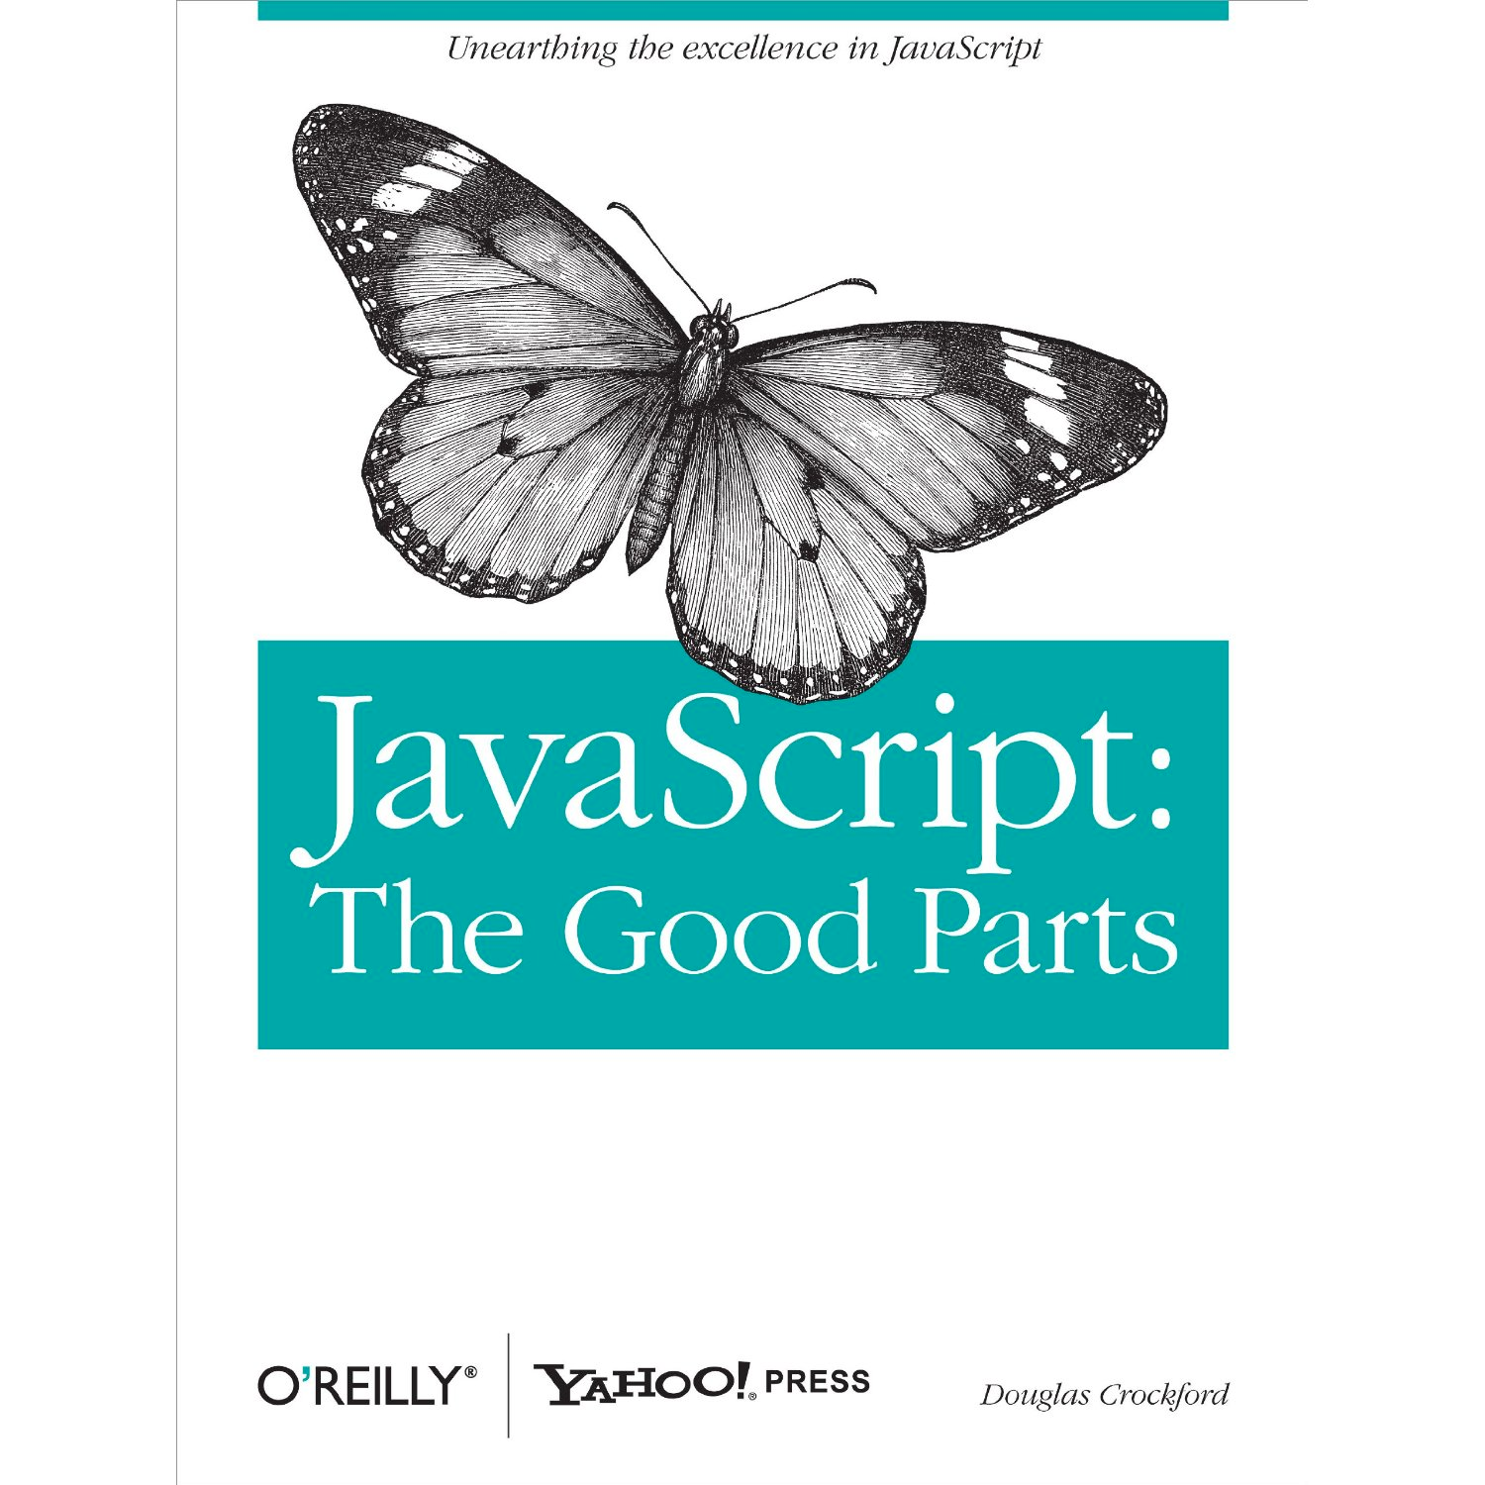
AngularJS

Slide 2
MVC
View
Controller
Model

Slide 3
MVVM
View
View
View Synchronization
“controllers”
ViewModel
ViewModel
ViewModel
Model
Model
Model
Model
“services”

Slide 4
git clone https://github.com/rangle/ngcourse.git
cd ngcourse
git branch --track 2014-12-16 origin/2014-12-16
git checkout 2014-12-16
npm install
bower install
sudo npm install -g http-server

Slide 5
To get the latest version
git stash
git pull
Or
git checkout -b my-version
# commit with git add, git commit
git checkout 2014-10-27
git pull

