Slide 1



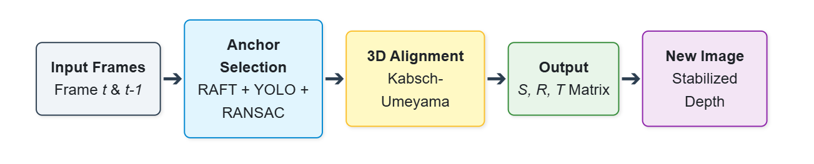
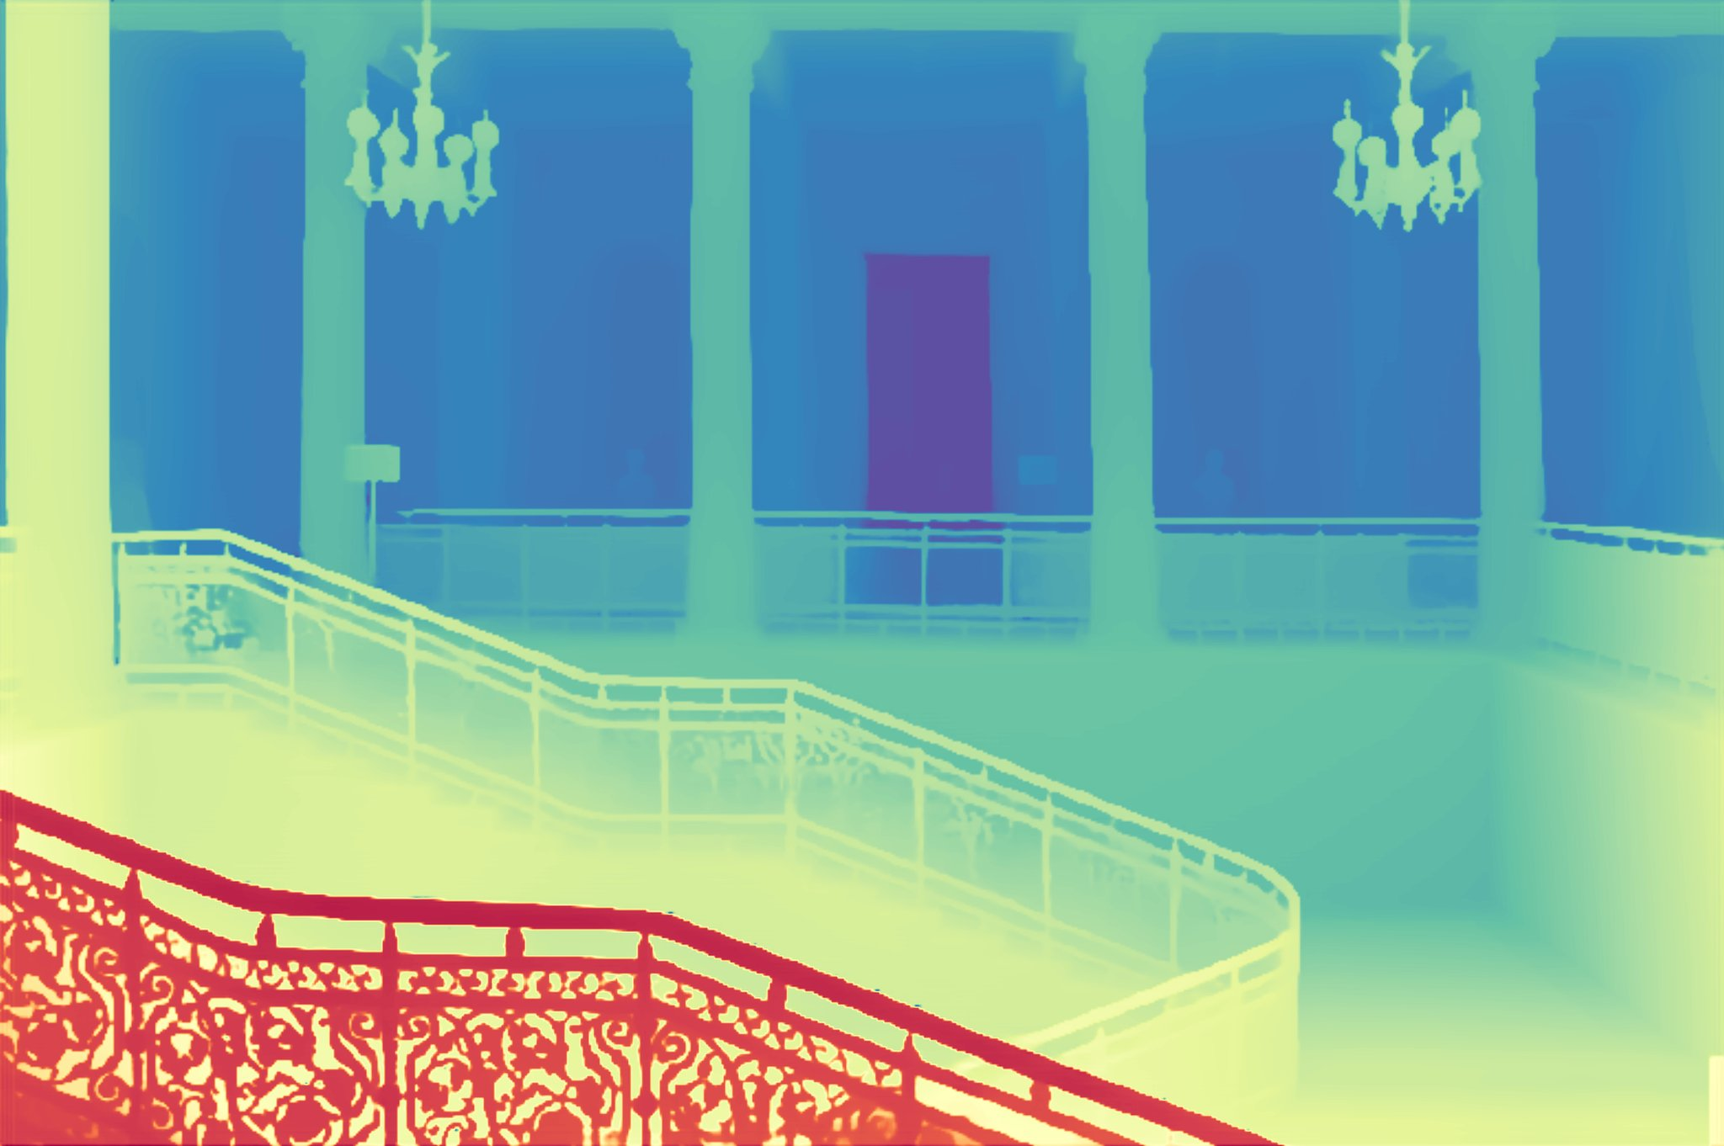
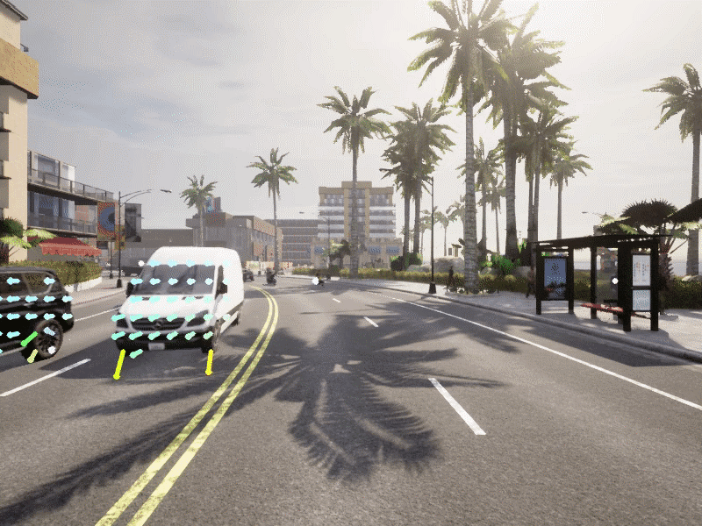
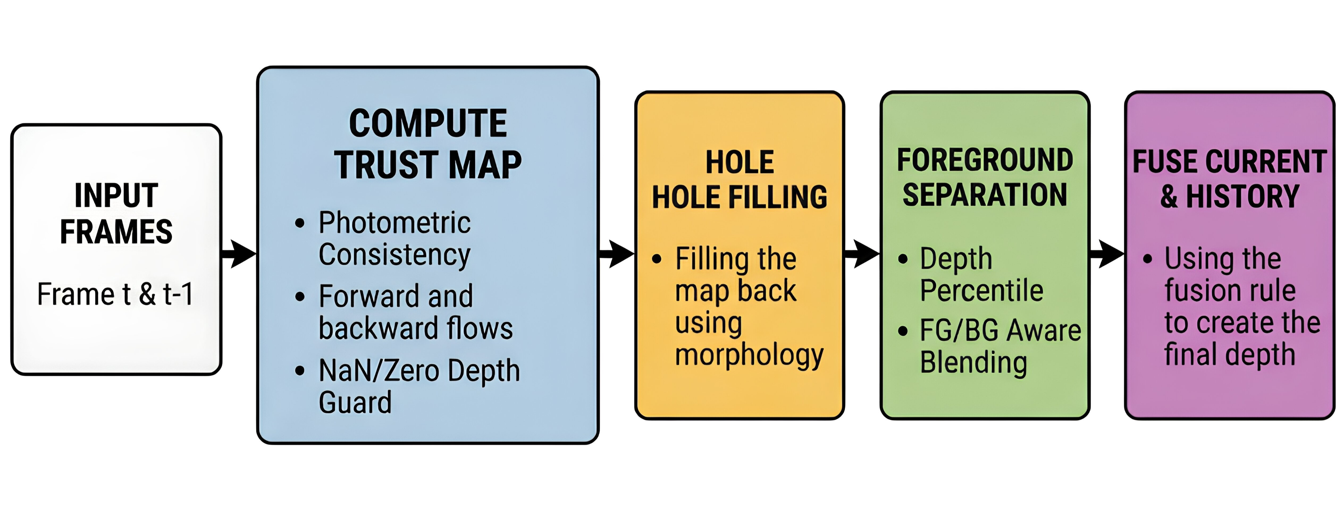
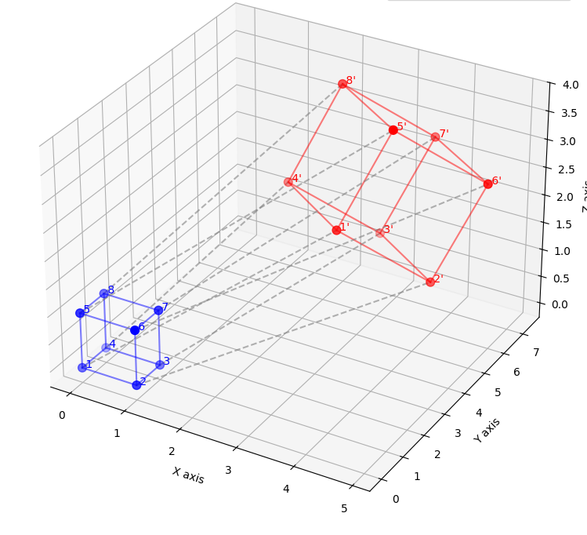
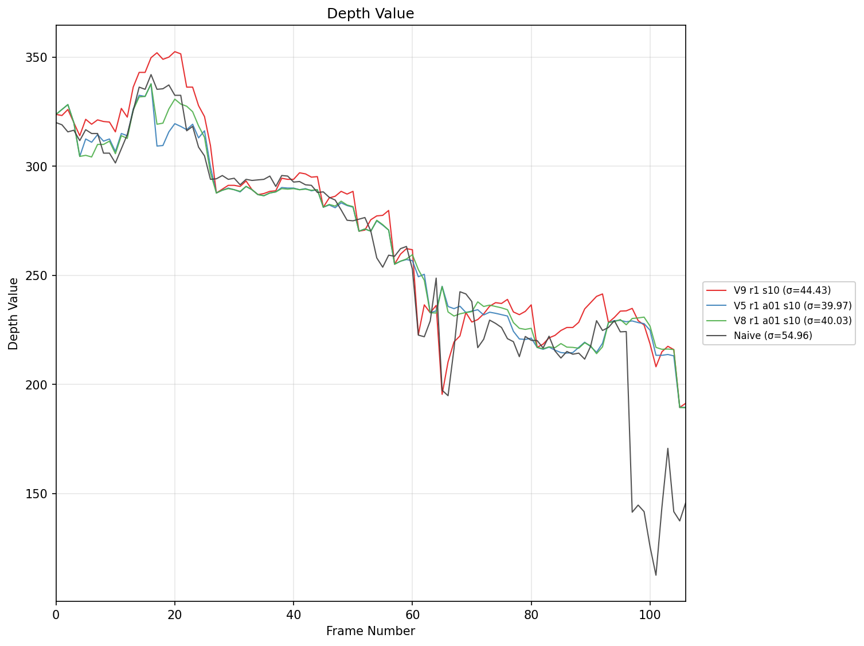
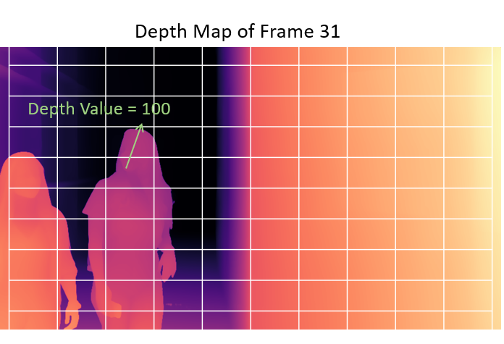
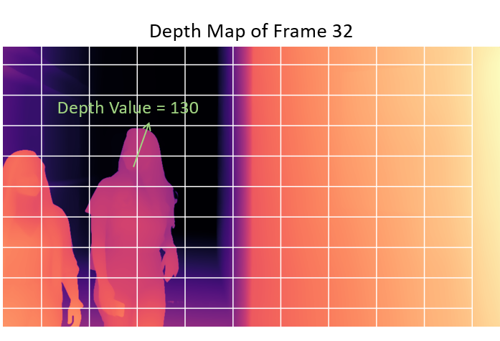
Temporally Consistent Monocular Depth Estimation for Video
Noam Murciano and Yuri Minin, Supervised by Dr. Meir Barzohar
Introduction
The Basic Depth Model
Chosen Solutions
Monocular Depth Estimation (MDE) predicts depth from a single image, eliminating the need for stereo cameras or Structure-from-Motion (SfM).
When applied MDE to video, frame‑independent predictions cause temporal flickering and inconsistent depth.
Depth Anything V2
State-of-the-art monocular depth model.
Architecture: ViT encoder (DINOv2) + DPT decoder, producing high‑quality single‑image depth maps.
Training: Large‑scale distillation using pseudo‑labels on millions of images, combining synthetic accuracy with real‑world diversity.
Compute the optimal scale, rotation, and translation via the Kabsch–Umeyama algorithm.
Apply the resulting transformation to the full 3D point cloud.
2. Temporal Fusion
Warp the previous depth map into the current frame using optical flow.
Construct a multi‑signal reliability mask based on warp validity, photometric consistency, and forward–backward flow agreement.
Apply morphological hole filling followed by adaptive temporal smoothing (stronger for background regions, weaker for dynamic foreground).
Tools
Geometric Alignment pipeline
RAFT (Optical Flow):
A deep optical‑flow model predicting per‑pixel motion between consecutive frames.
Winner of the Best Paper Award at ECCV 2020
Kabsch–Umeyama algorithm:
Suggested in TRAPI 1991 by S. Umeyama
A closed‑form method that finds the similarity transform (scale, rotation, translation) that minimizes the MSE between corresponding 3D points.
Depth Anything V2 depth prediction
Goals
Developing a pipeline that generates temporally stable depth maps from monocular video.
Stabilizing both global scale and local temporal consistency across frames.
Challenges
Flow Vectors
Temporal Fusion pipeline
Results
Monocular depth predictors estimate relative, not absolute, depth → results in scale changes between frames.
Dynamic objects introduce noise and destabilize the alignment across frames.
Temporal instability disrupts downstream visualization and interpretation of depth over time.
Naive depth predictions exhibit strong frame‑to‑frame fluctuations.
Our stabilization pipelines reduce temporal flicker and scale drift across videos.
Fixed‑pixel depth trajectories show smoother curves with reduced high‑frequency noise.
Set of points before and after similarity transform
Depth stability over time
Chosen Solutions
Conclusions
We propose two complementary approaches for stabilizing monocular depth in video:
Geometric Alignment
Convert each depth map into a 3D point cloud using the pinhole camera model.
Estimate per‑pixel motion via RAFT optical flow.
Identify low‑motion background anchors using multiple selection strategies.
Depth Anything V2 provides strong single‑frame depth but lacks temporal stability.
Our geometric alignment and temporal fusion methods both contribute significant temporal stabilization to monocular video depth.
These improvements enable more reliable downstream visualization and analysis.
The project was implemented in Python environment.
Depth maps of consecutive frames
March 2026

