Slide 1
Definitions & Gaze Strategies
Concept: We moved beyond simple "looking time" to analyze every AOI transition and classify each gaze strategy.
Strategy 1 - Man Face <-> Woman Face (Social Verification): Direct gaze shifts between the giver and receiver that verify shared intent.
Strategy 2 - Body <-> Toy (Mechanical Tracking): Tracks the hands/bodies and the moving object without invoking the agents' minds.
Strategy 3 - Face <-> Toy (Object-Face Linking): Links an agent's face and the object yet stops short of connecting both people.
Visual: Diagram shows every bidirectional arrow for the three strategies.
Man Face
Woman Face
Agent Face
Body
Toy

Slide 2
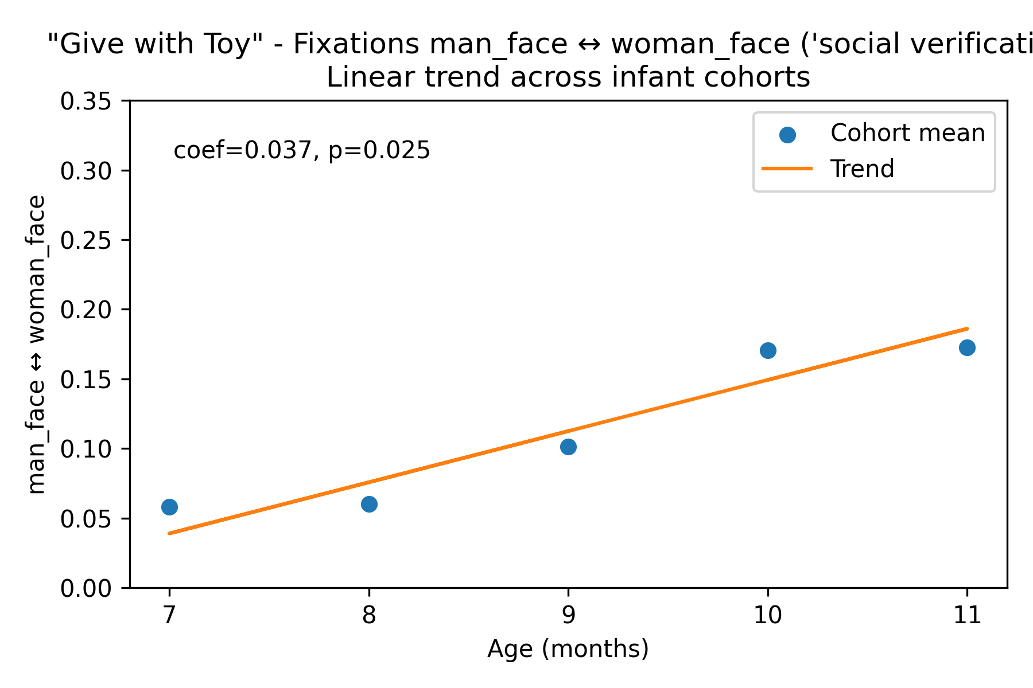
The Rise of Social Verification
Story: Older infants increasingly verify the social connection between actors.
Key Finding: Face <-> Face transitions climb steadily from 7 to 11 months (~4 percentage points per month).
Stats: Linear trend across 7-11 months is significant (p = 0.025).
Adults Comparison: Adults show far higher Social Verification than 7-month-olds (p = 0.006).
Visual: Linear trend scatter with regression line.

Slide 3
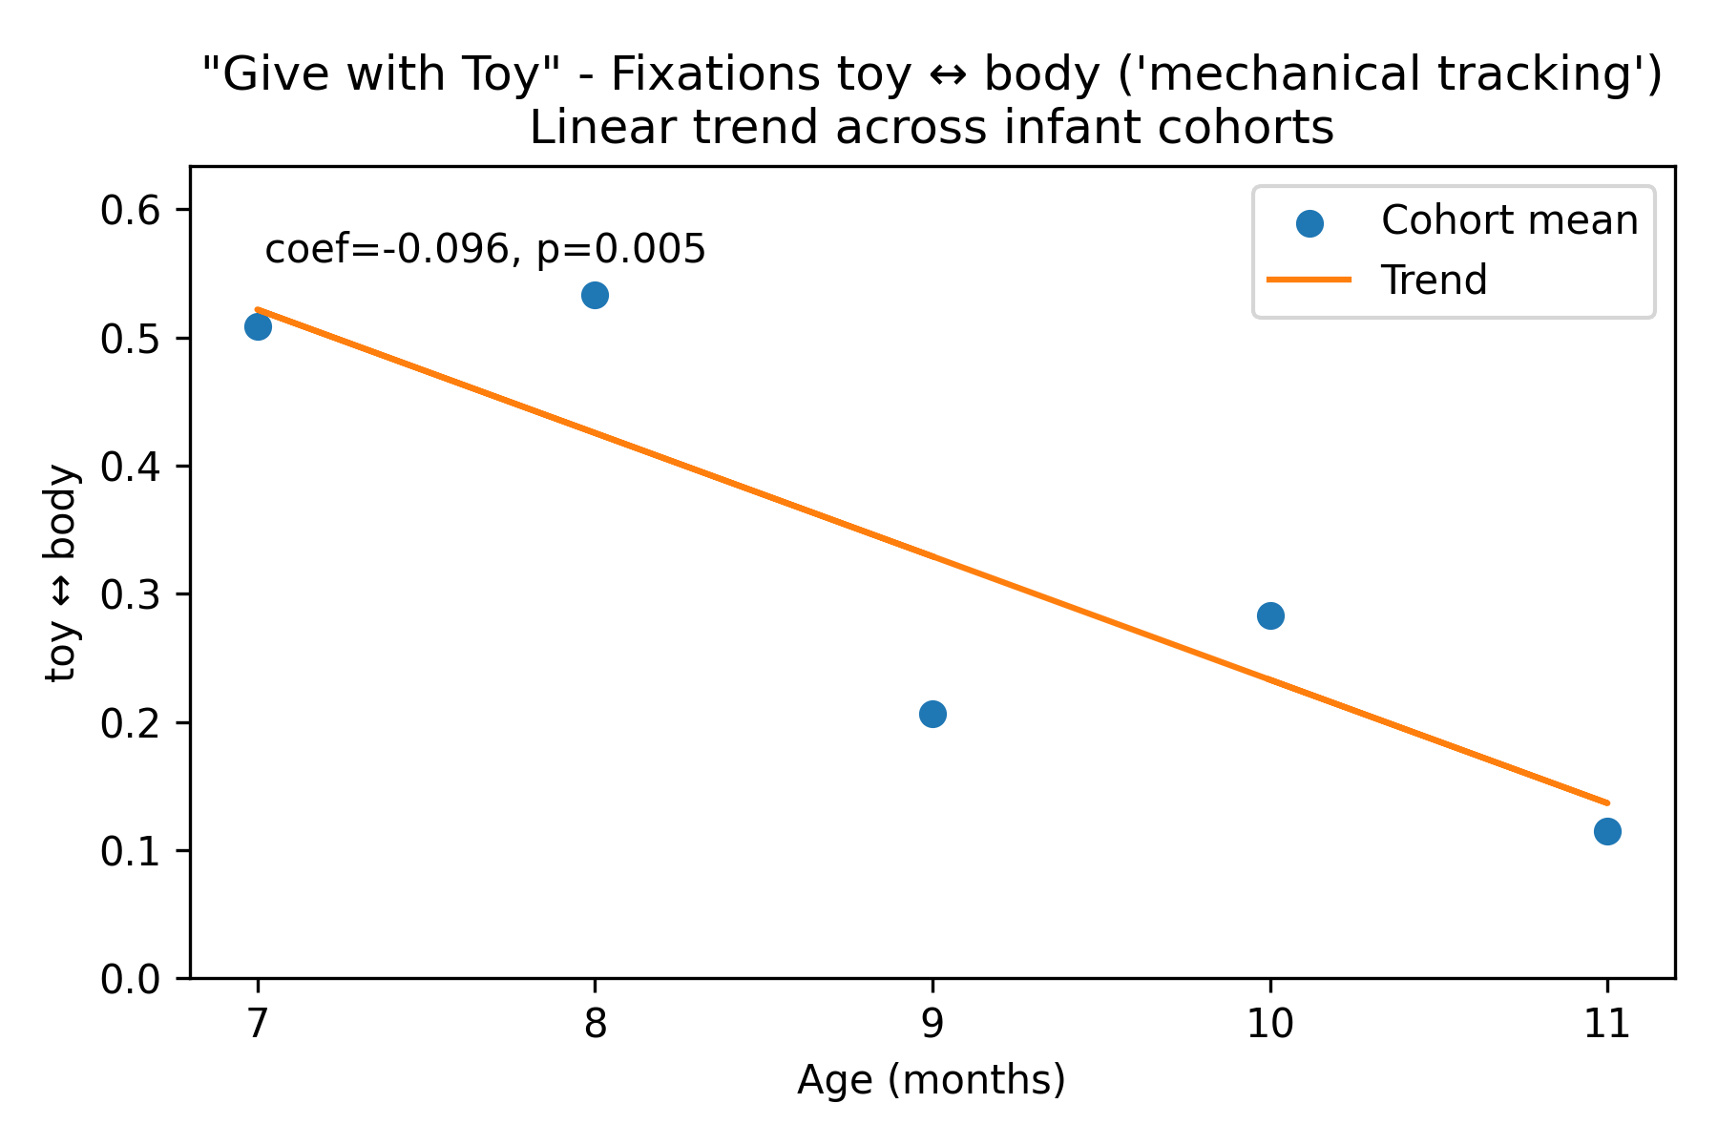
The Decline of Mechanical Tracking
Story: As Social Verification rises, purely mechanical tracking falls.
Key Finding: 7-month-olds devote over half of their transitions to Body <-> Toy tracking before the strategy drops with age.
Stats: Linear trend shows a significant negative slope (p = 0.005).
Baseline: Mechanical Tracking dominates early gaze behavior.
Visual: Linear trend scatter for Mechanical Tracking.

Slide 4
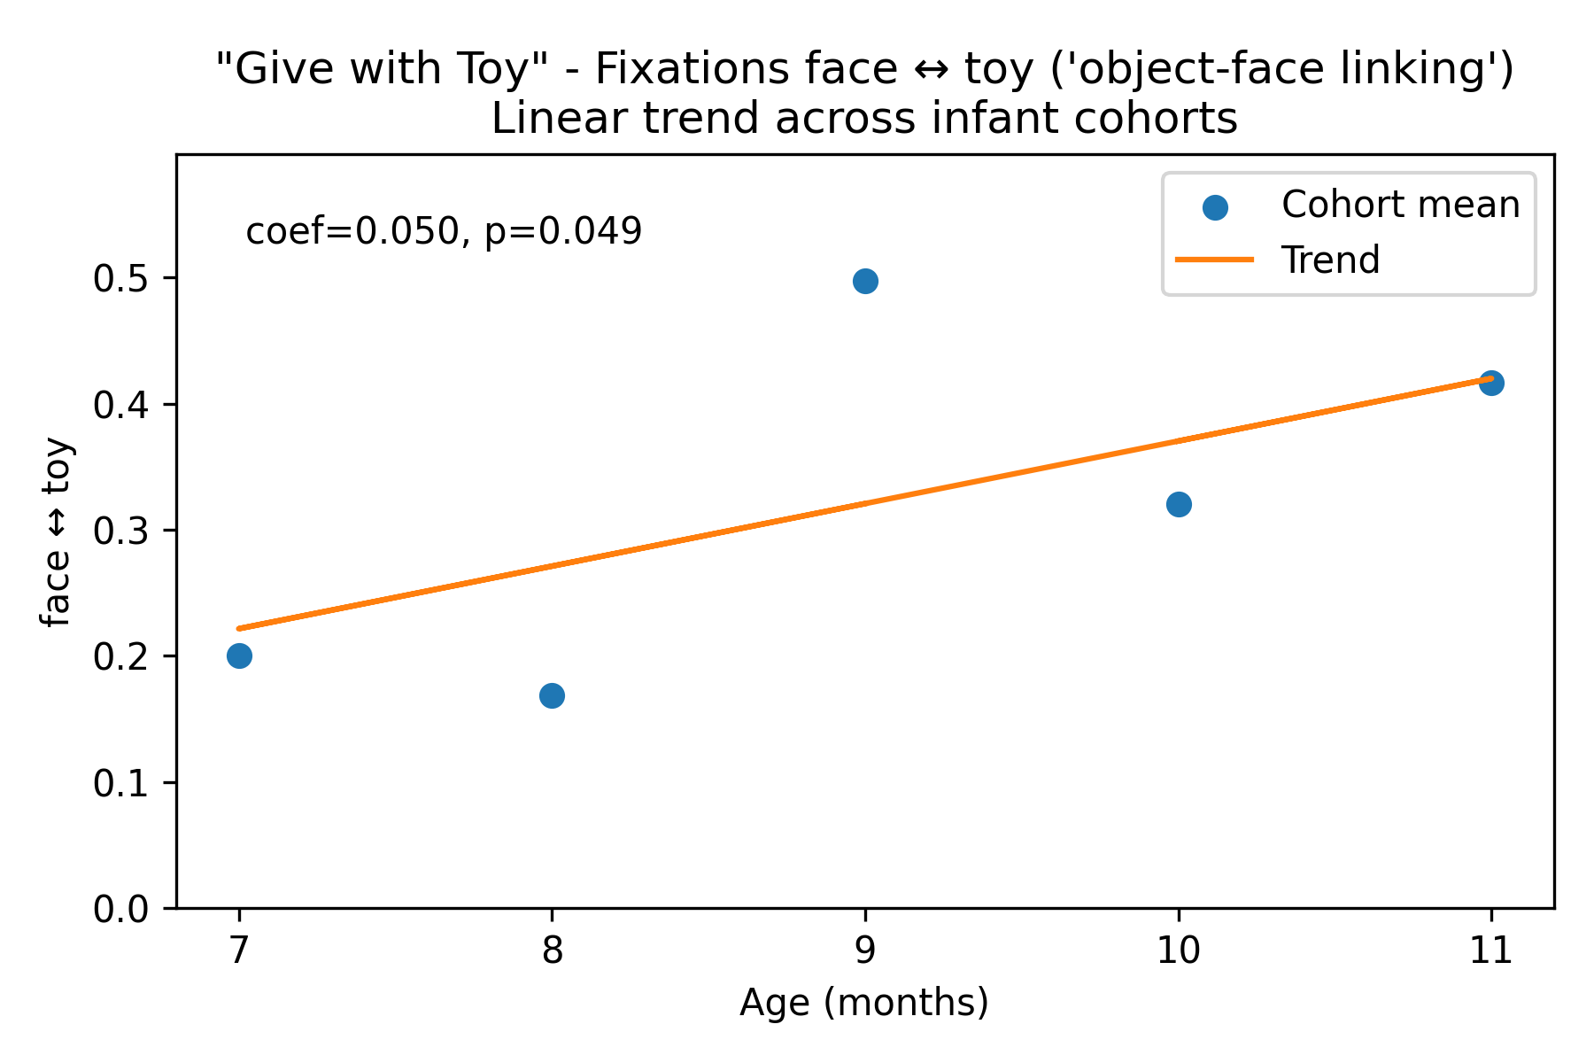
Object-Face Linking
Story: Face <-> Toy transitions peak at 9 months, bridging mechanical tracking and full social verification.
Observation: 9-month-olds allocate roughly half of their transitions to linking the agent and the object but not the recipient.
Stats: Placeholder for the detailed GEE stats describing the 9-month peak and adult contrasts.
Visual: Developmental profile of Object-Face Linking.

Slide 5
Semantic Control (GW vs UGW)
Question: Do 10-month-olds fixate faces because of semantic understanding or simple facial attraction?
Method: Compare the upright Give (GW) to the inverted Give (UGW).
Key Finding: GW maintains high Social Verification (17%) but UGW collapses to 0.8%.
Conclusion: Strategy is driven by semantics; the gaze pattern disappears when meaning breaks.
Visual: Paired bar chart (GW vs UGW) for Social Verification.

Slide 6
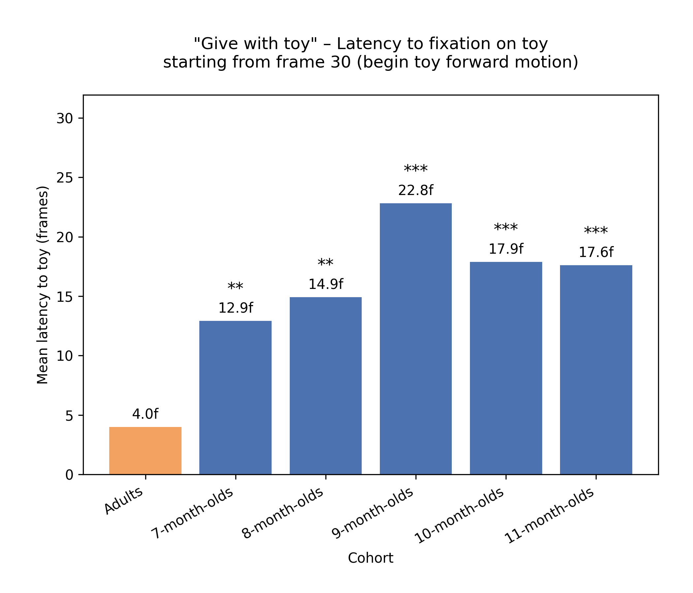
The Anticipation Gap (Latency to Toy)
Concept: Theory of Mind should enable predictive saccades toward the toy before the transfer completes.
Finding: Adults anticipate instantly (4.0 frames) while infants remain reactive at 13-22 frames.
Stats: Every infant cohort is significantly slower than adults (p < 0.01).
Conclusion: Eleven-month-olds understand structure (faces) but still process rather than predict.
Visual: Mean latency bar chart with significance markers.

Slide 7
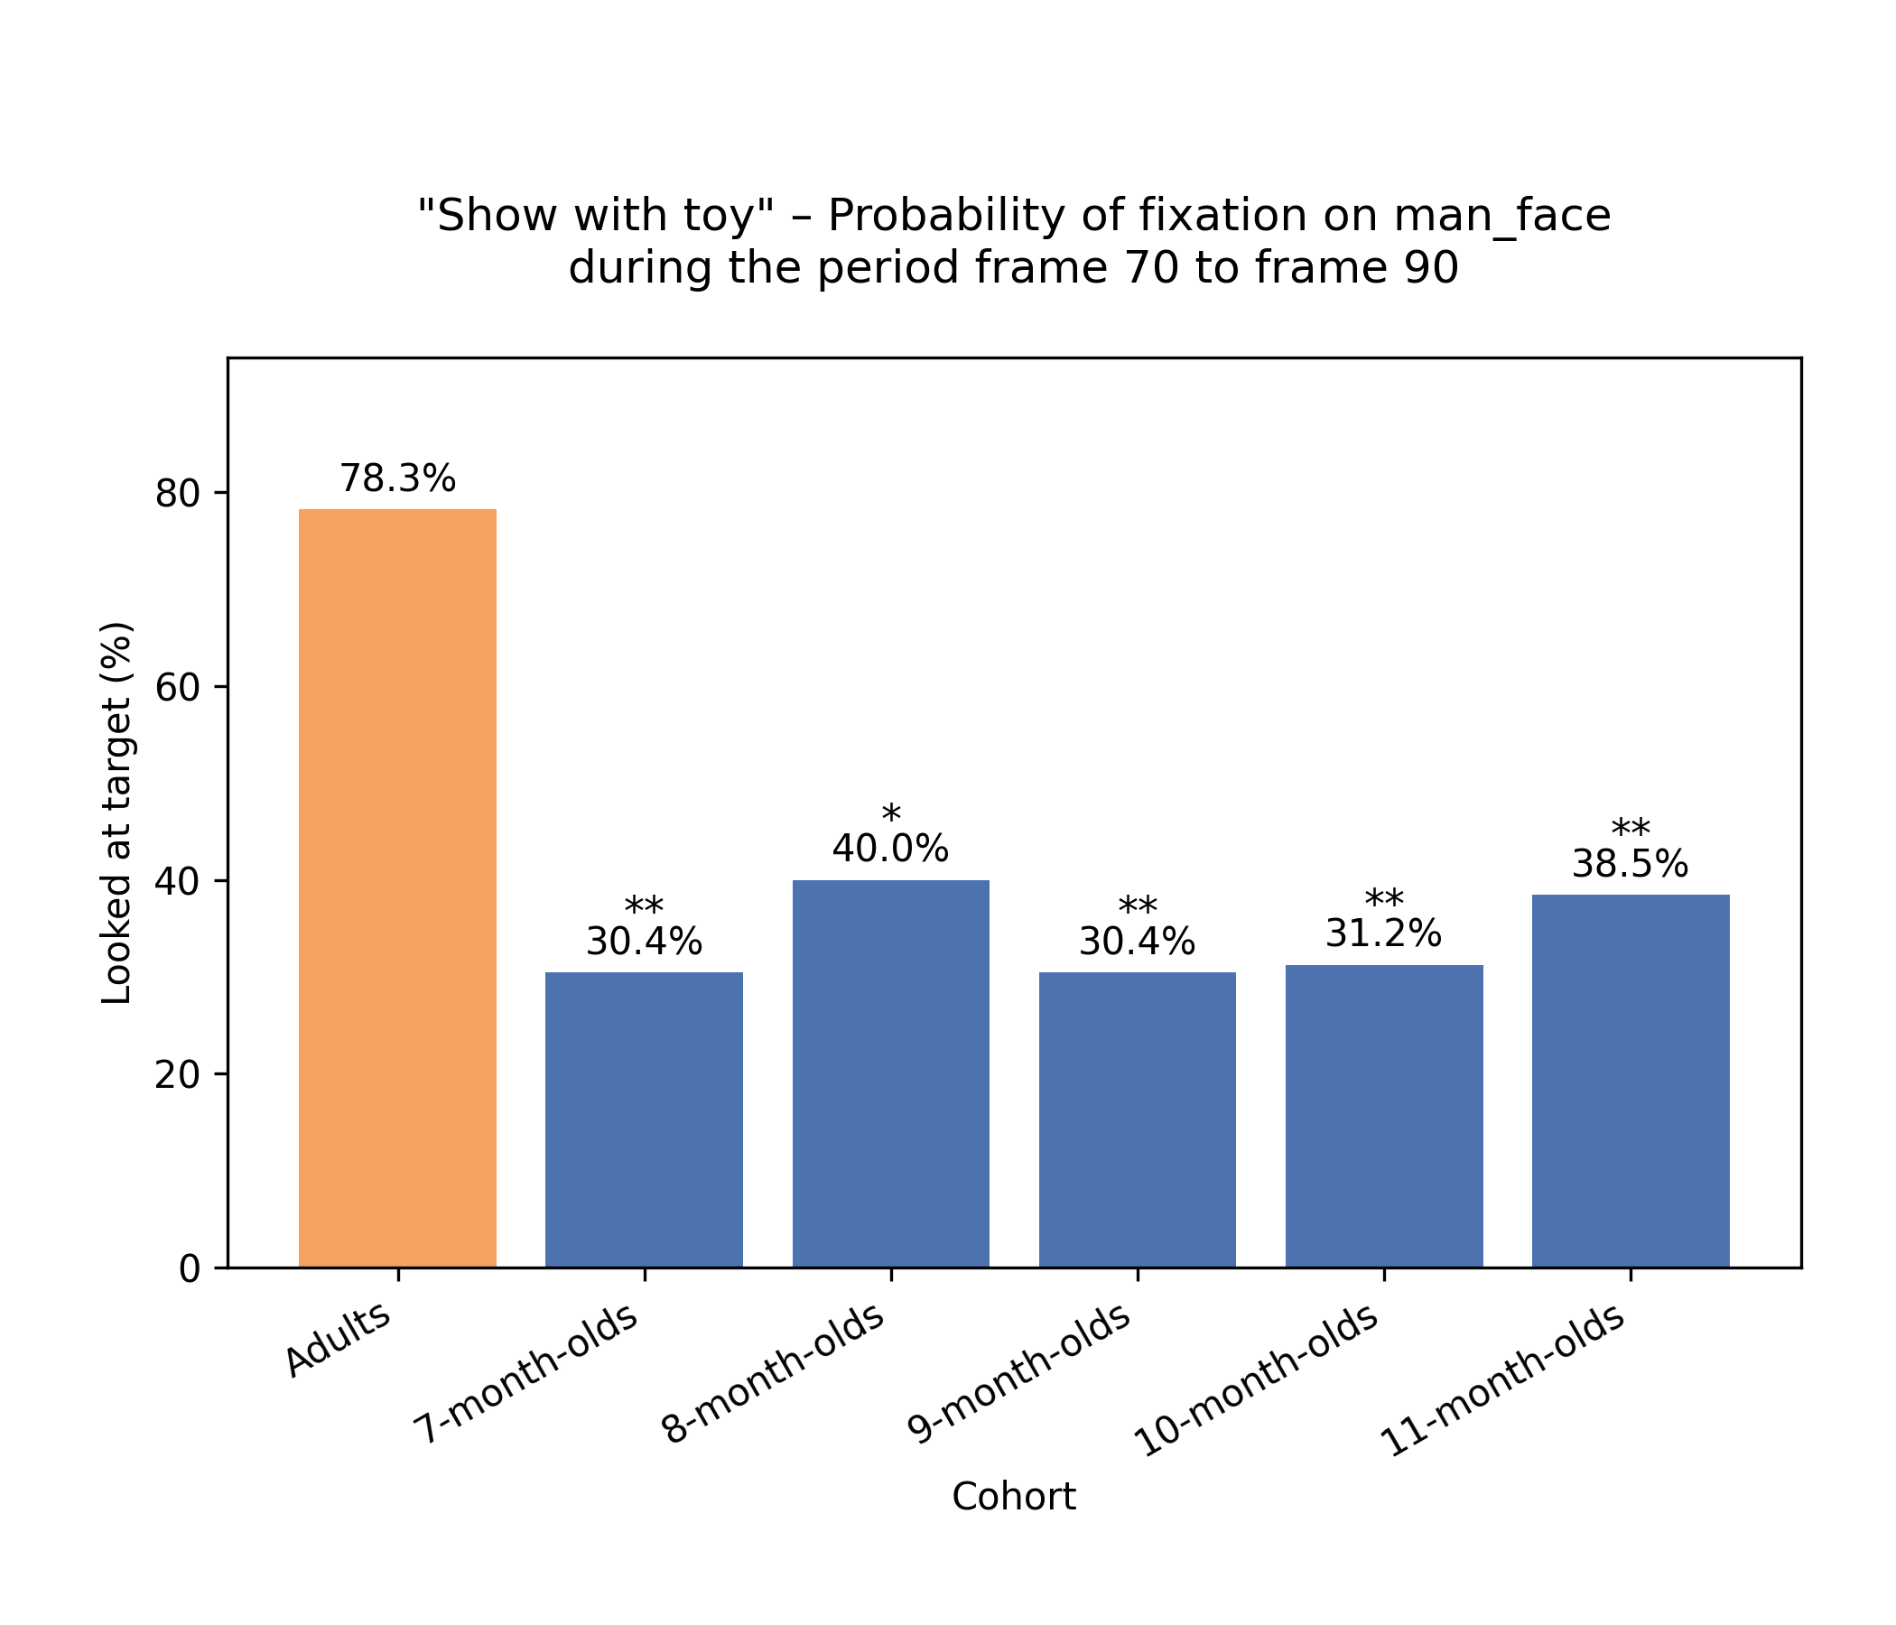
The Reaction Check (Show Condition)
Concept: In the Show event, success requires monitoring the observer's (Man's) reaction.
Finding: Adults check the Man's face 52% of the time; 7-month-olds never check and 11-month-olds reach only 9%.
Stats: All infant cohorts are significantly lower than adults (p < 0.001).
Conclusion: Pre-linguistic event representation is partial: agent and object are encoded, but the social goal is missed.
Visual: Reaction-window bar chart for looking at the Man.

Slide 8
The Story in Summary
7-8 Months: Mechanical trackers driven by motion (Body <-> Toy) with reflexively fast reactions.
9 Months: Object linkers obsessed with Agent-Object connections and slower processing times.
10-11 Months: Social verifiers who capture the giver, recipient, and object but still process slowly and miss reactions.
Adults: Experts who are fast, predictive, and fully socially integrated.
Takeaway: Event structure understanding emerges in stages; efficiency and social goals lag behind structural mastery.

