Slide 1
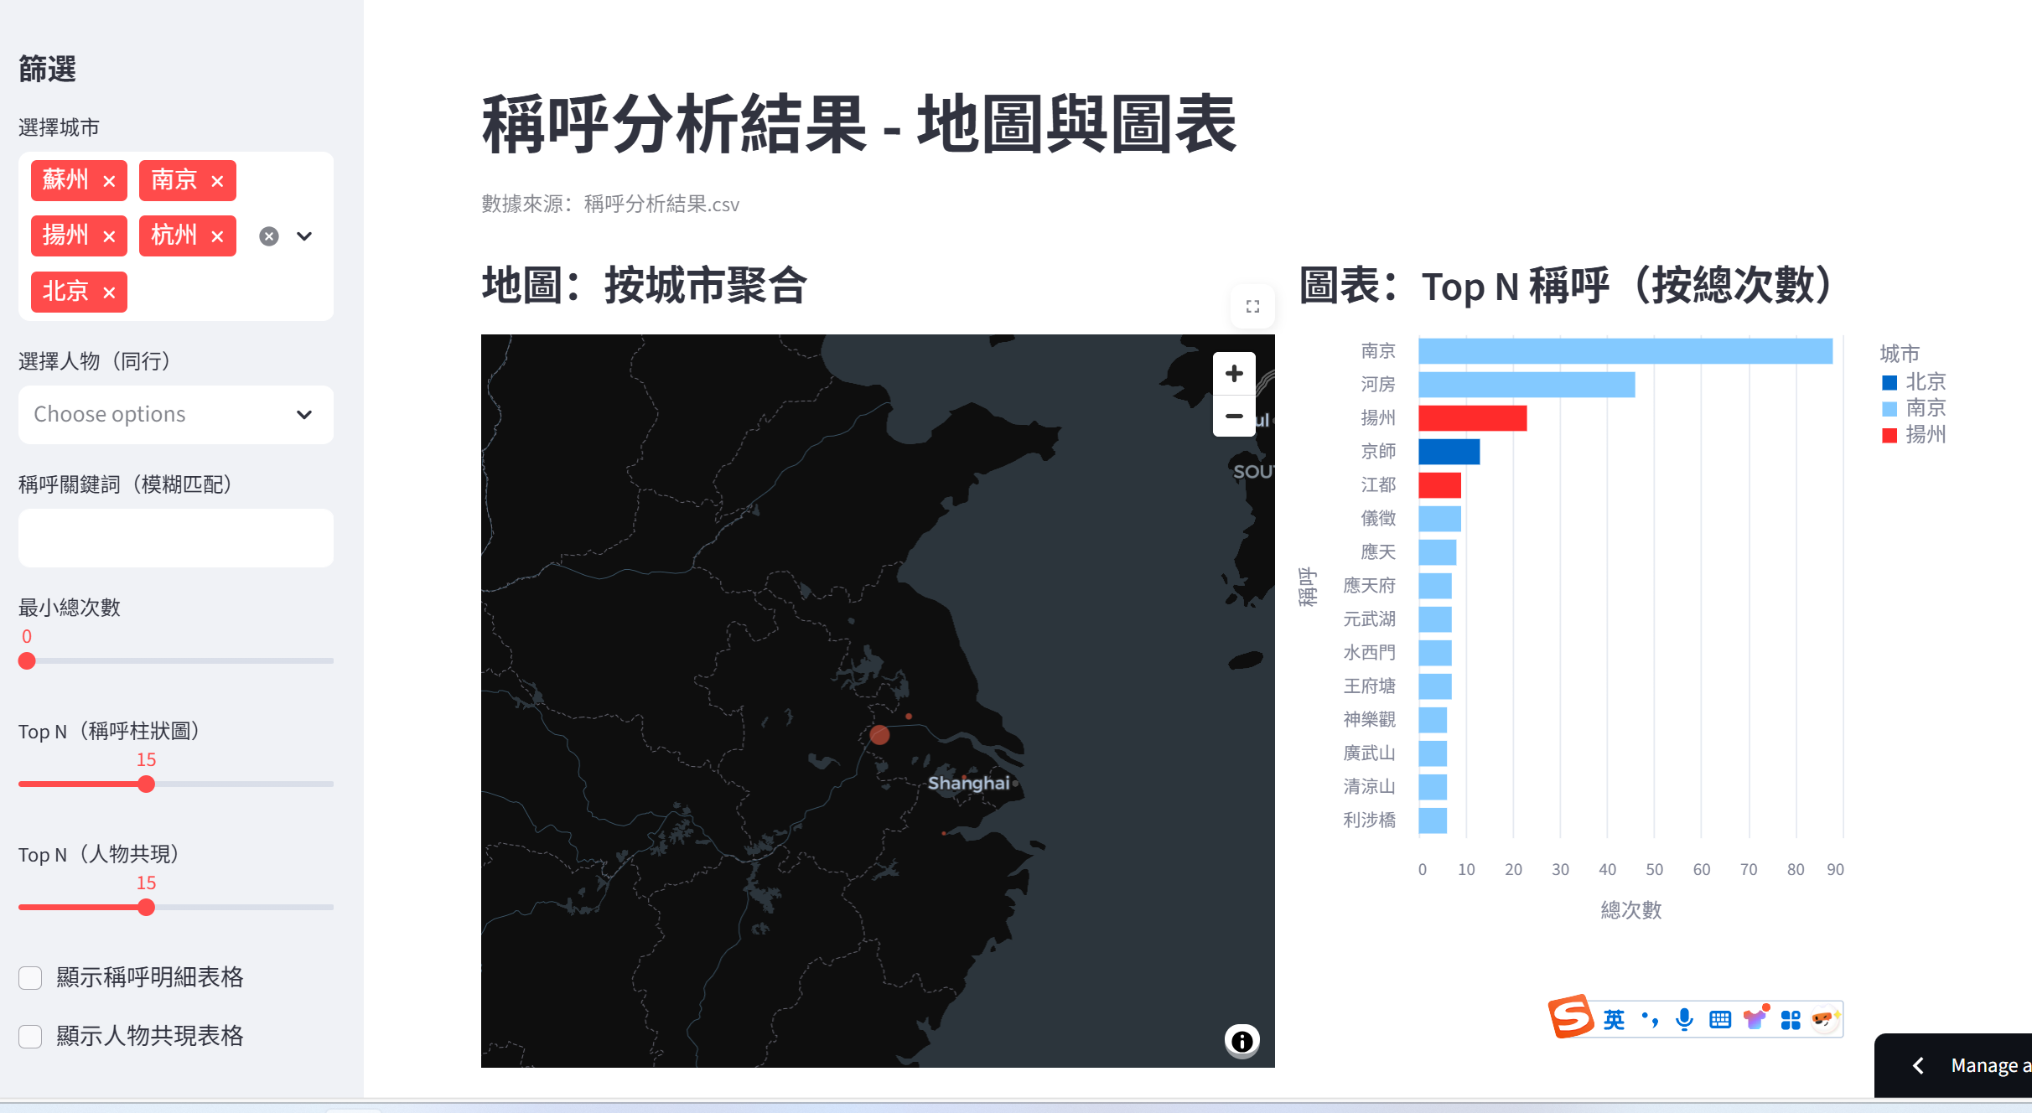
Introduction
稱呼分析結果 - 地圖與圖表 · Streamlit
yurihuruitao/A2

Slide 2
Introduction
How are the five cities referred to in The Scholars? And what is the frequency count for these terms?"
How do changes in address term frequency across chapters relate to changes in the people appearing with them?
Cities:南京、蘇州、杭州、北京、揚州
Chapters:30-50 from Ctexts
Download from the computer in Polyu and split according to the chapters.

Slide 3
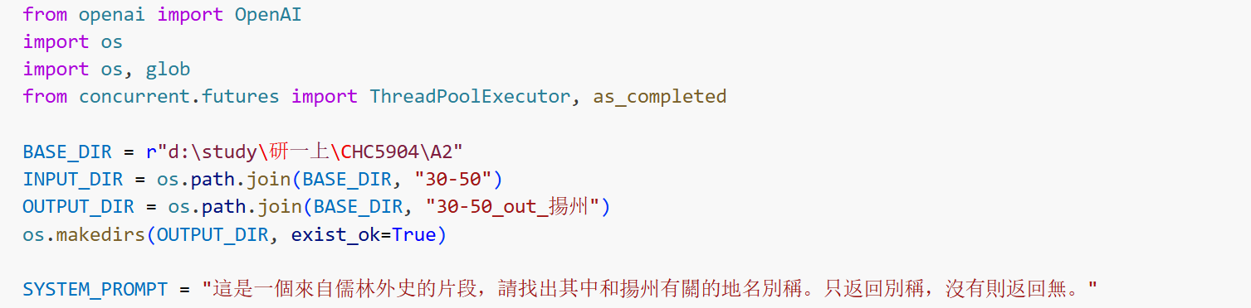
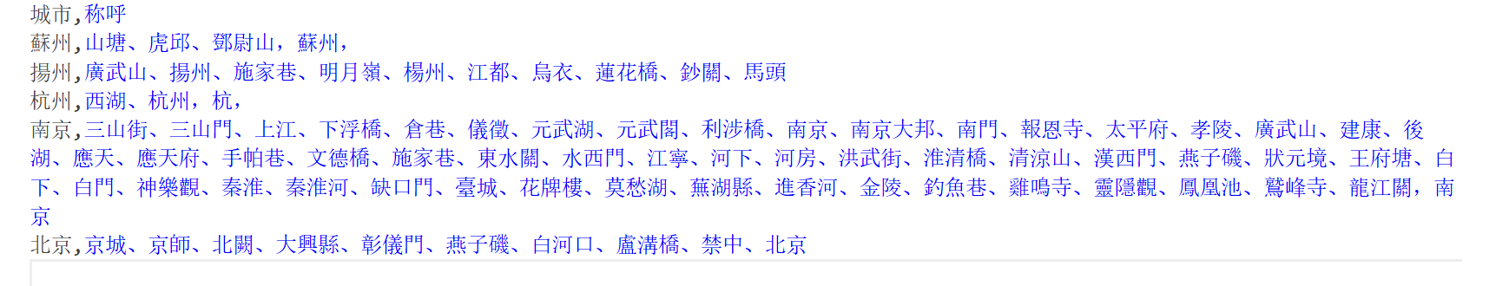
Methodology
1. Identify the terms
Qwen-max is used to close reading of The Scholars for extracting the terms related to the cities.
Qwen-max cannot identify those terms very accurately, so I double-check the results.

Slide 4
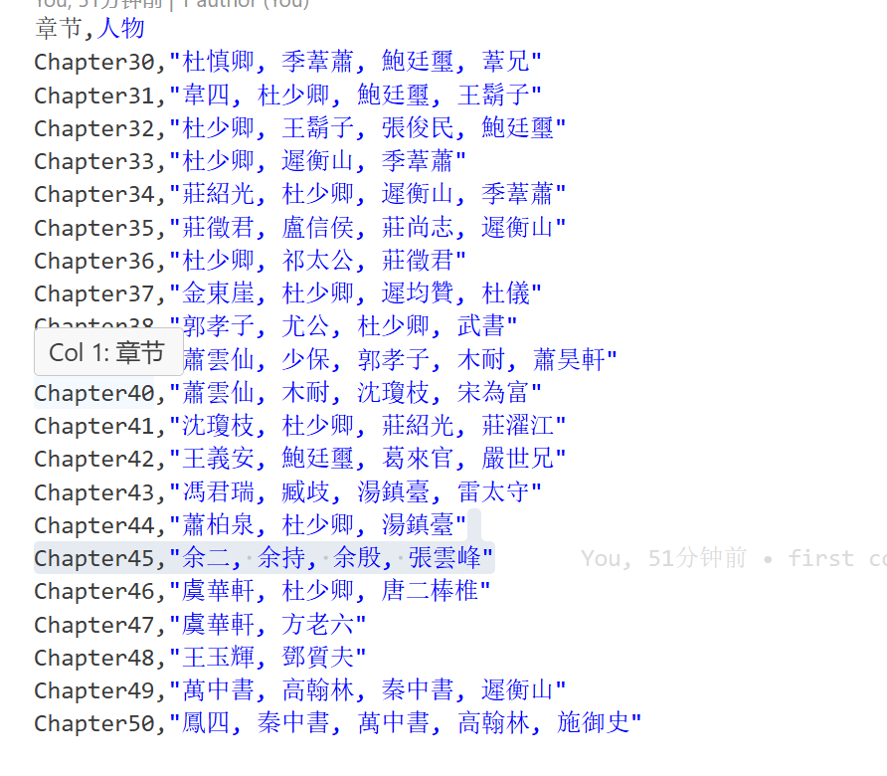
Methodology
2. Extract the names of people
Hanlp tokenizer is used to segment the texts into words.
Hanlp NER is used to extract the names of people.

Slide 5
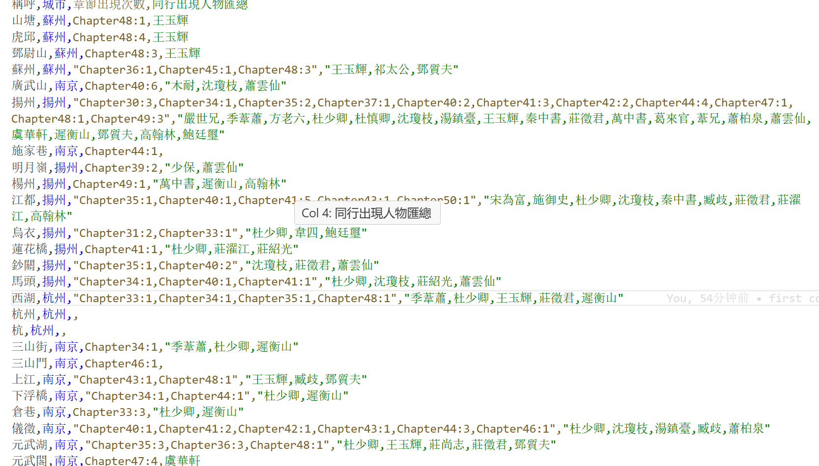
Methodology
3. Find the correlation between cities’ terms, chapters and people
Just search the terms in the unsegmented texts. Find people appear in the same paragraph. Get the frequency tables.

Slide 6
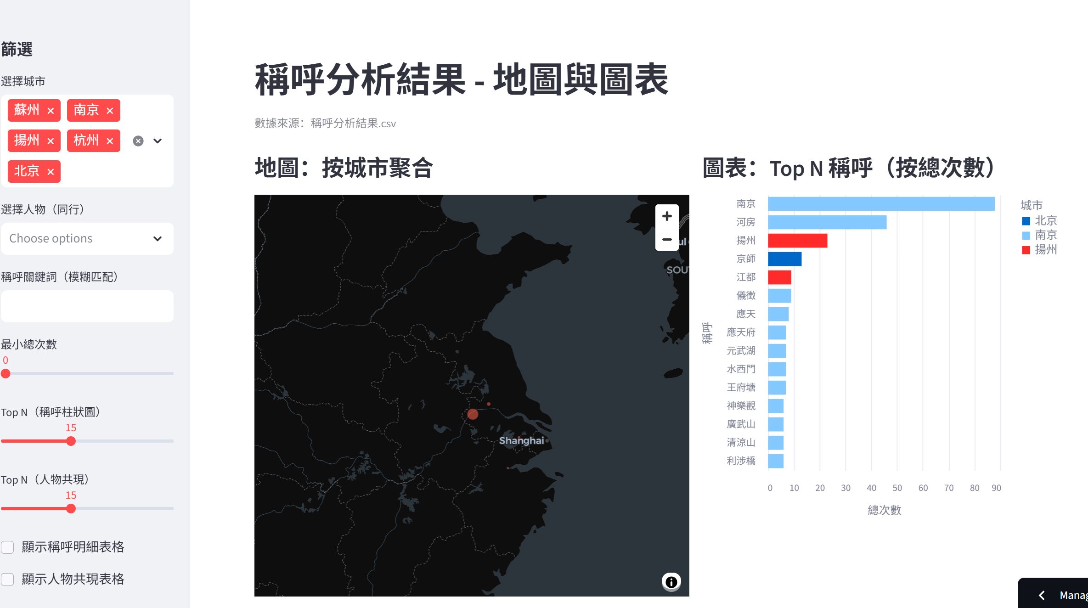
Methodolgy
4. Demonstrate the result
Using Streamlit

Slide 7
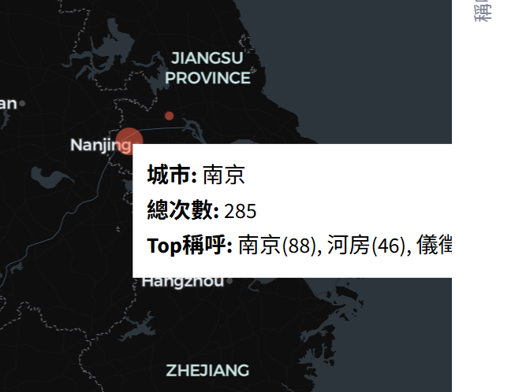
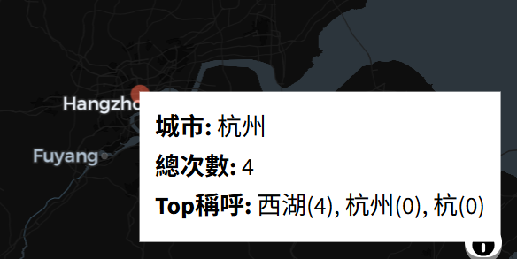
Results
Nanjing is the most popular city in The Scholars. It appears 285 times in chapter30-50. It has the most related terms.
In the five cities, Hangzhou is the most unpopular. Only 4 times and it is referred using 西湖。

Slide 8
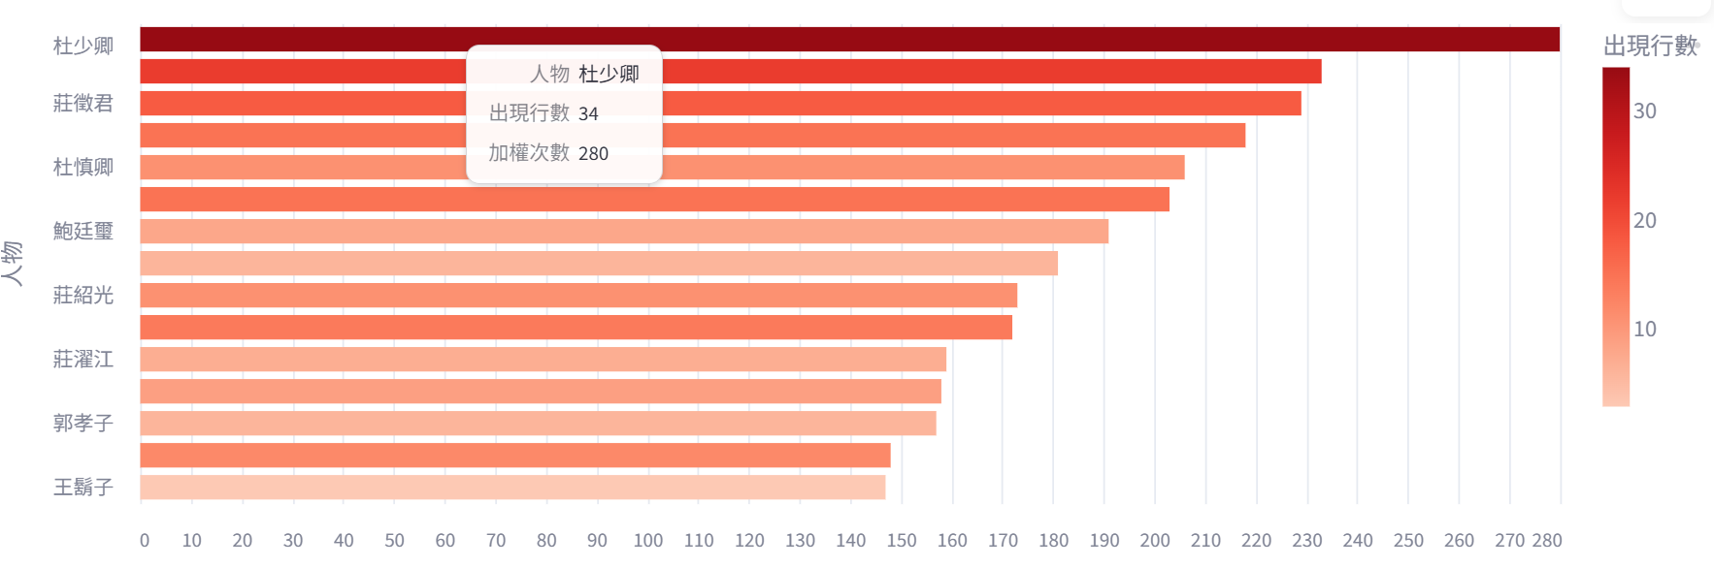
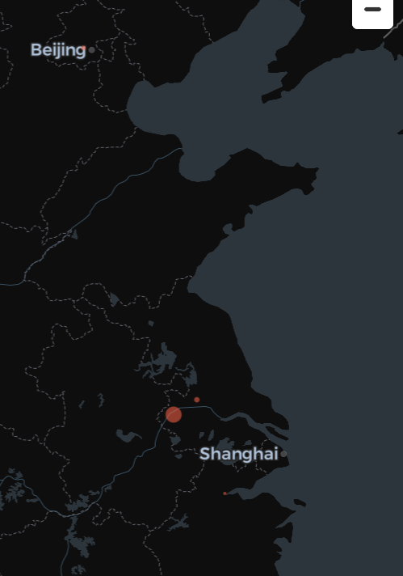
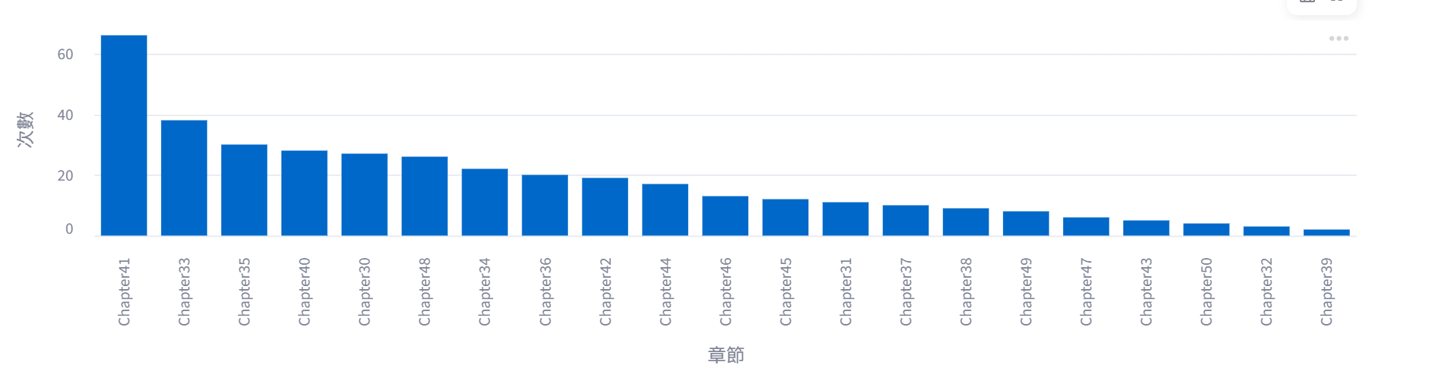
Results
杜少卿 relates most to the five cities. He often comes with the southern cities.
Chapter 41 has the most related terms

Slide 9
Reflection
南京 often referred as 南京
北京 often referred as 京师
扬州 as 扬州
杭州 as 西湖
Frequency count is in the Streamlit and CSV

Slide 10
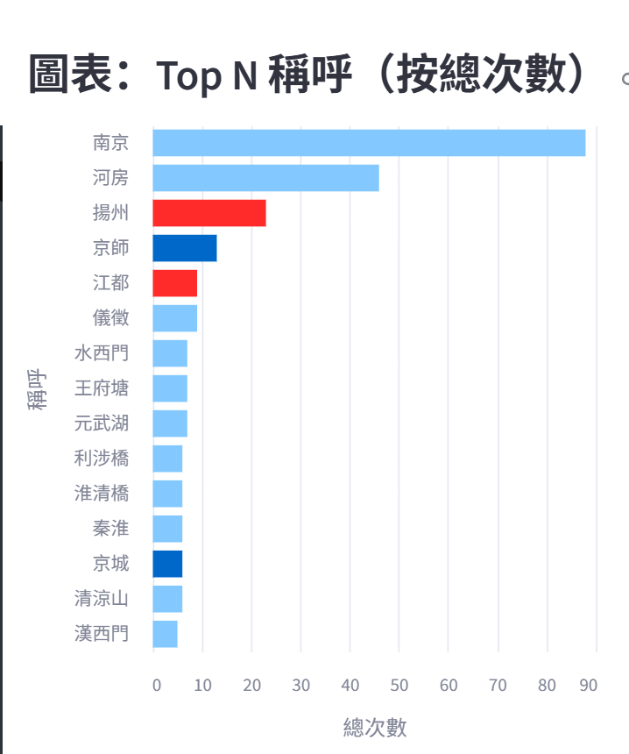
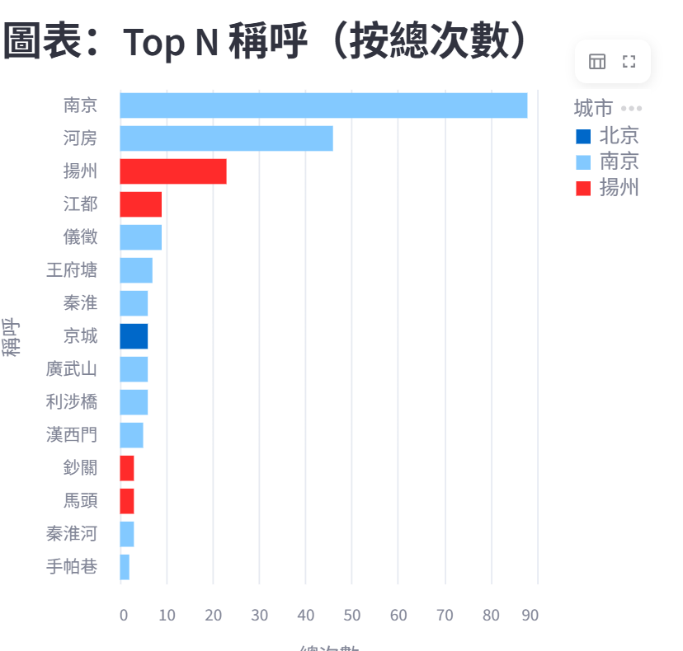
Reflection
Terms used by 杜少卿
Terms used by沈瓊枝

Slide 11
Reference
He, H., & Choi, J. D. (2021). The Stem Cell Hypothesis: Dilemma behind Multi-Task Learning with Transformer Encoders. Proceedings of the 2021 Conference on Empirical Methods in Natural Language Processing, 5555–5577. https://aclanthology.org/2021.emnlp-main.451
吴敬梓. (n.d.). 儒林外史. Chinese Text Project. Retrieved October 16, 2025, from https://ctext.org/xiyouji/zhs

