Slide 1
Adding your title
Developing Intercultural Communication in a Transnational education (TNE) setting: What do students struggle with and can EAP help?
Matthew Ketteringham & Joanne Shiel
Notes:
Who: Matthew
EAP Lecturer LC and teach insessional on Levels 1 & 2 at the joint school
Joanne Shiel – Introduce herself
Other people involved:
EEE Faculty: Alexander Valavanis @Leeds and Shengxian Zhuang @SWJTU
Andrew Hollins for Engineering Student Education Service @ Leeds and Yixin Shen@SWJTU
Student intern: Lakshita Pursani

Slide 2
Overview
Context
Research Aims
IC in a TNE Context
Methodology
Implications for Future IC Initiatives & EAP Support
Notes:
Who: Matthew

Slide 3
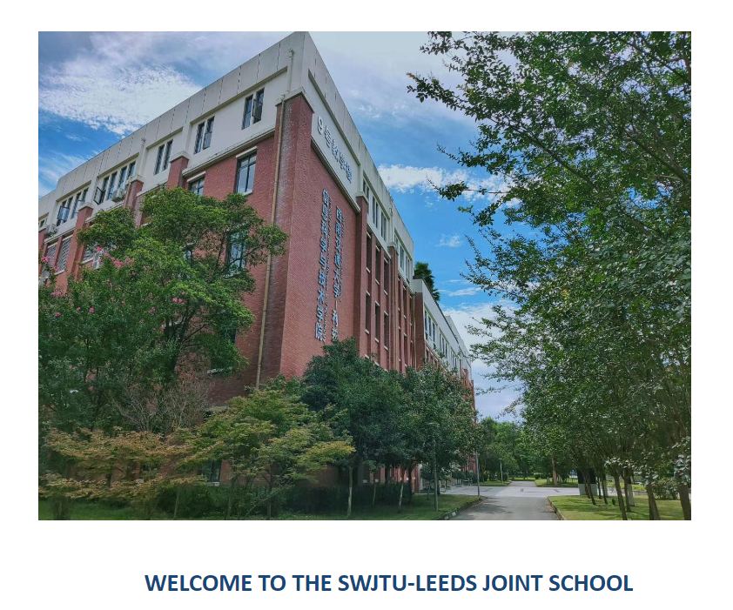

Context: SWJTU
Notes:
Who: Joanne
SWJTU-Leeds Joint School: 4 Engineering degree programmes
Role of EAP Lecturers:
Year 1 – Key 60 credit foundation year module
Year 2 & 3 – Supernumerary insessional modules
Year 4 – Final year project module

Slide 4
Context: EEE Module
Level 2 UG – Electronic & Electrical Engineering Module:
Transistors and Optoelectronics
Engineering is truly a global discipline, and in your future careers, you will need to work confidently with colleagues and collaborators all across the world. In this semester, therefore, each of the Chengdu study groups will be partnered with study groups in Leeds. You will then work together, internationally, on your research seminar task:
Global Solutions to Photovoltaic Power
Notes:
Who: Joanne
Students had to work together in mixed cohort groups to produce a video presentation on the topic of photovoltaic power. The seminar was assessed on presentation skills, technical content and how well the students worked internationally in their groups.

Slide 5
Research Aims
Identify students’ difficulties working across complex cultural and national boundaries in a Collaborative Online International Learning (COIL) assessed seminar task.
To inform teaching and learning on the EEE module and highlight areas for English for Specific Academic Purposes (ESAP) support to improve students’ soft skills particularly intercultural communication.
Notes:
Who: Joanne

Slide 6
IC in a TNE Context: Rationale
Engineering & TNE
An increased demand from engineering companies and accreditation bodies for graduates to be able to communicate in a more globalised interconnected labour market (Rico-Garcia & Burns, 2020; Handforth, et al., 2017; Yu, 2011; UK Royal Academy of Engineering, 2007; U.S. National Academy of Engineering, 2004).
Ministry of Education (2011) encourages Chinese higher education English language instruction in order to increase learners’ crosscultural communicative skills and international competitiveness (cited in Hu & Lei, 2014).
Notes:
Who: Joanne

Slide 7
IC in a TNE Context: Rationale
Collaborative Review – Recommendations:
Student intercultural opportunities should be explored and enhanced where possible
The Joint School is a vehicle for transnational engagement. But currently under-utilised with regard to the opportunities for intercultural communication.
Ensure support by the LC is relevant to student needs.
Notes:
Who: Joanne

Slide 8
IC in a TNE Context: Soft Skills
Engineering education has traditionally focussed on ‘hard skills’ engineering knowledge, but demand for ‘soft skills’ is increasing (Gilleard & Gilleard, 2002).
‘Soft Skills’: effective communication, teamwork, and problem solving (Deep et al., 2020).
Intercultural communication (IC) can be defined as ‘communicating across different cultures’ (Rico-Garcia & Burns, 2020, p. 834).
Notes:
Who: Matthew
Engineers are typically stereotyped as poor communicators
Soft Skills is a broad term but encompasses effective communication, teamwork and problem solving
One such facet of the generic term effective communication is intercultural communication (IC) which can be defined as ‘communicating across different cultures’

Slide 9
IC in a TNE Context: Culture
Hofstede (2007, p.16) defines culture ‘as the collective programming of the mind that distinguishes one group or category of people from another’.
In this study, culture was framed as a given, in this instance, students in the UK and China.
Criticisms for being essentialist in nature and taking a ‘reductionist’ approach (Holliday, 1993, 2013; Handforth, et al. 2017).
Notes:
Who: Matthew
In this study, culture was framed as a given, which describes cultures as predefined groups, in this instance, students in the UK and China.
Although this approach has its criticisms for being essentialist in nature and taking a ‘reductionist’ approach which ignores the multiple identities which cultures typically have, it was the most practical approach for this context

Slide 10
IC in a TNE Context: COIL
Study/work abroad programmes and language courses have been offered to engineering students to help develop their IC (Yu, 2011).
Collaborative Online International Learning (COIL) has been used as an experiential learning pedagogy to aid IC.
COIL is a new teaching and learning approach that ‘promotes the development of intercultural competence across shared multicultural learning environments’ (Rubin, 2015, p.4).
Notes:
Who: Matthew
Traditionally, study/work abroad programmes and language courses have been offered to engineering students to help develop their IC (Yu, 2011).
Collaborative Online International Learning (COIL) has been used as an experiential learning pedagogy to aid IC. Essentially a ‘study abroad at home’ opportunity that is also inclusive as no additional costs travel or school fees are required.

Slide 11
Methodology
Case Study. Mixed Methods: Questionnaire, observation of seminars & communication via Teams, Focus groups
IC difficulties were identified from previous studies of IC/COIL: Language, Communication, Teamwork, Technology, and Engineering Content
A student intern observed the seminars and ran the focus groups
Notes:
Who: Matthew
Questionaire:
Student numbers:
Leeds: 83
Chengdu: 73
Total: 156
Total number of seminar groups: 12 (13 students)
Observation of seminars: Naturalist approach with the observation of 3 x 1 hour seminar over the course of about 1 month and the intern dropped in to the live seminars and took a narrative of 3 groups in each seminar. We also observed team communication via Teams
Focus
1 with the Leeds cohort with 5 student and 1 with the SWJTU cohort with 5 students
Student Intern – Final Year Business Student - Although not a participant she had similar shared experiences as the student and we hoped that it would perhaps put the students at ease
Villar-Onrubia and Rajpal (2015) – COIL project at Coventry - Civil Engineering students at Coventry University and South China University of Technology
Gonzales, et al., (2008) analysed IC student difficulties in Mechanical Engineering design teams between students from Tecnológico de Monterrey (ITESM) in México, Virginia Tech & Howard University in USA, Darmstadt University in Germany, and Shanghai Jiao Tong University in China

Slide 12
Implications for Future IC Initiatives & EAP Support
Experience of IC: 71 % (93% of SWJTU)
Technology:
Cameras/Mics off
WhatsApp, WeChat & QQ
Engineering Content:
‘All the students have studied and learnt the same things’ (Focus Group 1)
‘Small’ culture (Holliday, 1999)
Constructivist view implies:
‘more in common between two engineers from different countries than between an engineer and someone in a very different profession from the same country’ (Maemura, 2017)
Notes:
Have you had experience of communicating with other engineering students from different cultural and national backgrounds on engineering topics?
Clearly highlights a need for further IC initiatives particularly at SWJTU where students have signed up for this intercultural experience. (Home – 15/21 – International 7/26 – SWJTU – 49/53
Technology: Timezones - Noise / Interference - large rooms – smaller rooms / private
Supposed to use Teams but student tended to work on Whats App (UK) / WeChat & QQ (SWJTU) – Not common and banned WA banned in China
It was interesting that from observation of the seminars, analysis of the chat and the focus groups, it seemed that there was very little discussion about engineering content within the groups.
This takes an emergent or constructivist view of culture rather than we we stated at the beginning with culture as a given – in this instance national culture
The - Constructivist view implies there may be more in common between two engineers from different countries than between an engineer and someone in a very different profession from the same country, depending on the topic and context of the communication,”
One way we can improve the seminars for next year is to teach students about cultural differences within their own countries, and similarities between different countries to try to better understand from where their own worldviews originate.
The - Constructivist view implies there may be more in common between two engineers from different countries than between an engineer and someone in a very different profession from the same country, depending on the topic and context of the communication,”

Slide 13
Implications: Language
Linguistic Issues: (Focus Group 2):
‘Speaking too fast’
‘Lot of short forms for words, whereas we used full forms – took a getting used to’.
‘It was difficult to understand Leeds students who had a strong accent we weren’t familiar’.
Idiomatic phrases
Coping Strategies:
Translation, Chat function & Clarification
Responsibility for Communication:
Raising awareness for both cohorts
Notes:
Who: Joanne

Slide 14
Implications: Communication
Both cohorts identified problems with communication which they perceived as originating in cultural differences.
An interesting comment from a Chinese Leeds-based student was that he did not notice any issues: ‘as he understands the way Chengdu students react and speak in English. He says that the issue is that they don’t react in a British way.’ (Focus Group 1)
One problem which a Leeds student highlighted was the Chengdu students not saying they did not understand ‘No one, ever said that they didn’t understand, however later it was seen that what was said wasn’t understood’. (Focus Group 1)
Kept asking Qs Quote – article

Slide 15
Implications: Teamwork
Uneven distribution of work:
One student doing all the work.
Some Leeds students also felt annoyed that the Chengdu students kept changing their work
Critical incidence: UK based Chinese student & SWJTU Student
Inter-cohort teamwork could be as much of a problem as intercultural teamwork (academic/institutional culture)
Working in Teams
- Research first – Task Division (Leeds)
- Task Division – Research (SWJTU)
Notes:
Both sets of students felt that the others had different ways of working. The Leeds cohort seemed to do the research first and then decide which topic each team member was going to focus on. The Chengdu students preferred to divide up the tasks first and then do the research.

Slide 16
Student Comments/Feedback
Two comments within groups from the different cohorts:
I am so happy to see that we can work together to finish this entire large work. Although we are lack of people, I do think we made this challenge, and finally produced a good work. (SWJTU)
I thought it was a great experience as well. I hope to work with this international seminar group again. (Leeds)
Notes:
Generally, it seemed they had found the experience a positive one, as evidenced by the focus groups, module evaluation feedback and their parting comments in the group chat. For example

Slide 17
Conclusion
Lack of IC opportunities
‘Small’ cultures approach
Language & Communication
Teamwork
Possible joint marking with EEE Module Lead
Increase COIL initiatives to develop IC across Engineering Faculty
Notes:
‘Small cultures approach’ for all students highlighting similarities and differences across the cohort before the seminar groups. This can help to reduce stereotyping and improve IC.

Slide 18
References
Deep, S., Ahmed, A., Suleman, N., Abbas, M., Nazar, U., and Razzaq, A. 2020. The Problem-Based Learning Approach towards Developing Soft Skills: A Systematic Review. The Qualitative Report. 25(11), pp. 4029-4054.
Gilleard, J and Gilleard, J.D. 2002. Developing Cross Cultural Communication Skills. Journal of Professional Engineering education and Practice. 128 (4), pp197-200.
Handford, M., Maele, J.V., Matous, P. and Maemura, Y. 2017. Which “culture”? A critical analysis of intercultural communication in engineering education. Journal of Engineering Education. 108, pp.161-177.
Hofstede, G. 2007. A European in Asia. Asian Journal of Social Psychology. 10(1), pp.16-21.
Holliday, A. (1999). Small cultures. Applied Linguistics. 20(2), pp. 237–264.
Holliday, A. (2013). Understanding intercultural communication: Negotiating a grammar of culture. London, England: Routledge.
Hu, G., & Lei, J. (2014). English-medium instruction in Chinese higher education: A case study. Higher Education, 67, pp. 551–567.
Rico-Garcia, M. and Burns, L.V.F. 2020. Intercultural communication in engineering studies: a key competence in global labour markets. European Journal of Engineering Education. 45(6), pp.833-853
Royal Academy of Engineering. 2007. Educating Engineering for the 21st Century. London: Royal Academy of Engineering. Available from: https://www.raeng.org.uk/publications/reports/educating-engineers-21st-century
Rubin, J. (2015). Faculty guide for collaborative online international learning course development. http://www.ufic.ufl.edu/UAP/Forms/COIL_guide.pdf
U.S. National Academy of Engineering. (2004). The engineer of 2020: Visions of engineering in the new century. Washington, DC: The National Academies Press. Available from: https://nap.nationalacademies.org/catalog/10999/the-engineer-of-2020-visions-of-engineering-in-the-new
Yu, H. 2011. Integrating Intercultural Communication into an Engineering Communication Service Class. IEEE Transactions on Professional Communication. 54(1), pp.83-96.

