Slide 1

DAFT SEP 2026 — TEAM BERLIN
Barcelona Short-Term Rental Performance
PRESENTERS
Jovana Zivkovic & Yurii Slobodchukov

Slide 2
2
Before We Begin
Occupancy
ADR (Average Daily Rate)
% of available nights booked
Average price per booked night
RevPAR
Revenue
Revenue generated per available night.
Total rental income over a period.
RevPAR = ADR × Occupancy Rate

Slide 3



3
Business Case
Client
Business Problem
Objective
A short-term rental operator considering expansion into Barcelona.
Know where to invest, how to price, and when demand peaks.
Use Airbnb, tourism, weather, and location data to identify what drives rental performance.
Core Statement
Barcelona’s short-term rental market is highly seasonal and competitive. The goal is to identify which factors most strongly affect occupancy, ADR, RevPAR, and revenue, and use them to improve pricing and property selection.

Slide 4


4
Data Sources & Scope
Kaggle — Airbnb Barcelona (2021–2026)
Open-Meteo Weather API
Jason_AirROI
~2,500 listings with property details, location, amenities, and ratings
Historical Weather API, from 1940
INE— Spanish National Statistics Institute. API
OpenStreetMap & Geoapify API
Monthly domestic and international tourist volumes and hotel overnight stays in Barcelona.
Metro and attraction locations data for proximity analysis

Slide 5
HYPOTHESES 1
5
Location & Rental Performance
Hypothesis Statement
“Rental performance varies by neighbourhood and proximity to metro stations and attractions.”
Q1
Q2
Q3
Neighbourhood
Metro Access
Attraction Density
Which neighbourhoods perform best and worst across Occupancy, ADR, RevPAR, and Revenue?
Does metro proximity relate to rental performance?
Does attraction proximity relate to rental performance?
Question: “Which matters more: neighbourhood or POI proximity?”

Slide 6
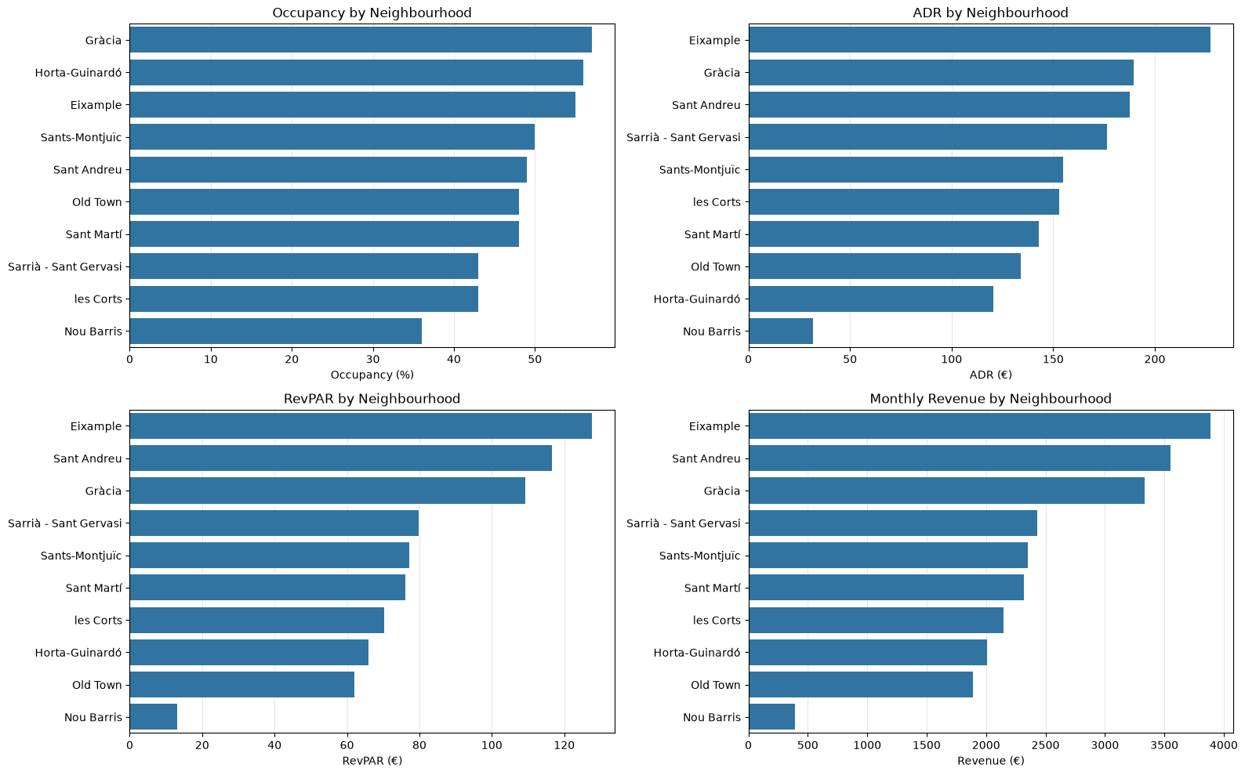
HYPOTHESES 1
6
Neighbourhood matters: Eixample leads in financial performance, Gràcia in occupancy, while Nou Barris consistently underperforms.

Slide 7

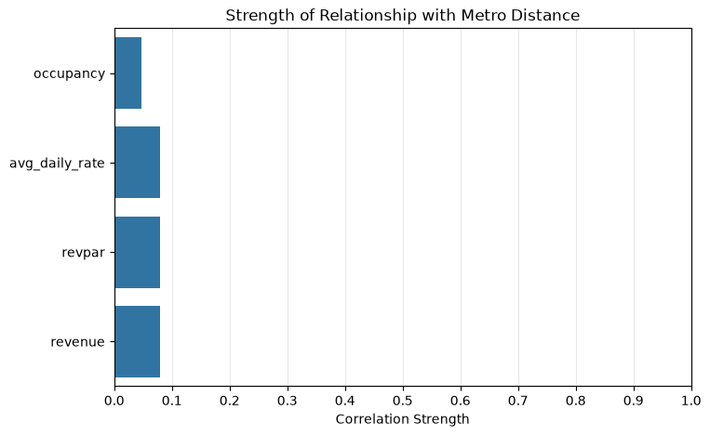
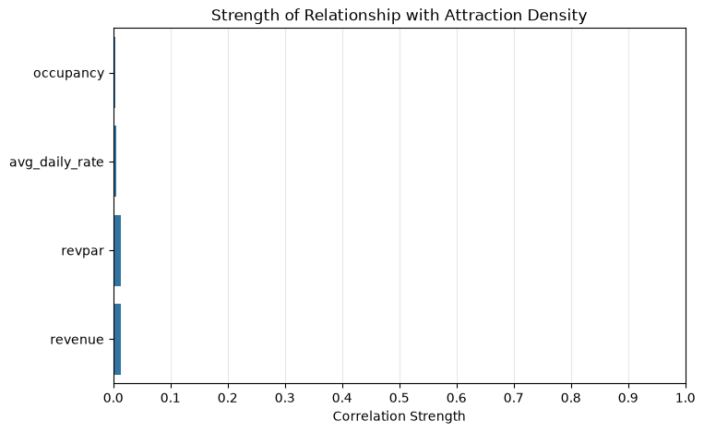
HYPOTHESES 1
7
Metro Proximity
Attraction Density
Metro proximity has a very weak relationship with rental performance. Correlation strength is 0.05–0.08 across Occupancy, ADR, RevPAR and Revenue
Point-of-interest counts within 1 km radius exhibit practically no direct statistical impact on financial performance. Correlation strength is close to zero

Slide 8
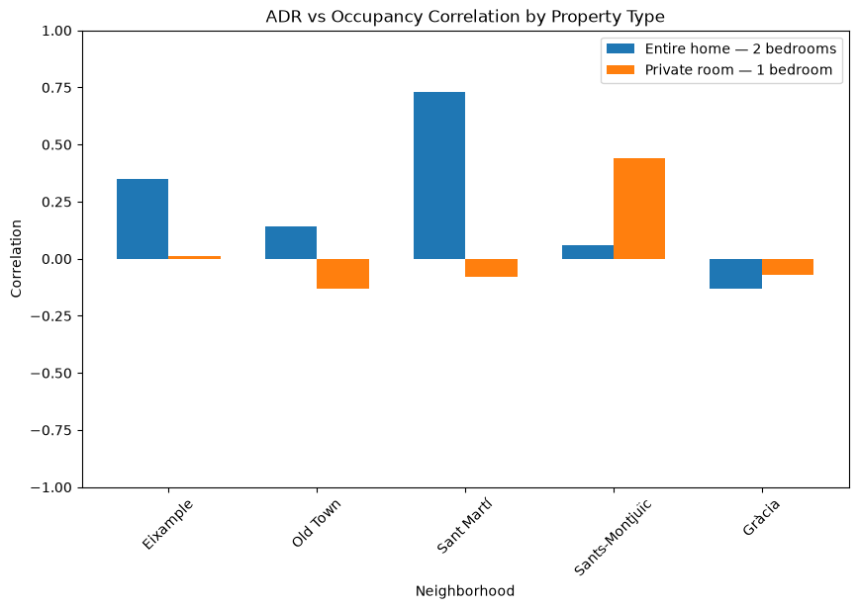
HYPOTHESES 2
ADR ↑ = Occupancy ↓ ?
For similar listings, higher price is associated with lower occupancy.
Controlled Sample Definition (370 Unique Listings)
Group 1 (169 listings): Entire homes
2 bedrooms
top 5 districts
Group 2 (201 listings): Private rooms,
1 bedroom
top 5 districts
Across both comparable samples, higher ADR is not consistently associated with lower occupancy. Most correlations are weak, close to zero, or positive.

Slide 9
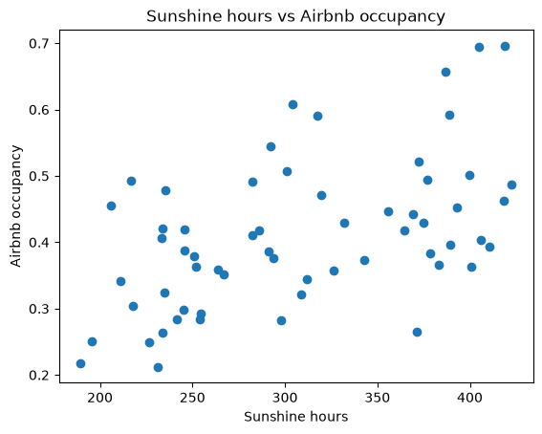
HYPOTHESES 3
9
Weather, Tourism & Occupancy
Mean Temperature
r = 0.543
Strongest correlation with occupancy
Sunshine Hours
r = 0.518
Moderate positive relationship
Precipitation
r = -0.108
Weak inverse relationship
INE Tourism Statistics
r = 0.05–0.18
Tourism indicators: travellers and nights
Question: “Are weather and tourism conditions associated with Airbnb occupancy?”

Slide 10
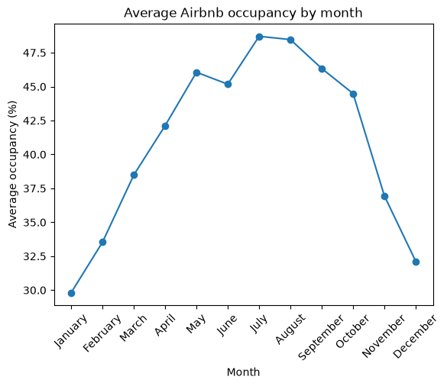
HYPOTHESES 4
10
Seasonality - Occupancy
Question: “Does Airbnb occupancy change depending on the time of year?”
Occupancy
January low (29.8%)
July peak (48.7%)
Core Statement
Airbnb occupancy follows a clear seasonal pattern, increasing towards summer and declining again afterwards.

Slide 11
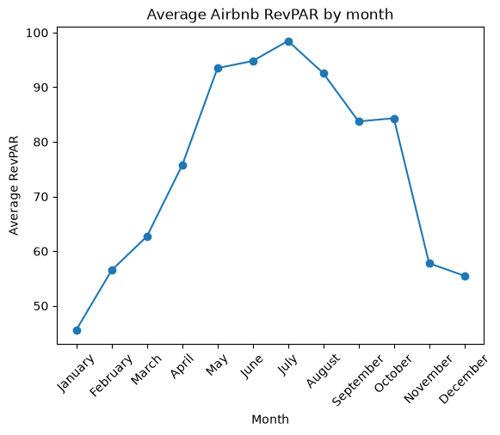
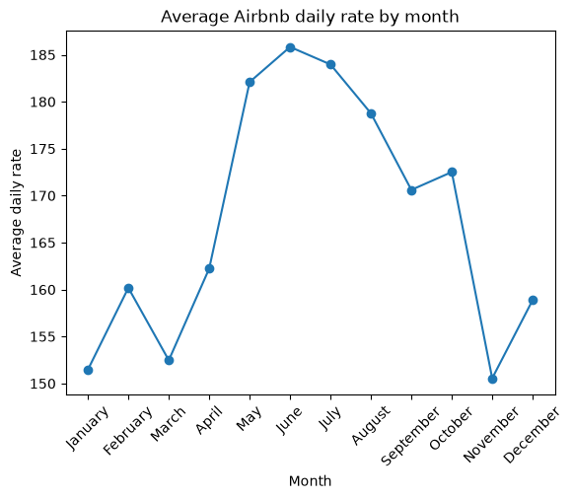
HYPOTHESES 4
11
Seasonality - RevPAR & ADR
Question: “Does rental revenue performance follow the same seasonal pattern?”
RevPAR
January low (45.6)
July peak (98.5)
Average Daily Rate (ADR)
June peak (186.8)

Slide 12
12
Key Takeaways for Business
1. Neighbourhood
5. Weather vs. Occupancy
“Eixample” is the leader. Never go to “Nou Barris”!
Prepare for higher occupancy in summer and lower demand in winter.
2. Avoid Transit Premiums
6. Use Weather To Support Forecasting
No relationship between proximity to metro stations and financial performance. Avoid paying a premium for properties closer to metro stations!
Temperature and sunshine can help anticipate changes in occupancy, but shouldn’t be treated as guarantees.
3. Ignore Micro POI Density
7. Adapt Pricing Throughout The Year
Attraction counts within 1 km do not yield pricing power (r ≈ 0.00–0.03).
Review prices monthly rather than using one pricing strategy year-round.
4. Protect Rate & Price Power
8. Focus On Revenue, Not Occupancy Alone
Cheaper does not mean fuller. Protect your price and compete through quality,
not discounts.
Monitor occupancy, ADR and RevPAR together to assess rental performance and pricing decisions.

Slide 13
¡Chao!
Thank you for listening! Questions?
Jovana Zivkovic & Yurii Slobodchukov

