Slide 1
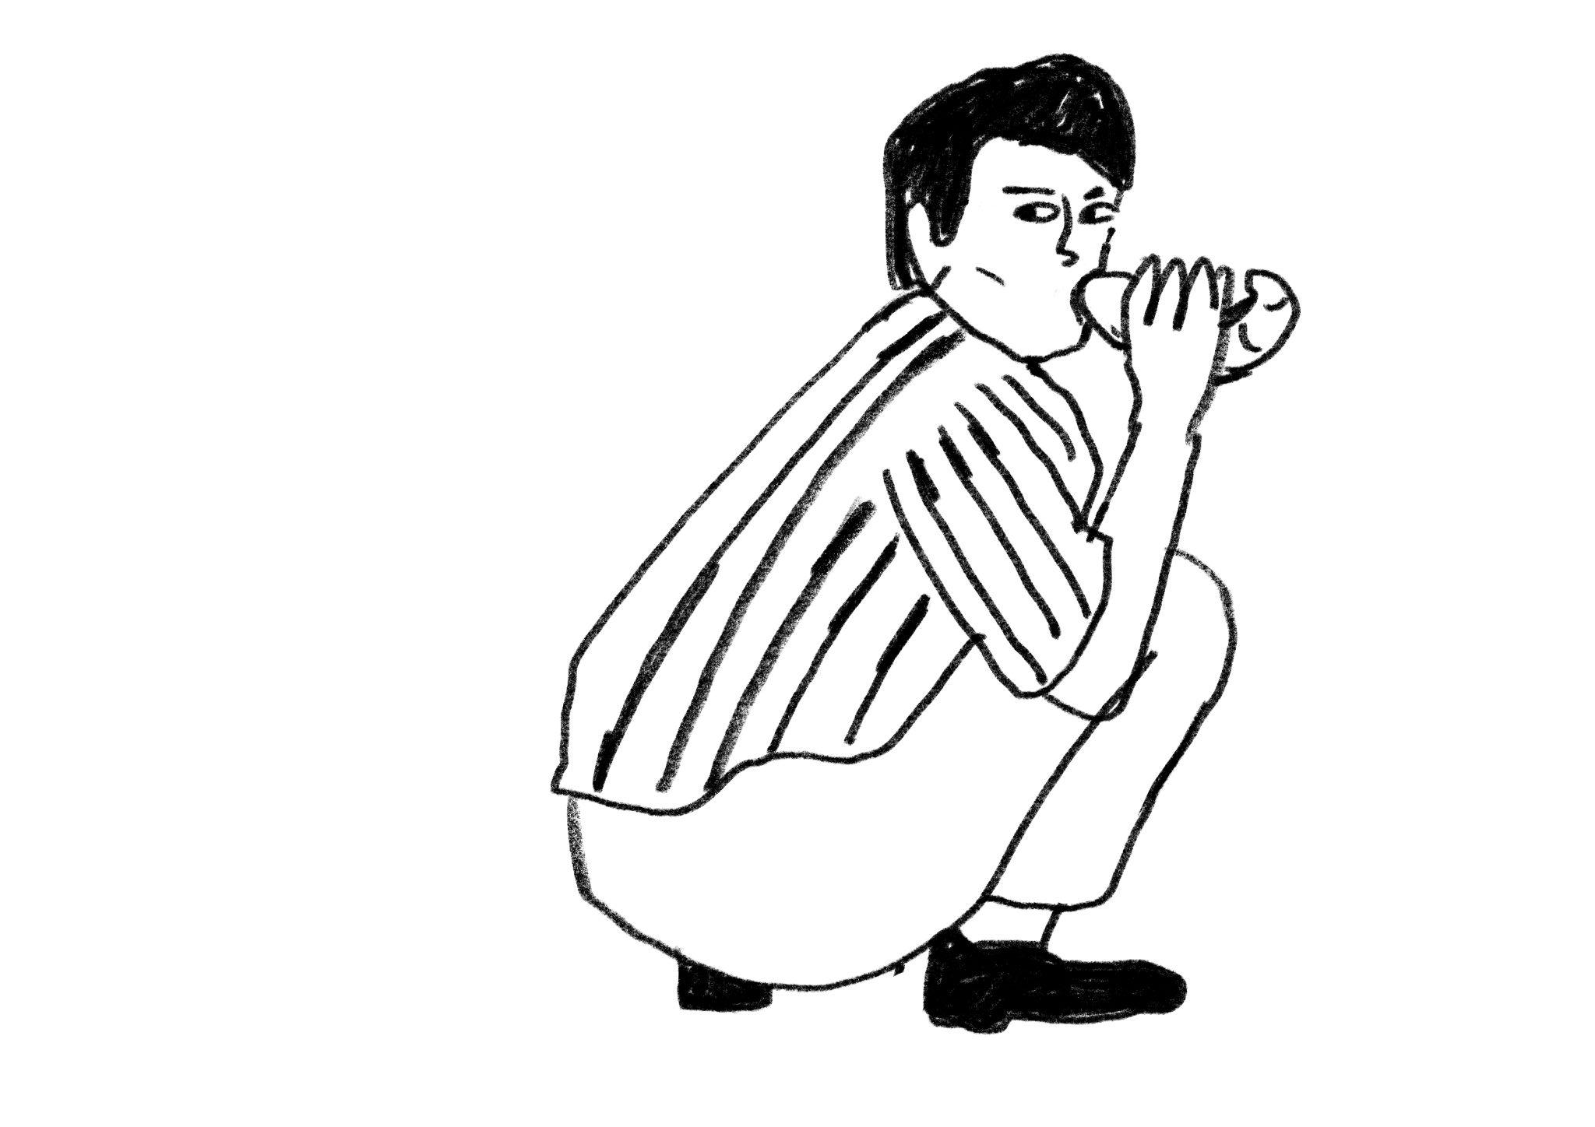
French Bakery
Demand Forecasting
Yurii Slobodchukov | DAFT SEP2026
01
Notes:
12 seconds
Morning everybody. I’ll present my project about the French bakery. And we’ll look at sales patterns and how we can use machine learning to predict daily sales.

Slide 2
The bakery and its sales data
A French bakery’s sales records, January 2021–September 2022
234,005
149
21
sales records
recorded product names
calendar months covered
What each record contains
Date and time
Product and quantity
Ticket and unit price
Source: French bakery daily sales, Kaggle
02
Notes:
22 seconds
We are looking at sales records from a French bakery. The dataset covers January 2021 to September 2022, with about 234 thousand sales records and 149 product names. Each record shows what was sold, when, how much and at what price. I explored patterns, and then built a daily forecast for predicting the next-day sales.

Slide 3
A few products carry most of the business
26
80.5%
41%
of 149 product names
of recorded revenue
of selected-product volume
Our forecasting scope
From these 26 products
From traditional baguettes
Planning effort starts with commercially important products
03
Notes:
25 seconds
As I had 149 different products. Instead of trying to predict sales for all of them, I decided to focus on the products that generating most of the revenue. I used the Pareto principle to find the products that made up about 80 percent of revenue. This gave me 26 products to focus on. Interesting fact that traditional baguettes alone made up to 41% of all units sold across these 26 products.

Slide 4
234,005 records became 13,467 rows
234,005
Original sales records
All 149 product names
173,609
Keep the 26 selected products
Focus on about 80% of revenue
172,629
Remove 980 negative-quantity records
Treat them as returns or corrections
13,493
Add up sales by product and date
Many individual sales become one daily total
13,467
Remove the first record for each product
26 rows have no previous sales history
One final row = one product on one recorded sales day
04
Notes:
35 seconds
I started with 234 thousand sales records. After keeping our 26 products and removing negative quantities, I had about 173 thousand records. Then I added up each product’s sales for each day and many separate sales became one daily total, leaving over 13 thousand rows for the model.

Slide 5
Sunday sales are almost twice Tuesday sales
Average daily sales across the 26 selected products
800
733
700
600
548
~2×
500
435
406
400
413
400
372
300
Sunday
vs Tuesday
200
100
0
Mon
Tue
Wed
Thu
Fri
Sat
Sun
The calendar matters for planning and prediction
05
Notes:
25 seconds
The week also has a clear rhythm. Sundays averaged 733 units across the selected products, compared with 372 on Tuesdays, almost twice as much. Saturdays were also stronger. A fixed daily production plan would miss this pattern. This is why the calendar matters for both planning and prediction.

Slide 6
A forecasting test must respect time
Random split
Past and future mix
Train
Test
Chronological split
First 80% of dates
Validation
Last 20%
Train: Jan 2021–May 2022
Test: Jun–Sep 2022
24 Feb–31 May 2022
All products on one date stay together
Tuning uses a later validation period within training. Test reuse still limits independence.
06
Notes:
40 seconds
Normally, train_test_split mixes the dates randomly. In this case, this could mean training from July sales to predict May. But in real life, we cannot see the future. So I kept the dates in order. I used the first 80 percent to teach the model and the last 20 percent to check its predictions. I also saved 20% of the training period for a validation check during hyperparameters tuning, to avoid touching test part. But since I used the test results to compare different models at the beginning, test can not be considered as a fully independent.

Slide 7
Seven models, one common benchmark
Initial test MAE: average error in units. Lower is better.
Baseline
8.8
Linear Regression
9
Decision Tree
7.74
KNN
6.35
Random Forest
5.92
Bagging
5.92
Gradient Boosting
6.09
AdaBoost
8.07
Random Forest and Bagging advance to tuning
07
Notes:
30 seconds
Our baseline simply repeats the previous recorded sale. We tested seven models against it. Average error is shown in product units, so lower is better. Linear regression did not even improve the baseline. KNN did better with scaled inputs, but Random Forest and Bagging were best, both near 5.92. We took both forward for tuning.

Slide 8
Bagging has slightly lower validation error
Nine settings per model, one chronological validation split
5.01
5.02
Validation MAE
Units per product-day
Bagging
Random Forest
n_estimators : 200
max_samples : 0.7
A small difference. Selected model refitted on all original training data.
08
Notes:
25 seconds
Next, I tried different hyperparameter settings to improve our two best models. I compared them on the validation part of the data before the final test. Their results were almost identical: 5.01 for Bagging and 5.02 for Random Forest. Bagging had a slightly lower error, so I chose it. The best version used 200 decision trees and 70% maximum sample size per tree. I then trained it again using all the training data.

Slide 9
Lower average error, with a clear tradeoff
33%
8.8
5.86
lower MAE than baseline
Baseline
Tuned Bagging
After tuning
MAE 5.92 to 5.86
RMSE 14.39 to 14.79
Average error improved slightly. Larger misses remain. Test R² = 0.95.
09
Notes:
45 seconds
Finally, I checked the tuned model on the test data. Its average error was 5.86 units per product per day, compared with 8.80 for our simple baseline. That is about 33 percent lower. Tuning itself made only a small difference: the error went from 5.92 to 5.86. However, RMSE, which gives more weight to large mistakes, increased from 14.39 to 14.79. So the model became slightly better on average, but handling large errors is still a challenge. And also reused test period also limits our confidence.

Slide 10

Thank you for your attention
Yurii Slobodchukov | DAFT SEP2026
10
Notes:
15 seconds
So the model can support more accurate daily planning, but the baker should always make the final decision. Thank you for your attention!

