Slide 1



Seoul Bike Sharing Demand Analysis
Created by Student: Yurii Hehediush
Course: DSC 323 Instructor: Nandhini Gulasingam
Predicting Rented Bike Count

Slide 2
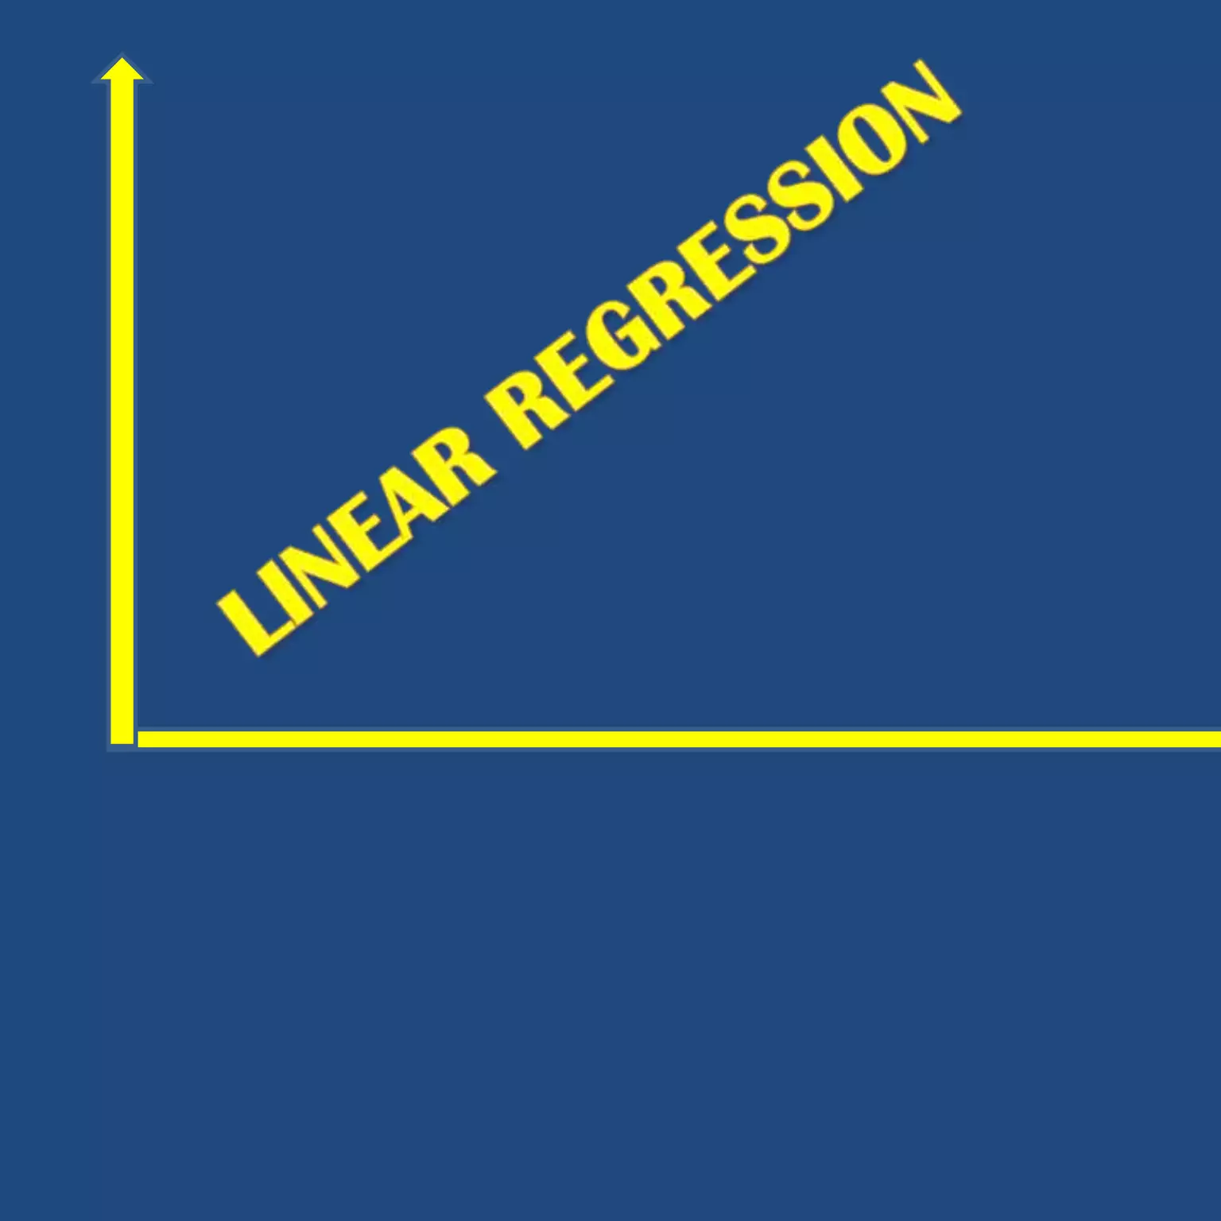
Introduction
Objective: Predict the number of bikes rented per hour in Seoul.
Dataset: Seoul Bike Sharing Demand
Key Points:
Dependent Variable: Rented Bike Count.
Independent Variables: Date, Hour, Temperature, Humidity, etc.
Total Observations: 8760

Slide 3

Data Preprocessing
Key Actions: Checked and ensured no missing values.
Data Cleaning / Removed special characters from variable names for consistency.
Converted categorical variables (e.g., Seasons, Holiday) into dummy variables.
Significance: Ensures data is clean and suitable for analysis.
Dummy variables allow for better handling in regression models.

Slide 4
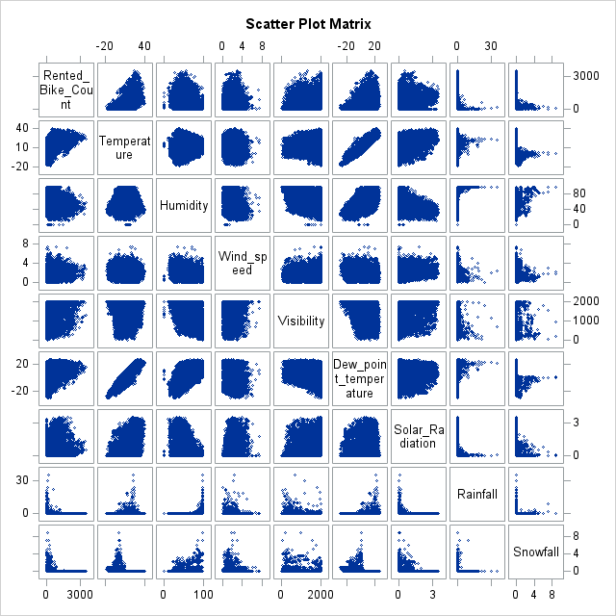
Exploratory Data Analysis (EDA)
Visualization
Scatter Plot Matrix Interpretation:
Some variables show linear relationships (e.g., Temperature vs. Rented Bike Count).
Noticeable patterns and clusters in the data.
Evidence of potential multicollinearity between variables (e.g., Dew Point Temperature and Temperature).
Insights:
Temperature, Wind Speed, and Solar Radiation seem to have a significant impact on bike rentals.
Certain variables (e.g., Rainfall, Snowfall) have less visible direct correlation with bike count.
This scatter plot matrix provides an initial understanding of relationships and potential multicollinearity among variables in the dataset.

Slide 5
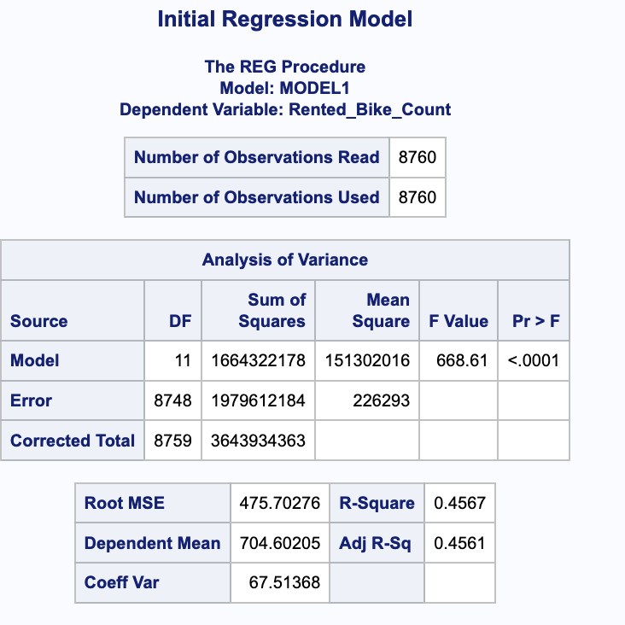
Initial Regression Model
Model Summary:R-Square: 0.4567
Adjusted R-Square: 0.4561
F-Value: 668.61 (Significant at p < 0.0001)
Root MSE: 475.70Coefficient of Variation: 67.51%
Data tell us: The model explains approximately 45.67% of the variance in the Rented Bike Count.
The high F-Value indicates that the model is statistically significant.
The Root MSE suggests that there is considerable variability in the data that the model does not capture.
These points summarize the initial regression model, highlighting its explanatory power and statistical significance.

Slide 6
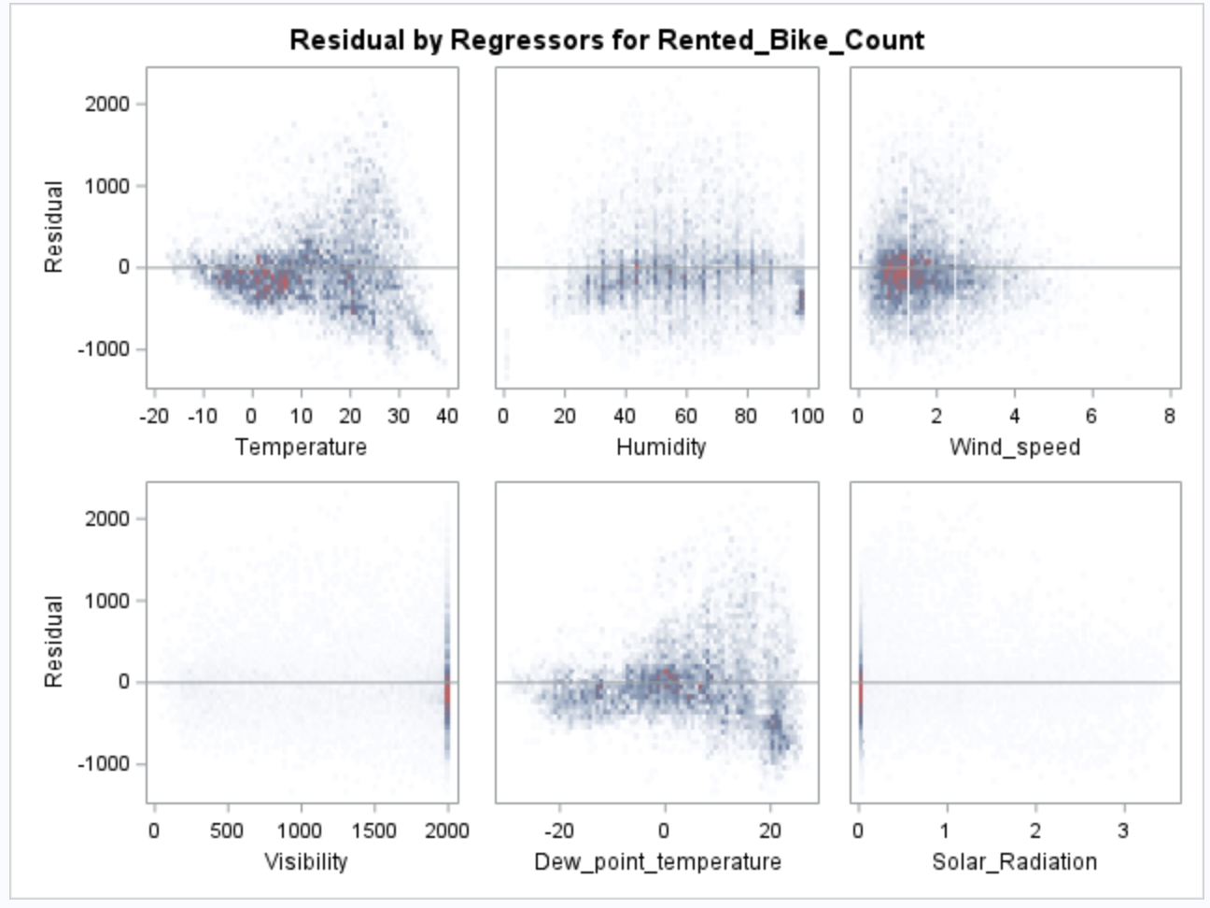
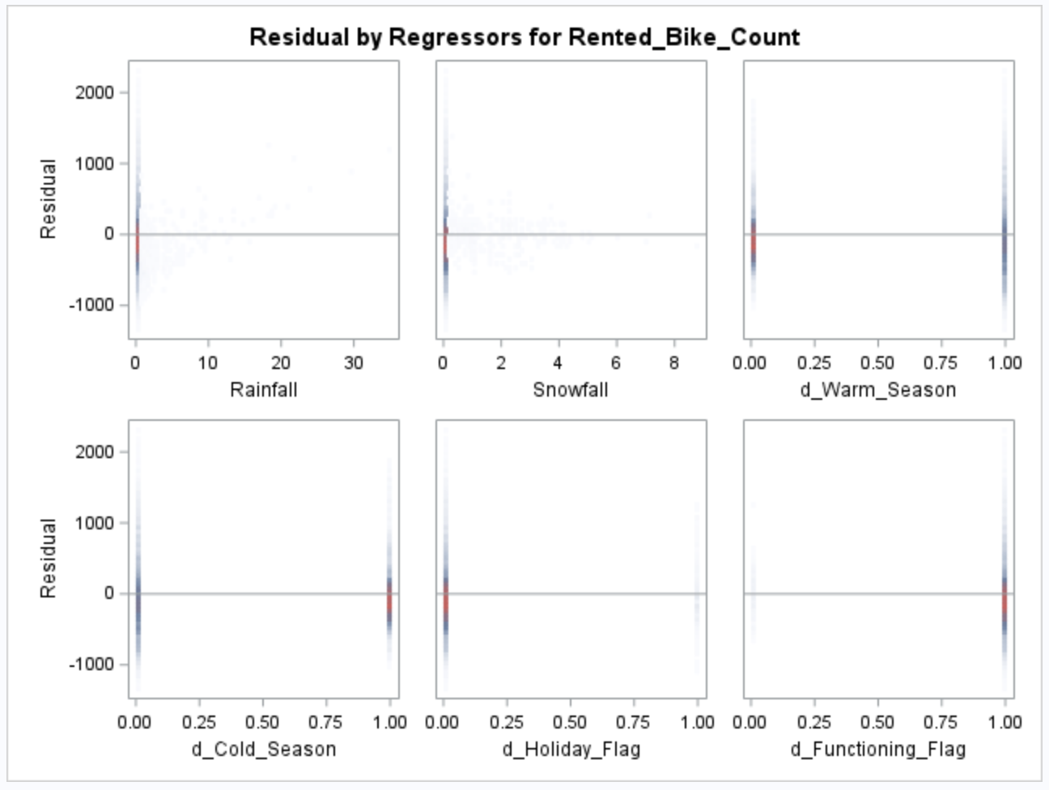
Residual Analysis for initial model
Checking Residuals: Residuals are plotted to examine the difference between observed and predicted values.
Assessing Model Fit: Residual plots help assess the model fit and identify potential issues with the model.
Model Fit: The residuals for most predictors appear randomly scattered around zero, suggesting a generally good fit. However, some variables show patterns indicating potential issues like heteroscedasticity or unmodeled relationships.
Notes:
Residual Analysis

Slide 7
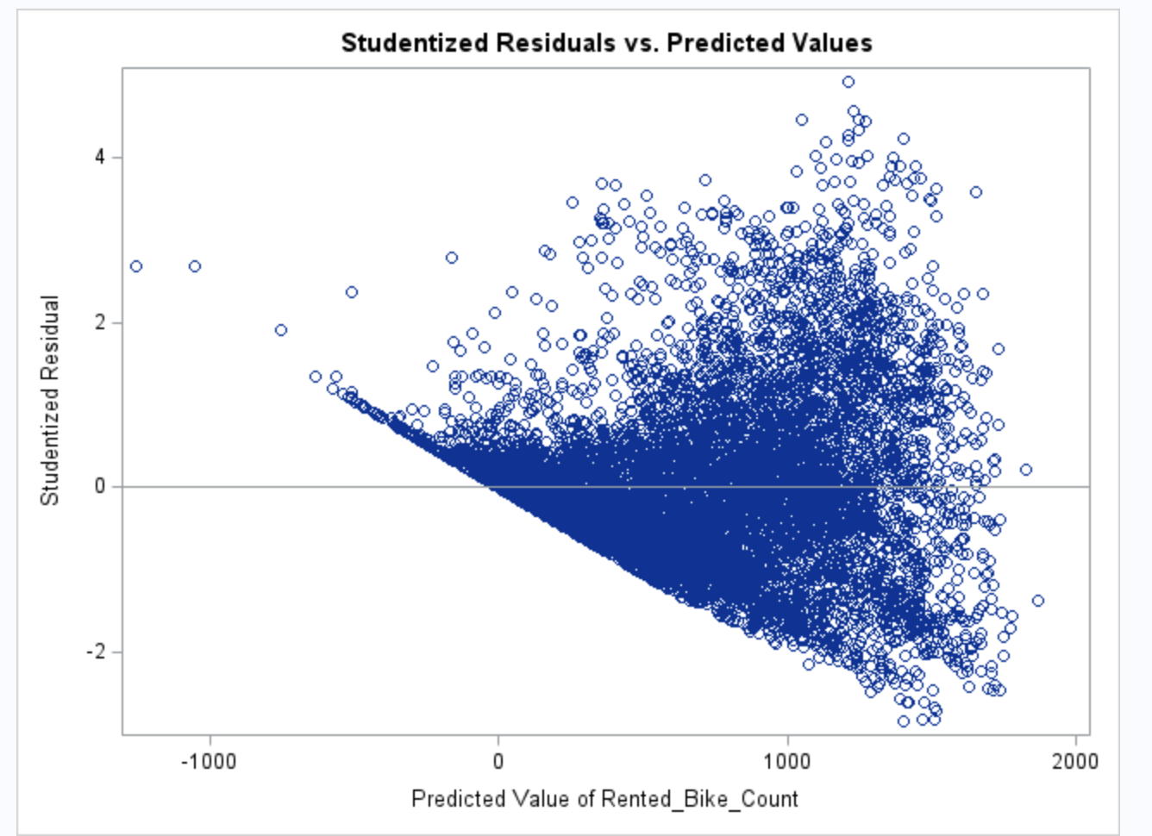
Influential Points and Diagnostics
Purpose: Identify influential points and outliers to improve model accuracy.
Tools Used: Cook's distance, leverage, and studentized residuals.
Action: Refine the model by addressing these influential points for better predictions.
Removing Insignificant Predictors: Visibility, Dew_Point, and Snowfall as they have p-values > 0.5
Residual Plots: Displaying residuals vs. predicted values to assess model fit and identify potential influential points.

Slide 8
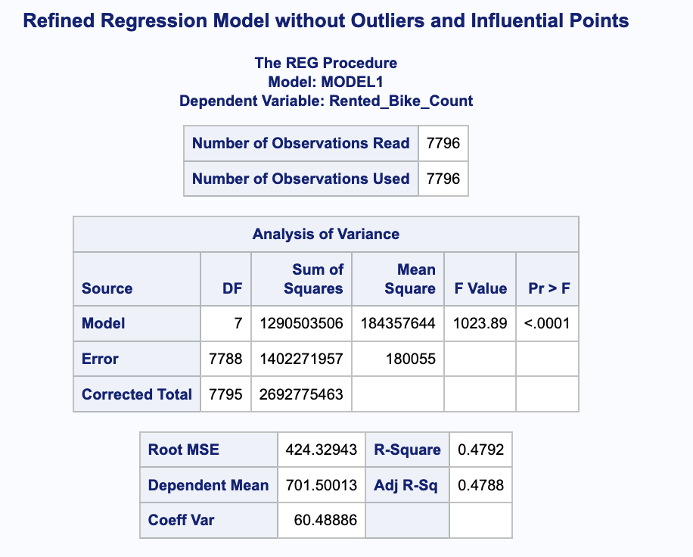
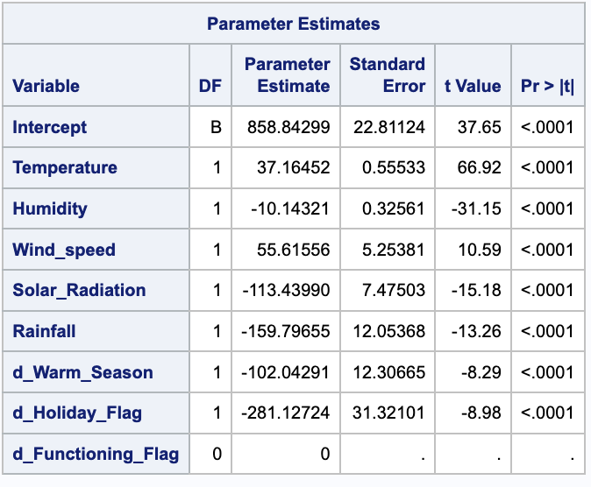
Model Refinement
Model Refinement: The improvements made in the previous step have enhanced the model.
Adjusted R-Square: The model's Adjusted R-Square improved to 0.4788, indicating a better fit.
Significant Predictors: Temperature, Humidity, Wind Speed, Solar Radiation, Rainfall, Warm Season, and Holiday Flag are significant predictors.

Slide 9
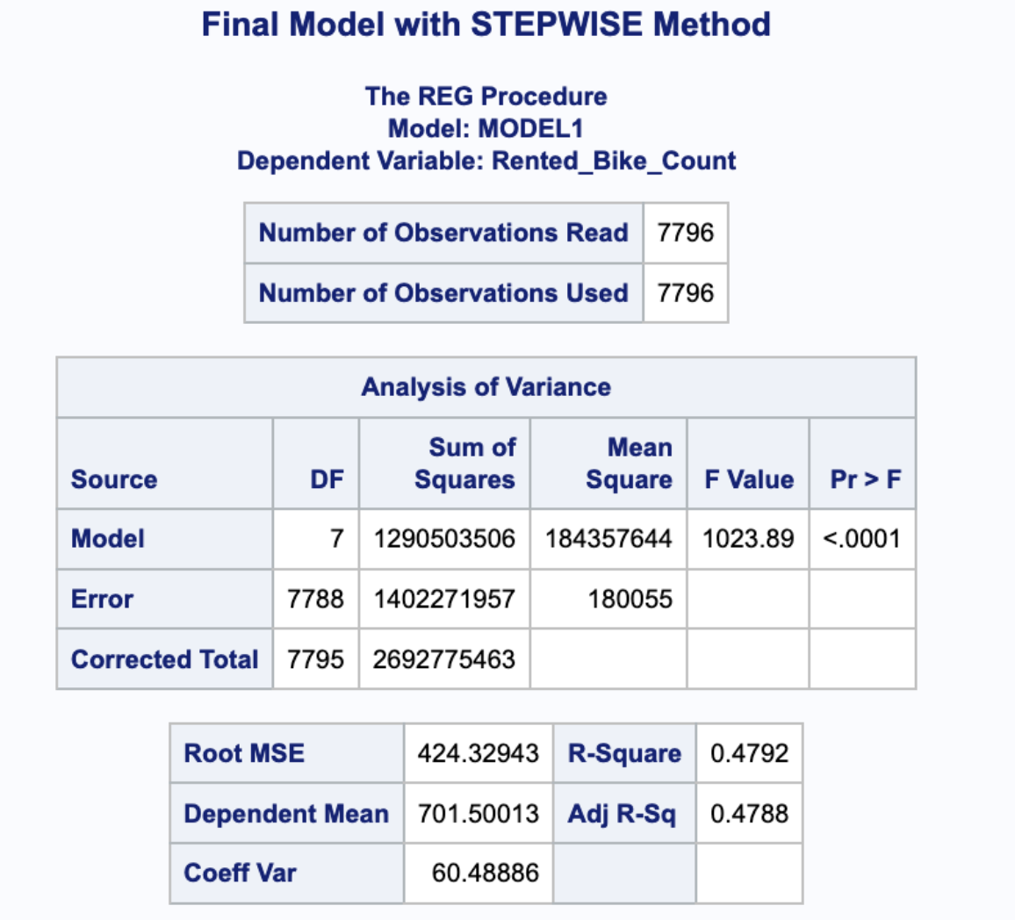
Model selection
Model Selection Methods:Testing both STEPWISE and CP methods to identify the best model for our data.
Final Model Choice:Selected the STEPWISE method.
Model Improvement:Adjusted R-Square improved from 0.4561 (initial model) to 0.4788, indicating a better fit and improved model accuracy.

Slide 10
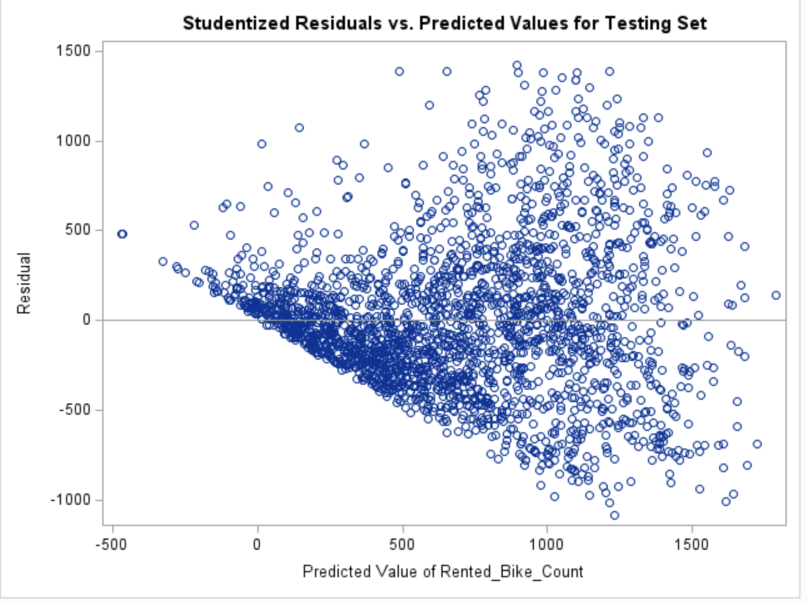
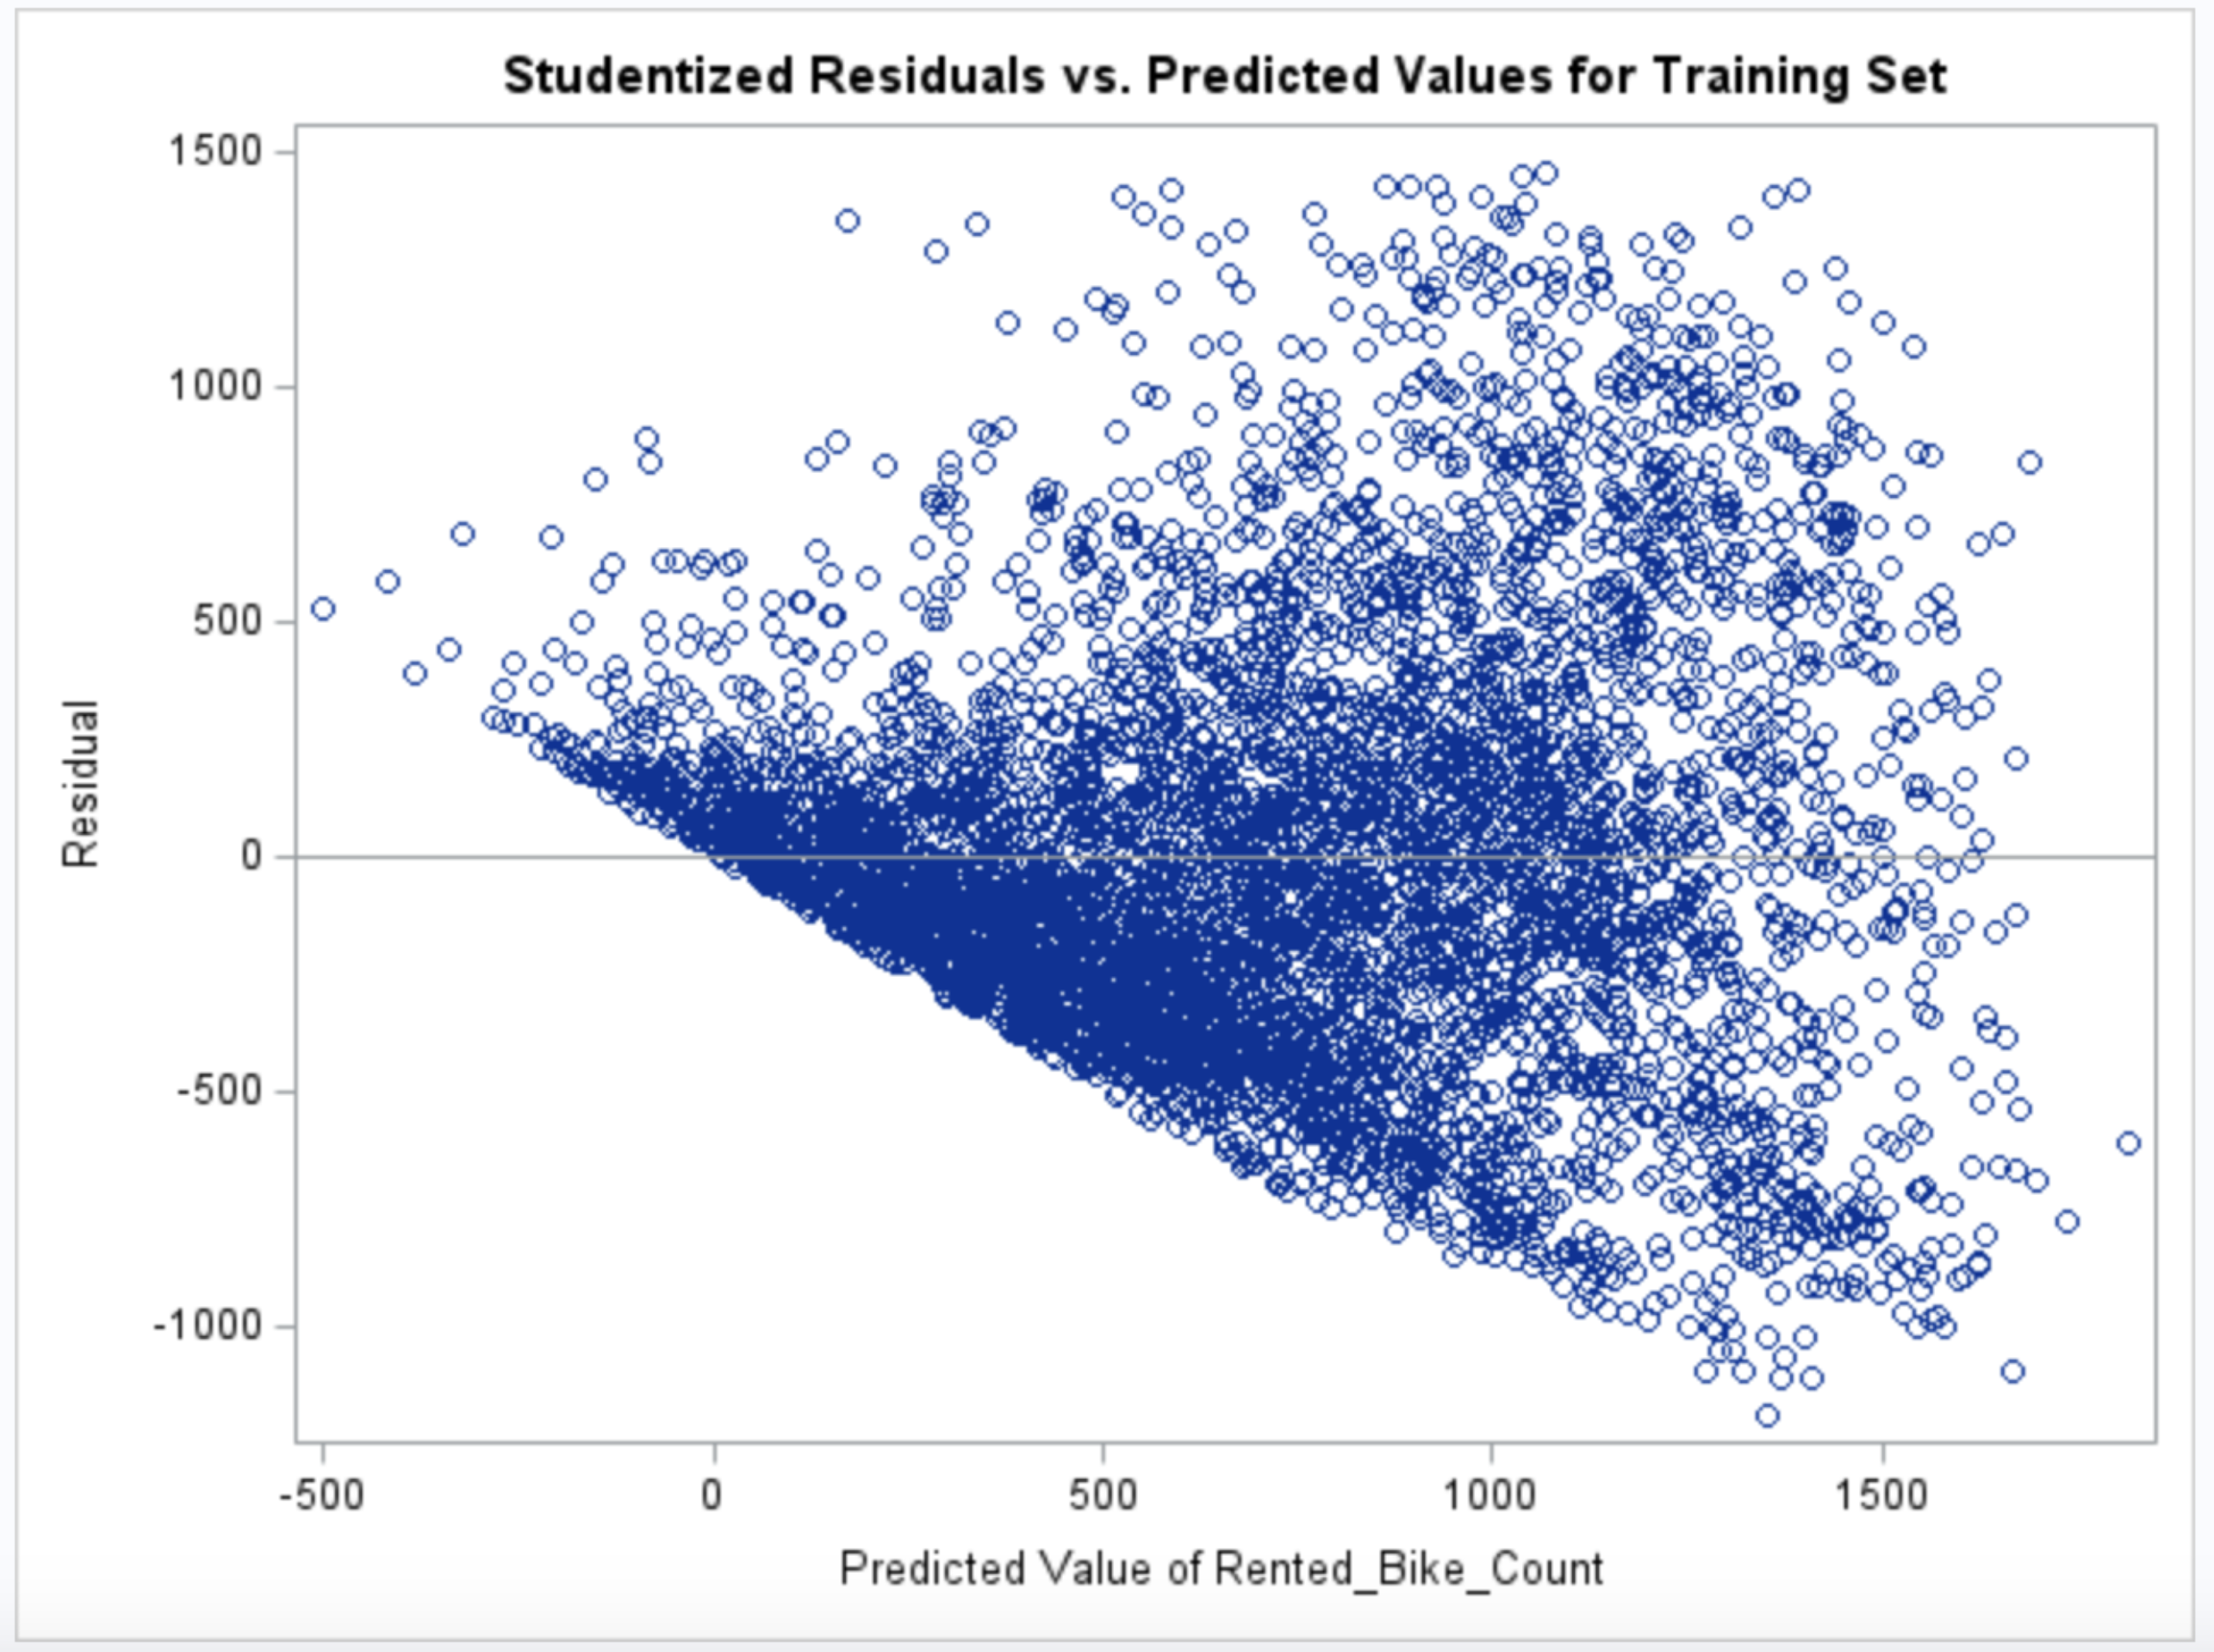
Train-Test Split for Model Validation
Training Set: 70% of Data
Testing Set: 30% of Data
Training Set Performance:
R-Square: 0.4792 / Adjusted R-Square: 0.4788
Indicates that nearly 48% of the variance in the rented bike count can be explained by the model using the training data.
Testing Set Performance:
R-Square: 0.5022 / Adjusted R-Square: 0.5007
Shows an improvement in model performance on the testing set, indicating that the model generalizes well to unseen data.

Slide 11

Stepwise Method Final Model
Model Improvement: The final model was built by sequentially adding significant variables.
Variable Inclusion:
Temperature (R-Square = 0.3376)
Humidity (R-Square = 0.4391)
Rainfall (R-Square = 0.4520)
Solar Radiation (R-Square = 0.4630)
Wind Speed (R-Square = 0.4700)
Holiday Flag (R-Square = 0.4746)
Warm Season (R-Square = 0.4792)
Model Performance: The final adjusted R-Square of 0.4788 indicates an improved fit compared to the initial model.
Notes:
Stepwise Method:

Slide 12
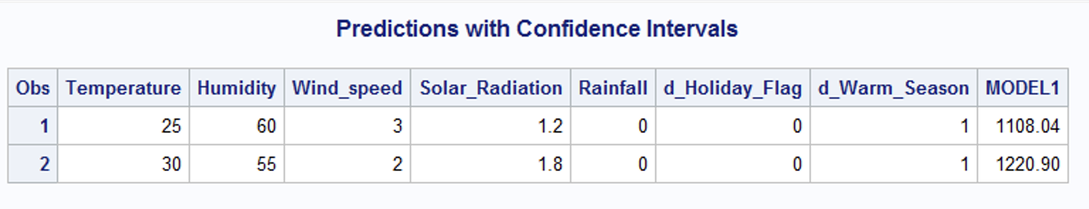
Predictions
Purpose: To predict the 'Rented_Bike_Count' based on specific values of the independent variables.
Observation 1:Input Values: Temperature = 25°C, Humidity = 60%, Wind Speed = 3 m/s, Solar Radiation = 1.2 MJ/m2, Rainfall = 0 mm, No Holiday, Warm Season.
Predicted Count: 1108.04 bikes.
Observation 2:Input Values: Temperature = 30°C, Humidity = 55%, Wind Speed = 2 m/s, Solar Radiation = 1.8 MJ/m2, Rainfall = 0 mm, No Holiday, Warm Season.
Predicted Count: 1220.90 bikes.
Model's Reliability: The predictions provide a reasonable estimate of bike rentals under given weather and seasonal conditions.
Implications: These predictions can help in resource planning and decision-making for bike-sharing services based on forecasted weather conditions

Slide 13
Summary of Findings:
Initial Model: Adjusted R-Square = 0.4561, indicating moderate explanatory power.
Model Refinement: Removal of outliers and influential points improved Adjusted R-Square to 0.4788.
Final Model: Stepwise selection method chosen for optimal model, achieving Adjusted R-Square = 0.4788.
Train-Test Split: 70% training, 30% testing to validate model accuracy.
Model Validation: Testing set Adjusted R-Square = 0.5007, indicating strong predictive performance.
Predictions: Model effectively predicts bike rentals based on weather and seasonal variables, aiding in resource planning.
Notes:
Pe

Slide 14

Thank you
yhehediu@depaul.edu
https://www.depaul.edu/

