Slide 1
SQL
By Yurii Martynenko

Slide 2
Agenda
Introduction
DDL Commands
DML Commands
SQL Statements, Operators, Clauses
Aggregate Functions

Slide 3
Introduction

Slide 4
What is database?
A database is an organized collection of data.
A database is a collection of information that is organized so that it can easily be accessed, managed, and updated.
What is DBMS?
Database management system (DBMS) is a special software application that interacts with the user, other applications, and the database itself to capture and analyze data.
E.g.: MySQL, PostgreSQL, Microsoft SQL Server, Oracle etc.

Slide 5
DBMS purpose
To store data properly
To provide simultaneous access to the data for many users
To delimit the access to the data for different users
To prevent data from loss

Slide 6
Data models
Hierarchical
Network
Relational
Object
RDBMS
Inplement a relational data model
Are used in most commercial projects
Have been used for almost 40 years

Slide 7
Structured Query Language (SQL)‏
The ANSI standard language for the definition and manipulation of relational database.
Includes data definition language (DDL), statements that specify and modify database schemas.
Includes a data manipulation language (DML), statements that manipulate database content.

Slide 8
Some Facts on SQL
SQL data is case-sensitive, SQL commands are not.
First Version was developed at IBM by Donald D. Chamberlin and Raymond F. Boyce. [SQL]
Developed using Dr. E.F. Codd's paper, “A Relational Model of Data for Large Shared Data Banks.”
SQL query includes references to tuples variables and the attributes of those variables

Slide 9
SQL: DDL Commands
CREATE TABLE: used to create a table.
ALTER TABLE: modifies a table after it was created.
DROP TABLE: removes a table from a database.

Slide 10
SQL: CREATE TABLE Statement
Things to consider before you create your table are:
The type of data
the table name
what column(s) will make up the primary key
the names of the columns
CREATE TABLE statement syntax:
CREATE TABLE <table name> (
column_name1 data_type(size),
column_name2 data_type(size),
column_name3 data_type(size)
...
);

Slide 11
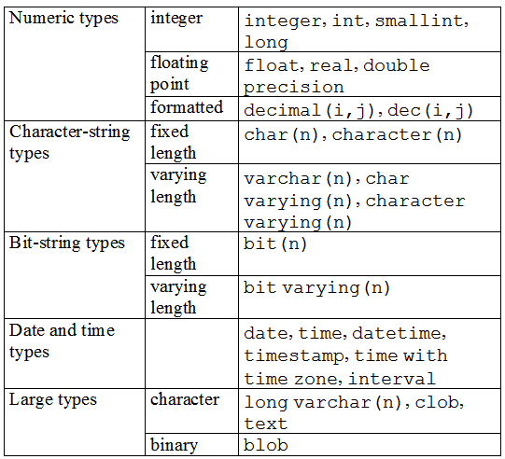
SQL: Attributes Types

Slide 12
SQL: ALTER TABLE Statement
To add or drop columns on existing tables.
ALTER TABLE statement syntax:
ALTER TABLE <table name>
ADD column_name datatype
or
DROP COLUMN attr;

Slide 13
SQL: DROP TABLE Statement
Has two options:
CASCADE: Specifies that any foreign key constraint violations that are caused by dropping the table will cause the corresponding rows of the related table to be deleted.
RESTRICT: blocks the deletion of the table of any foreign key constraint violations would be created.
DROP TABLE statement syntax:
DROP TABLE <table name> [ RESTRICT|CASCADE ];

Slide 14

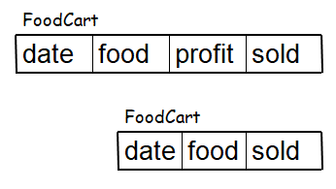
Example:
CREATE TABLE FoodCart (
date varchar(10),
food varchar(20),
profit float
);
ALTER TABLE FoodCart (
ADD sold int
);
ALTER TABLE FoodCart(
DROP COLUMN profit
);
DROP TABLE FoodCart;

Slide 15
SQL: DML Commands
INSERT: adds new rows to a table.
UPDATE: modifies one or more attributes.
DELETE: deletes one or more rows from a table.

Slide 16
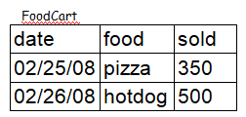
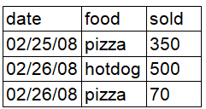
SQL: INSERT Statement
To insert a row into a table, it is necessary to have a value for each attribute, and order matters.
INSERT statement syntax:
INSERT INTO <table name>
VALUES ('value1', 'value2', NULL);
Example: INSERT into FoodCart VALUES (’02/26/08', ‘pizza', 70 );

Slide 17
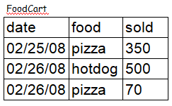
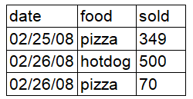
SQL: UPDATE Statement
To update the content of the table:
UPDATE statement syntax:
UPDATE <table name> SET <attr> = <value>
WHERE <selection condition>;
Example: UPDATE FoodCart SET sold = 349 WHERE date = ’02/25/08’ AND food = ‘pizza’;

Slide 18
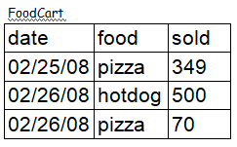
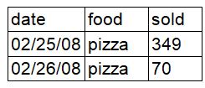
SQL: DELETE Statement
To delete rows from the table:
DELETE statement syntax:
DELETE FROM <table name>
WHERE <condition>;
Example: DELETE FROM FoodCart WHERE food = ‘hotdog’;
Note: If the WHERE clause is omitted all rows of data are deleted from the table.

Slide 19
SQL Statements, Operations, Clauses
SQL Statements:
Select
SQL Operations:
Join
Left Join
Right Join
Like
SQL Clauses:
Order By
Group By
Having

Slide 20
SQL: SELECT Statement
A basic SELECT statement includes 3 clauses
SELECT <attribute name> FROM <tables> WHERE <condition>
SELECT
Specifies the attributes that are part of the resulting relation
FROM
Specifies the tables that serve as the input to the statement
WHERE
Specifies the selection condition, including the join condition.
Note: that you don't need to use WHERE

Slide 21
SQL: SELECT Statement (cont.)‏
Using a “*” in a select statement indicates that every attribute of the input table is to be selected.
Example: SELECT * FROM … WHERE …;
To get unique rows, type the keyword DISTINCT after SELECT.
Example: SELECT DISTINCT * FROM … WHERE …;

Slide 22
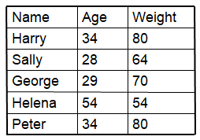
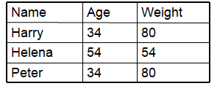
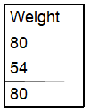

Example:
Person
1) SELECT * FROM person WHERE age > 30;
2) SELECT weight FROM person WHERE age > 30;
3) SELECT distinct weight FROM person WHERE age > 30;

Slide 23
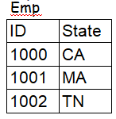
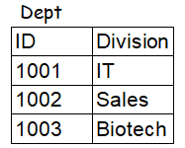
SQL: Join operation
A join can be specified in the FROM clause which list the two input relations and the WHERE clause which lists the join condition.
Example:

Slide 24

SQL: Join operation (cont.)‏
INNER JOIN= JOIN
SELECT *
FROM emp JOIN dept (or FROM emp, dept)‏
ON emp.id = dept.id;

Slide 25

SQL: Join operation (cont.)‏
LEFT OUTER JOIN = LEFT JOIN
SELECT *
FROM emp LEFT JOIN dept
on emp.id = dept.id;

Slide 26

SQL: Join operation (cont.)‏
RIGHT OUTER JOIN = RIGHT JOIN
SELECT *
FROM emp RIGHT JOIN dept
on emp.id = dept.id;

Slide 27
SQL: Like operation
Pattern matching selection
% (arbitrary string)‏
SELECT *
FROM emp
WHERE ID like ‘%01’;
-> finds ID that ends with 01, e.g. 1001, 2001, etc
_ (a single character)‏
SELECT *
FROM emp
WHERE ID like ‘_01_’;
-> finds ID that has the second and third character as 01, e.g. 1010, 1011, 1012, 1013, etc

Slide 28
SQL: The ORDER BY Clause
Ordered result selection
desc (descending order)‏
SELECT *
FROM emp
ORDER BY state desc
-> puts state in descending order, e.g. TN, MA, CA
asc (ascending order)‏
SELECT *
FROM emp
ORDER BY id asc
-> puts ID in ascending order, e.g. 1001, 1002, 1003

Slide 29
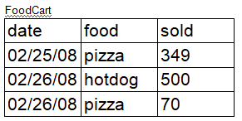

SQL: The GROUP BY Clause
The function to divide the tuples into groups and returns an aggregate for each group.
Usually, it is an aggregate function’s companion
SELECT food, sum(sold) as totalSold
FROM FoodCart
GROUP BY food;

Slide 30
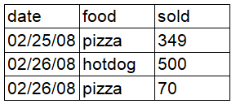

SQL: The HAVING Clause
The substitute of WHERE for aggregate functions
Usually, it is an aggregate function’s companion
SELECT food, sum(sold) as totalSold
FROM FoodCart
GROUP BY food
HAVING sum(sold) > 450;
FoodCart

Slide 31
SQL: Aggregate Functions
Are used to provide summarization information for SQL statements, which return a single value.
COUNT(attr)‏
SUM(attr)‏
MAX(attr)‏
MIN(attr)‏
AVG(attr)‏
Note: when using aggregate functions, NULL values are not considered, except in COUNT(*) .

Slide 32
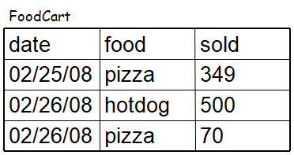
SQL: Aggregate Functions (cont.)‏
COUNT(attr) -> return # of rows that are not null
Ex: COUNT(distinct food) from FoodCart; -> 2
SUM(attr) -> return the sum of values in the attr
Ex: SUM(sold) from FoodCart; -> 919
MAX(attr) -> return the highest value from the attr
Ex: MAX(sold) from FoodCart; -> 500

Slide 33
SQL: Aggregate Functions (cont.)‏
MIN(attr) -> return the lowest value from the attr
Ex: MIN(sold) from FoodCart; -> 70
AVG(attr) -> return the average value from the attr
Ex: AVG(sold) from FoodCart; -> 306.33
Note: value is rounded to the precision of the datatype

Slide 34
References
http://en.wikipedia.org/wiki/SQL
http://www.w3schools.com/sql/sql_tryit.asp
http://en.wikipedia.org/wiki/SQL
http://en.wikipedia.org/wiki/Join_(SQL)‏

Slide 35
Thank you!

