Slide 1
JavaScript EcmaScript 2015
By Yurii Martynenko

Slide 2
AGENDA
let and const
Template Literals
Arrow Functions
Spread Operators
Rest Parameters
Destructuring
Classes
Default Parameter Values

Slide 3
What is new in ECMASCRIPT 2015?
Scoping (Block-Scoped Variables, Block-Scoped Variables)
Arrow Functions
Extended Parameter Handling (Default Parameter Value, Rest Parameter, Spread Operator)
Template Literals
Enhanced Regular Exression
Destructuring Assignment
Modules
Classes
Symbol Type
Iterators
Generators
Promises
Map/Set & WeakMap/WeakSet

Slide 4
let and const

Slide 5

let and const
let and const are two new keywords that are now available in ES2015. They are used to declare variables, however there is one key feature these variables share that sets them apart from var: they create block scoped variables.
When you use the var keyword to create a variable it is function scoped, and it is local only to that function. This means it is available within the function it was created in and any function nested inside of that one. But it is NOT available outside of there. If you used var to define a variable outside of any function it would be available globally.
One common issue we will run into with function scoped variables is the for loop.

Slide 6



var is function scoped, so creating a variable inside of a block with var will make it available outside of the block as well.
When you define a variable with the let keyword it will create a new variable only within the { } or block.
This defines and binds a variable only to the block in which it is in! If we take look at the for loop example again, and replace var with let

Slide 7
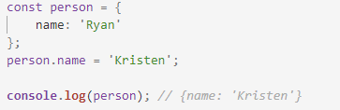
Now it works as intended. The const keyword behaves the exact same way, with one exception. Once the base value is defined, it can never be redefined. It is a read-only value.
The browser will throw an error if you try to reassign a value to a variable defined with const. That being said, you can do something like this.
Using const does not create an immutable value, the value stored on the person variable is still an object, however we have just changed a property inside of it.

Slide 8
When to use let and when to use const
There is a bit of debate going on right now about when to use let vs const. The general rule of thumb is that if you know the value will not be redefined throughout your program, go with const, if you need a value that might change, go with let. Letting the browser know that a variable will be constant throughout the program will allow it to make certain adjustments, and this could increase performance!

Slide 9
Template Literals

Slide 10



In ES2015 there is a new way to define a string, and it comes with some added benefits. Currently if you want to define a string, you can use '' or "".
If you want to concatenate strings together you can use the + operator.
As the amount you need to concatenate grows, this pattern gets pretty tedious and unruly. Enter template literals!
To create a template literal string, we use the backtick ` in place of the quotes.

Slide 11


They behave exactly the same as a regular string literal, but there is one difference. With a template literal, concatenation becomes a lot easier.
Notice the ${} syntax inside of the string? This is a template placeholder. It allows us to template out our strings, and the browser will replace the ${} expression with the proper value at runtime. This makes concatenating large strings a lot more enjoyable.
These new placeholders also allow you to carry out expressions inside!

Slide 12


Multi line
One last thing to look at with template literals is how they can handle multi line strings. With a regular string if you wanted to have it span more than one line, you would have to do something like this.
Including the \n or new line character will force text to go to a new line. If you tried to just put the text on two lines, like this:
It would throw an error Uncaught SyntaxError: Unexpected token ILLEGAL.

Slide 13

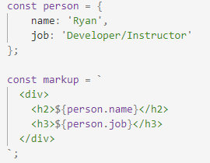
However with template literals we CAN do just that and add line breaks wherever we'd like!
This allows us to organize our markup in a way that is considerably cleaner!

Slide 14
Arrow Functions

Slide 15

Arrow Functions
Arrow functions are a new syntax for creating functions in ES2015. This does not replace the function() {} syntax that we know and love, but we will be seeing it more and more as the go-to function syntax.
The core part of the syntax is the lack of the function keyword when defining a new function. Instead we have the => or fat arrow. You can call the function just as you would any other.

Slide 16
There are actually a few ways you can define the arrow function. For example, if the function simply returns a value and there is nothing else in the function body, we can remove the {} and the return keyword.
The return here is implicit, meaning that it is implied as opposed to us having to explicitly add return to our block. If the function only had one parameter you can actually leave the () off the definition of the function.
If there are no parameters to be used in the function, empty parenthesis are used as a placeholder.
Or there is a new pattern emerging where people will use a _ as a placeholder in place of the empty parenthesis.

Slide 17
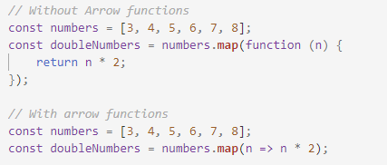
Arrow functions and functional programming
Because the syntax for the arrow function is so small, and most operations in functional programming require very few operations in the function's body. This syntax is a perfect match for this programming style!
The syntax allows you to make this nice and simple operation into one line!

Slide 18
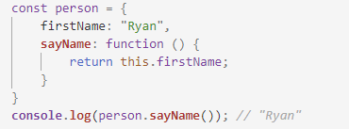
The this keyword
One place to be cautious of when working with arrow functions is how they handle the this keyword. Consider a method on an object.
Inside of the sayName method, the this keyword is bound to the person object. So running the method will produce Ryan. With an arrow function, the this keyword is lexically scoped. This means that the scope of the function will be bound based on where it was defined. The value of this then refers to the parent scope.

Slide 19
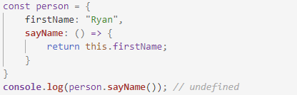
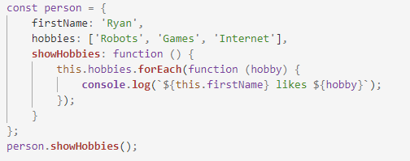
In this example, if we changed the sayName method from an anonymous function to an arrow function it will return undefined! The this will be bound lexically, and in this case it will be the window object, on which there is no firstName property. There will be cases where you might want to have that be the correct result! Take a look at this example.

Slide 20
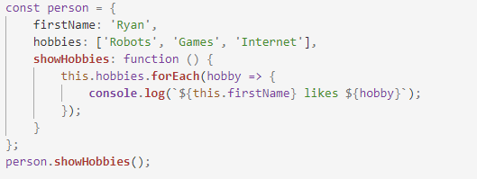
Running this will produce Uncaught TypeError: Cannot read property 'firstName' of undefined. The this in the callback function for our .forEach() method is bound to nothing(in strict mode, in non strict it will be the window). But if we change the callback to an arrow function we can use the lexically bound this to get the value we want!
The this inside of our forEach will be bound to the person object!

Slide 21
Spread Operators

Slide 22


Spread Operators
Sometimes we want to do something with an array that we can't! For example let's assume we have an array of numbers that we want to find the max of. Math.max seems like the right method for this.
Math.max is a method that takes a comma separated list of values and will return the highest! Sadly we can not pass an array to it. There is a way to get around this though, we can use a method called .apply that takes an array and calls a function as if we had passed them in as a list.

Slide 23

Enter the Spread Operator
In ES2015 there is the spread operator. The syntax looks like this:
...numbers
What this tool does is spread out, or disperse the elements from the array! It will expand them in place. We can change the above .apply method call to look something like this now.
Spread will expand the array in place and pass the elements in as if it were a comma separated list.

Slide 24

Using the spread operator to concat
You can also use the spread operator to concatenate arrays together! Since spread expands arrays, we can expand arrays in arrays!

Slide 25
Rest Parameters

Slide 26

Rest Parameters
The spread operator allows us to pass an array of arguments into a function. On the flip side of that, rest parameters allows us to gather the parameters passed to our functions! Just like the spread operator the rest parameter syntax also involves the ... at the beginning of a variable name.
Let's look at an example of this. Imagine we have a function that takes any number of arguments and returns the sum, add(2, 3, 4, 5, 6, 7) would return 27.

Slide 27
Without rest parameters, we would have to use the arguments keyword, and call Array.prototype.slice.call(arguments). What in the world does Array.prototype.slice.call(arguments) mean?! arguments is an Array-LIKE object, meaning it is not an actual array but, is a collection of the arguments passed to a function. However, if we wanted to use an Array method like .reduce() on arguments, we would need to do some fiddling.
JavaScript is built up from a bunch of objects. All of these objects have a parent object that they inherit their methods and properties from. They do this via the .prototype property. Arrays have the .slice method that we can use to create an actual array from our arguments value. Using .call we can call the .slice method from the prototype with arguments as the context to create an array....whoa that is a lot.

Slide 28


Enter rest parameters!
That was a lot easier. Rest parameters create an actual array from the arguments passed to a function, so we can use methods like .reduce on it. This allows us the freedom to perform similar tasks much easier!
It is important to point out that you can mix and match with rest parameters and the spread operator. Consider a function that takes a multiplier as the first argument, and then will multiply any value after it by that number.
We define the function with a parameter for the multiplier and use rest parameters to collect however many arguments get passed to this function!

Slide 29
Destructuring

Slide 30
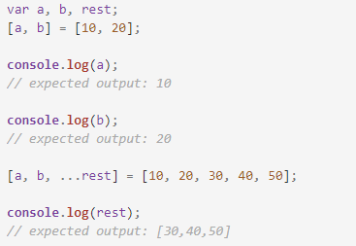
Destructuring
The destructuring assignment syntax is a JavaScript expression that makes it possible to unpack values from arrays, or properties from objects, into distinct variables.

Slide 31

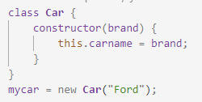
Classes
A class is a type of function, but instead of using the keyword function to initiate it, we use the keyword class, and the properties is assigned inside a constructor() method.
Use the keyword class to create a class, and always add a constructor method.
The constructor method is called each time the class object is initialized.
Now you can create objects using the Car class:

Slide 32
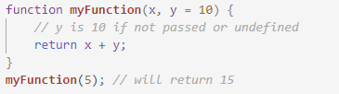
Default Parameter Values
ES6 allows function parameters to have default values.

Slide 33
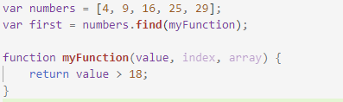
Array.find()
The find() method returns the value of the first array element that passes a test function.
This example finds (returns the value of ) the first element that is larger than 18:
Note that the function takes 3 arguments:
The item value
The item index
The array itself

Slide 34

Exponentiation Operator
The exponentiation operator (**) raises the first operand to the power of the second operand.
x ** y produces the same result as Math.pow(x,y):

Slide 35
USEFUL LINKS
https://developer.mozilla.org/uk/docs/Web/JavaScript/
http://es6-features.org
https://css-tricks.com/lets-learn-es2015/

Slide 36
Thank you!

