Slide 1
JAVASCRIPT STRINGS
By Yurii Martynenko

Slide 2
AGENDA
String literals
Template literals
String object and its methods

Slide 3
STRING LITERALS

Slide 4

STRING LITERALS
Strings are values made up of text and can contain letters, numbers, symbols, punctuation, and even emoji.
Strings are contained within a pair of either single quotation marks '' or double quotation marks "".
Enclosing quotation marks
Let’s say you’re trying to use quotation marks inside a string. You’ll need to use opposite quotation marks inside and outside. That means strings containing single quotes need to use double quotes and strings containing double quotes need to use single quotes.

Slide 5
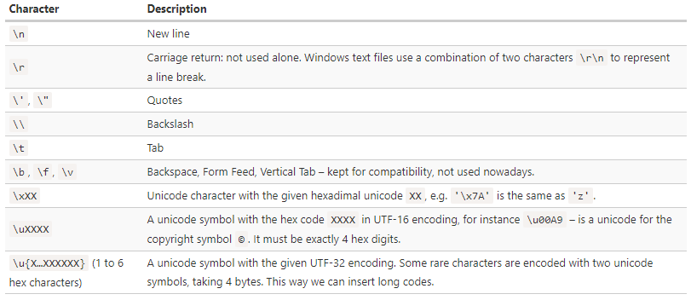
SPECIAL CHARACTERS

Slide 6
ESCAPE CHARACTER
All special characters start with a backslash character \. It is also called an “escape character”.
We might also use it if we wanted to insert a quote into the string.
For instance:
As you can see, we have to prepend the inner quote by the backslash \', because otherwise it would indicate the string end.
Of course, only to the quotes that are the same as the enclosing ones need to be escaped. So, as a more elegant solution, we could switch to double quotes or backticks instead:
But what if we need to show an actual backslash \ within the string?
That’s possible, but we need to double it like \\:

Slide 7
STRING LENGTH
The length property has the string length:
Note that \n is a single “special” character, so the length is indeed 3.

Slide 8


STRINGS ARE IMMUTABLE
Strings can’t be changed in JavaScript. It is impossible to change a character.
Let’s try it to show that it doesn’t work:
The usual workaround is to create a whole new string and assign it to str instead of the old one.
For instance:

Slide 9
CHARACTER ACCESS
There are two ways to access an individual character in a string. The first is the charAt()method:
The other way (introduced in ECMAScript 5) is to treat the string as an array-like object, where individual characters correspond to a numerical index:

Slide 10
TEMPLATE LITERALS

Slide 11
TEMPLATE LITERALS
The Template Literal, introduced in ES6, is a new way to create a string. With it comes new features that allow us more control over dynamic strings in our programs. Gone will be the days of long string concatenation!
To create a template literal, instead of single quotes (') or double quotes (") quotes we use the backtick (`) character. This will produce a new string, and we can use it in any way we want.
Basic usage:

Slide 12

MULTI-LINE
The great thing about Template Literals is that we can now create multi-line strings! In the past, if we wanted a string to be on multiple lines, we had to use the \n or new line character.
With a Template Literal string, we can just go ahead and add the new line into the string as we write it.

Slide 13


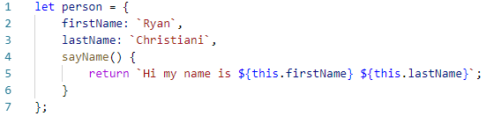
EXPRESSIONS
In the new Template Literal syntax we have what are called expressions, and they look like this: ${expression}. Consider the code below.
We can evaluate any sort of expressions that we would like
We can also use this with a more complex object

Slide 14
STRING OBJECT AND ITS METHODS

Slide 15
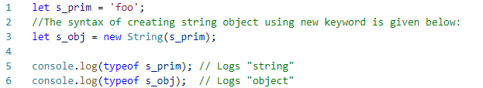
STRING OBJECT

Slide 16
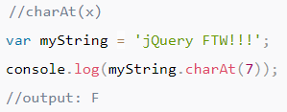
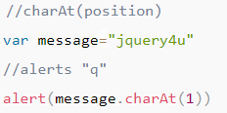
STRING METHODS
String.prototype.charAt() Returns the character (exactly one UTF-16 code unit) at the specified index.
String.prototype.charCodeAt() Returns a number that is the UTF-16 code unit value at the given index.

Slide 17
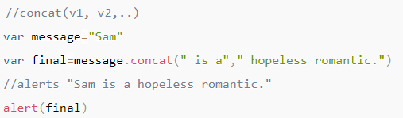
String.prototype.concat() Combines the text of two strings and returns a new string.
String.prototype.includes() Determines whether one string may be found within another string.

Slide 18
String.prototype.indexOf() Returns the index within the calling String object of the first occurrence of the specified value, or -1 if not found.
String.prototype.lastIndexOf() Returns the index within the calling String object of the last occurrence of the specified value, or -1 if not found.
String.prototype.match() Used to match a regular expression against a string.

Slide 19


String.prototype.repeat() Returns a string consisting of the elements of the object repeated the given times.
String.prototype.replace() Used to find a match between a regular expression and a string, and to replace the matched substring with a new substring.
String.prototype.search() Executes the search for a match between a regular expression and a specified string.
String.prototype.slice()

Slide 20


String.prototype.split() Splits a String object into an array of strings by separating the string into substrings.
String.prototype.startsWith() Determines whether a string begins with the characters of another string.
String.prototype.substr() Returns the characters in a string beginning at the specified location through the specified number of characters.

Slide 21



String.prototype.substring() Returns the characters in a string between two indexes into the string.
String.prototype.toLowerCase() Returns the calling string value converted to lower case.
String.prototype.toString() Returns a string representing the specified object. Overrides the Object.prototype.toString() method.

Slide 22



String.prototype.toUpperCase() Returns the calling string value converted to uppercase.
String.prototype.valueOf() Returns the primitive value of the specified object. Overrides the Object.prototype.valueOf() method.
String.prototype.trim() Trims whitespace from the beginning and end of the string. Part of the ECMAScript 5 standard.

Slide 23
USEFUL LINKS
https://developer.mozilla.org/uk/docs/Web/JavaScript/Reference/Global_Objects/String
https://www.javascript.com/learn/strings
https://javascript.info/string
https://www.javatpoint.com/javascript-string
https://css-tricks.com/template-literals/

Slide 24
Thank you!

