Slide 1
Functions. Part2
By Yurii Martynenko

Slide 2
Agenda
Binding and Applying
IIFE
Closures
Predefined functions

Slide 3
Introduction
Working with JavaScript “this” keyword can be tricky. Not knowing the background rules may end up with the famous “it works, but I don’t know why” or worse: “it doesn’t work and I don’t know why”. It’s good to know the theory before putting things into practice. Call(), Apply() and Bind() methods can come in handy when setting the “this” value.
Basic rules worth remembering:
“this” always refers to an object.
“this” refers to an object which calls the function it contains.
In the global context “this” refers to either window object or is undefined if the ‘strict mode’ is used.

Slide 4
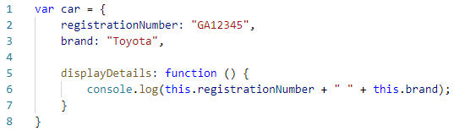

The above will work perfectly fine as long as we use it this way:
But what if we want to borrow a method?
Well, this won’t work as the “this” will be now assigned to the global context which doesn’t have neither the registrationNumber nor the brand property.

Slide 5
BINDING & APPLYING

Slide 6
BIND
Syntax
The bind() method creates a new function that, when called, has its this keyword set to the provided value, with a given sequence of arguments preceding any provided when the new function is called. – MDN
For such cases we can use the ECMAScript 5 bind() method of the Function.prototype property. This means bind() can be used by every single function.
The bind() method creates a new function where “this” refers to the parameter in the parenthesis in the above case “car”. This way the bind() method enables calling a function with a specified “this” value.

Slide 7
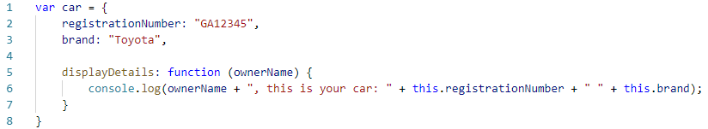
BIND
What if we would like to pass a parameter to the displayDetails function? We can use the bind method again. The following argument of the bind() method will provide an argument to the function bind() is called on.
Let me rewrite the car object:
Example of passing arguments with bind():

Slide 8
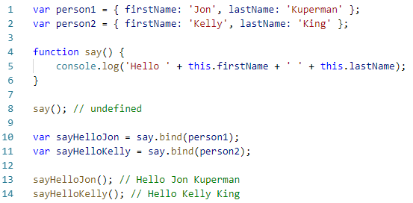
Other example
Notes:
1, 2 – Створюємо простий обєкт, щоби використовувати його в якості контексту
4 – функція, яка повертає властивість this.firstName I this.lastName, контекста this.
8 – властивість не існує в текучій зоні видомості
10, 11 – але якщо звяжемо цю функцію з контекстом
13, 14 – Тепер властивість в області видомості

Slide 9
Apply
Syntax
The apply() method calls a function with a given this value, and arguments provided as an array (or an array-like object). - MDN
Similar but slightly different usage provide the call() and apply() methods which also belong to the Function.prototype property.
This time there is a car object without the displayDetails function, which is located in the global context.

Slide 10
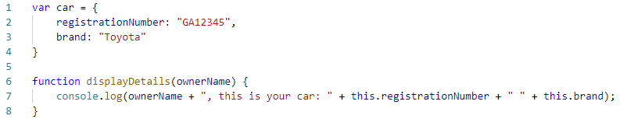
Apply
We can use the apply() function:
Note that when using the apply() function the parameter must be placed in an array.

Slide 11
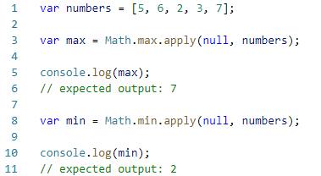
Other example
Note: When the first argument is undefined or null a similar outcome can be achieved using the array spread syntax.

Slide 12
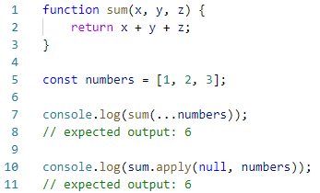
Spread syntax
Spread syntax allows an iterable such as an array expression or string to be expanded in places where zero or more arguments (for function calls) or elements (for array literals) are expected, or an object expression to be expanded in places where zero or more key-value pairs (for object literals) are expected. - MDN

Slide 13
Syntax
For function calls:
For array literals or strings:
For object literals (new in ECMAScript 2018):

Slide 14
IIFE

Slide 15

IIFE
An IIFE (Immediately Invoked Function Expression) is a JavaScript function that runs as soon as it is defined. – MDN.
It is a design pattern which is also known as a Self-Executing Anonymous Function and contains two major parts. The first is the anonymous function with lexical scope enclosed within the Grouping Operator (). This prevents accessing variables within the IIFE idiom as well as polluting the global scope.
The second part creates the immediately executing function expression () through which the JavaScript engine will directly interpret the function.

Slide 16

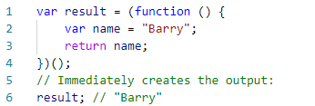
Example
The function becomes a function expression which is immediately executed. The variable within the expression can not be accessed from outside it.
Assigning the IIFE to a variable stores the function's return value, not the function definition itself.

Slide 17
CLOSURES

Slide 18
What’s a closure?
closure is a function together with a referencing environment for the non-local variables of that function
closure is a specified kind of object that combines two things: a function, and the environment in which that function was created
a function remembers what happens around it

Slide 19
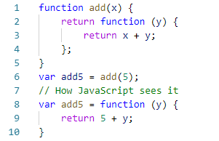
How to create a closure?
Crate a inner function and return it to outside.
For example:

Slide 20
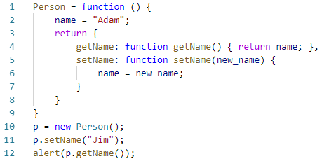
Emulate private function

Slide 21
Advantage & Disadvantage
Advantage
bring any object along with the scope chain
data encapsulation
make event handling logic more clear
Disadvantage
slow speed
more memory consumption

Slide 22
PREDEFINED FUNCTIONS

Slide 23
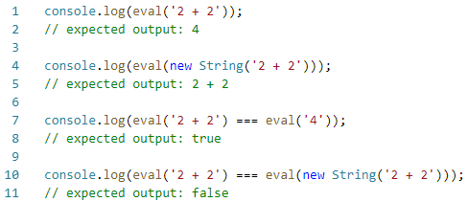
PREDEFINED FUNCTIONS
JavaScript has several top-level, built-in functions:
The eval() function evaluates JavaScript code represented as a string.

Slide 24
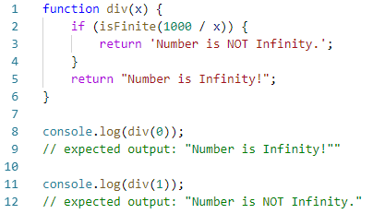
PREDEFINED FUNCTIONS
The global isFinite() function determines whether the passed value is a finite number. If needed, the parameter is first converted to a number.

Slide 25
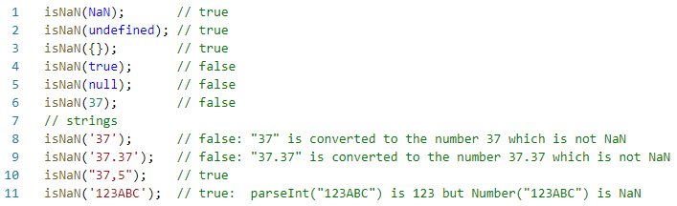

PREDEFINED FUNCTIONS
The isNaN() function determines whether a value is NaN or not.
The parseFloat() function parses an argument and returns a floating point number.

Slide 26


PREDEFINED FUNCTIONS
The parseInt() function parses a string and returns an integer.
The Number() function converts an object's value to a number.

Slide 27
PREDEFINED FUNCTIONS
The String() function convert different objects to strings.
The encodeURI() / decodeURI() functions encodes / decodes special characters, except: , / ? : @ & = + $ #.

Slide 28

PREDEFINED FUNCTIONS
The encodeURIComponent() / decodeURIComponent() functions can encode / decode special characters: , / ? : @ & = + $ #.

Slide 29
USED MATERIALS
https://habr.com/ru/post/199456/
https://developer.mozilla.org/en-US/docs/Web/JavaScript/Reference/Operators/Spread_syntax
https://developer.mozilla.org/en-US/docs/Web/JavaScript/Reference/Global_Objects/Function/apply
https://www.codingame.com/playgrounds/9799/learn-solve-call-apply-and-bind-methods-in-javascript

Slide 30
Thank you!

