Slide 1
ZK Circuits Workshop

Slide 2
Outline
Introduction to zk-SNARK
Introduction to zk Circuits
Introduction to Noir
Exercise

Slide 3
zk-SNARK
The acronym zk-SNARK stands for Zero-Knowledge Succinct Non-Interactive Argument of Knowledge and refers to a proof construction where one can prove possession of certain information, e.g., a secret key, without revealing that information, and without any interaction between the prover and verifier.
Source: https://z.cash/learn/what-are-zk-snarks/

Slide 4
zk-SNARK
Zero Knowledge: The prover convinces the verifier about the truth of a statement without revealing any information.
Argument of Knowledge: The prover convinces the verifier that they know the solution to a problem (not only that it exists)
  Example 1: I convince you that I know the solution to a Sudoku without telling you the solution numbers

Slide 5

zk-SNARK
  Example 2: Where's Waldo?

Slide 6
zk-SNARK
  Example 2: Where's Waldo?

Slide 7

zk-SNARK

Slide 8
zk-SNARK
Non-Interactive: The prover can generate the proof on its own, without interaction with the verifier.
Succint: The proof can be verified very quickly and is small, even if the problem behind it is big.

Slide 9
zk-SNARK
More examples:
  I know the private key to this public key
    By showing that I can derive the public key from it
  I know the preimage of this hash
    By showing that I get this hash by applying the hash function to some value
  I’m over 18 years old
    By showing that the government has signed my birth date, and elapsed(current date, my birth date) >= 18 years

Slide 10
Zk Circuits
A zk-SNARK allows us to convince a 3rd party that we know the solution to a computational problem.
Moreover we can choose which data we make public and which data is kept private.

Slide 11
Zk Circuits: Flow
Setup
  Choose a problem that can be encoded into a function that returns a boolean.
  Encode the function as a circuit (this encoding depends on the zkSNARK system)
  Perform a setup using the circuit to generate auxiliary verifying keys that bind the circuit

Slide 12
Zk Circuits: Flow
Proving & Verifying
  Prover has a solution to the problem (some inputs to the function that make it return True)
  Prover uses this inputs to generate a proof. This takes a long time.
  Prover sends the proof and some of the inputs (the public inputs) to the verifier
  Verifier takes the proof and keys from the setup, and runs a check that returns true if the proof is valid

Slide 13
Zk Circuits: Flow
func f(publicInputs: []Int, privateInputs: []Int) bool
Prover:
  Knows `publicInputs` and `privateInputs` such that:
    `f(publicInputs, privateInputs) == true`
  Uses these inputs to generate a `proof`
Verifier:
  Runs a verification: `verification(proof, verifyingKey, publicInputs)` which is only `true` if the `proof` was generated with `publicInputs` and `privateInputs` such that:
    `f(publicInputs, privateInputs) == true`

Slide 14
Zk Circuits: Aritmetization
The process of encoding the function is called arithmetization
Different proof systems use different arithmetizations:
  Groth16: R1CS
  Halo2, Plonky2: Plonk(ish)
  Plonky3: AIR
  GKR: arithmetic circuits

Slide 15
Zk Circuits: Aritmetization
Most arithmetizations consist of a way to create a list of polynomial expressions (with different restrictions) that when evaluated on the witness (the “problem” solution) become 0.
Only* if all those expressions evaluate to 0 the proof verification succeeds.

Slide 16
Zk Circuits: Aritmetization
Define a list of arithmetic expressions that use `publicInputs` and `privateInputs` as variables, and evaluate to 0 only if `f(publicInputs, privateInputs) == true`
Example1:
func f(x: Int, y: Int, z: Int) bool {
return x * y == z
}
p(x, y, z) = x * y - z

Slide 17
Zk Circuits: Aritmetization
Example2:
func f(opt: bool, x: Int, y: Int, z: Int) bool {
if (opt) {
return x * y == z
} else {
return x + y == z
}
}
p(opt, x, y, z) = (1-opt)*(x + y - z) + opt*(x * y - z)

Slide 18
Zk Circuits: Aritmetization
Example2:
func f(opt: bool, x: Int, y: Int, z: Int) bool {
if (opt) {
return x * y == z
} else {
return x + y == z
}
}
p(opt, x, y, z) = (1-opt)*(x + y - z) + opt*(x * y - z)

Slide 19
Zk Circuits: Difference from CPU execution
In a CPU we have a set of instructions that take variable time, and in each cycle we run one instruction.
  When we have an if/else the execution only follows one path
In an arithmetic circuit we don't have cycles! We must "flatten" all the possible execution paths, and "run" them all at the same time and discard the paths that we don't need by multipying by 0.

Slide 20
Zk Circuits: Difference from CPU execution
Example3:
func f(n: Int, x: Int, y: Int) bool {
r := 0
for (i = 0; i < n; i++) {
r = r + x
}
return r == y
}
For an arithmetic circuit we need to unroll the loop to the max value of `n`!

Slide 21
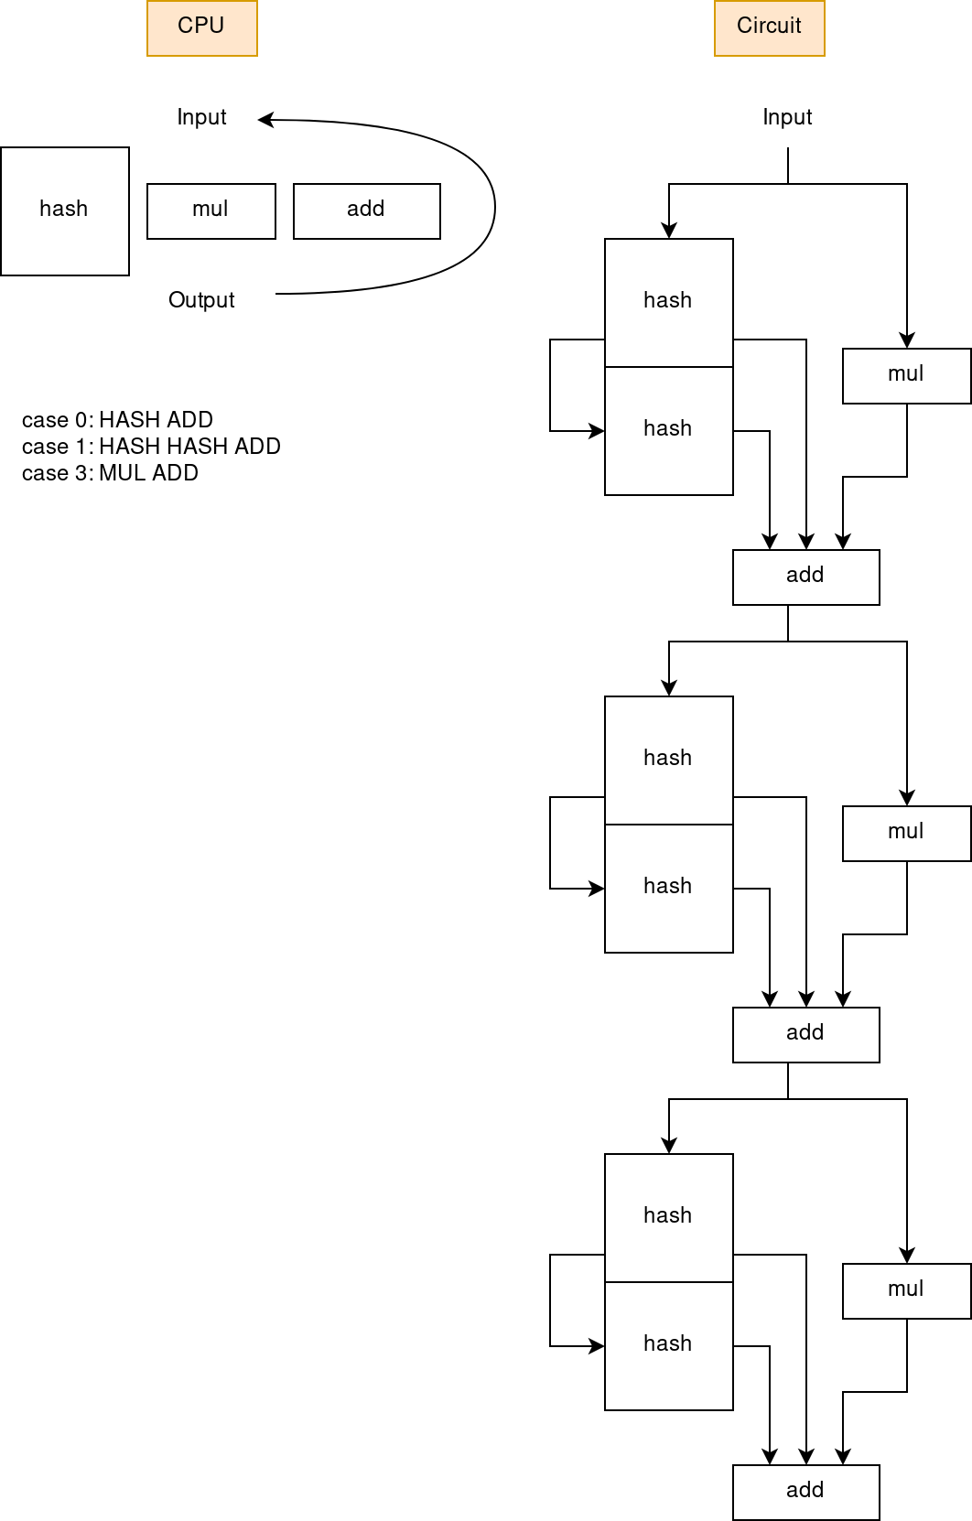
Zk Circuits: Difference from CPU execution
Example4:
func f(opts: [3]Int, x: Int, y: Int) bool {
r := 0
for opt in opts {
switch (opt) {
case 0:
r += hash(x)
case 1:
r += hash(hash(x))
case 2:
r += x * x
}
}
return r == y
}

