Slide 1
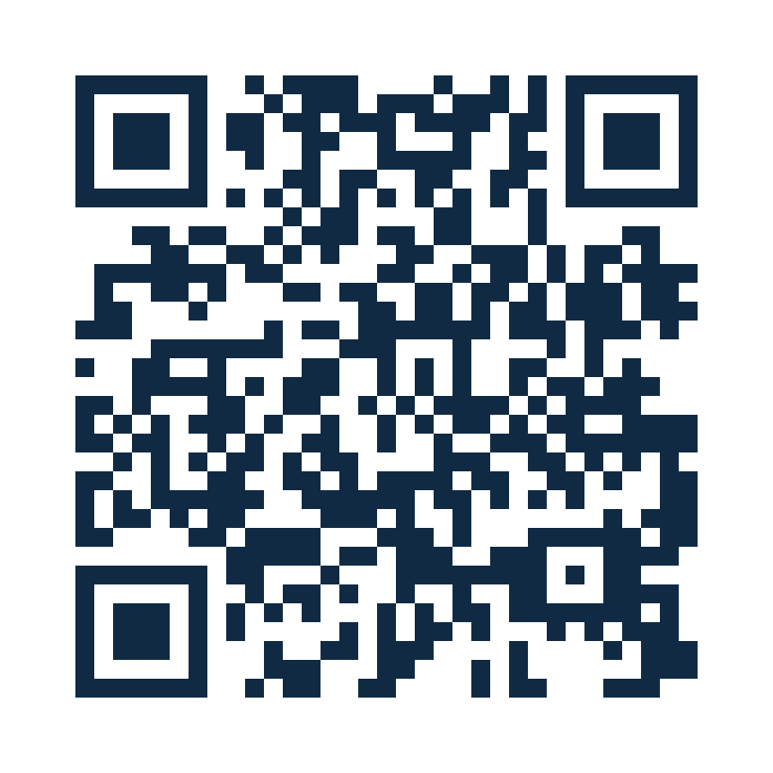
HANDS-ON WORKSHOP
Build a Governed
MCP Agent
From REST API to APIM-hosted MCP tools, Microsoft Foundry agents, and production controls
Six-hour workshop | Labs 0 through 6
Microsoft Foundry + Azure API Management + Model Context Protocol
WORKSHOP REPO
aka.ms/MCPWorkshop
Public workshop edition
Notes:
Open with the participant outcome: one governed tool layer that can serve both code-first and low-code agents. Frame the workshop as a build sequence rather than a product tour.

Slide 2
WORKSHOP PROMISE
What participants will build
A complete path from an API contract to a governed agent experience
Reliable API surface
MCP tool layer
Agent experiences
Production controls
Import a synthetic OpenAPI contract and use APIM mock responses for a repeatable sandbox.
Expose selected operations as MCP tools and validate them before an agent enters the flow.
Connect a .NET Foundry agent and compare the same tools in Copilot Studio.
Apply identity, approvals, policies, monitoring, and ownership boundaries.
Success = the final prompt is grounded in the API, protected by clear approval boundaries, and observable end to end.
Outcome first: build, validate, govern
Notes:
Use this slide to set the success criteria. The workshop is complete only when the tool call is grounded, controlled, and observable.

Slide 3
REFERENCE ARCHITECTURE
One governed tool layer, two agent paths
APIM hosts the MCP boundary. Agents focus on intent, tool selection, and response composition.
Microsoft Agent 365
Governance plane
APIM Control Plane
Policies and controls
Participant
Agent Harness
MCP Server
REST contract
Backend
Prompt or client
Foundry or Copilot Studio
Tools and policy boundary
OpenAPI operations
Mock response or Petstore
Application Insights
Agent and APIM telemetry
Architecture: intent stays with the agent harness, controls stay in APIM, and telemetry converges in Application Insights
Notes:
Explain the separation of responsibilities. APIM is the stable governed MCP boundary. The backend can be a mock, a public API, or a real enterprise service without changing the agent concept.

Slide 4
WORKSHOP JOURNEY
Six hours from sandbox to production decisions
Breaks and lunch sit outside the six hours.
Lab 0
60 min
Labs 1 + 2
90 min
Lab 3
75 min
Lab 4
30 min
Lab 5
45 min
Lab 6
45 min
1
Confirm
2
Expose
3
Build
4
Compare
5
Govern
6
Demonstrate
Verified sandbox
REST API as MCP tools
Code-first agent
Low-code path
Security and monitoring
Validated pattern
LAB 0
LABS 1 + 2
LAB 3
LAB 4
LAB 5
LAB 6
Six hours of guided build time
Notes:
Use the timeline to protect time. The longest blocks are the API to MCP transformation and the code-first agent. Optional extensions should not displace the core path.

Slide 5
LAB 0 | CONFIRM
Start with a sandbox that can succeed
Validate identity, network, tools, quota, and synthetic data before the build begins.
Local tools
Identity
.NET 10, Azure CLI, azd, Node.js, VS Code, Foundry Toolkit
Azure CLI sign-in, project access, APIM access, and model deployment permissions
Network
Sandbox values
Reach Foundry, APIM, model endpoints, and package feeds from the participant laptop
Project endpoint, APIM gateway URL, MCP path, deployment name, and test data
Gate: every participant can call the model endpoint and reach the APIM gateway before Lab 1.
Lab 0 output: verified prerequisites
Notes:
Do not start with configuration drift. Resolve identity and network issues here. Keep customer or production data out of the workshop sandbox.

Slide 6
LAB 1 | IMPORT
Turn an OpenAPI contract into a reliable sandbox API
APIM mock responses remove backend dependencies while preserving realistic operations and schemas.
1
Import the contract
2
Apply mock-response
3
Test REST first
Create the work-request API from OpenAPI. Preserve operation IDs, schemas, and example payloads.
Return static examples through APIM so every participant sees the same data and errors.
Call each operation directly. Confirm status codes, payload shape, and the selected subscription model.
Sandbox simplification
Optional live profile
Static mocks do not persist creates or updates. Discuss this limit before the final demonstration.
Import Swagger Petstore to demonstrate the same pattern against a public backend.
Lab 1 output: tested REST API
Notes:
Stress the ordering: prove REST behavior before generating MCP tools. The mock path keeps the group moving. The Petstore path adds a live backend without changing the architecture.

Slide 7
LAB 2 | EXPOSE
Transform selected REST operations into MCP tools
Tool names, schemas, and descriptions come from the API contract. Good OpenAPI becomes good tool design.
REST operations
Generated MCP tools
GET
/work-requests/{id}
READ
getAWorkRequest
APIM
REST → MCP
POST
/work-requests
WRITE
createAWorkRequest
PATCH
/work-requests/{id}/status
WRITE
updateWorkRequestStatus
MCP endpoint
https://<gateway>/<mcp-path>/mcp
Lab 2 output: working MCP endpoint
Notes:
The REST to MCP step is a transformation, not a rewrite. Point out how operation IDs and descriptions influence the model's tool selection.

Slide 8
LAB 2 | VALIDATE
Test the MCP server before connecting an agent
A direct client separates tool and policy issues from agent orchestration issues.
MCP Inspector
VS Code MCP client
Pass criteria
Best for protocol visibility.
List tools, inspect schemas, add headers, and run individual tools with explicit arguments.
Best for developer workflow.
Add the server configuration, discover tools, and validate the endpoint from the editor.
Tools list successfully.
A read-only tool returns the expected payload. Errors are understandable and traceable.
Streaming rule: keep frontend response payload logging at 0 bytes and do not access context.Response.Body in MCP policies.
Checkpoint: prove the protocol before the agent
Notes:
This checkpoint saves time. If MCP Inspector cannot list and call the tools, stop here. Agent troubleshooting should begin only after the direct MCP client passes.

Slide 9
LAB 3 | BUILD
Create a code-first Foundry agent that uses MCP tools
The ASP.NET Core application exposes the Responses protocol and keeps the tool profile in configuration.
Configuration drives behavior
.NET 10 agent app
PROJECT_ENDPOINT
Foundry project
ASP.NET Core hosted agent
MODEL_DEPLOYMENT
Chat model
Responses protocol endpoint
MCP_ENDPOINT
APIM MCP URL
AzureCliCredential for local auth
Environment-driven MCP profile
ALLOWED_TOOLS
Tool allowlist
Approval groups for write tools
APPROVAL_TOOLS
State changes
One compiled app supports multiple workshop profiles.
Lab 3 output: configurable code-first agent
Notes:
Position the sample as a reusable profile-driven host. The application code stays stable while endpoints, tool lists, names, and approval behavior change through environment variables.

Slide 10
LAB 3 | AGENT BEHAVIOR
Keep reads automatic. Require consent for material state changes.
The agent approval boundary complements APIM policy. It does not replace API authorization.
Interpret
Discover
Decide
Execute
Compose
Understand the request and select a tool
Load the allowed MCP tool schema
Check whether the tool needs approval
Call APIM and receive the result
Return a grounded response
getAWorkRequest
createAWorkRequest
updateWorkRequestStatus
AUTOMATIC
APPROVAL REQUIRED
APPROVAL REQUIRED
Approval is a deliberate product boundary
Notes:
Use the tool examples to make approval concrete. The read path should feel fluid. Creates and status changes should pause before execution so participants can discuss consent and auditability.

Slide 11
LAB 3A | RUN LOCALLY
Start the Responses API, then test it two ways
Run the ASP.NET Core host on port 8088 before connecting PowerShell or Agent Inspector.
1. Run the ASP.NET Core web project
Responses endpoint
http://localhost:8088/responses
dotnet run --project .\src\Workshop.Agent\Workshop.Agent.csproj
2A. PowerShell smoke test
2B. Foundry Agent Inspector
Create $body from the lab payload, then call the running API.
Confirm the expected tool is selected and the response is grounded.
Open Agent Inspector from Foundry Toolkit and connect to http://localhost:8088.
Use /responses if the connection form requires the full endpoint, then inspect the complete run.
Invoke-RestMethod -Method Post `
-Uri "http://localhost:8088/responses" `
-ContentType "application/json" `
-Body $body
Foundry Toolkit: Open Agent Inspector
Local auth: set AZURE_TOKEN_CREDENTIALS=AzureCliCredential, then restart the agent.
Local validation: protocol behavior and execution trace
Notes:
Run the ASP.NET Core web project first. Confirm that the Responses API is listening at http://localhost:8088/responses before opening either client. For the PowerShell smoke test, prepare $body from the lab request payload and run the displayed Invoke-RestMethod command. Open Agent Inspector from Foundry Toolkit for the teaching view because it exposes model input, tool discovery, tool calls, approvals, and the final response.

Slide 12
LAB 3B | SWITCH PROFILE
Reuse the same agent host against a different MCP server
Configuration changes the endpoint, allowlist, approvals, name, and instructions. The binary stays the same.
Work-request profile
Endpoint: work-request MCP
Allowed: get, create, update status
Approval: create and update
Backend: APIM mock-response
Shared agent host
ASP.NET Core
Responses protocol
Foundry integration
Petstore profile
Endpoint: Petstore MCP
Allowed: find by ID, find by status
Approval: none for read-only tools
Backend: public Swagger Petstore
Profile-driven design separates reusable hosting code from scenario-specific tool policy.
Optional extension: same host, different tool profile
Notes:
This slide reinforces reuse. The Petstore profile is not a second application. It proves that the host can be configured for a different MCP server and approval model.

Slide 13
LAB 3C | DEPLOY
Move from localhost to a Foundry-managed agent runtime
Two deployment interfaces read the same azure.yaml and create the same hosted-agent runtime.
Path A: Foundry Toolkit
Use the VS Code deployment experience.
Read the service from azure.yaml, resolve values from the source .env, then deploy from the editor.
Foundry Agent Service
Path B: Azure Developer CLI
Single shared target
Managed compute + sandbox
Immutable agent version
Use the same azure.yaml from the repository.
Resolve values from the selected azd environment, then deploy one named agent service.
BOTH PATHS INCLUDE
Code deployment
Remote dependency resolution
No participant-managed ACA or ACR
No physical infra folder required
Hosted option: Foundry manages the runtime
Notes:
Present Path A and Path B as two interfaces over the same deployment manifest. Foundry Toolkit reads the selected service from azure.yaml and resolves declared values from the source .env or process environment. azd reads the same service definition and resolves values from the selected azd environment. Both paths package the same source and create an immutable hosted-agent version in Foundry Agent Service.

Slide 14
LAB 4 | COMPARE
Use the same MCP tools in two agent experiences
The governed tool layer is reusable. The orchestration and maker experience can vary.
Comparison
Foundry code-first agent
Copilot Studio agent
Primary audience
Developers
Makers and fusion teams
Control surface
Code, config, SDKs
Visual authoring and connectors
Deployment
Foundry Agent Service
Copilot Studio environment
Approval UX
Application-defined
Platform and flow dependent
Best fit
Custom runtime behavior
Rapid business workflow iteration
Choose the agent experience by workflow and operating model, not by tool access.
Lab 4 output: low-code path using the same tools
Notes:
Avoid declaring one approach universally better. The value is the shared governed tool layer. Selection depends on customization needs, delivery ownership, and the target workflow.

Slide 15
LAB 5 | GOVERN
Layer controls across identity, APIM, agents, and operations
Use defense in depth. When enabled, Agent 365 adds an enterprise governance plane around these runtime controls.
AGENT 365 ENTERPRISE GOVERNANCE
Identity and access
Who can connect? Which tenant, application, user, or workload identity is trusted?
APIM gateway policy
Validate tokens, limit rates, add correlation, protect backends, and shape audit evidence.
Agent tool policy
Allowlist tools, define approvals, and constrain the agent's action surface.
Monitoring and response
Observe latency, failures, usage, and material actions. Define escalation and support.
Governed action
Lab 5 output: governed sandbox design
Notes:
Walk from outside to inside. Identity determines who connects. APIM enforces gateway controls. The agent limits tools and asks for approval. Operations teams monitor and respond. The surrounding Microsoft Agent 365 plane adds enterprise inventory, ownership, identity, lifecycle, security, and compliance when it is enabled. It complements these runtime controls rather than replacing them. Published Foundry agents appear in the Agent 365 registry automatically. Activity ingestion and broader security and compliance features require tenant licensing and administrator enablement. Hosted-agent telemetry also requires the Agent 365 SDK and Microsoft Entra permissions.

Slide 16
LAB 5 | IDENTITY EXTENSION
Choose the Lab 5 access path
Start with the anonymous sandbox. The optional identity extension uses the same bearer token, supplied manually or acquired through OAuth + PKCE.
Anonymous sandbox
Manual token injection
Client-managed OAuth
No access token or user identity.
Fastest workshop path.
Use correlation, rate limiting, tracing, and a controlled network boundary.
Do not mistake policy controls for authentication.
Acquire a delegated access token outside the MCP client.
Send Authorization: Bearer <access-token>.
Useful for one-time validation, not a production sign-in experience.
Discover the protected resource and authorization server.
Run interactive sign-in and consent with Authorization Code + PKCE.
Cache and refresh tokens in the client.
UNAUTHENTICATED
MANUAL TEST
CLIENT-MANAGED
Same bearer token reaches APIM. Only token acquisition, discovery, and lifecycle differ.
Lab 5 optional extension: delegated Microsoft Entra OAuth
Notes:
Slide 16 is the optional identity extension within Lab 5. Bearer is the token presentation method, not an alternative to OAuth. Both authenticated paths send the delegated access token in the Authorization header, and APIM validates the same issuer, audience, client, and scope claims. The middle card is manual token injection for a one-time test. The right card is client-managed MCP OAuth, which uses protected-resource metadata, a 401 challenge, compatible client registration, Authorization Code with PKCE, consent, token caching, and refresh.

Slide 17
LAB 5 | MONITOR
Verify Lab 5 correlation from APIM to the backend
Correlation identifies the request path; JWT identifies the caller. APIM creates or preserves x-correlation-id.
Client
Agent
APIM MCP
REST API
Backend
Client + agent tracing: production extension
LAB 5: x-correlation-id + trace metadata
Latency
Failures
Usage
Audit
Model, tool, API, backend
Auth, schema, streaming, backend
Requests, tools, tokens, users
Approvals and material actions
Lab 5 verification: gateway correlation and diagnostics
Notes:
Slide 17 is the monitoring verification within Lab 5. The workshop policy preserves an incoming x-correlation-id or creates a GUID at APIM, records it in trace metadata, and forwards it downstream. This correlation ID is separate from the JWT. The access token establishes identity and authorization; the correlation ID connects telemetry for one request. Because the workshop policy starts at APIM, correlating the client and agent requires an upstream correlation header or additional W3C trace-context instrumentation.

Slide 18
LAB 6 | DEMONSTRATE
Tell one complete story with three prompts
The final demo moves from safe retrieval to a governed state change.
1
Retrieve
2
Recommend
3
Change
"Get work request WR-1001 and explain what is blocking approval."
"What information should be collected before this request can move forward?"
"Update the status after the required details are confirmed."
AUTOMATIC READ AND GROUNDED SUMMARY
REASONING OVER TOOL OUTPUT
APPROVAL BEFORE EXECUTION
Lab 6 output: end-to-end validation and action plan
Notes:
Narrate the increasing risk. Retrieval is automatic. Recommendation stays grounded in retrieved data. The final state change pauses for approval and makes the control boundary visible.

Slide 19
PRODUCTION ADAPTATION
Replace workshop shortcuts with owned platform decisions
The reference pattern is reusable. The production implementation must be explicit about each boundary.
Workshop baseline
Production decision
Backend
Static mock or public API
Enterprise API, data lifecycle, and error contract
Identity
Anonymous or manual bearer
Workload and delegated identity with lifecycle ownership
Network
Public workshop access
Private connectivity, DNS, firewall, and egress controls
Approvals
Sample tool grouping
Risk-based approvals tied to business authority
Operations
Facilitator monitoring
SLOs, alerts, runbooks, cost, and support model
Production readiness is a set of owned decisions, not a final toggle.
Adapt the pattern without losing the control boundaries
Notes:
Use this slide for the architecture discussion. For each row, identify an owner and the evidence needed before a production release.

Slide 20
FACILITATION CHECKPOINTS
Protect the core path with explicit recovery routes
The workshop should continue even when optional tooling or identity paths fail.
REST import or mock fails
Use the facilitator-provided APIM API and continue to MCP.
MCP streaming fails
Set frontend response logging to 0 bytes. Remove response-body policy access.
Local auth reaches IMDS
Set AzureCliCredential in the local environment, then restart.
OAuth sign-in cannot start
Use a separately acquired bearer token. Keep full discovery as an extension.
Time rule: teach the core pattern first. Add Petstore, hosted deployment, and OAuth only after the baseline passes.
Facilitator pattern: checkpoint, recover, continue
Notes:
Explain that recovery routes are part of the workshop design. The facilitator should preserve the learning sequence instead of spending the session debugging optional extensions.

Slide 21
CLOSEOUT
Leave with a pattern and a decision list
Confirm the next API, owner, identity model, approval boundary, and production evidence.
Select the use case
Assign control owners
Plan the delivery path
Choose a real workflow with a clear API and measurable outcome.
Identity, APIM, approvals, monitoring, and support.
Environment promotion, protected deployment, smoke tests, and rollback.
Workshop repository
Open the repository README for workshop files
Labs, policies, sample agent, architecture, and deployment guidance
Notes:
Close by converting learning into decisions. Capture the candidate API, business owner, platform owner, identity pattern, approval rules, deployment method, and the next validation date.

