Slide 1
Uninformed Search
Computer Science cpsc322, Lecture 5
(Textbook Chpt 3.5)
May 18, 2017
Notes:
Lecture 5

Slide 2
Recap
Search is a key computational mechanism in many AI agents
We will study the basic principles of search on the simple deterministic planning agent model
Generic search approach:
define a search space graph,
start from current state,
incrementally explore paths from current state until goal state is reached.

Slide 3
Searching: Graph Search Algorithm with three bugs ☹
Input: a graph,
a start node,
Boolean procedure goal(n) that tests if n is a goal node.
frontier := { ⟨g⟩: g is a goal node };
while frontier is not empty:
select and remove path ⟨n₀, n₁, …, n_{k}⟩ from frontier;
if goal(n_{k})
return ⟨n_{k}⟩ ;
for every neighbor n of n_{k}
add ⟨ n₀, n₁, …, n_{k} ⟩ to frontier;
end while
No solution found
The goal function defines what is a solution.
The neighbor relationship defines the graph.
Which path is selected from the frontier defines the search strategy.
Notes:
Discuss In groups - Give a few mins
After the algorithm returns, it can be asked for more answers and the procedure continues.

Slide 4

Lecture Overview
Recap
Criteria to compare Search Strategies
Simple (Uninformed) Search Strategies
Depth First
Breadth First

Slide 5
Comparing Searching Algorithms: will it find a solution? the best one?
Def. (complete): A search algorithm is complete if, whenever at least one solution exists, the algorithm is guaranteed to find a solution within a finite amount of time.
Def. (optimal): A search algorithm is optimal if, when it finds a solution , it is the best solution
Notes:
Lecture slides DO NOT contain everything that is said in class, but you are still responsible for this content
So, make sure you bring yourself up-to-date if you miss a class

Slide 6
Comparing Searching Algorithms: Complexity
Def. (time complexity)
The time complexity of a search algorithm is an expression for the worst-case amount of time it will take to run,
expressed in terms of the maximum path length m and the maximum branching factor b.
Def. (space complexity) : The space complexity of a search algorithm is an expression for the worst-case amount of memory that the algorithm will use (number of nodes),
Also expressed in terms of m and b.
Notes:
m maximum depth of the search tree

Slide 7
Lecture Overview
Recap
Criteria to compare Search Strategies
Simple (Uninformed) Search Strategies
Depth First
Breadth First

Slide 8
Depth-first Search: DFS
Depth-first search treats the frontier as a stack
It always selects one of the last elements added to the frontier.
Example:
the frontier is [p₁, p₂, …, p_{r} ]
neighbors of last node of p₁ (its end) are {n₁, …, n_{k}}
What happens?
p₁ is selected, and its end is tested for being a goal.
New paths are created attaching {n₁, …, n_{k}} to p₁
These “replace” p₁ at the beginning of the frontier.
Thus, the frontier is now [(p_{1,} n₁), …, (p_{1,} n_{k}), p₂, …, p_{r}] .
NOTE: p₂ is only selected when all paths extending p₁ have been explored.
Notes:
LIFO queue
The deepest in the current frontier

Slide 9
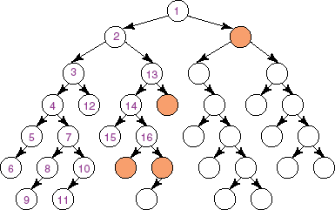
Depth-first search: Illustrative Graph --- Depth-first Search Frontier
Notes:
The longest path is expanded

Slide 10
Depth-first Search: Analysis of DFS
Is DFS complete?
Is DFS optimal?
Notes:
Show AI space: Depth-first search isn't guaranteed to halt on graphs with cycles.
Space complexity is linear

Slide 11

Depth-first Search: Analysis of DFS
What is the time complexity, if the maximum path length is m and the maximum branching factor is b ?
What is the space complexity?
O(b^{m})
O(m^{b})
O(bm)
O(b+m)
O(b^{m})
O(m^{b})
O(bm)
O(b+m)
Notes:
Show AI space: Depth-first search isn't guaranteed to halt on graphs with cycles.
Space complexity is linear

Slide 12
Depth-first Search: Analysis of DFS Summary
Is DFS complete?
Depth-first search isn't guaranteed to halt on graphs with cycles.
However, DFS is complete for finite acyclic graphs.
Is DFS optimal?
What is the time complexity, if the maximum path length is m and the maximum branching factor is b ?
The time complexity is ? ?: must examine every node in the tree.
Search is unconstrained by the goal until it happens to stumble on the goal.
What is the space complexity?
Space complexity is ? ? the longest possible path is m, and for every node in that path must maintain a fringe of size b.
Notes:
Show AI space: Depth-first search isn't guaranteed to halt on graphs with cycles.
Space complexity is linear

Slide 13
Analysis of DFS
Def. : A search algorithm is complete if whenever there is at least one solution, the algorithm is guaranteed to find it within a finite amount of time.
Is DFS complete?
No
If there are cycles in the graph, DFS may get “stuck” in one of them
see this in AISpace by adding a cycle to “Simple Tree”
e.g., click on “Create” tab, create a new edge from N7 to N1, go back to “Solve” and see what happens

Slide 14
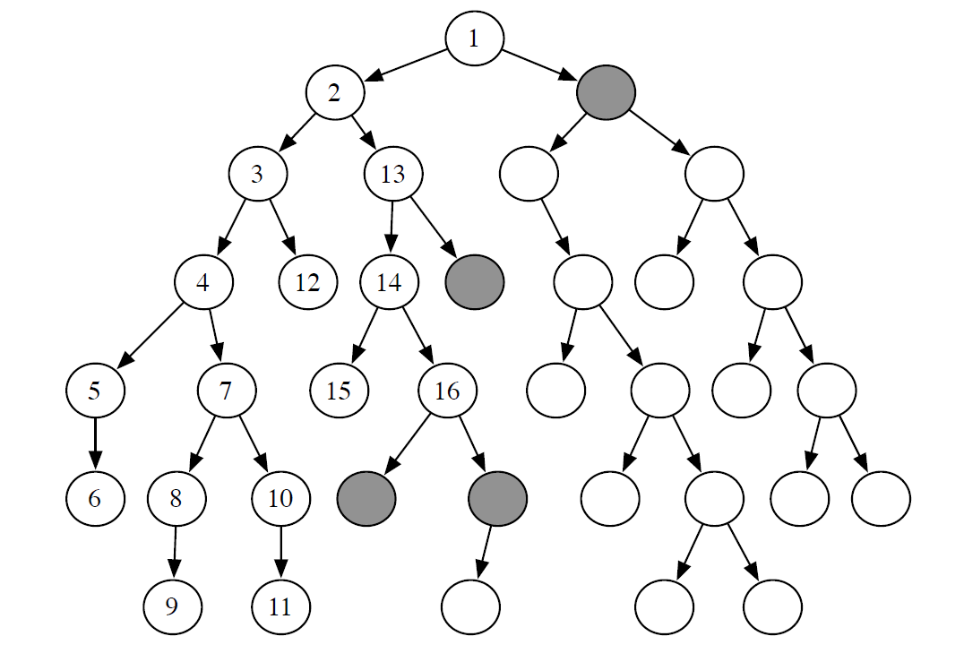
Analysis of DFS
Def.: A search algorithm is optimal if when it finds a solution, it is the best one (e.g., the shortest)
Yes
No
Is DFS optimal?
E.g., goal nodes: red boxes

Slide 15
Analysis of DFS
Def.: A search algorithm is optimal if when it finds a solution, it is the best one (e.g., the shortest)
Is DFS optimal?
No
It can “stumble” on longer solution paths before it gets to shorter ones.
E.g., goal nodes: red boxes
see this in AISpace by loading “Extended Tree Graph” and set N6 as a goal
e.g., click on “Create” tab, right-click on N6 and select “set as a goal node”

Slide 16
Analysis of DFS
Def.: The time complexity of a search algorithm is
the worst-case amount of time it will take to run,
expressed in terms of
maximum path length m
maximum forward branching factor b.
What is DFS’s time complexity, in terms of m and b ?
O(b^{m})
O(m^{b})
O(bm)
O(b+m)
E.g., single goal node -> red box

Slide 17
Analysis of DFS
Def.: The time complexity of a search algorithm is
the worst-case amount of time it will take to run,
expressed in terms of
maximum path length m
maximum forward branching factor b.
What is DFS’s time complexity, in terms of m and b ?
O(b^{m})
In the worst case, must examine every node in the tree
E.g., single goal node -> red box

Slide 18
Analysis of DFS
Def.: The space complexity of a search algorithm is the worst-case amount of memory that the algorithm will use
(i.e., the maximal number of nodes on the frontier), expressed in terms of
maximum path length m
maximum forward branching factor b.
What is DFS’s space complexity, in terms of m and b ?
O(b^{m})
O(m^{b})
O(bm)
O(b+m)
See how this
works in

Slide 19
Analysis of DFS
Def.: The space complexity of a search algorithm is the
worst-case amount of memory that the algorithm will use
(i.e., the maximum number of nodes on the frontier), expressed in terms of
maximum path length m
maximum forward branching factor b.
What is DFS’s space complexity, in terms of m and b ?
for every node in the path currently explored, DFS maintains a path to its unexplored siblings in the search tree
Alternative paths that DFS needs to explore
The longest possible path is m, with a maximum of b-1 alterative paths per node
O(bm)
See how this
works in

Slide 20
Depth-first Search: When it is appropriate?
There are cycles
Space is restricted (complex state representation e.g., robotics)
There are shallow solutions
You care about optimality
Notes:
Show AI space: Depth-first search isn't guaranteed to halt on graphs with cycles.
Space complexity is linear
Ordering heuristic is weak

Slide 21
Depth-first Search: When it is appropriate?
Appropriate
Space is restricted (complex state representation e.g., robotics)
There are many solutions, perhaps with long path lengths, particularly for the case in which all paths lead to a solution
Inappropriate
Cycles
There are shallow solutions
Notes:
Show AI space: Depth-first search isn't guaranteed to halt on graphs with cycles.
Space complexity is linear
Ordering heuristic is weak

Slide 22
Why DFS need to be studied and understood?
It is simple enough to allow you to learn the basic aspects of searching (When compared with breadth first)
It is the basis for a number of more sophisticated / useful search algorithms
Notes:
Show AI space: Depth-first search isn't guaranteed to halt on graphs with cycles.
Space complexity is linear

Slide 23
Lecture Overview
Recap
Simple (Uninformed) Search Strategies
Depth First
Breadth First

Slide 24
Breadth-first Search: BFS
Breadth-first search treats the frontier as a queue
it always selects one of the earliest elements added to the frontier.
Example:
the frontier is [p₁,p₂, …, p_{r}]
neighbors of the last node of p₁ are {n₁, …, n_{k}}
What happens?
p₁ is selected, and its end tested for being a path to the goal.
New paths are created attaching {n₁, …, n_{k}} to p₁
These follow p_{r} at the end of the frontier.
Thus, the frontier is now [p₂, …, p_{r}, (p₁, n₁), …, (p₁, n_{k})].
p₂ is selected next.

Slide 25
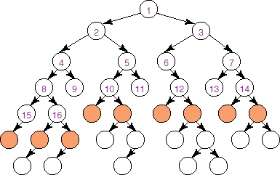
Illustrative Graph - Breadth-first Search

Slide 26
Breadth-first Search: Analysis of BFS
Is BFS complete?
Is BFS optimal?

Slide 27
Breadth-first Search: Analysis of BFS
What is the time complexity, if the maximum path length is m and the maximum branching factor is b ?
What is the space complexity?
O(b^{m})
O(m^{b})
O(bm)
O(b+m)
O(b^{m})
O(m^{b})
O(bm)
O(b+m)
Notes:
Show AI space: Depth-first search isn't guaranteed to halt on graphs with cycles.
Space complexity is linear

Slide 28


Analysis of Breadth-First Search
Is BFS complete?
Yes
In fact, BFS is guaranteed to find the path that involves the fewest arcs (why?)
What is the time complexity, if the maximum path length is m and the maximum branching factor is b?
The time complexity is ? ? must examine every node in the tree.
The order in which we examine nodes (BFS or DFS) makes no difference to the worst case: search is unconstrained by the goal.
What is the space complexity?
Space complexity is ? ?
Notes:
Is BFS complete?
(we are assuming finite branching factor)
we must store the whole frontier in memory

Slide 29
Using Breadth-first Search
When is BFS appropriate?
space is not a problem
it's necessary to find the solution with the fewest arcs
although all solutions may not be shallow, at least some are
When is BFS inappropriate?
space is limited
all solutions tend to be located deep in the tree
the branching factor is very large
Notes:
there may be infinite paths

Slide 30
When to use BFS vs. DFS?
The search graph has cycles or is infinite
We need the shortest path to a solution
There are only solutions at great depth
There are some solutions at shallow depth
Memory is limited
BFS
DFS
BFS
DFS
BFS
DFS
BFS
DFS
BFS
DFS

Slide 31
What have we done so far?
GOAL: study search, a set of basic methods underlying many intelligent agents
AI agents can be very complex and sophisticated
Let’s start from a very simple one, the deterministic, goal-driven agent for which: he sequence of actions and their appropriate ordering is the solution
We have looked at two search strategies DFS and BFS:
To understand key properties of a search strategy
They represent the basis for more sophisticated (heuristic / intelligent) search

Slide 32
Learning Goals for today’s class
Apply basic properties of search algorithms: completeness, optimality, time and space complexity of search algorithms.
Select the most appropriate search algorithms for specific problems.
BFS vs DFS vs IDS vs BidirS-
LCFS vs. BFS –
A* vs. B&B vs IDA* vs MBA*

Slide 33
Next Class
To test your understanding of today’s class
Work on Practice Exercise 3.B
http://www.aispace.org/exercises.shtml
Iterative Deepening
Search with cost
(read textbook.: 3.7.3, 3.5.3)
(maybe) Start Heuristic Search
(textbook.: start 3.6)

Slide 34
Recap: Comparison of DFS and BFS
 | Complete | Optimal | Time | Space
DFS
BFS
Notes:
Assume b finite
And step are all identical
big O notation usually only provides an upper bound on the growth rate of the function

