Slide 1
Applications of BFS and DFS
CSE 2011
Winter 2011

Slide 2
Some Applications of BFS and DFS
BFS
  To find the shortest path from a vertex s to a vertex v in an unweighted graph
  To find the length of such a path
  To find out if a strongly connected directed graph contains cycles
  To construct a BSF tree/forest from a graph
DFS
  To find a path from a vertex s to a vertex v.
  To find the length of such a path.
  To construct a DSF tree/forest from a graph.

Slide 3
Computing Spanning Trees

Slide 4
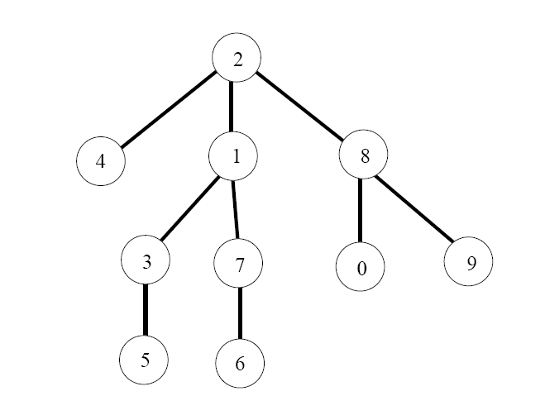
Trees
Tree: a connected graph without cycles.
Given a connected graph, remove the cycles ⇒ a tree.
The paths found by BFS(s) form a rooted tree (called a spanning tree), with the starting vertex as the root of the tree.
BFS tree for vertex s = 2
What would a level-order traversal of the tree tell you?

Slide 5
Computing a BFS Tree
Use BFS on a vertex BFS( v ) with array prev[ ]
The paths from source s to the other vertices form a tree

Slide 6
Computing Spanning Forests

Slide 7
Computing a BFS Forest
A forest is a set of trees.
A connected graph gives a tree (which is itself a forest).
A connected component also gives us a tree.
A graph with k components gives a forest of k trees.

Slide 8
Example
A graph with 3 components
P
Q
N
L
R
O
M
D
s
E
C
A
F
B
K
G
H

Slide 9
Example of a Forest
We removed the cycles from the previous graph.
P
Q
N
L
R
O
M
D
s
E
C
A forest with 3 trees
A
F
B
K
G
H

Slide 10
Computing a BFS Forest
Use BFS method on a graph BFSearch( G ), which calls BFS( v )
Use BFS( v ) with array prev[ ].
  The paths originating from v form a tree.
BFSearch( G ) examines all the components to compute all the trees in the forest.

Slide 11
Applications of DFS
Is there a path from source s to a vertex v?
Is an undirected graph connected?
Is a directed graph strongly connected?
To output the contents (e.g., the vertices) of a graph
To find the connected components of a graph
To find out if a graph contains cycles and report cycles.
To construct a DSF tree/forest from a graph

Slide 12
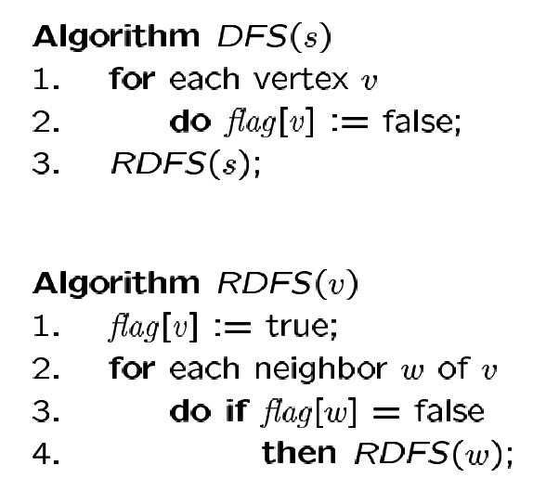
DFS Algorithm
Flag all vertices as not
visited
Flag yourself as visited
For unvisited neighbors,
call RDFS(w) recursively
We can also record the paths using prev[ ].
Where do we insert the code for prev[ ]?

Slide 13
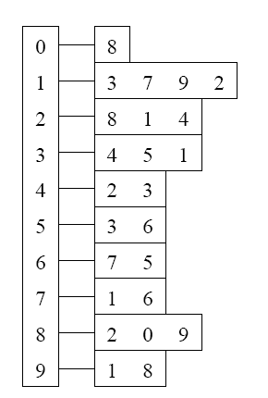
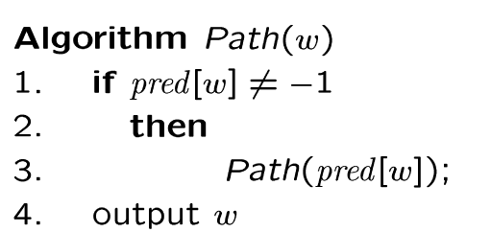
DFS Path Tracking
0
Adjacency List
Visited Table (T/F)
8
0
1
2
3
4
5
6
7
8
9
T
T
T
T
T
T
T
T
T
T
8
9
-
1
3
3
5
6
2
8
source
2
9
1
3
7
6
4
5
DFS find out path too
Pred
Try some examples.
Path(0) ->
Path(6) ->
Path(7) ->

Slide 14
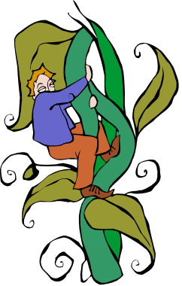
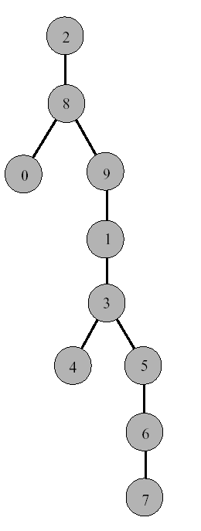
DFS Tree
Resulting DFS-tree.
Notice it is much “deeper”
than the BFS tree.
Captures the structure of the recursive calls
when we visit a neighbor w of v, we add w as child of v
whenever DFS returns from a vertex v, we climb up in the tree from v to its parent

Slide 15
Finding Cycles Using DFS
Similar to using BFS.
For undirected graphs, classify the edges into 3 categories during program execution: unvisited edge, discovery edge, and back (cross) edge.
  Code Fragment 13.1, p. 613.
  If there exists a back edge, the undirected graph contains a cycle.

Slide 16
Applications – DFS vs. BFS
What can BFS do and DFS can’t?
  Finding shortest paths (in unweighted graphs)
What can DFS do and BFS can’t?
  Finding out if a connected undirected graph is biconnected
    A connected undirected graph is biconnected if there are no vertices whose removal disconnects the rest of the graph

Slide 17
DFS vs. BFS
Applications | DFS | BFS
Spanning forest, connected components, paths, cycles | √ | √
Shortest paths |  | √
Biconnected components | √
L₀
A
A
L₁
B
C
D
B
C
D
L₂
E
F
E
F
DFS
BFS

Slide 18
Final Exam
Final Exam
  Sunday, April 17, 10:00-13:00
Materials:
  All lectures notes and corresponding sections in the textbook from the beginning to today’s lecture
  All assignments
  Homework questions

