Slide 1
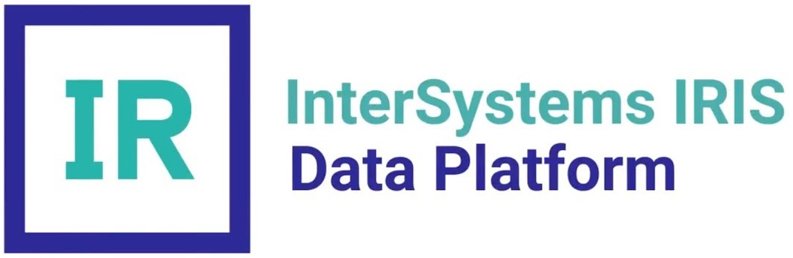







Value Canvas: Migration from InterSystems Caché to IRIS
Gains creators
Do more spending less
Integrate, enrich and orchestrate data
Analyze and get insights to make decisions
Automize workflows
Bring IA to tasks and analysis
Get IoT projects
Gains
End-to-end projects
Strategic projects
Higher performance
Cloud/DevOps support
Reports, SLA and Dashboards
API for mobile and web apps
AI and NLP functions
New features
Products and Services
Customer jobs
ML and Auto ML
Interoperability
Analytics
API Manager
NLP
Native API
Reports
Sharding
Cloud
Workflows
EDI
IoT
Realize end-to-end digital transformation
AI/Analytics jobs
IoT jobs
Mobile/Web jobs
SOA/ESB jobs
API jobs
Big Data jobs
Java, .NET, Node.js, Python jobs
Realize backend to web and mobile apps
Lack of integration
Low Performance
Low strategic value
Weak Cloud/DevOps operation
No report or dashboard options
No more evolutive versions
No IA/NLP support
IA and Auto ML help users to do creative tasks
Interoperability brings data quality, governance, reuse and business alignment
Analytics brings visibility, data empowerment and better decisions
Cloud/DevOps and Sharding allows scale to any operation scenario
Database projects only
Not performs end-to-end projects
Pain relievers
Pains

