Slide 1

552 ACNS / KUNAI

Slide 2
User Stories for Sprint
As a Do, I want to have a location to upload data from ETMS Reports, so that I am able to store the data from said reports in the application.
Digest ETMS Data (Cyber Awareness, LoW, SABC, FP, Religious Freedom)
As a DO, I want to be able to upload LOX data to the application, so that I can store my unit's readiness information
Move from Alpha Roster for Person object

Slide 3
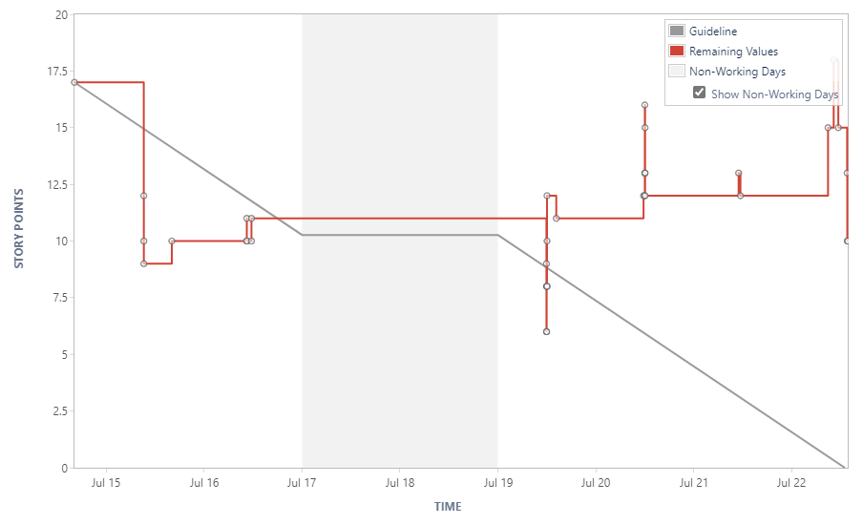
Burndown/Velocity Charts

Slide 4
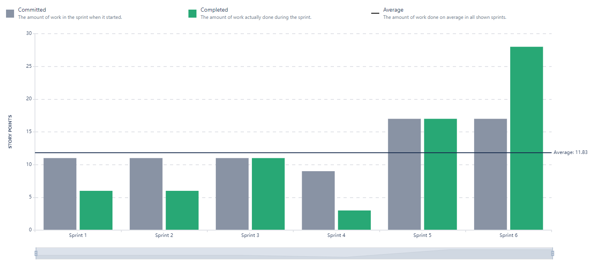
Burndown/Velocity Charts

Slide 5
Gathering Additional Requirements
Need ETMS data prioritization
IMR/UPMER Reports?
Automatic Updates Vs. Manual Uploads
Crewbuilder (Autobuild)
Lookup Tables (Supporting Information)
Exporting Data to clipboards / (ex. for hot sheets)

