Slide 1
Genetic Programming for
Multi-output Symbolic Regression
PhD Thesis
Victoria University of Wellington
Presenter: Chunyu Wang
Supervisors: Qi Chen, Bing Xue and Mengjie Zhang

Slide 2
Content
Introduction
Contribution 1: Semantic-aware Transfer
Contribution 2: RL-based Transfer
Contribution 3: Feature Selection-based Transfer
Contribution 4: Evolutionary Feature Construction
Conclusions and Future Work

Slide 3
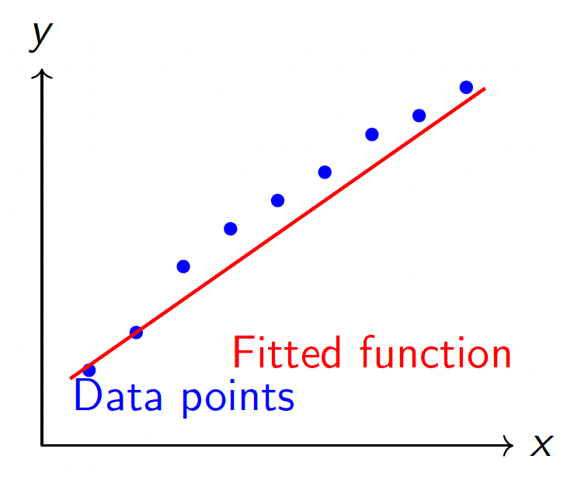
Introduction: Symbolic Regression
Definition:
  Predict continuous output Y from input X
  Simultaneously identify the model structure and the associated coefficients.
  Learn function f : X → Y
  Minimize prediction error
Evaluation Metrics:
  Normalized Root Mean Squared Error (NRMSE)
  R² Score

Slide 4
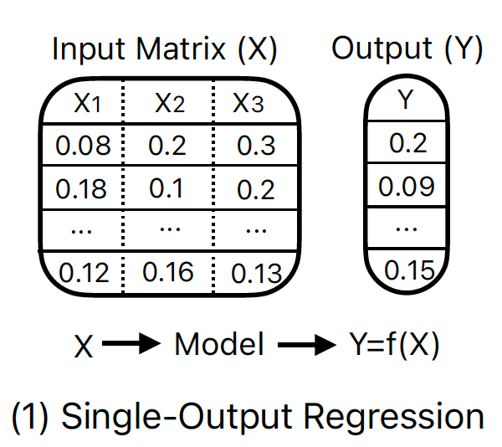
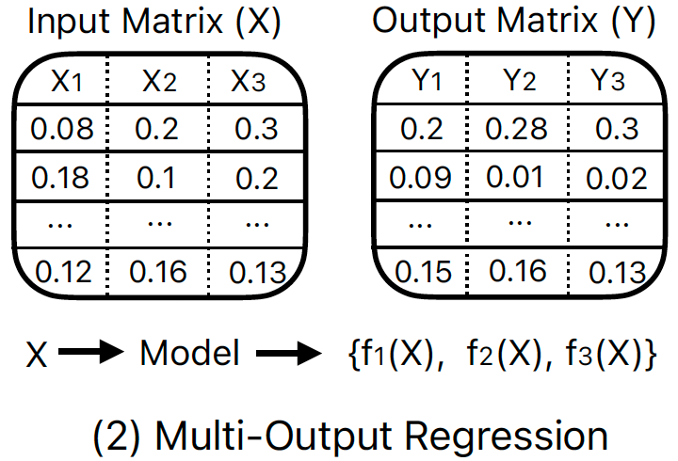
Introduction: Multi-output Symbolic Regression (MSR)
Single-output symbolic regression
  Inputs: X1, X2, ..., Xm
  Outputs: Only one dependent variable Y.
Multi-output symbolic regression
  Inputs: X1, X2, ..., Xm
  Outputs: The number of output variables is more than one Y1, Y2, ..., Yd.

Slide 5
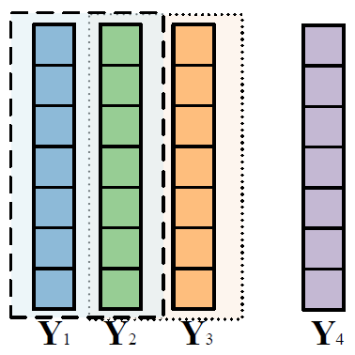
Introduction: MSR Challenge
Challenge:
  Heterogeneous Output Dependencies
  Information-Sharing Requirements
  Complex Feature Interactions
  Imbalanced Output Performance
Why GP?
  Support for MSR: multi-task/multi-tree
  Effective learning in high-dimensional datasets
  Flexible, adaptive representation
  Interpretability
{X₁}
{X₁ , X₂}
{X₂}
{X₃ , X₄}
0.1
0.2
0.03
0.8

Slide 6
Core Research Questions
How can we explore GP-based approaches to improve learning accuracy and generalization performance?
  Output Dependencies: Can we use semantics to capture output dependencies?
  Information-Sharing Requirements: Can RL help information sharing?
  Complex Feature Interactions: Can output-specific feature selection be useful?
  Imbalanced Output Performance: Can output correlations balance the output performance?

Slide 7
Content
Introduction
Contribution 1: Semantic-aware Transfer
Contribution 2: RL-based Transfer
Contribution 3: Feature Selection-based Transfer
Contribution 4: Evolutionary Feature Construction
Conclusions and Future Work

Slide 8
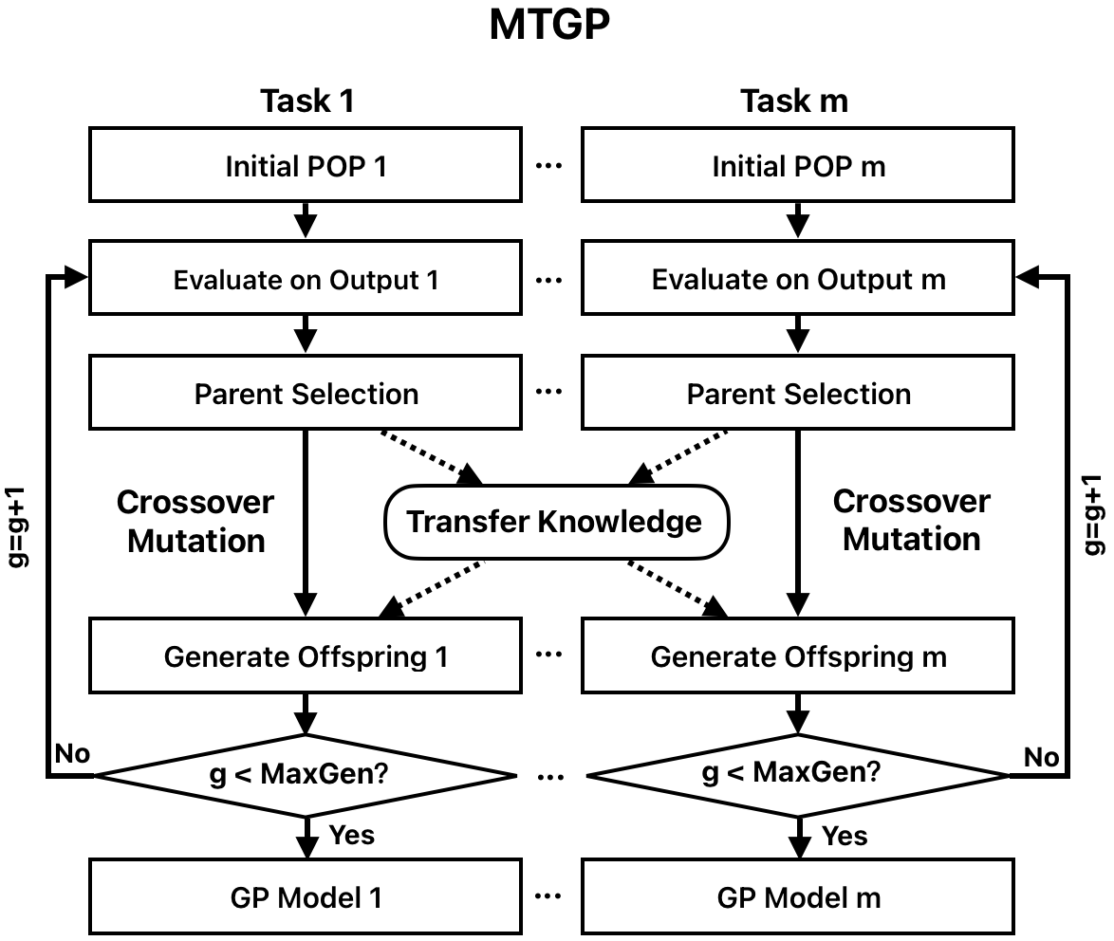
Contribution 1: Multi-task GP for MSR
Problem: MSR -> Multi-task learning: one task for one output
Multi-task Multi-population GP:
One task has one population
Best-ind in each task for one output
Transfer knowledge in different pop
Notes:
Evolutionary computation is a promising method for solving regression problems.

Slide 9
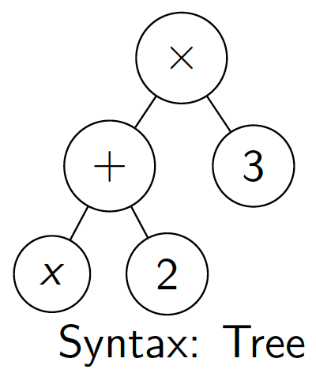
Contribution 1: Semantics in GP
Syntax vs Semantics:
  Syntax: Structure of the program (tree)
  Semantics: The output of the program (tree)
Semantics Definition:
For a GP tree ϕ and dataset X:
Semantics: s(ϕ) = [ϕ(x₁), ϕ(x₂), ..., ϕ(x_{n})]
For dataset: X = {1, 2, 3}
s(ϕ) = [9, 12, 15]
Example:
  Tree 1: (x + 2) * 3
  Tree 2: 3x + 6
  Different syntax, same semantics.
Notes:
Evolutionary computation is a promising method for solving regression problems.

Slide 10
Rethinking Transfer: From Random to Semantic
Traditional MTGP Approach:
  Transfer knowledge by crossover operator between different tasks
  No semantic consideration
Our insight: Semantic similarity impacts generalization in single-output SR
Semantics-based Crossover:
  Measure semantic similarity using cosine similarity: the direction of vectors rather than their magnitudes
  Inter-Task Semantic-based Crossover
  Intra-Task Semantic-based Crossover

Slide 11
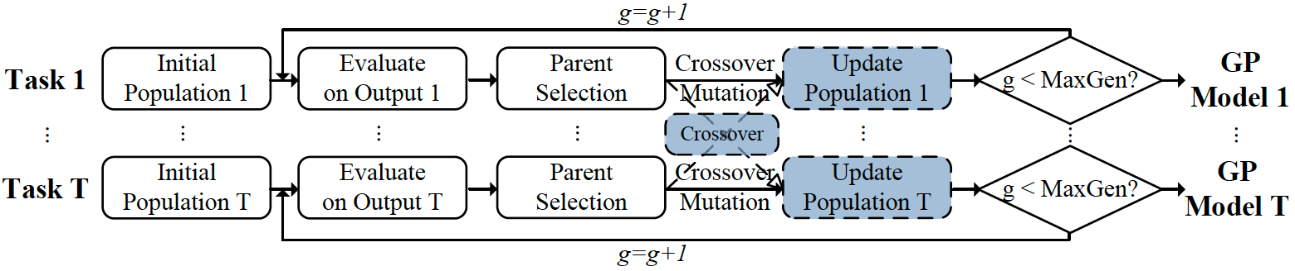
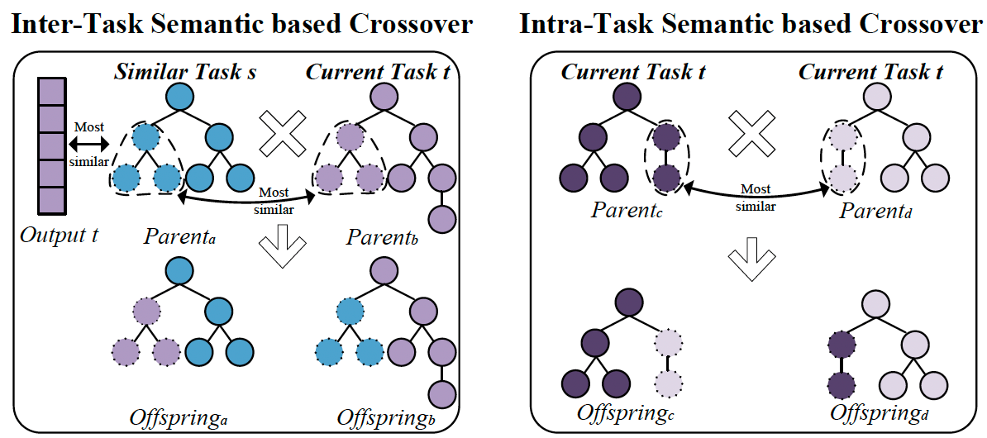
Contribution 1: Semantics-based Crossover
Notes:
Evolutionary computation is a promising method for solving regression problems.

Slide 12
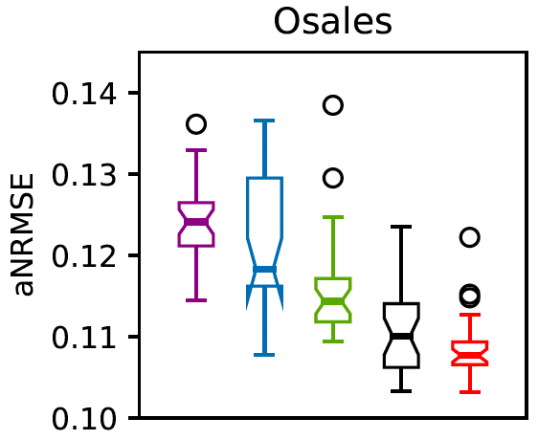
Contribution 1: Key Findings
Semantic similarity can improve generalization in MSR
MTGP
MTGPSC
Test set in 30 runs

Slide 13
Challenge for MTGP in MSR
When knowledge should be transferred:
  RL controls transfer or self-evolution
Which task knowledge should be transferred
  RL selects task ID
What knowledge should be transferred
  Propose semantics-based transfer knowledge strategy
  RL controls transfer type
Key insight: Address challenges of MTGP using RL

Slide 14
Content
Introduction
Contribution 1: Semantic-aware Transfer
Contribution 2: RL-based Transfer
Contribution 3: Feature Selection-based Transfer
Contribution 4: Evolutionary Feature Construction
Conclusions and Future Work

Slide 15
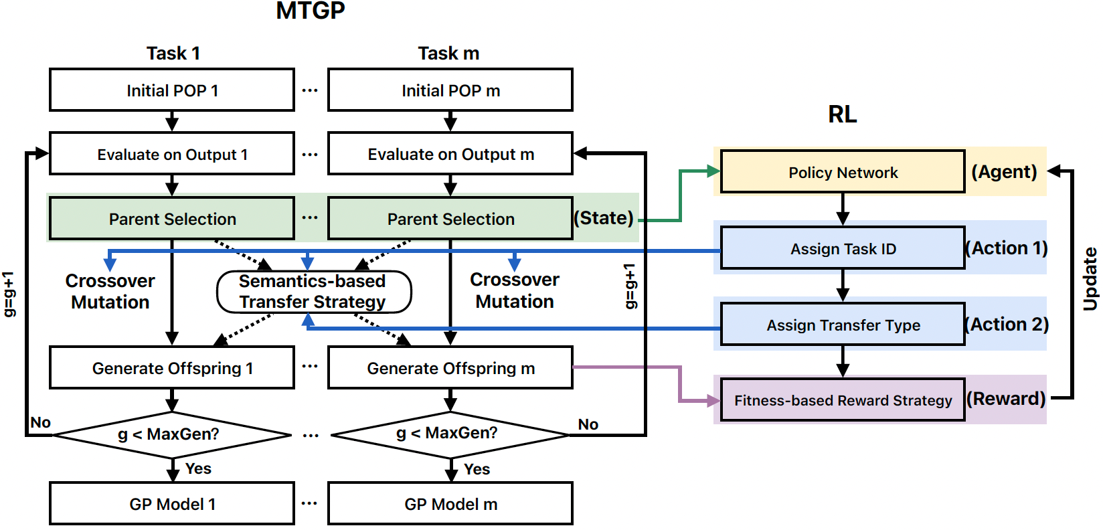
Contribution 2: Overall Algorithm
State: The semantics of parents

Slide 16
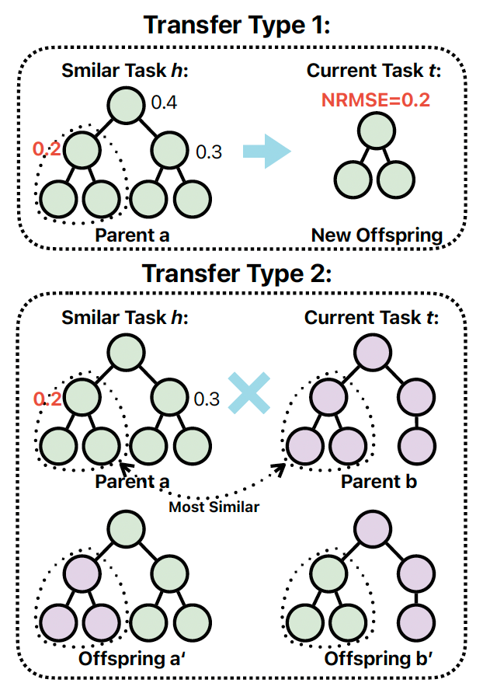
Contribution 2: Semantics-based transfer strategy
Type 1: Individual Transfer
Choose best subtree/tree as new individual
Type 2: Subtree Transfer
Semantic similarity crossover
RL chooses Transfer Type 1 or 2

Slide 17
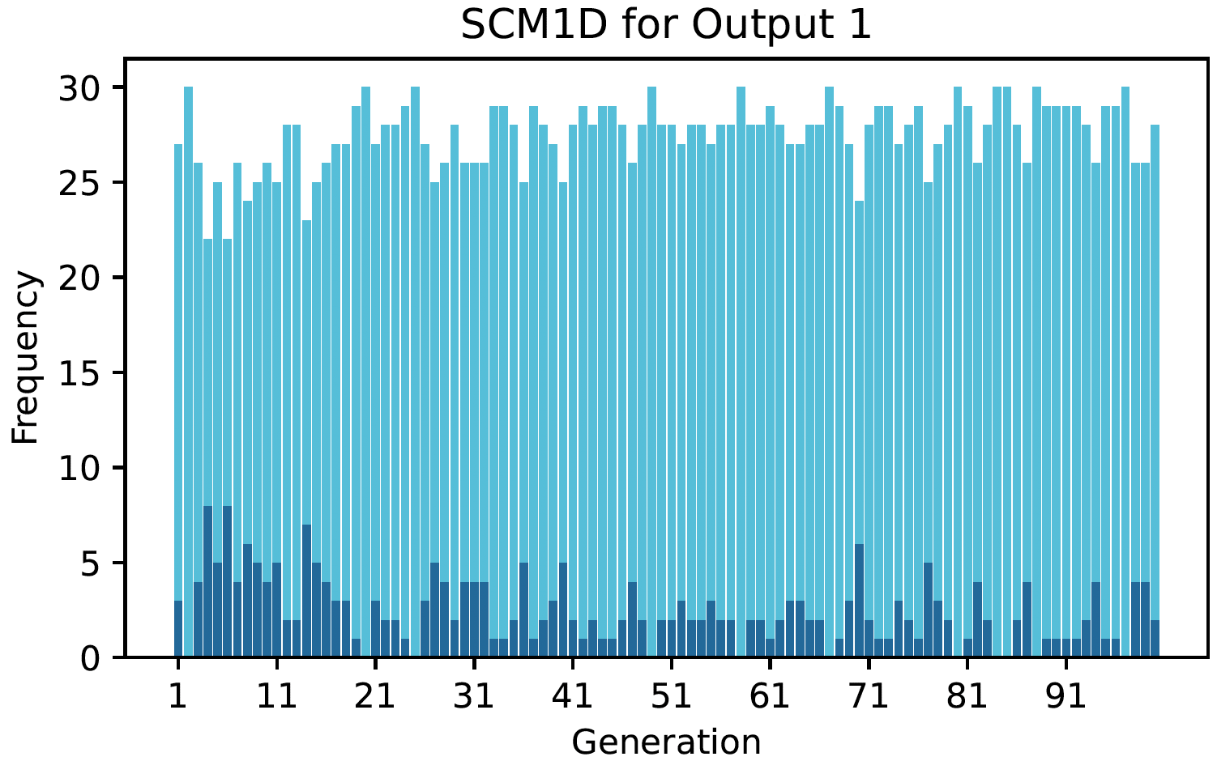
Contribution 2: Key Findings
Most best solutions are generated from knowledge transfer, RL can help useful knowledge transfer.

Slide 18
Content
Introduction
Contribution 1: Semantic-aware Transfer
Contribution 2: RL-based Transfer
Contribution 3: Feature Selection-based Transfer
Contribution 4: Evolutionary Feature Construction
Conclusions and Future Work

Slide 19
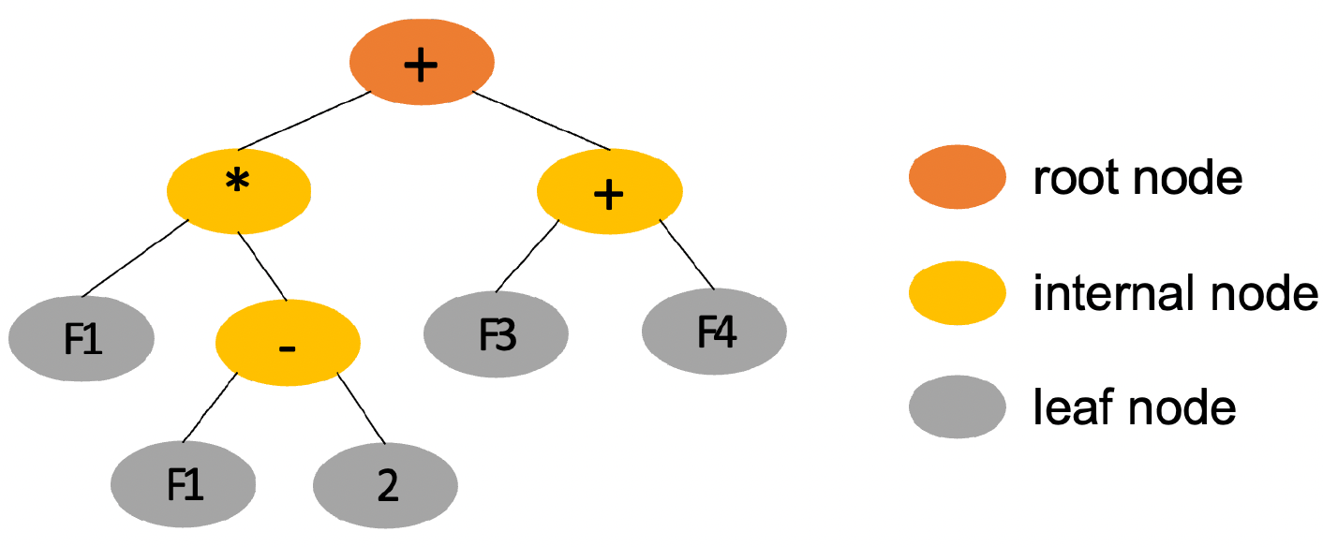
Contribution 3: Feature Selection (FS)
FS:
  Definition: a process identify relevant features related to the output variable(s).
  Advantages: irrelevant and redundant features->reduce the dimensionality of the data->reduce the risk of overfitting and improve the generalization ability
GP for FS
  Advantages: an 'embedded' ability to explore the feature space and select important features
  Challenge: GP natural ability is not strong enough in MSR

Slide 20
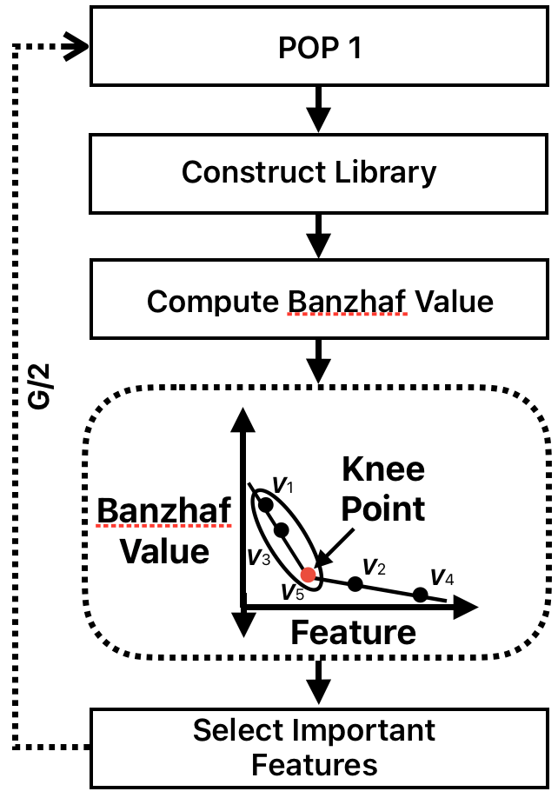
Contribution 3: Output-Specific FS in MTGP
How to select output-specific features :
  Definition: Select important features for each output
  Method:
    Construct library to store high-quality inds for each output
    Banzhaf Value for each library
    Use Knee point to select important features based on Banzhaf values
Why Banzhaf value?
  Definition: a classical solution concept from cooperative game theory that quantifies a player’s influence by measuring its average marginal contribution across all possible coalitions
  Advantages: robustness to noise than Shaply value.

Slide 21
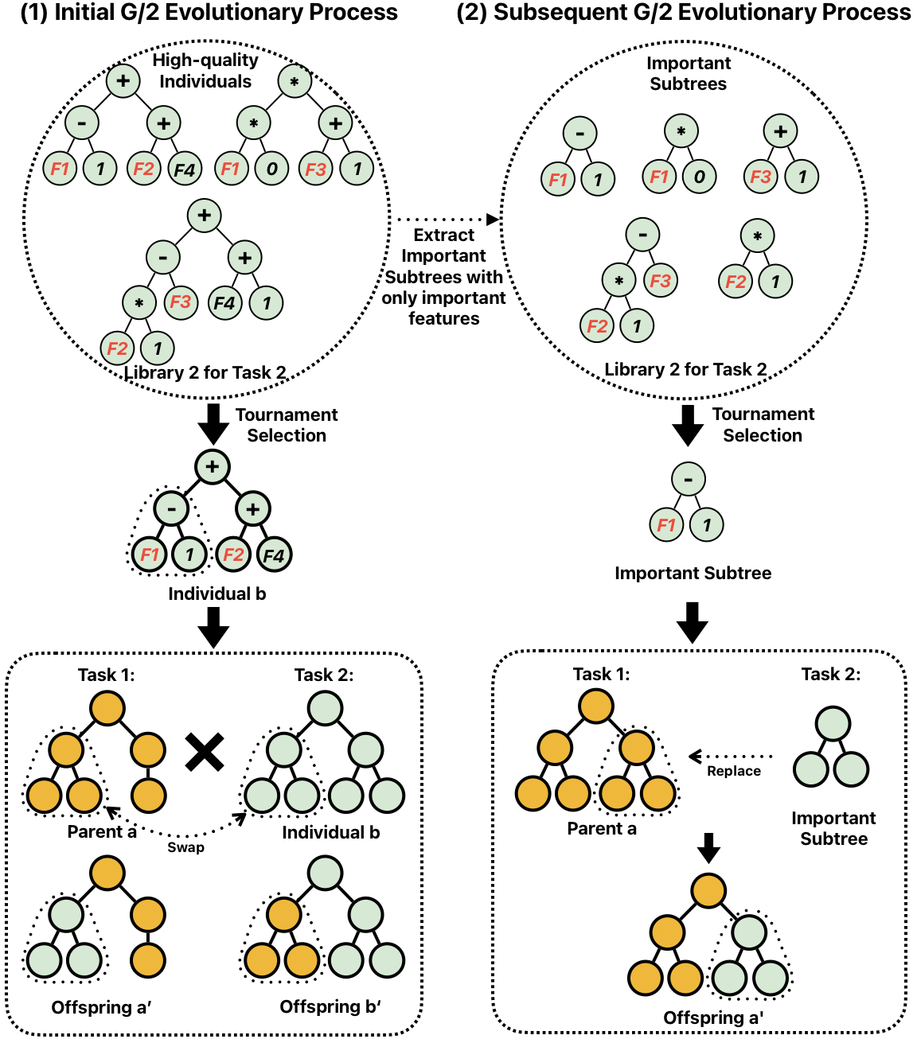
Contribution 3: Output-Specific FS in MTGP
How to use output-specific features :
  Method:
    Extract Ind in library to subtrees with only important features
    Store high-quality subtrees in library
    Transfer Knowledge in library from similar tasks

Slide 22
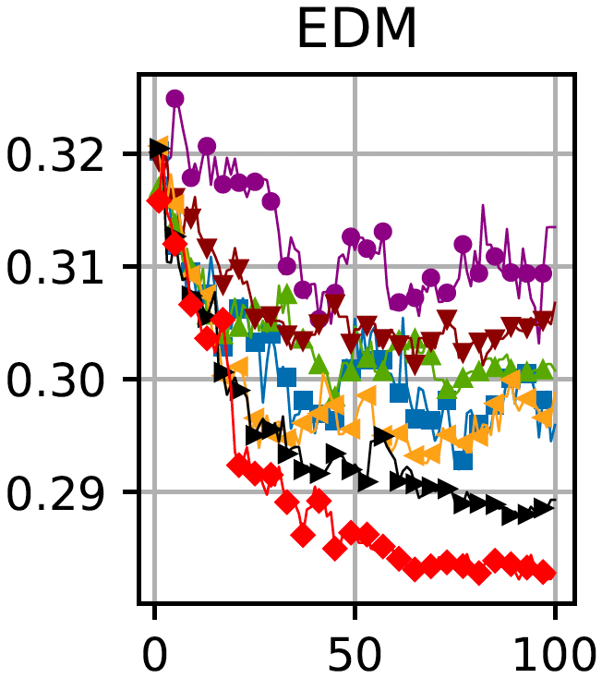
Contribution 3: Key Findings
FS can reduce the risk of overfitting.
MTGP
MTGPSC
MTGPFS
Test set in 30 runs

Slide 23
Content
Introduction
Contribution 1: Semantic-aware Transfer
Contribution 2: RL-based Transfer
Contribution 3: Feature Selection-based Transfer
Contribution 4: Evolutionary Feature Construction
Conclusions and Future Work

Slide 24
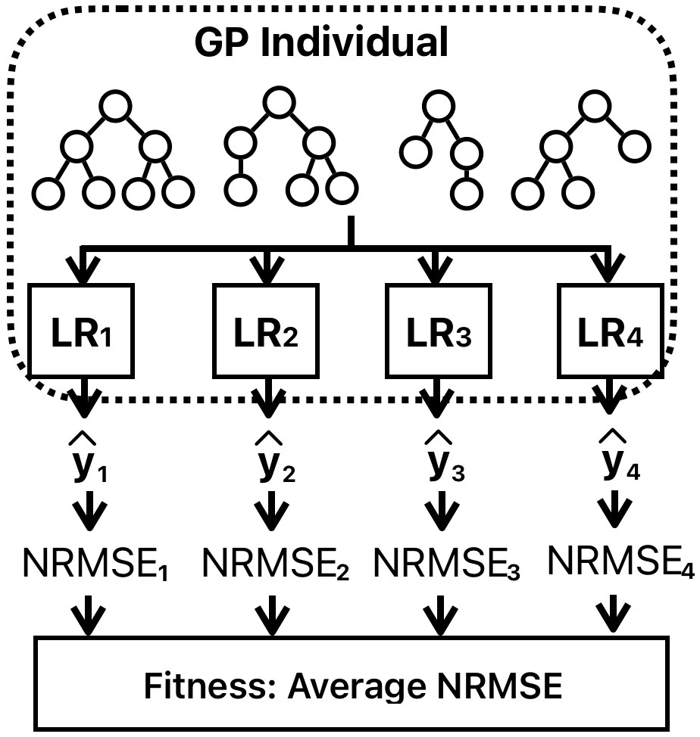
Contribution 4: GP-based Feature Construction for MSR
GP-based feature construction:
  Only one population
  Multi-tree GP representation
  Multi-tree GP+One LR->one output
  Fitness function: average
Challenge:
  Ignore Output Relationships
  Imbalance Output Performance

Slide 25
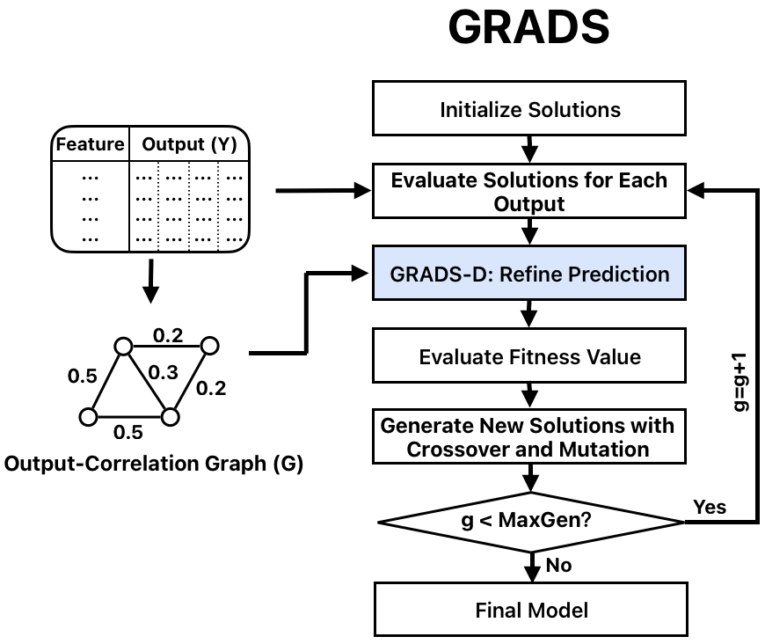
Contribution 4: Overall Algorithm
Construct output-correlation graph
  Pearson to compute output-correlation
  Construct Graph using Pearson
Final model:
  One GP model for all outputs
  Multi-tree GP generated constructed features and use them in all outputs
  Coefficients is different for outputs
Notes:
Evolutionary computation is a promising method for solving regression problems.

Slide 26
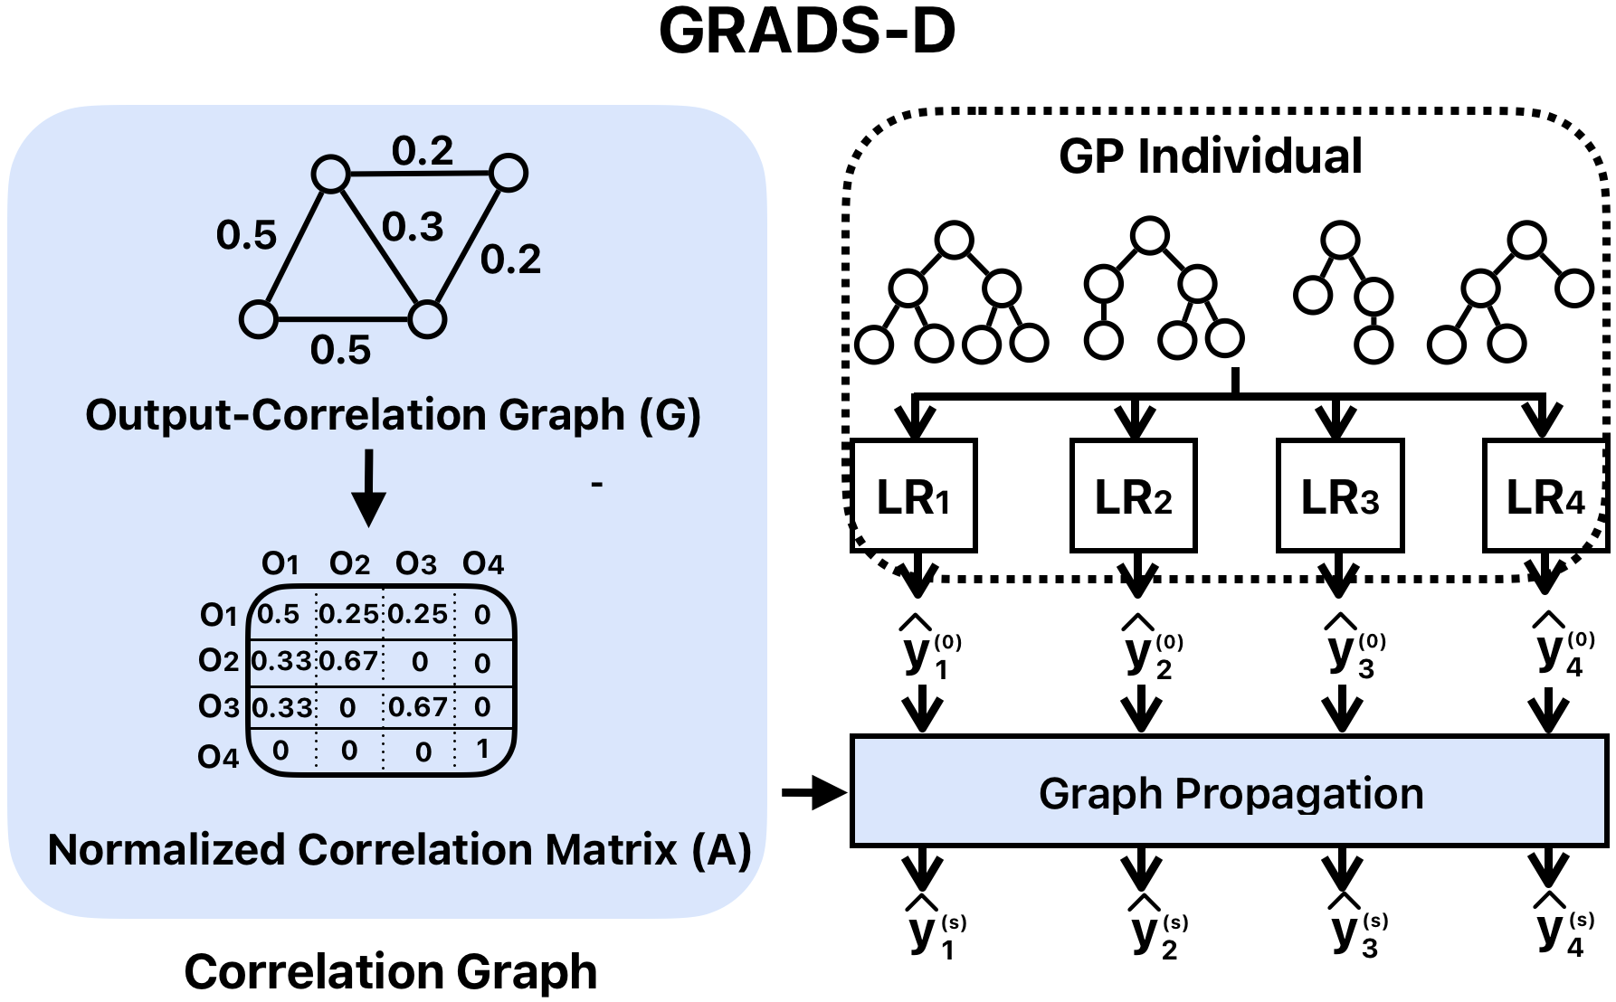
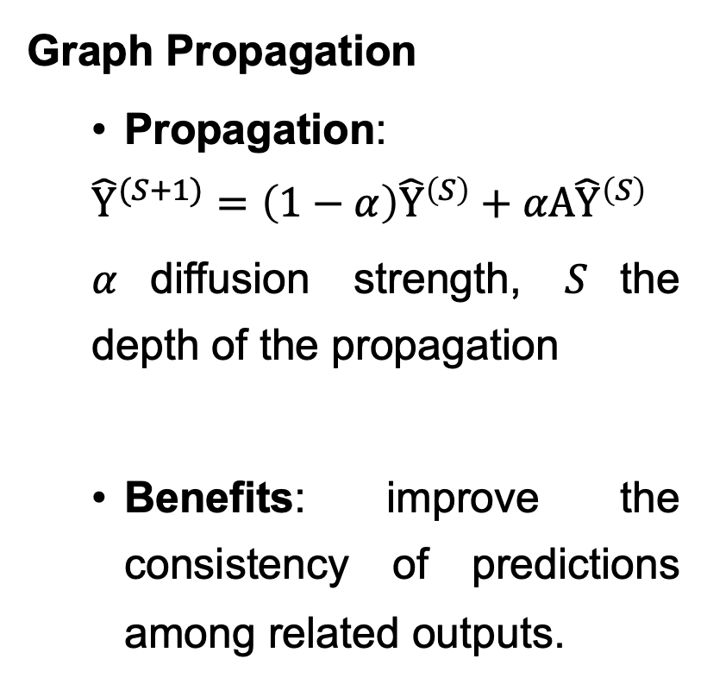
Contribution 4: Refine Prediction
Graph Propagation
  Propagation:
  $${\hat{Y}}^{(S+1)}=\left(1−α\right){\hat{Y}}^{\left(S\right)}+αA{\hat{Y}}^{\left(S\right)}$$
  $α$diffusion strength, $S$the depth of the propagation
  Benefits: improve the consistency of predictions among related outputs.
Notes:
Evolutionary computation is a promising method for solving regression problems.

Slide 27
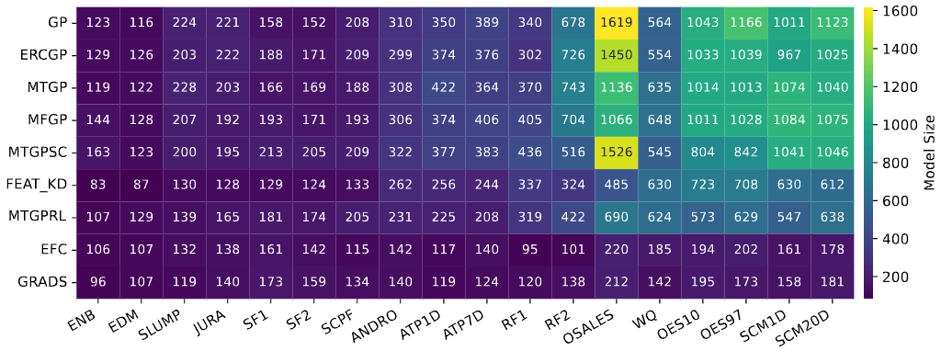
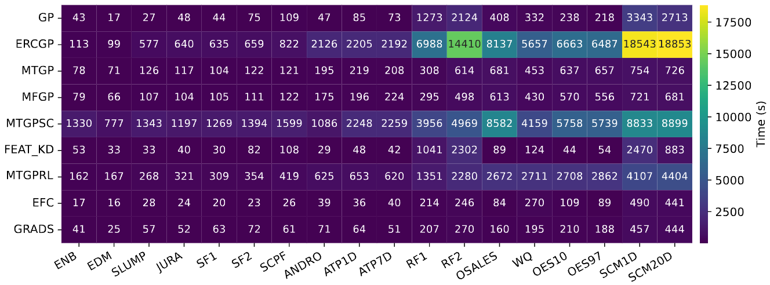
Contribution 3: Key Findings
Feature construction framework can generate more compact models (reuse symbolic trees) and have lower training time (single pop) than multi-task GP methods.

Slide 28
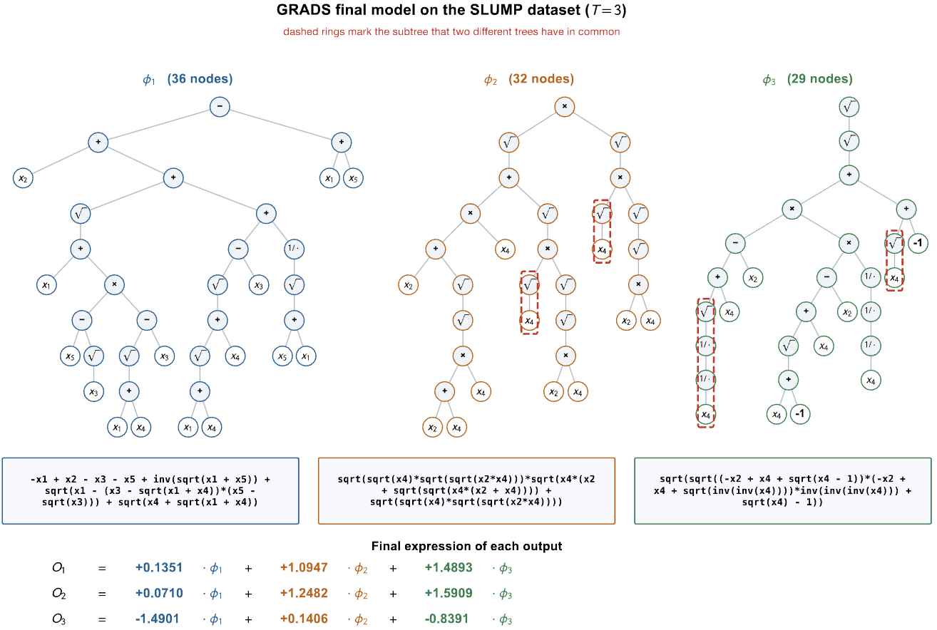
Contribution 3: Key Findings
Pearson Correlation:
O₁ and O₂: +0.92
O₁ and O₃: -0.19
O₂ and O₃: -0.15
Assign similar coefficients between related outputs and different coefficients between unrelated outputs
Trees are mainly built by different structures

Slide 29
Content
Introduction
Contribution 1: Semantic-aware Transfer
Contribution 2: RL-based Transfer
Contribution 3: Feature Selection-based Transfer
Contribution 4: Evolutionary Feature Construction
Conclusions and Future Work

Slide 30
Summary of Contributions
Challenge | Solution | Key Innovation
Output Dependencies | Semantics in MTGP (MTGPSC) | Semantics-based Crossover
Varying Information-Sharing | Reinforcement learning (RL) | Incorporate RL in MTGP
High-Dimensional Feature Space | Output-specific feature selection (FS) | Dynamic library + Banzhaf value
Imbalanced Output Performance | Refine prediction in GP-based FC (EFC) | Output-correlation graph
Publications:
  2025 TEVC (RL)
  2025 PR (MTGPSC)
Revise and Resubmit:
  2026 TEVC (FS)/(EFC)
Core Achievements: Propose GP-based methods through innovations to address MSR challenges.

Slide 31
Future Research Directions
Future Research Directions:
  Investigate more GP representations for MSR
  LLM-driven algorithm design for MSR
  Industrial deployment frameworks
  Investigate GP for incomplete MSR
Final Goal: Explore MSR using trustworthy, efficient, interpretable AI.
Notes:
Evolutionary computation is a promising method for solving regression problems.

Slide 32
Conclusion
This thesis demonstrates that GP-based methods can
improve learning accuracy and generalization performance through:
  Semantics-based crossover that transfer useful knowledge
  RL-based transfer strategy that enable flexible multi-task control
  FS-based transfer strategy that construct high-quality knowledge while reducing overfitting
  Graph-based feature construction that refine prediction to reduce imbalance outputs while generating compact GP models.
Questions?
  Thanks for your attention
Notes:
Evolutionary computation is a promising method for solving regression problems.

Slide 33
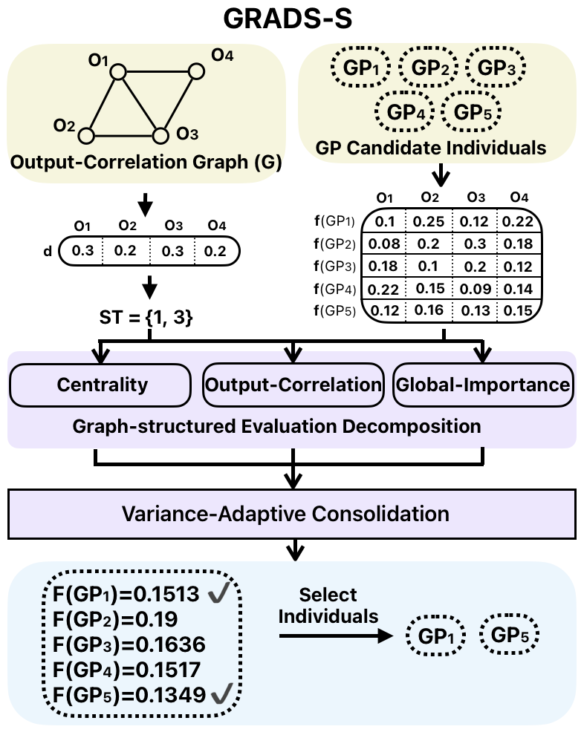
Contribution 4: Parent Selection
Notes:
Evolutionary computation is a promising method for solving regression problems.

