Slide 1
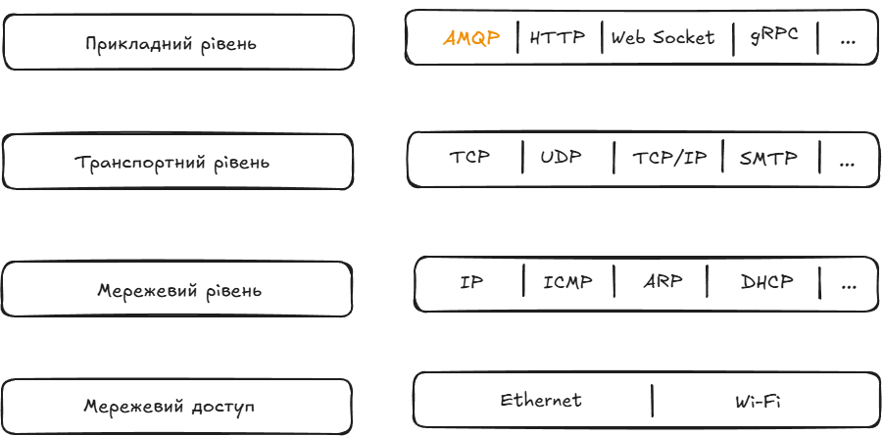
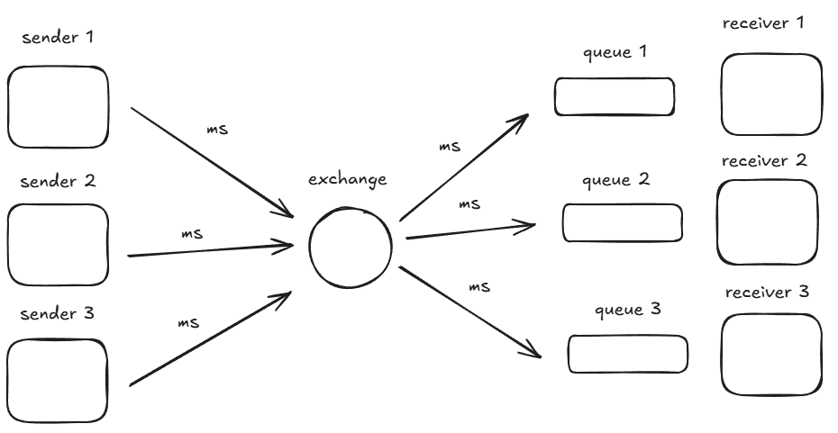
RabbitMQ – open source message broker
FIFO - principle
AMQP (Advanced Message Queuing Protocol) — is an open standard application layer protocol designed for asynchronous messaging between applications and systems
event-driven messaging pipeline

