Slide 1
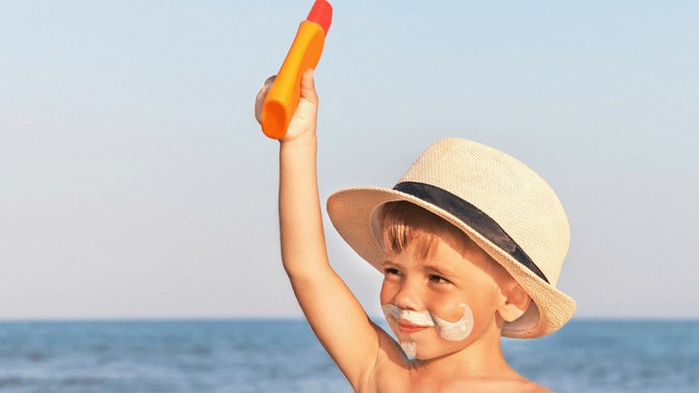
US Sunscreen Market Raise Skin Cancer Prevention Awareness
6/1/2022
Daniel Kim

Slide 2
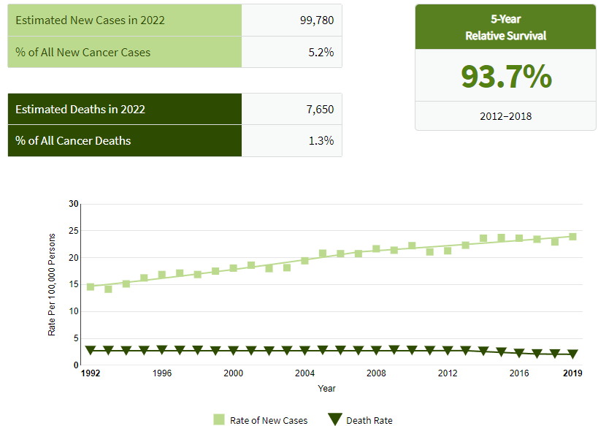
Increasing Skin Cancer New Case Rates
Rate of New Cases nearing 25%
Relatively Death Rate was slightly decreasing.
(Source : https://seer.cancer.gov/statfacts/html/melan.html)

Slide 3
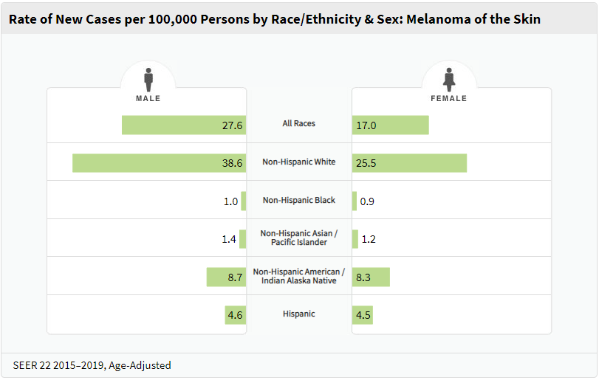
Male Cases Outnumber Female Cases.
Regardless of Races, the number of New Cases of Male outnumbers the one of Female.
(Source : https://seer.cancer.gov/statfacts/html/melan.html)

Slide 4
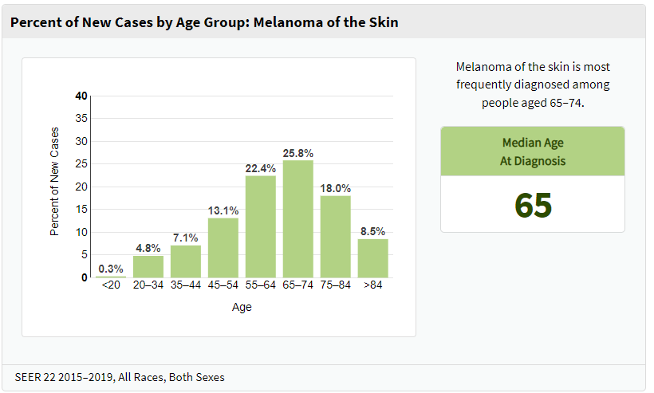
How to Raise Skin Cancer Prevention Awareness
Targeting Keywords for Aging Population.
‘Anti-Aging’ or ‘Antioxidant’
‘Effective Prevention to Skin Cancer’
(Source : https://seer.cancer.gov/statfacts/html/melan.html)

Slide 5
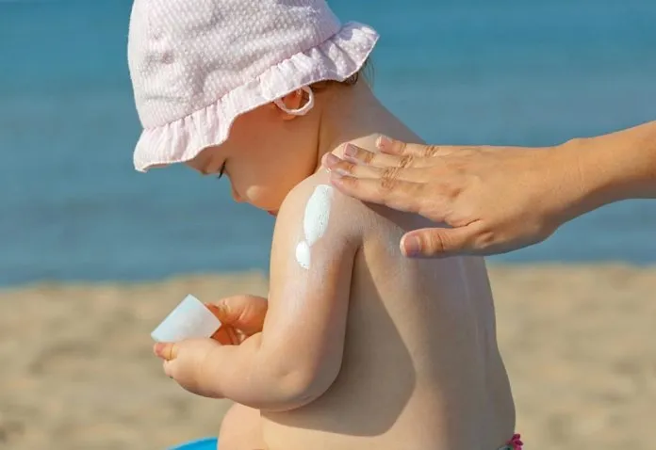
Skincare Total Sun Products Market in the US
Outstanding Growth Rate of Skin Total Sun Products Market on an average 27.3% for the past 3 years.
Especially, last year’s Skincare Total Sun Products grew by +39.4% than the previous year.
CAGR +27.3%

Slide 6
Skincare Total Sun Products Market in the US
Skincare Face in Sun (Facial Sunscreen) occupies the most share 67%.
Self-Tanner 27%, and Skincare Body in Sun (Body Sunscreen 10%)
CAGR +42.5%
CAGR +10.6%
CAGR -0.2%
CAGR +19.7%
CAGR +10.9%

Slide 7
Skincare Total Sun Products Market in the US
Retailer Shares of Skincare Total Sun
The most popular retailers where US consumers purchase Skincare Total Sun Products : Sephora, Amazon, and Ulta.

Slide 8
Skincare Total Sun Products Market in the US
Retailer Shares of Skincare Face in Sun
When it comes to purchasing Facial Sunscreens, Amazon and Sephora are the most popular place to buy ones.

Slide 9
Skincare Total Sun Products Market in the US
Retailer Shares of Skincare Self-Tanner
Ulta is the number one place to buy Self-Tanner products.

Slide 10
Skincare Total Sun Products Market in the US
Retailer Shares of Skincare Body in Sun
Amazon and Ulta are the most popular place to buy Body Sunscreen products.

Slide 11
Skincare Total Sun Products Market in the US
Brand Shares of Skincare Total Sun
‘ELTA MD’ is the number one brand in Skincare Total Sun Products with moderate growth rate (YoY 49%)
‘SUPERGOOP!’ is the number two brand with remarkable growth rate (YoY 93%).

Slide 12
Skincare Total Sun Products Market in the US
Brand Shares of Skincare Face in Sun
ELTA MD is the number one Facial Sunscreen brand with moderate growth rate, YoY 50%.
SUPERGOOP! is the second popular brand with remarkable growth rate, YoY 96%.
Facial Sunscreen is the hottest category with soaring growth rates.

Slide 13
Brands and Retailers Comparison: ELTA MD vs. SUPERGOOP!
Although ELTA MD is the number one Facial Sunscreen brand, it has limited number of places to buy.
Rapid growth of SUPERGOOP! seem attributable to diversified places to buy its products.

Slide 14
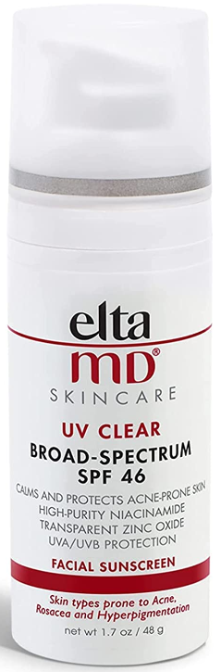
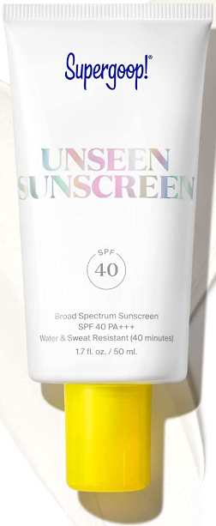
Facial Sunscreen Bestseller Comparison: ELTA MD vs. SUPERGOOP!
 | ELTA MD | SUPERGOOP!
Pricing | $39 | $36
SPF | 46 | 40
Package Type | Pump Bottle | Upside Down Tube
Size | 1.7 oz | 1.7 oz
Other Selling Points | Acne Niacinamide Zinc Oxide | Water & Sweat Resistance
Overall Review | Medical Product Look Convenient Use More Functions | Beauty Product Look Portable Use Makeup Caring

Slide 15
Facial Sunscreen Bestseller Comparison: ELTA MD vs. SUPERGOOP! *Customer Reviews Sentiment Analysis
Retailers | ELTA MD | SUPERGOOP!
Amazon | Positive 17.3% Neutral 76.0% Negative 6.6% | Positive 20.1% Neutral 74.2% Negative 5.7%
Sephora | N/A | Positive 20.9% Neutral 73.9% Negative 5.2%
Dermstore | Positive 21.9% Neutral 73.8% Negative 4.4% | Positive 23.0% Neutral 71.7% Negative 5.3%
Overall Sentiments | Positive 20.3% Neutral 74.5% Negative 5.1% | Positive 20.9% Neutral 73.7% Negative 5.4%

Slide 16
Facial Sunscreen Bestseller Comparison: ELTA MD vs. SUPERGOOP! *Customer Reviews Top 20 Frequent Keywords
ELTA MD |  | SUPERGOOP!
keyword | weight | keyword | weight
sunscreen love sunscreens sunscreeni favorite white sun oily sunscreenthis dermatologist moisturizer best light great skin daily moisturizing acne easy makeup | 896.8877 151.9620 149.6481 100.8923 98.7953 88.4982 79.2322 78.3739 73.0215 72.7848 68.5683 62.9479 61.3085 58.7730 50.8567 47.8090 41.5258 40.4357 40.2609 39.3623 | sunscreen love sunscreens oily helpful makeup smooth white sun light favorite greasy great skin best primer silicone product perfect clear | 624.7785 142.3952 99.5966 86.7740 80.2727 79.8932 67.4052 53.7297 49.0846 48.5773 41.0710 40.3145 39.3816 36.2673 30.5023 29.8325 26.3827 25.2256 24.8459 24.5414

Slide 17
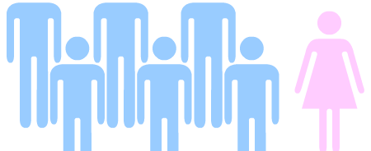
How to Raise Skin Cancer Prevention Awareness
Sunscreen products need to TARGET more male customers.
Looking back the fact that male skin cancer patients outnumbers female skin cancer patients, there seem not enough homme branded sunscreens.
Sunscreen Looks
Femme Skincare Looks
Homme Skincare Looks

Slide 18
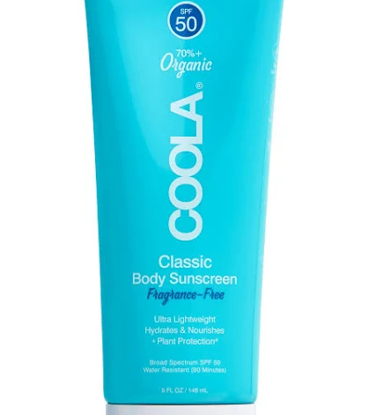
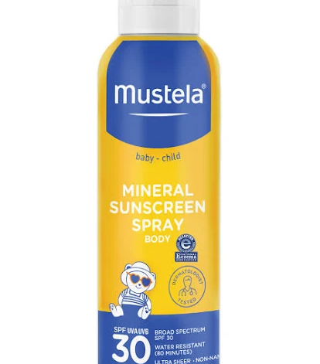
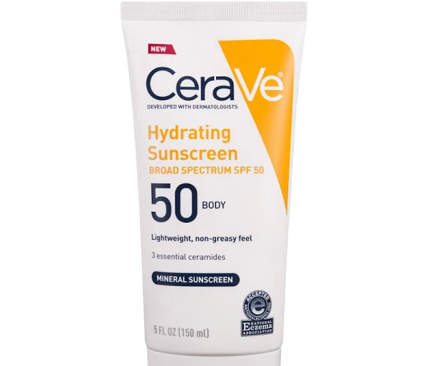
How to Raise Skin Cancer Prevention Awareness
Promote a campaign to use body sunscreen products more for more skin cancer prevention.

Slide 19
How to Raise Skin Cancer Prevention Awareness
Promote daily use of sunscreen campaign regardless of seasons.
Place sunscreen products in diverse retailers such as Home Depot, Ace Hardware, or Automotive Aftermarket Shop, etc.
Promote marketing plans to draw more reviews with positive sentiments.
Promote ‘Skin Cancer Preventative Key Words’.

Slide 20
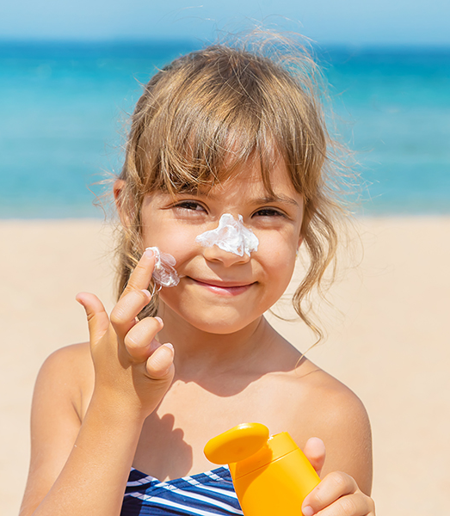
Follow-up Research
Research on Homme Skincare and Anti-Aging Skincare.
Analyze review sentiments on Homme Skincare and Anti-Aging Skincare.
Project potential market growth by applying the above findings into Sunscreen segments.

Slide 21
Skincare Total Sun Products Market in the US

