Slide 1
CAU CSE
Big Data 2020-2
Term Project #1
20134652 이제홍
20122088 심정섭
20140682 최윤석
20140588 조용훈

Slide 2
INDEX
DATA COLLECT
01
Data Model
02
Learning Model
03
Recommendation Result
04

Slide 3
Data Collect

Slide 4

Data Collect
Which data we collect
We are trying to make the Recommendation System that recommends steam’s game based on user’s information.

Slide 5
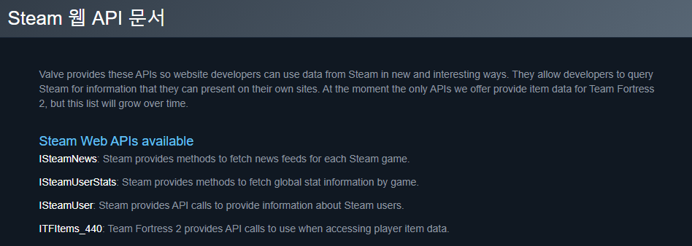
Data Collect
How to collect
Steam offers some API that developers can access to their data.
You can find the API reference from down below:
https://steamcommunity.com/dev?l=koreana
https://partner.steamgames.com/doc/webapi_overview
https://developer.valvesoftware.com/wiki/Steam_Web_API

Slide 6
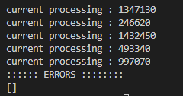
Data Collect
How to collect
But Steam doesn’t offers some specific data like game’s details, user’s info etc.,
So, I did crawling the steam’s website to get those data by using python.
It took literally 3 days for crawling data.

Slide 7
Data Collect
Data Access
You can get our dataset from here:
Download from GoogleDrive :
https://drive.google.com/file/d/10vaEmYkahxF5Vs40OHkPLWZcnI1TFvvx/view?usp=sharing
Download from Personal server :
https://cloud.sutora.org/s/6MYXWdZ3MpZmw3f

Slide 8
Data Model

Slide 9

Data Model
Data Infographics
Game’s Detail Data
User Summary
User’s Friend ID
Recommender
User’s Recent Played Game Data
User’s Owned Game List Data

Slide 10
Data Model
Data details
Game_Detail : Contains game’s information such as game’s name, images, videos, description etc.,
User_Idx : Get 14000user set from Steam’s community and give them id for processing purpose
User_Summary : Contains user’s information such as name, region, etc.,
User_Friend_List : Contains user’s friends as form of list. If user does not have any friend, then list returns []
User_Owned_Games : Contains user’s owned games number, and that list as form of list.
User_Recently_Played_Games : Contains user’s recently played game data(minute). This contains user id, game id as app_id, and time. If user played multiple games in 2 weeks. This will return the list.

Slide 11
Learning Model

Slide 12

Learning Model
Using Spark
We are using apache’s pyspark to implement our recommender system.
Which helps us interface with Resilient Distributed Datasets .

Slide 13
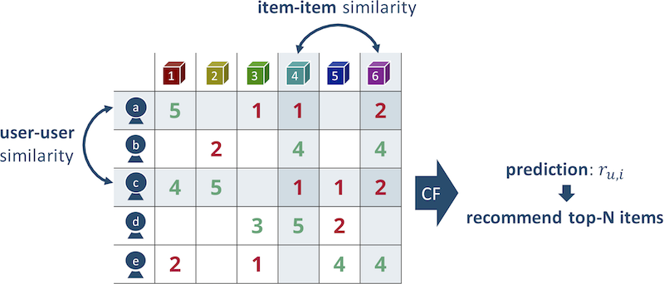
Learning Model
Collaborative Filtering
Our basic think was there’s user A who has played one game called Z, then the Man B who play that game called Z played another game called Y, then system recommends game Y to user A.
And user C who played game Z, plays More time in game X than user B played in game Z, then game X gets more weight to calculate matrix.
And implement this principle with Collaborative Filtering.

Slide 14
Learning Model
Collaborative Filtering
In Collaboration Filtering techniques, we need to fill in the missing components of user-item associated matrix.
For that, Spark supports Alternating Least Squares algorithms(a.k.a ALS) to predict those missing entries.
Here’s some references about Spark’s collaborative filtering document :
https://spark.apache.org/docs/2.2.0/mllib-collaborative-filtering.html#collaborative-filtering

Slide 15
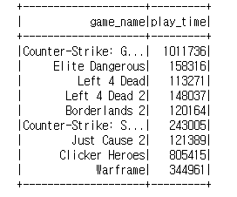
Learning Model
Cold Start Problem
Also, this model doesn’t return the list of recommendation when the player did not played any game.
This is Cold Start Problem.
To solve this problem, We need to find the game’s that globally popular games.

Slide 16
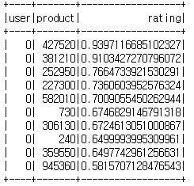
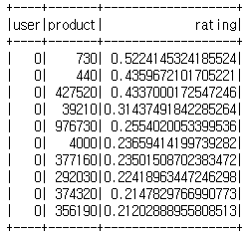
Learning Model
2 Way Recommendation
And also, steam’s api offers some information about game play time in recent 2 weeks.
Life-time played time is also important because this prefers that user’s love on that game.
But recent-2week information is also important that this user recently interested in this recent-played game.
So, Our system offers 2-way recommendation about game.

Slide 17
Recommendation
Result

Slide 18
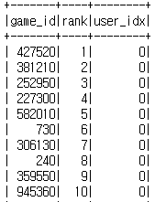
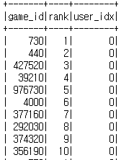
Recommendation Result
Result Example
Our system offers simple format of recommendation set.
Result set contains all user’s recommendation and if you have rdd about game_id or user_idx you can easily find the recommendations.
This is filed into JSON
You can find it in our github :
https://github.com/yusa-imit/cse20_bigdata_recommender/tree/main/results

Slide 19
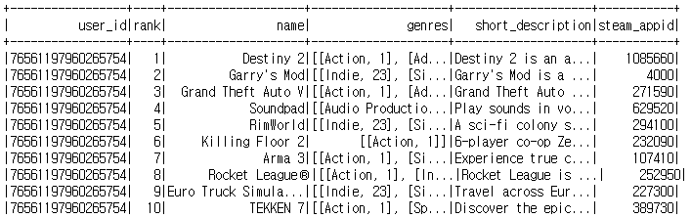
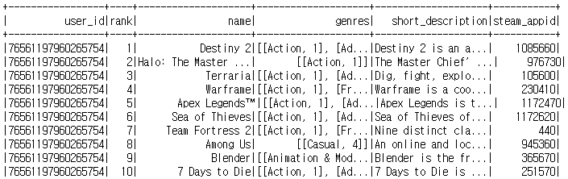
Recommendation Result
Result Example
Our system also offers complicate version of result sets.
Which have pretty much information of both users and games.
This also filed into JSON but it is shred into 100~ish files.
You can find it in our github :
https://github.com/yusa-imit/cse20_bigdata_recommender/tree/main/results

Slide 20
Thank you
Insert the title of your subtitle Here

