Slide 1
CAU CSE
Big Data 2020-2
Term Project #1
20134652 이제홍

Slide 2
INDEX
DATA COLLECT
01
Data Model
02
Learning Model
03
Recommendation Result
04

Slide 3
Data Collect

Slide 4

Data Collect
Which data we collect
We are trying to make the Recommendation System that recommends steam’s game based on user’s information.

Slide 5
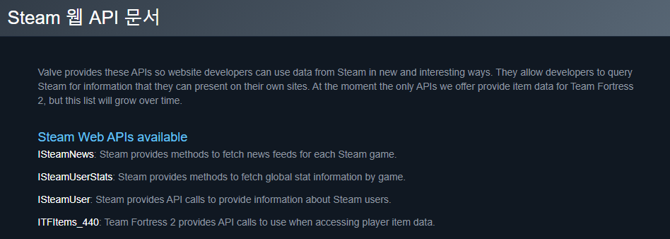
Data Collect
How to collect
Steam offers some API that developers can access to their data.
You can find the API reference from down below:
https://steamcommunity.com/dev?l=koreana
https://partner.steamgames.com/doc/webapi_overview
https://developer.valvesoftware.com/wiki/Steam_Web_API

Slide 6
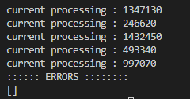
Data Collect
How to collect
But Steam doesn’t offers some specific data like game’s details, user’s info etc.,
So, I did crawling the steam’s website to get those data by using python.
It took literally 3 days for crawling data.

Slide 7
Data Collect
Data Access
You can get our dataset from here:
Download from GoogleDrive :
https://drive.google.com/file/d/10vaEmYkahxF5Vs40OHkPLWZcnI1TFvvx/view?usp=sharing
Download from Personal server :
https://cloud.sutora.org/s/6MYXWdZ3MpZmw3f

Slide 8
Data Model

Slide 9

Data Model
Data Infographics
Game’s Detail Data
User Summary
User’s Friend ID
Recommender
User’s Recent Played Game Data
User’s Owned Game List Data

Slide 10
Data Model
Data details
Game_Detail : Contains game’s information such as game’s name, images, videos, description etc.,
User_Idx : Get 14000user set from Steam’s community and give them id for processing purpose
User_Summary : Contains user’s information such as name, region, etc.,
User_Friend_List : Contains user’s friends as form of list. If user does not have any friend, then list returns []
User_Owned_Games : Contains user’s owned games number, and that list as form of list.
User_Recently_Played_Games : Contains user’s recently played game data(minute). This contains user id, game id as app_id, and time. If user played multiple games in 2 weeks. This will return the list.

Slide 11
Learning Model

Slide 12
Recommendation
Result

Slide 13
Thank you
Insert the title of your subtitle Here

