Slide 1
MACHINE LEARNING PROJECT
PrecisionAutoAI
Project output
A trained regression pipeline plus a web interface where users can enter vehicle details and receive a TRY price estimate.
An ML project trained in Colab, deployed through a Flask interface, and designed to estimate used-car prices in TRY.
DATASET
FINAL DATA
TEST R2
TEST MAE
108,540
99,322
0.968
265K TRY
raw listings
after cleaning
XGBoost
average error
PrecisionAutoAI | Used car price prediction ML project
01

Slide 2
OBJECTIVE
The project turns raw UK used-car listings into a Turkey-oriented TRY price estimator.
Goal: predict the expected used-car price from brand, model, year, km, fuel type, transmission and engine size.
Why the problem matters
ML task definition
Final product
Used-car prices are noisy and depend on many factors.
Supervised regression problem.
Reusable preprocessing artifacts.
Age, mileage and engine size strongly affect valuation.
Target variable: localized price_tl.
XGBoost model saved with joblib.
Evaluation: MAE, RMSE and R2.
Turkey requires currency and tax localization.
Flask UI for user-friendly prediction.
PrecisionAutoAI | Used car price prediction ML project
02

Slide 3
DATASET
Kaggle's 100k UK used-car dataset gave the model broad brand coverage.
Source: adityadesai13/used-car-dataset-ford-and-mercedes; scraped used-car listings split into manufacturer CSV files.
Raw rows by brand after merging
CSV FILES
COLUMNS
Ford
23,419
11
8
Mercedes
17,018
manufacturer files
after dropping tax/mpg
Volkswagen
15,157
Opel
13,632
Core features used
BMW
10,781
Audi
10,668
model, year, transmission
Toyota
6,738
mileage, fuelType, engineSize
Skoda
6,267
brand added during merge
Hyundai
4,860
Kaggle source: https://www.kaggle.com/datasets/adityadesai13/used-car-dataset-ford-and-mercedes
PrecisionAutoAI | Used car price prediction ML project
03

Slide 4
DATA PREPARATION
Data noise was systematically reduced before model training.
The pipeline removed impossible engine values, restricted the year range, grouped rare models and filtered outliers with IQR.
1
2
3
4
5
Merge
Normalize
Clean
Grouping
Filtering
11 CSV files were read and every row received a brand label.
Hyundai tax column was normalized; tax/mpg columns were removed.
286 engineSize=0 rows and invalid year values were removed.
193 models were reduced to 113 after rare models with <=100 rows were mapped to Other.
IQR removed 8,907 rows; 99,322 rows remained.
PrecisionAutoAI | Used car price prediction ML project
04

Slide 5
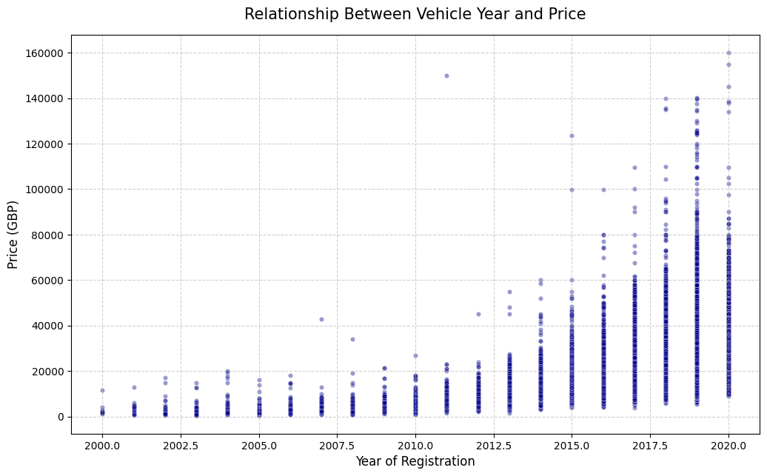
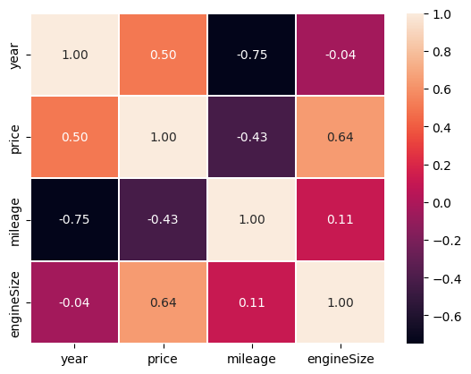
EDA
EDA confirmed that age, transmission and engine size carry price signal.
Before model selection, distributions, correlations and nonlinear relationships were examined through notebook visuals.
Newer vehicles are generally more expensive; the heatmap supports year and engineSize as important numerical drivers.
Because correlation alone is not enough, nonlinear ensemble models were also tested.
PrecisionAutoAI | Used car price prediction ML project
05

Slide 6
LOCALIZATION
The target variable was adapted from UK list price to a Turkey-oriented TRY price.
This made the project closer to the intended UI experience instead of predicting raw GBP values.
Currency conversion
Distance
Tax multiplier
GBP price x 58
miles x 1.609
<=1.6L: x3.0
<=2.0L: x4.5
The fixed exchange rate in the notebook was used.
After conversion, the mileage column was renamed to km.
>2.0L: x6.0
Result: the final target variable became price_tl, a localized price estimate aligned with the deployed UI output.
PrecisionAutoAI | Used car price prediction ML project
06

Slide 7
PIPELINE
The preprocessing pipeline kept training and deployment behavior consistent.
The same encoders, scaler and feature order were saved as artifacts and reused in Flask.
Raw input
Encoding
Scaling
Model
Artifact
brand, model, year, km, transmission, fuelType, engineSize
LabelEncoder for brand/model; BinaryEncoder for transmission/fuelType
StandardScaler for km, engineSize and year
XGBRegressor trained with an 80/20 train-test split
joblib package containing model + preprocessing objects
SPLIT
SCALED COLS
CATEGORICAL
DEPLOY FILE
80/20
3
4
pkl
random_state=42
km, engineSize, year
encoded inputs
model artifacts
PrecisionAutoAI | Used car price prediction ML project
07

Slide 8
MODEL COMPARISON
Ensemble models clearly outperformed linear baselines.
Nine regression models were compared using the same train/test split and preprocessing.
Test R2 by model before tuning
Main interpretation
Linear
0.800
0.800
Linear models stayed around 0.80 R2.
Lasso
Ridge
0.800
KNN, Random Forest and XGBoost captured nonlinear patterns.
KNN
0.963
0.949
Decision Tree showed clear overfitting: train R2 0.999, test R2 0.949.
Decision Tree
Random Forest
0.966
XGBoost was selected for hyperparameter tuning.
AdaBoost
0.835
Gradient Boost
0.936
XGBoost
0.966
PrecisionAutoAI | Used car price prediction ML project
08

Slide 9
FINAL MODEL
Tuned XGBoost produced the strongest final test result.
RandomizedSearchCV selected tree depth, learning rate and column sampling strategy.
TEST R2
TEST MAE
TEST RMSE
TRAIN R2
0.968
265,370 TRY
417,255 TRY
0.986
explained variance
mean absolute error
penalizes large errors
fit quality
Best tuning parameters
What the error means
Selected: max_depth=12, learning_rate=0.1, colsample_bytree=0.7, n_estimators=100; the final training used 200 estimators.
After localization, the average absolute deviation is about 265K TRY; expensive and rare configurations remain harder.
PrecisionAutoAI | Used car price prediction ML project
09

Slide 10
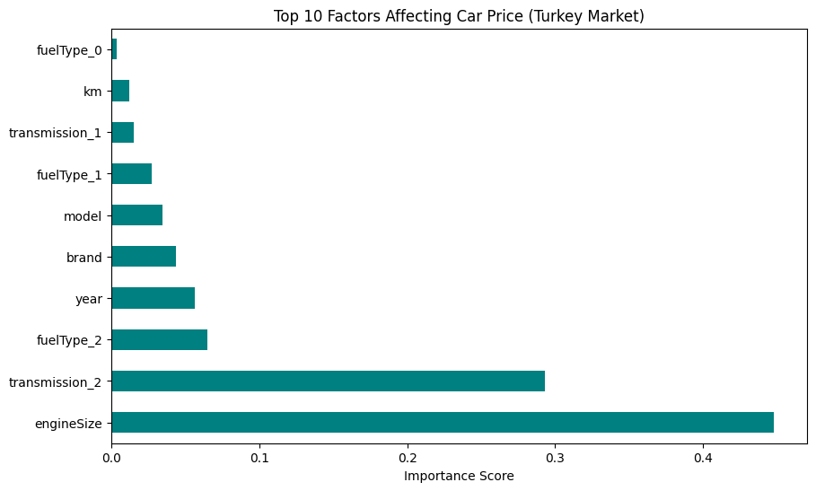
INTERPRETABILITY
The final model's strongest signals align with real used-car pricing logic.
The feature importance chart shows year and engine size as leading signals for the localized Turkey target.
Technical insight
Year represents depreciation and market recency.
EngineSize affects both base value and the tax multiplier.
Encoded model/brand fields add segment-level price signal.
Km is important, but it works interactively with year and model.
PrecisionAutoAI | Used car price prediction ML project
10

Slide 11
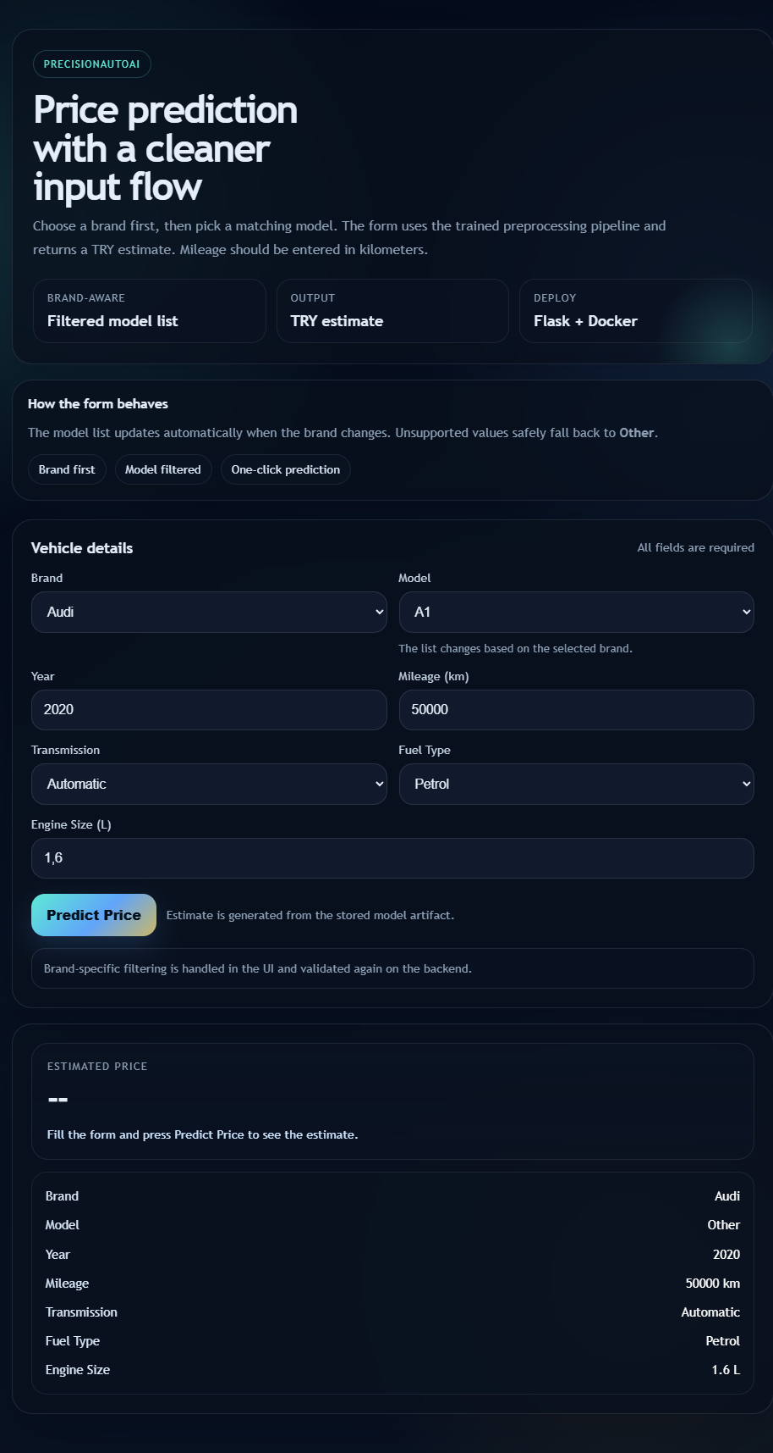
UI & DEPLOYMENT
The model was converted into a usable prediction interface.
Flask loads the saved artifact package, validates user input, applies the same preprocessing and returns a TRY estimate.
Implementation details
The brand is selected first, then the model list is filtered in the UI.
Unsupported model values safely fall back to Other.
The backend uses saved encoders, scaler and feature columns.
Dockerfile/Procfile make the deployment path explicit.
PrecisionAutoAI | Used car price prediction ML project
11

Slide 12
RESULTS
The project delivered a high-performing regression model and a deployable user flow.
The main value is not only the model score, but the full ML path from data cleaning to a working prediction interface.
What was achieved
Limitations
Next steps
99,322 usable rows
UK listing source, not Turkish sales data
Add local marketplace data
TRY-localized target
Fixed exchange rate and tax assumptions
Add SHAP explanations
0.968 test R2
Rare models were grouped as Other
Track model drift
Flask UI deployment
Add confidence intervals
No live market/inflation update
Conclusion: PrecisionAutoAI is a complete ML project covering data acquisition, preprocessing, feature engineering, model selection, tuning, evaluation, interpretation and UI deployment.
PrecisionAutoAI | Used car price prediction ML project
12

