Slide 1
THESIS RESEARCH PROPOSAL
Economic Development,
a Political Materialism Perspective
SEVERANCE
Disruption ↓
RESEARCH QUESTION
RICHER ENTRY
Which changes in domestic power and international alignment produce major economic discontinuities?
Acceleration ↑
Carlos Gustavo Salas Flores
Beijing Normal University
Includes preliminary results
1960–2019 · All empirical results are preliminary
1
Notes:
[0:00–0:45]
Thank you for making the time. The project asks a simple question: which political and international changes actually break a country's economic trajectory? I approach this through political materialism. The central object is a change in the material capabilities available to the state, including market access, capital, technology, energy, subsidies, and security guarantees. I will give you the framework and research design in three minutes, show the strongest preliminary patterns, and then spend most of the presentation on four cases. Cuba and Estonia fit the signed predictions. Vietnam and Peru expose different problems that the next stage needs to resolve.

Slide 2
FRAMEWORK
Economic breaks follow material capabilities
Severance
Capabilities
withdrawn
Disruption
External
realignment
Richer entry
Capabilities
supplied
Acceleration
Material capabilities: market access · capital · technology · energy prices · subsidies · security guarantees
H1
H2
H3
Turnover or nominal regime change alone leaves the trajectory intact.
Severance produces disruption; richer entry produces acceleration.
Realignment works with or without domestic political transformation.
Lake (2009); Rodrik (1999); Hausmann, Pritchett & Rodrik (2005). Predictions assume comparable material endowments.
2
Notes:
[0:45–2:10]
The framework separates domestic political labels from changes in effective power and international alignment. H1 says that replacing rulers or changing formal rules should leave the economy on its previous path when effective power and external alignment remain untouched. H2 supplies the signed mechanism. Severance withdraws capabilities associated with a dominant-power relationship and predicts disruption. Entry into a richer sphere supplies capabilities and predicts acceleration. H3 says realignment should generate its outcome with or without a domestic political transformation; domestic change alone is insufficient under H1.
The important empirical implication is that alliances, subsidies, market access, and security guarantees are observable separately from GDP. I can therefore code the proposed cause before examining the outcome. Material endowments remain a comparison condition: the strongest qualitative tests use countries with similar structural constraints.

Slide 3
RESEARCH DESIGN
Observable events make the theory testable
73
4,380
1960–2019
46 / 28
countries
country-years
four regions
episodes / countries
EVENTS CODED INDEPENDENTLY OF OUTCOMES
THREE COMPLEMENTARY TESTS
Domestic
Turnover · formal regime change · effective power · apparatus
01
Matched comparisons
Comparable material endowments
External
Two or more security, economic, institutional, or coercive ties
02
Process tracing
Event sequence and capability flows
Outcome
Disruption within 5 years · acceleration onset within 8 years
03
Panel models
Country and year fixed effects · planned
Sources: WDI; IMF WEO; Maddison; Archigos; Comparative Constitutions Project; ATOP/COW; legal and historical records.
3
Notes:
[2:10–3:25]
The accepted coding state covers 73 countries and 4,380 country-years across Latin America, post-Soviet Eurasia, East Asia, and Europe. The event-time analysis uses 46 severance or richer-entry episodes in 28 countries. Domestic events come from leader records, constitutional documents, and legal evidence. External realignment requires the establishment or termination of at least two documented ties within three years. Unknown evidence stays missing.
The outcomes are fixed independently. Disruption includes a severe peak-to-trough contraction, a sustained growth collapse, or inflation above 500 percent. Acceleration requires at least 3.5 percent annual growth for eight years and a two-point improvement over the previous regime. The design combines matched comparisons, process tracing, and, in the next stage, country and year fixed-effects models. Today's numerical results are descriptive; the case evidence is what lets me examine sequence and mechanism.

Slide 4
PRELIMINARY EVIDENCE
The aggregate associations have the predicted signs
Mean annual real GDP-per-capita growth during t+1 to t+5 · interval-start coding
FIVE-YEAR FORWARD GROWTH
75.0% vs 21.1%
Severance
-3.28%
Forward disruption after severance vs no realignment
20 country-years
No realignment
+2.23%
4,335 country-years
60.0% vs 14.4%
New acceleration onset after richer entry vs no realignment
Richer entry
+3.43%
20 country-years
IMPOSED SEVERANCES
Negative growth
Positive growth
−3.29% · 83.3%
Reference: no realignment combines all domestic-event rows.
Mean growth · disruption rate
PRELIMINARY · Descriptive associations, not regression estimates. Small event cells; forward windows overlap.
4
Notes:
[3:25–5:05]
These are the central model-free associations. Growth is measured as annual real GDP-per-capita growth averaged over complete forward windows from t plus one through t plus five. Bare severance country-years average minus 3.28 percent, compared with plus 2.23 without realignment. Bare richer-entry country-years average plus 3.43. The outcome frequencies point in the same direction: disruption occurs in 75 percent of severance observations versus 21.1 percent without realignment, while new acceleration onset occurs in 60 percent of richer-entry observations versus 14.4 percent.
The imposed-severance subset is especially useful because patron withdrawal reduces the concern that a country chose to leave in anticipation of decline. It retains mean growth of minus 3.29 percent and an 83.3 percent disruption rate. These cells are small, their windows overlap, and wrong-sign outcomes remain common. I read the pattern as a promising motivation for the formal tests. The next figure shows why timing and case selection matter.

Slide 5
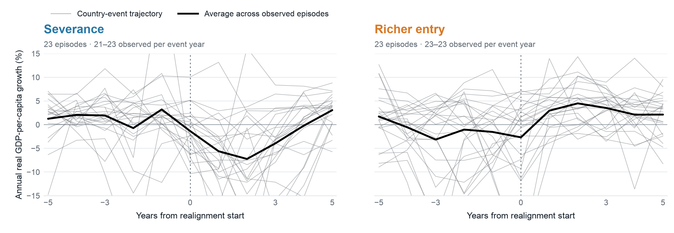
PRELIMINARY EVIDENCE
Growth shifts around realignment
Annual real GDP-per-capita growth · five years before and after interval start
Severance
Richer entry
Dispersion
The average falls sharply after the interval start.
The average rises, then levels off above zero.
Gray paths reveal pre-event breaks and wrong-sign cases.
PRELIMINARY · 46 episodes in 28 countries. Black means weight observed episodes equally; composition can change across event time.
5
Notes:
[5:05–6:30]
This figure moves from five-year averages to annual trajectories. Each gray line is one country-event, and the black line is the equally weighted average of episodes observed at that event year. Year zero is the start of the realignment interval. Severance is on the left and richer entry on the right, with identical vertical scales.
The severance average declines sharply after year zero and reaches its lowest level around years two and three. The richer-entry average rises after year zero and then stabilizes at roughly three to four percent. Those average paths match H2. The gray lines also show why the aggregate means cannot carry the argument alone: some countries were already declining or accelerating, and others move in the opposite direction. Missing observations can change the composition of the mean. This is exactly why the case narratives and the dating robustness checks are central to the project.

Slide 6
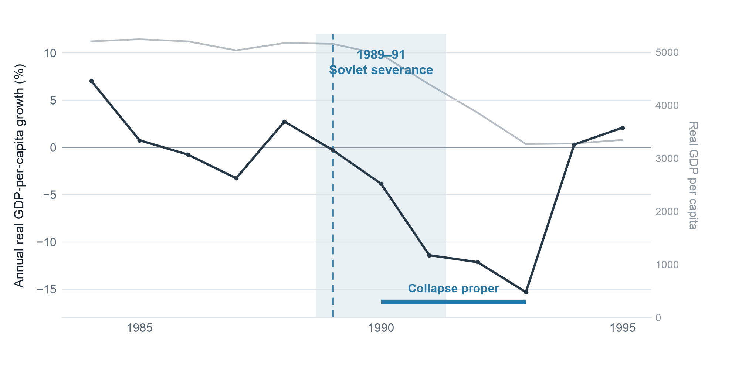
SUPPORTING CASE · H2 NEGATIVE
Cuba: imposed severance, intact domestic power
IMPOSED SEVERANCE
1989–1991
≈23% of GDP
Soviet subsidies before the shock
≈−33%
Contraction during 1990–93
Domestic power structure intact
Timing qualification: stagnation preceded severance; the collapse proper followed it. New-onset coding remains sensitive to the timing rule.
PRELIMINARY · E005 / D019 · WDI growth and level · Case note: CUB_1989.md
6
Notes:
[6:30–8:10]
Cuba is the strongest negative process-tracing case. Before the shock, Soviet subsidies were approximately 23 percent of GDP, alongside subsidized trade and security ties. The severance was imposed: the patron withdrew support and then ceased to exist. The power structure, ruling coalition, and state apparatus in Cuba remained intact. The collapse proper then ran from 1990 through 1993, with annual per-capita contractions reaching minus 15.3 percent and a cumulative contraction of roughly one third.
One timing detail matters. The registered D019 drawdown uses a 1985 peak, so its full peak-to-trough depth includes earlier stagnation. I therefore distinguish that stagnation from the 1990–93 collapse. Under the strict new-onset rule, Cuba can be classified as having a pre-existing disruption rather than a new consequence. That does not weaken the observed mechanism, but it does affect episode counts. The case supports the material-capability mechanism while also demonstrating why onset and drawdown measures must be reported separately.

Slide 7
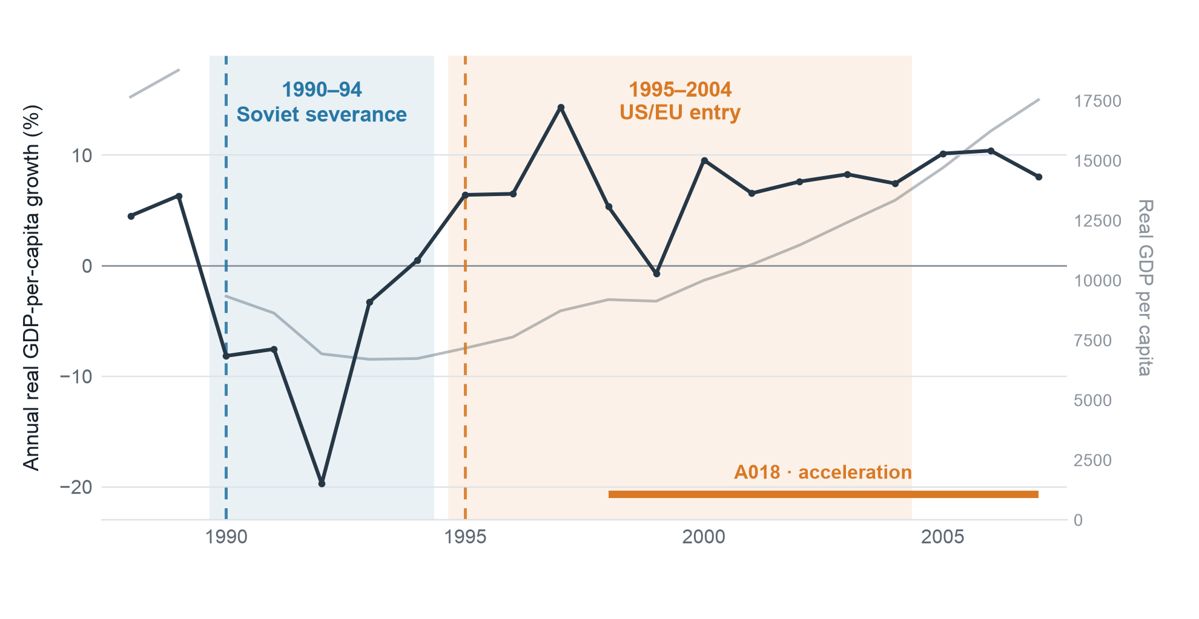
SUPPORTING CASE · H2 NEGATIVE AND POSITIVE
Estonia displays the complete signed sequence
SEVERANCE · 1990–94
−28.2%
D027 · 1990–95
RICHER ENTRY · 1995–2004
6.78% / year
A018 · 1998–2007
Acceleration begins inside the entry interval
Domestic transformation and the Soviet systemic shift coincide with severance; the within-case sequence carries more weight than a single before/after contrast.
PRELIMINARY · E010 / E013 / D027 / A018 · WDI/Maddison · Accepted episode register
7
Notes:
[8:10–9:35]
Estonia supplies the positive counterpart and a complete signed sequence. Soviet severance during 1990–94 coincides with D027, a 28.2 percent peak-to-trough disruption. Entry into the US and EU sphere then runs from the 1995 Europe Agreement through NATO and EU accession in 2004. The qualifying acceleration, A018, runs from 1998 through 2007 and averages 6.78 percent annually. Its onset falls inside the entry interval, which avoids Vietnam's timing problem.
Estonia is not a clean isolation of external realignment. Independence, domestic power transformation, and the Soviet systemic shift all overlap the negative phase. I would therefore use process tracing to establish which trade, subsidy, financial, and security flows changed, and compare Estonia with other post-Soviet republics whose domestic paths differed. The case is valuable because it shows both signs within one country and because the positive phase has a defensible temporal sequence.

Slide 8
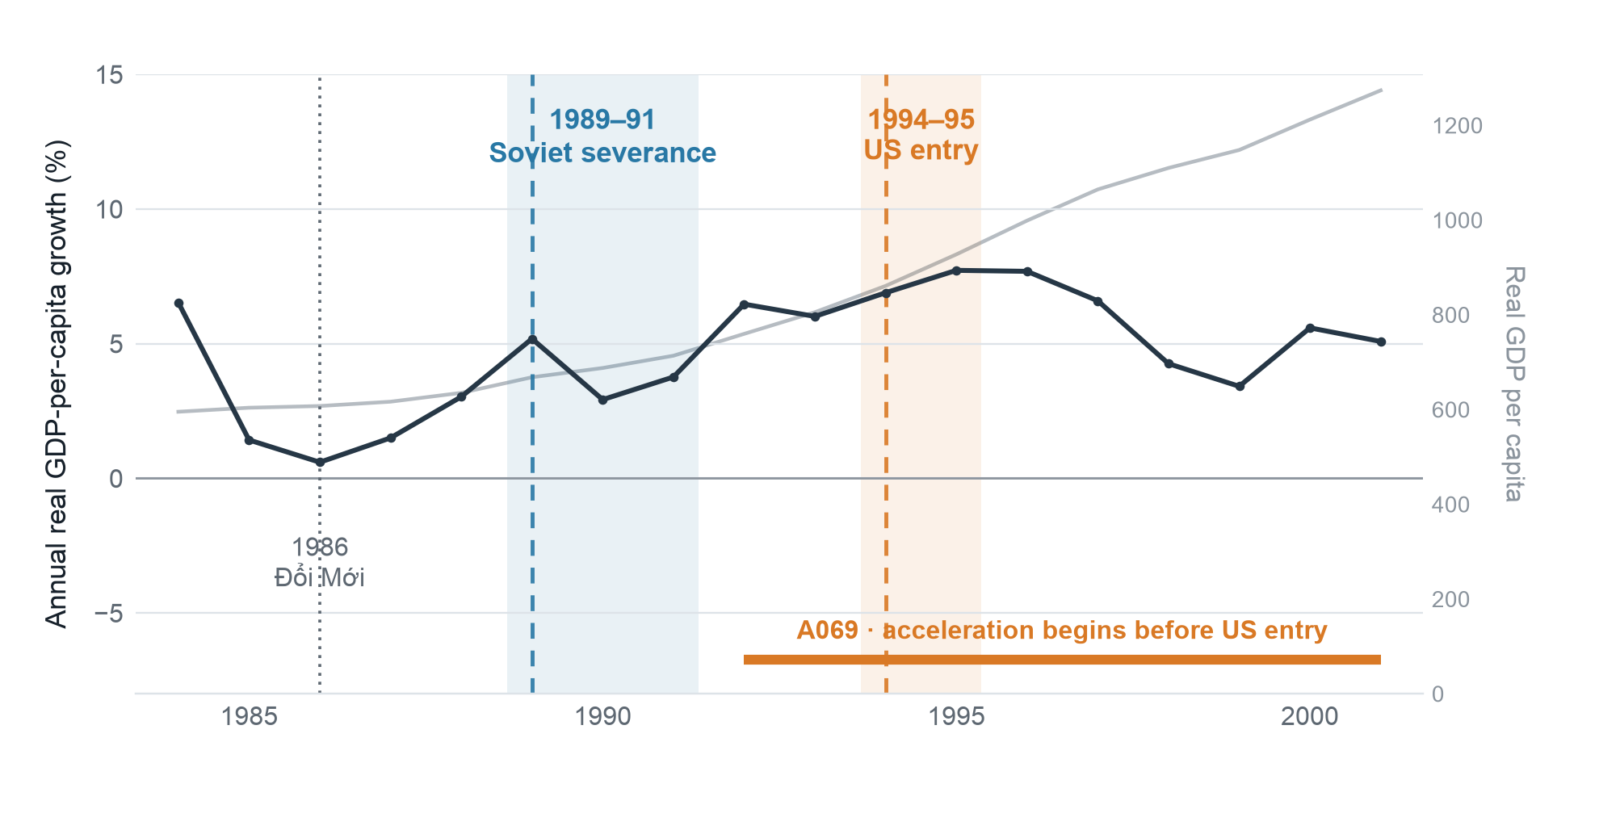
CONTRADICTORY CASE · H2
Vietnam: realignment without the predicted timing
01
No collapse
Growth remained positive during the 1989–91 Soviet severance: +5.2%, +2.9%, +3.8%.
02
Acceleration first
A069 begins in 1992, before US entry in 1994–95. Đổi Mới began in 1986.
Research implications: measure dependence and replacement flows · separate domestic policy reform · distinguish economic-order from security-sphere entry.
PRELIMINARY · E008 / E009 / A069 · E009 medium confidence; UN-voting validation flag · Case note: VNM_1989.md
8
Notes:
[9:35–11:20]
Vietnam is the most informative anomaly. It experienced an imposed Soviet severance over 1989–91, but growth stayed positive: 5.2, 2.9, and 3.8 percent. No qualifying disruption followed. One plausible explanation is that Đổi Mới had already begun reorienting the economy toward East Asian markets, so the lost Soviet capabilities mattered less than the membership record alone would suggest.
The positive event also fails the timing rule. Acceleration A069 begins in 1992 and averages 6.13 percent through 2001, but the coded US entry begins in 1994. The acceleration therefore cannot be attributed to that entry. E009 itself is a partial, medium-confidence coding: Vietnam entered the US-led economic order without joining its security sphere, and UN voting does not converge. Vietnam gives me three concrete refinements: measure the degree of dependence and replacement flows, keep domestic policy reform analytically separate from power transformation, and distinguish economic-order entry from full security-sphere entry.

Slide 9
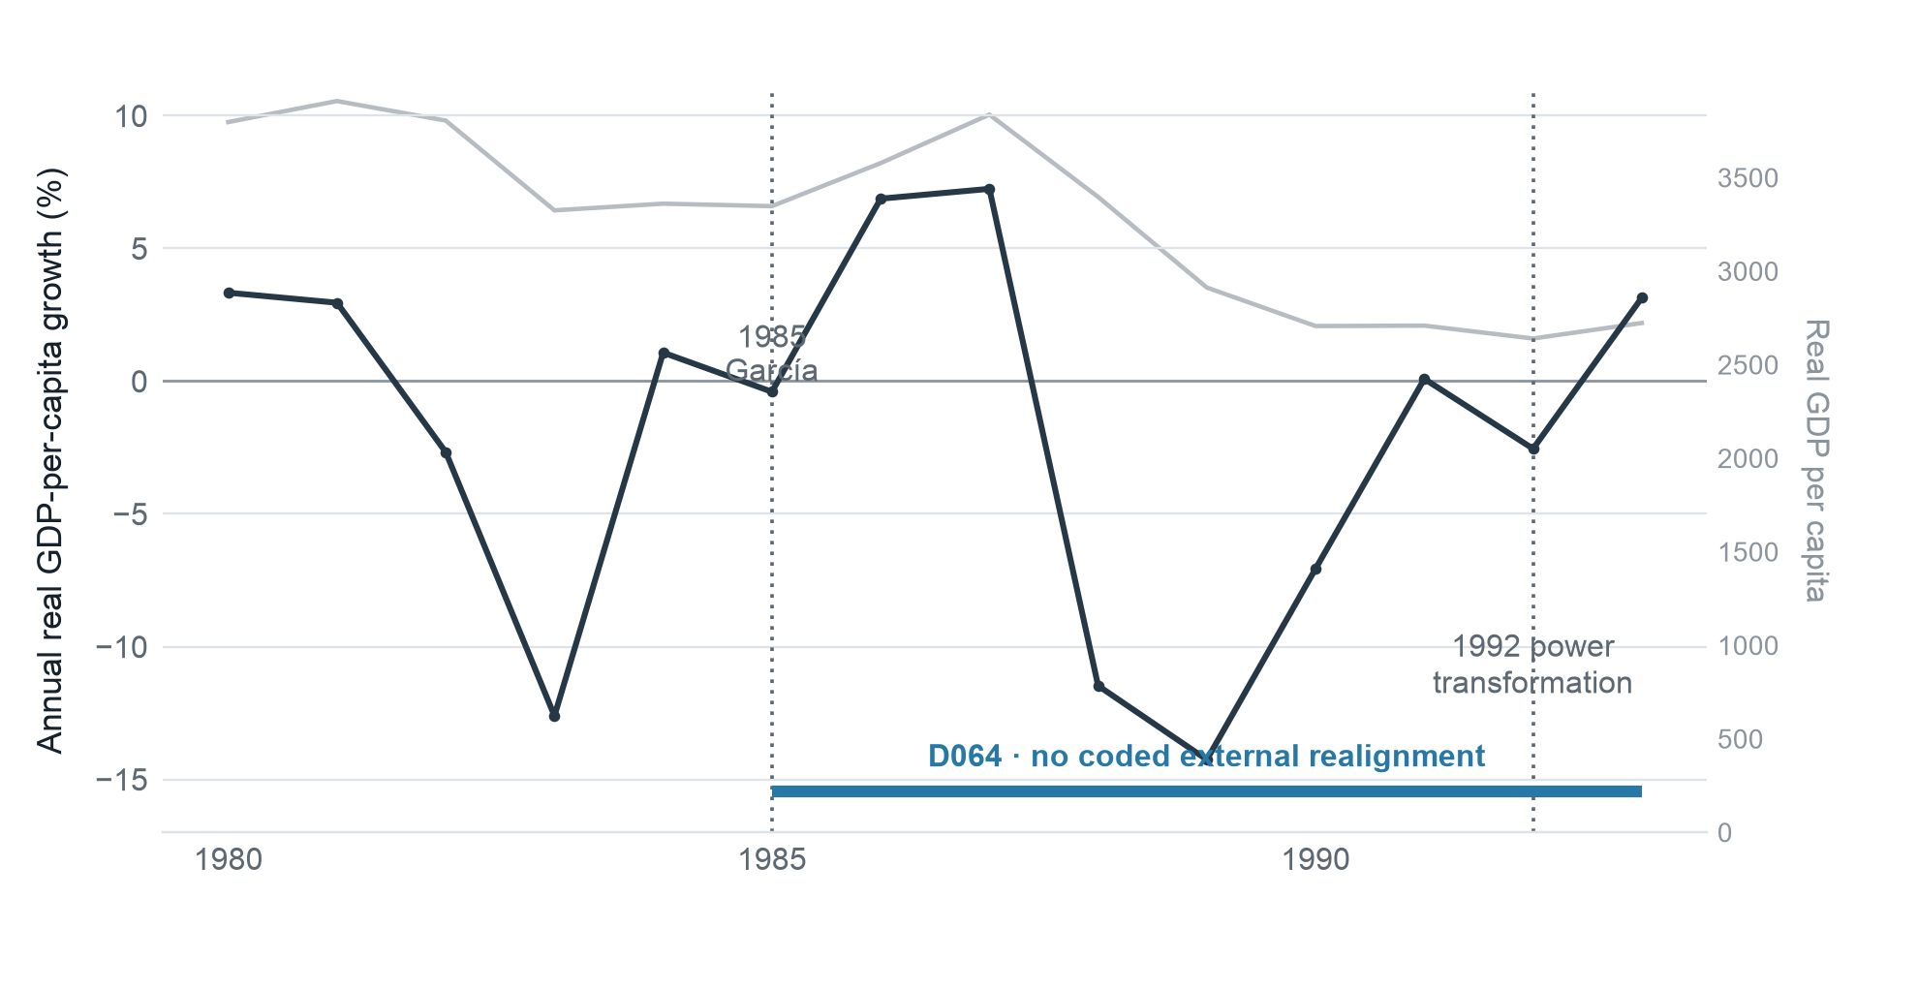
CONTRADICTORY CASE · H3 AND SCOPE
Peru: disruption without external realignment
D064 · 1985–93
−31.2%
Peak-to-trough output
7,482%
Inflation in 1990
No coded external realignment
The 1992 deep transformation follows the crisis
Required scope condition: H1–H3 address changes of rulers, rules, power, and alignment; they do not imply immunity from paradigm-level domestic policy shocks.
PRELIMINARY · PER has no external-realignment episode in the current register · Outcome: WDI · Hard case retained by design
9
Notes:
[11:20–12:55]
Peru challenges a broad necessity reading of H3. D064 records a 31.2 percent peak-to-trough contraction and inflation above 7,000 percent in 1990, without a coded external realignment. The crisis begins under García's domestic policy program, before Fujimori's 1990 turnover and before the 1992 power-structure and apparatus transformation. The sequence rules out the later institutional transformation as an explanation of the initial collapse.
I would keep Peru as a hard case. Its implication is that the hypotheses need an explicit scope condition: changes of rulers, rules, effective power, and alignment are the political events under test; paradigm-level domestic policy shocks form a separate category. With that scope condition, Peru does not directly falsify narrow H1. It does falsify any broader claim that all major disruption requires realignment. The next stage must code policy change systematically enough that this defense cannot become an ad hoc exemption.

Slide 10
CONCLUSION
A sharper test of material capabilities
WHAT WE SEE
WHAT ANOMALIES TEACH
NEXT STAGE
•
Severance: weaker growth and more disruption
•
Dating and pre-existing outcomes matter
•
Estimate country and year fixed-effects models
•
Richer entry: stronger growth and more acceleration
•
Replacement flows can absorb severance
•
Complete matched comparisons and process tracing
•
Imposed severances retain the negative pattern
•
Domestic policy shocks require explicit treatment
•
Measure market, capital, technology, energy, subsidy, and security flows
Payoff: identify when political change produces economic discontinuity—and when it leaves trajectories intact.
All empirical findings remain preliminary. Anomalous cases remain in the data and guide the next stage.
10
Notes:
[12:55–14:10]
The preliminary evidence gives the project a clear empirical foundation. The aggregate signs match the realignment predictions, and the imposed-severance pattern is especially encouraging. The anomalies are equally useful: they identify the measurements and scope conditions that the formal stage must address.
The next stage has three priorities. First, estimate the country and year fixed-effects models with alternative dating and outcome definitions. Second, complete matched comparisons and process tracing so that the sequence of events carries the causal interpretation. Third, measure the proposed mechanism directly: market access, capital, technology, energy prices, subsidies, and security guarantees. The payoff is an account of economic discontinuity that can explain both major breaks and cases where conspicuous political events leave economic trajectories intact. I will stop here and welcome your criticism, especially on case coding and the proposed scope conditions.
[14:10–15:00] Reserve for initial questions and transitions.

Slide 11
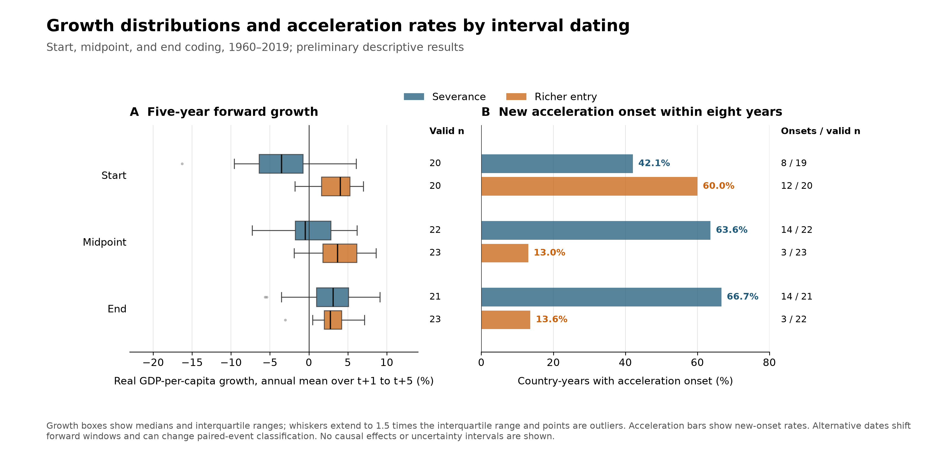
ROBUSTNESS · BACKUP
Appendix: interval dating changes the onset results
PRELIMINARY · Severance endpoint growth: +2.70%. Richer-entry acceleration onset: 13.0% at midpoint and 13.6% at endpoint.
11
Notes:
Backup slide. Use this if asked about dating sensitivity. Alternative interval dates move the forward windows and can change paired-event classification. Severance mean growth rises from minus 3.28 percent at interval starts to plus 2.70 at endpoints. Richer-entry growth remains positive, but its new-acceleration-onset rate falls from 60 percent at starts to approximately 13 percent at midpoints and endpoints. Growth levels and onset rates therefore respond differently to the dating convention.

Slide 12
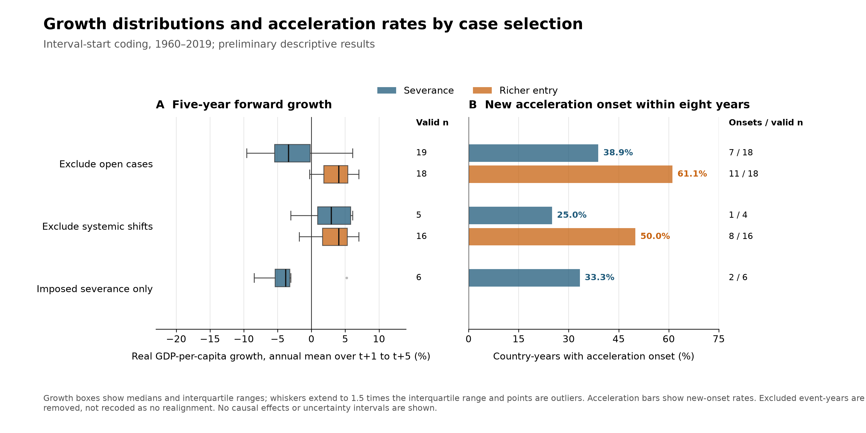
ROBUSTNESS · BACKUP
Appendix: case selection and the strongest patterns
PRELIMINARY · Excluding systemic shifts leaves only five bare-severance observations; imposed severance remains negative but historically clustered.
12
Notes:
Backup slide. Use this if asked about open cases, systemic shifts, or imposed severance. Excluding open cases removes unresolved classifications rather than reassigning them to no realignment. Excluding systemic shifts removes episodes associated with changes in the wider distribution of capabilities, especially the Soviet collapse; only five bare-severance observations remain, so their positive mean growth is highly fragile. The imposed-severance subset retains negative mean growth and high disruption, but it is small and historically clustered.

