Slide 1

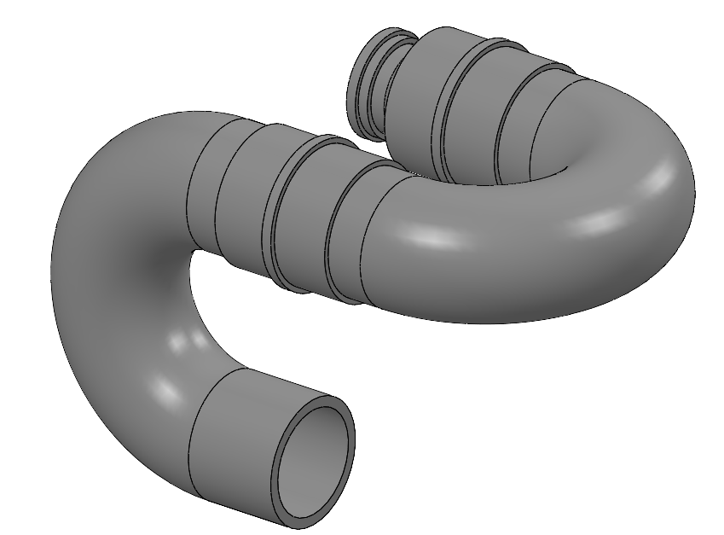
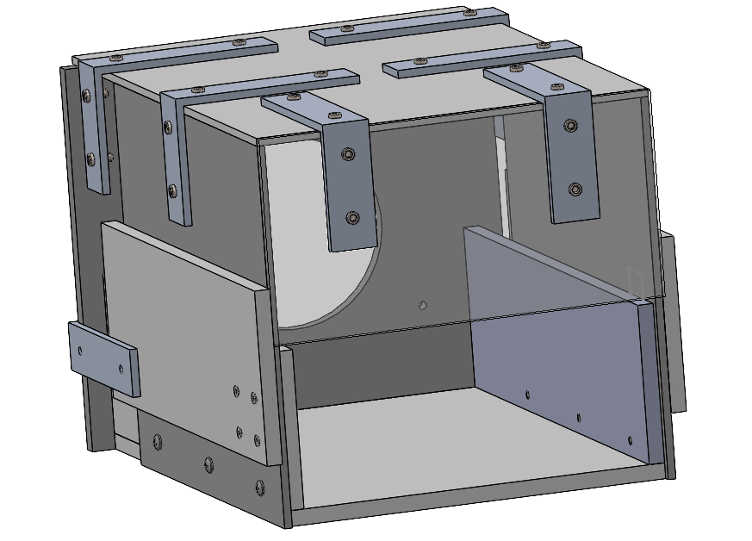
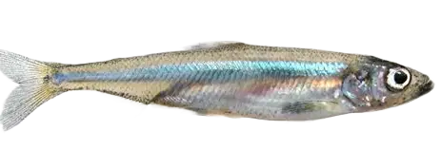
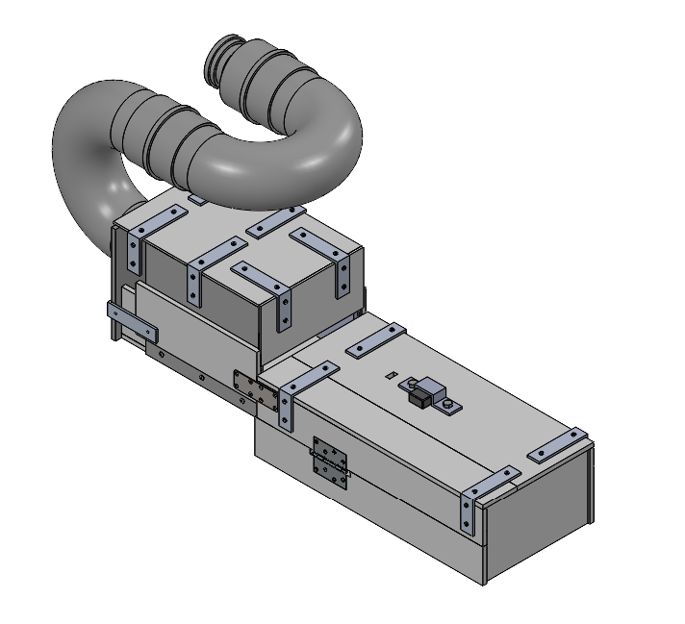
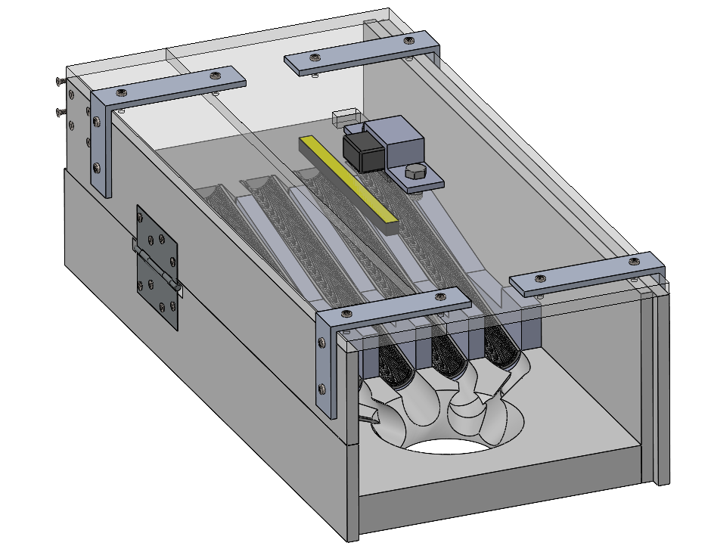
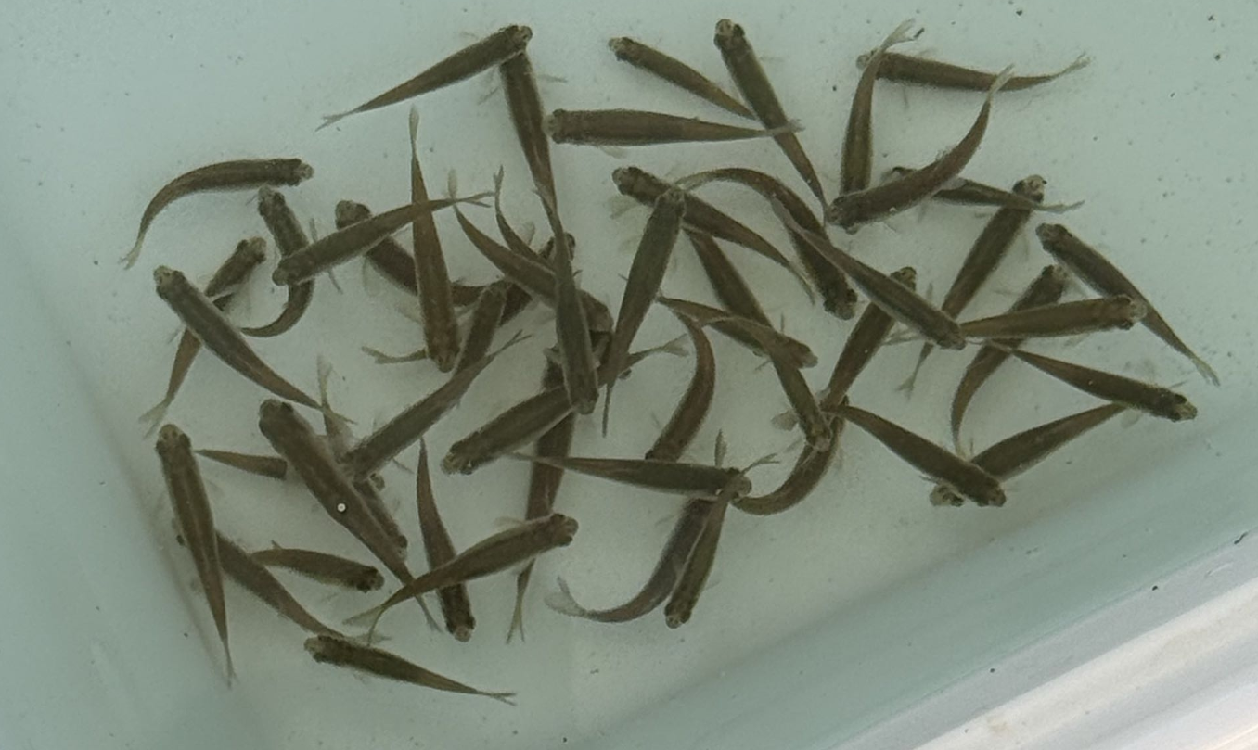
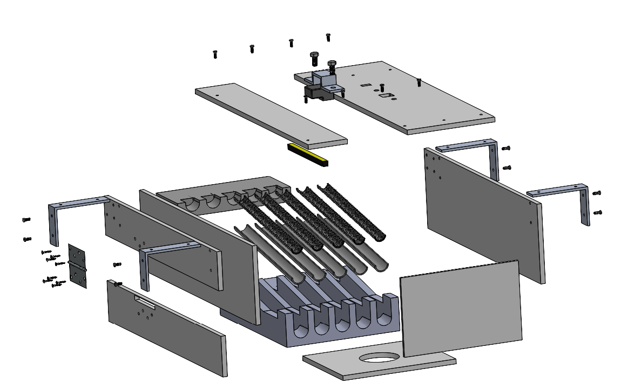
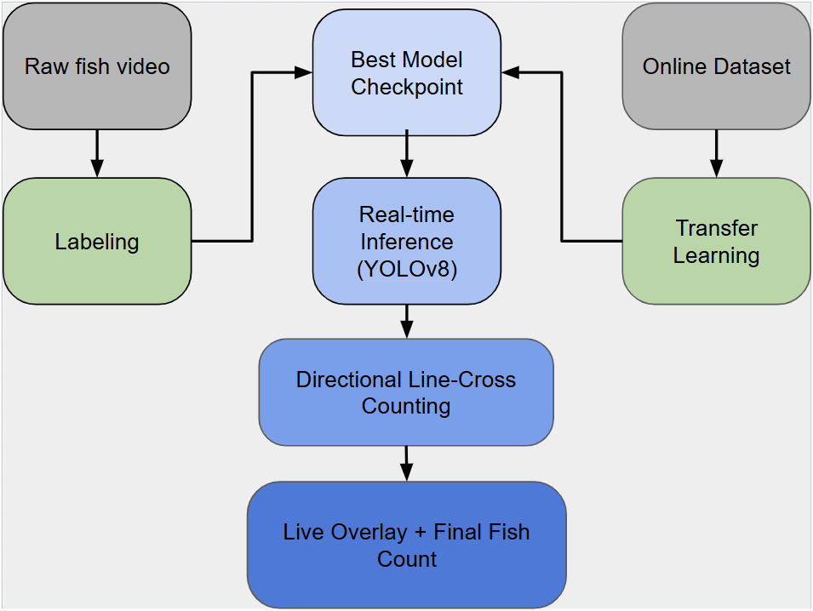
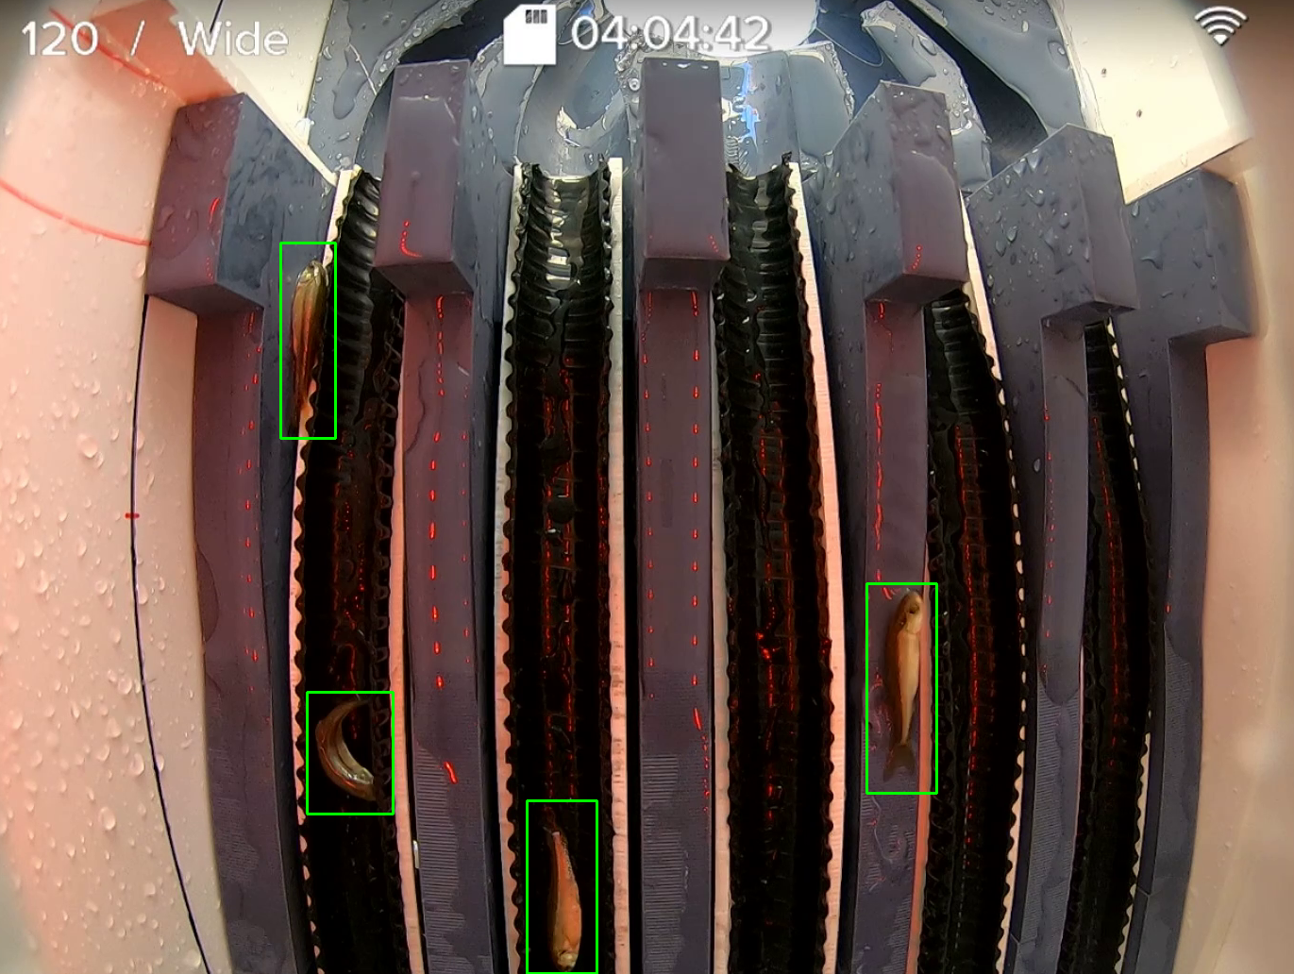
Counting Little Fish For Science
Team Members: Christian Ledesma Villa, Nathan Kivley, Martin Dennison, Huzaifa Neemuchwala, Eric Dong, Yusen Hu
Advisor: Professor Iman Soltani TA: Ziba Fazel
Introduction
The delta smelt is an endangered species only found in the San Francisco Estuary. They are indicator species and represents the overall health of the ecosystem. Its declining population signals a deep crisis for the entire ecosystem. While the Fish Conservation and Culture Lab is working tirelessly to protect them, their research is bottlenecked by a highly labor-intensive process: counting the fish by hand. Our device solves this problem. By automating the counting process, it drastically reduces labor time, improves accuracy, and boosts operational efficiency—ultimately accelerating critical research to save the delta smelt.
Design Overview
Manufacturing
Materials:
PVC - Fish safe and won’t leach harmful chemicals into the water. Material ordered in sheets and cut down using manufacturing tools such as the drill press, bandsaw, jigsaw, and grinder. PVC was put together utilizing PVC primer and cement as it is fish safe and can hold our system together.
Polythene - Material used in corrugated pipes. Corrugated pipes are ideal for transporting liquids and the fish. The grooves allow the fish to safely travel through water without hitting any material. Cut using a bandsaw and attached with a interference fit onto cut pipes.
PLA - Easy to manufacture complicated parts. Utilized the ESDC 3D printers to print sections such as the 5 lanes in the transfer unit.
Steel - Used in brackets to hold parts together. Ordered online and put onto the system via the drill press and power drill.
The system starts by attaching to the pump hose and slowing down the flow in the two 180° bends, going from 4 to 6 inches.
The flow then passes through this middle container where the flow is allowed to expand horizontally like a fan.
How It Works
A fish pump is used to transfer the fish from their enclosure to the fish counter transfer unit. The pump outputs a flow too fast for the camera to capture and count the fish. To solve this problem, two 180° bends with a wider diameter is attached to the input of the transfer unit to slow down the speed of the flow. After slowing the water down, the fishes are separated into lanes which makes them easier for the camera to count. Once counted the fishes exit from a hole at the end of the counter and into a large box which will be used to transport them back to their natural habitat.
The fish are pushed down the 5 lanes where the camera can differentiate between them and create a count.
Fish safely transferred into the tank.
Pump
Transfer
Unit
Tank
Computer Vision
Block diagram for computer vision model development.
GoPro Camera
Computation
Active Fish Counting
AI Model Trained by annotating images and videos of a database of fishes
Fine-Tuning based on the videos captured while running tests
Program that actively inputs frames from the GoPro and uses the trained model
Future Improvements
Future improvements would be get the model trained on more and more runs of the fish in order to improve the accuracy of the computer vision.
The current system is over 125 pounds and lacks a way to pick it up without putting too much force on the hinges. So, making it lighter in weight with a material change of polypropylene would make the weight ~85 pounds and would allow for changes to be made for ease of use and handling. Another improvement would be to find another way to decrease water velocity of the pump. The two 180 degree bends take up a lot of space an are difficult to assemble together.
Acknowledgements:
We would like to thank Professor Soltani and Ziba Fazel for their guidance throughout this project, but we would also like to thank Dennis Cochorell, TIffany Huynh, Jack Gunst, Florian Mauduit, and Chad Justice for their continued support in every way.

Slide 2
Raw fish video
Best Model Checkpoint
Online Dataset
Labeling
Real-time Inference (YOLOv8)
Transfer Learning
Directional Line-Cross Counting
Live Overlay + Final Fish Count

Slide 3
Transfer
Unit
Tank
Pump
GoPro Camera
Computation
Active Fish Counting
AI Model Trained by annotating images and videos of a database of fishes
Fine-Tuning based on the videos captured while running tests
Program that actively inputs frames from the GoPro and uses the trained model

Slide 4
Transfer
Unit
Tank
Pump
GoPro Camera
Computation
Active Fish Counting
AI Model Trained by annotating images and videos of a database of fishes
Fine-Tuning based on the videos captured while running tests
Program that actively inputs frames from the GoPro and uses the trained model

Slide 5
