Slide 1





AiversePulse
AiversePulse
Pitch Deck
NoBugPls

Slide 2

AiversePulse
AI is changing work.
Your next move should be clearer
AiversePulse connects people, skills and opportunities with AI-powered insights for a future-ready workforce.

Slide 3





AiversePulse
Problem Statement
Job market signals
Outdated
Workers & Graduates
Employers
The Gaps
  Don't know which skills to learn
  Unsure which roles are in demand
  Hard to find up-to-date guidance
  Struggle to plan reskilling
  Lack visibility of future skills needs
  Risk of talent gaps
  Outdated job signals
  Static learning pathways
  Uncertain AI-driven changes
Skill gaps
Growing
New skills emerging

Slide 4



AiversePulse Solution
AiversePulse
1. Build Your Profile
2. Live AI & Job-Market Signals
3. Future Role Matches
Upload your CV or complete a short questionnaire.
Track the latest trends from trusted sources.
Get personalised recommendations with match scores and skills gaps.
4. Learning Pathway
5. HR Review
Follow a flexible, low-cost reskilling plan linked to relevant SDGs.
Employers can use the HR tools to review candidates and plan development.

Slide 5
What Makes It Different
AiversePulse
Explainable Role Match
Evolving Trend Signals
  Every recommended role has a match score and a breakdown of why. It shows which skills you already have, which are missing, and how much each one affects the score
  Most tools return a job title with no reasoning. Explainability builds trust and turns the result into an action: “here is what to build next.”
  The system continuously pulls in AI and job-market data, so the Future Skills Radar changes when the data changes. It isn’t a hard-coded list
  Ensure the shown data is the latest data

Slide 6
What Makes It Different
AiversePulse
Human in Control
Mock Interview
  AI recommends, explains and plans, but the user makes the decisions. It never makes final career or hiring choices, and users can explore alternative roles and adjust their plan
  Follow the rule AI is a partner, not a replacement, and the brief’s human-centred rule
  After choosing a target role, the user practises with an AI interviewer that asks role-specific questions and gives feedback on answers
  User can have interview experience and improve their interview skills

Slide 7
AiversePulse
Product Demonstration

Slide 8
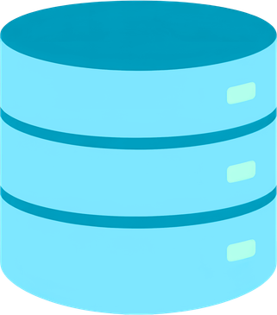



Technical Feasibility
AiversePulse
Data Sources
AI Analysis
Multi-Agent System
Platform
  ESCO + O*NET
  Job-market & AI trends
  MiniLM + STF-KAN
  Assistive / Agentic scenarios
  LangGraph + FastMCP
  Role matching + pathway generation
>
>
>
  FastAPI
  SQLite + Chroma
  Replit + RunPod
Tech Stack
  HTML / JS
  Python
  FastAPI + MCP
  SQLite + Chroma
  Gemini + PyTorch

Slide 9
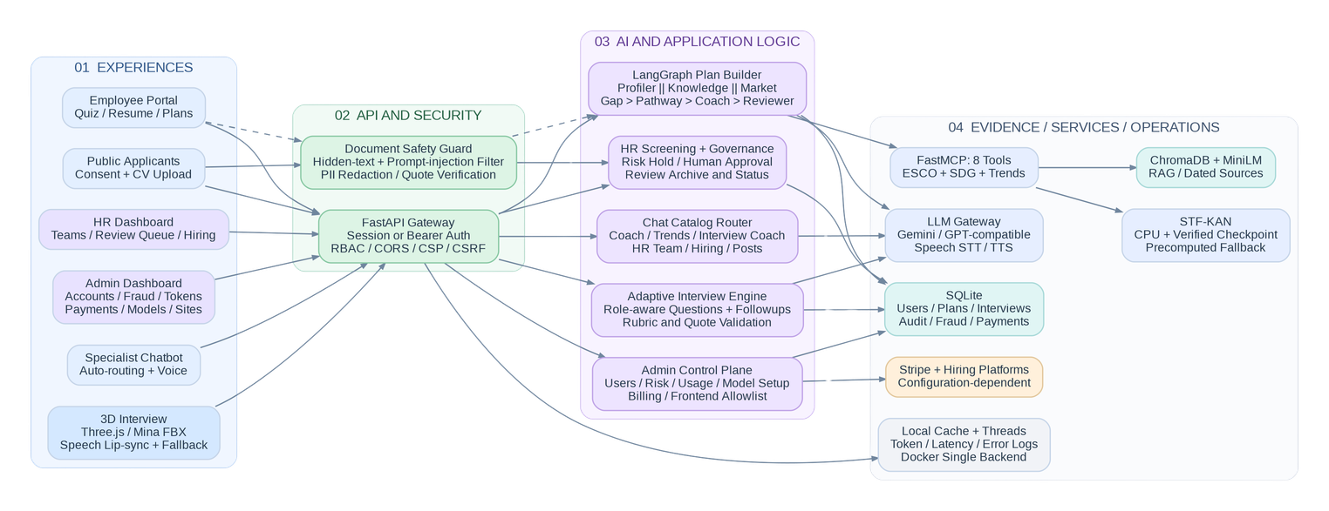
System Architecture
AiversePulse
  Frontend Plain HTML/CSS/JS, no build step. Agent progress streams live over SSE.
  API FastAPI serves the public site, the HR console and the public apply page.
  Agents A LangGraph graph calls 8 FastMCP tools: ESCO search, matching, skill outlook, trends, SDG.
  Storage SQLite for accounts, immutable plan versions and the audit log; Chroma for vectors.
  Compute CPU serving on Replit or Docker; GPU training offline on RunPod

Slide 10
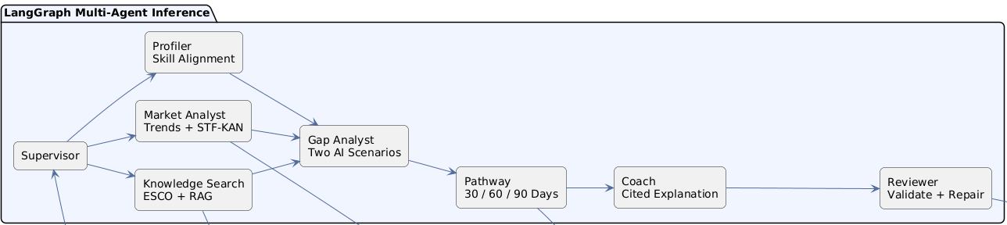
Multi-Agent Workflow
AiversePulse
  Route A supervisor answers simple lookups at once and fans complex requests out.
  Parallel Profiler, Knowledge (MCP) and Market Analyst (STF-KAN) run side by side.
  Plan Gap Analyst ranks gaps under two AI scenarios, then Pathway and Coach write the plan.
  Check Reviewer validates schema, evidence, maths and capacity; at most 2 repairs, else flagged.
  LLM Deterministic by default; Gemini or any OpenAI-compatible model is optional.

Slide 11
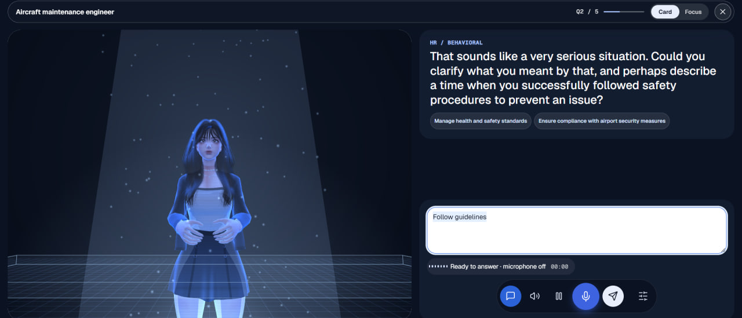
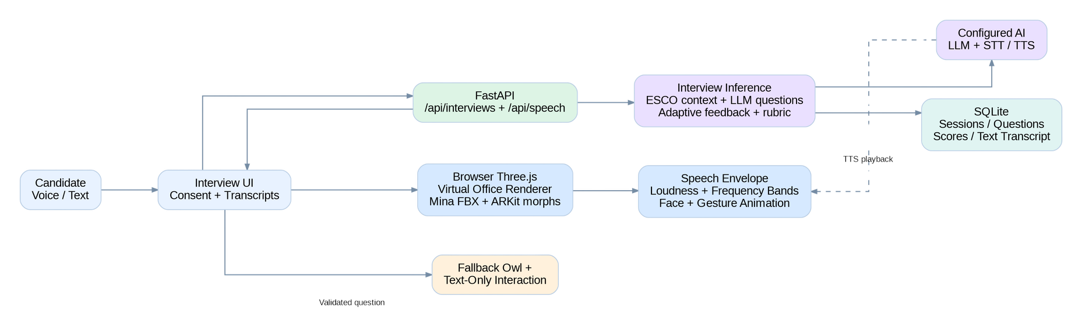
AiversePulse
Interview-Agent
Workflow

Slide 12
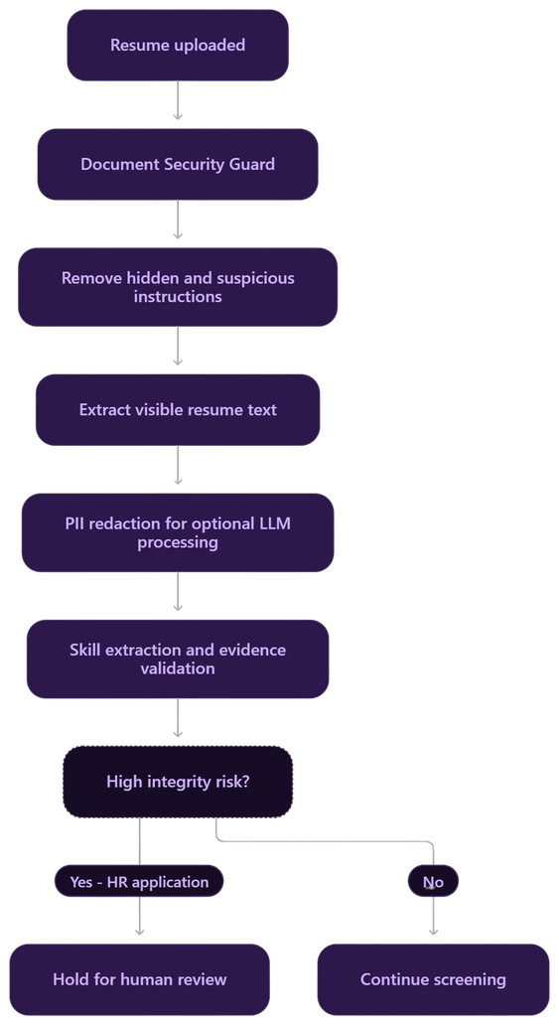
Resume-Agent Workflow
AiversePulse

Slide 13





SDG Impact
AiversePulse
SDG 4 – Quality Education
SDG 3 – Good Health & Well-being
  Lifelong learning opportunities
  More accessible, inclusive training
  Build future-ready skills
  Growth in health-tech and digital health roles
  Less career anxiety through clearer, data-backed guidance
SDG 8 – Decent Work & Economic Growth
SDG 9 – Industry, Innovation & Infrastructure
  Higher employability
  Stronger workforce productivity
  Fairer transition to new jobs
  Skills pathways aligned with emerging technologies
  Better planning for employers adopting AI
Intended Outcomes
Faster time to actionable pathway
More skills gaps identified
Higher pathway completion

Slide 14
Don't just react to the future of work.
Prepare for it.
AiversePulse — Human-centred AI. Personalised career pathways. Real-world impact.
AiversePulse

Slide 15

Thank You
AiversePulse

